Slide 1
Program Training: Referrals and Enrollment
April 13, 2021

Slide 2
Enrollment in 3 Distinct Programs
CalFresh (CF)
CFET
CEPP

Slide 3
Phases of Rollout
Phase 1: Reverse referrals (from CEPP Provider to DPSS via WDACS)
Phase 2: Referrals (from DPSS to CEPP Provider via WDACS)
Rollout of access to data on benefit enrollment: YBN, CalFresh Confirm, CalSAWS

Slide 4
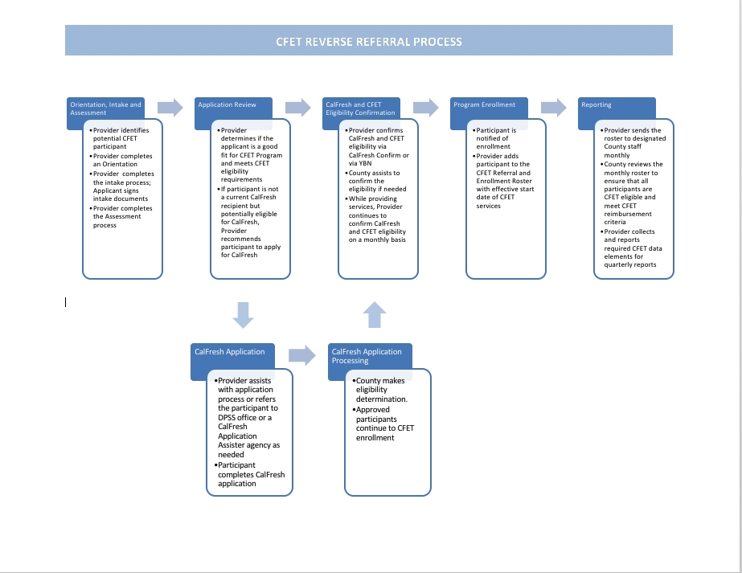
Additional Eligibility Factors

Slide 5
CFET Enrollment by DPSS
DPSS enrollment into CFET: triggered by Provider CFET Referral and Enrollment Roster
Effective date of CFET enrollment: same as CEPP enrollment date on Roster
CFET enrollment required for CEPP enrollment
Almost all clients correctly entered will be enrolled
DPSS will communicate when issues arise
ABAWD status: communicated via DPSS return of Roster

Slide 6
???
?
Questions?

Slide 7
Initial CEPP Enrollment Steps by Provider: CalWORKs Status
CalWORKs (CW) provides cash aid and services to eligible families with a child(ren) in the home
CW recipients cannot enroll in CFET – only exception is child-only CW
Ask about CW status at intake
Timed-out CW can participate but should be informed that they may lose eligibility if CW status changes
CalWORKs status should be confirmed at initial enrollment via YBN or CalFresh Confirm as well as monthly

Slide 8
Initial CEPP Enrollment Steps by Provider: CalFresh Questions
On CalFresh?
Willing to Apply?
Likely Eligible?
Need Assistance?
If yes or unsure, confirm with YBN or CalFresh Confirm
Optional questions

Slide 9
CalFresh Confirm
Confirmation of CalFresh non-CalWORKs status and exclusion of those on CFAP, a CF lookalike that doesn’t count for CFET
Batch queries
Confidentiality and security requirements
Anticipated rollout
Not real-time data; initial monthly updates will increase over time
Alternatives

Slide 10
Initial CEPP Enrollment Steps: Orientation, Intake and Assessment
Orientation
Excite about opportunity
Intake
Collect/review basic info
Collect client signatures
Assessment
Assess client interest, skills and capacity
Describe provider services, CEPP eligibility/reqs/benefits
Review addl eligibility factors

Slide 11
Intake Forms or Fields
Small amount of required data (such as name, SSN, ESL, and HS/GED status)
Signature with specific language (such as willingness to participate in CEPP)
Consent for release of confidential information
Participant agreement/contract (recommended)
Individual employment plan (recommended)

Slide 12
Assessment Options

Slide 13
Sample Assessment Topics
Education, including literacy level;
Communication skills, including English-language proficiency;
Employment history
Employment skills, abilities, and interest; and
Barriers to employment and steps necessary to overcome these barriers

Slide 14
Initial CEPP Enrollment Steps: Additional Eligibility Factors
Not on CalWORKs (once on CalFresh, this information is available on CalFresh Confirm)
Resides in Los Angeles County
Wants to work in near future
Is at least 16 years old
If co-enrolled in high school, is receiving distinct services through CEPP

Slide 15
CEPP Enrollment Decision and Referral
If no, refer
If CF non-CW unconfirmed, decision is made contingent on confirmation

Slide 17
???
Provider decision-making on integration of CEPP functions into existing functions:
Which tasks will be integrated into existing processes or be separate?
Which staff will be responsible?
Example: Will CFET-specific questions be added to the intake form for all clients, or be a separate form just for potential CEPP clients? Who will complete the CEPP intake process? Does it make sense to do a warm handoff to dedicated CEPP staff at some point during intake?
Further discussion during TA meetings

Slide 18
Policy Decision for Clients Not Yet on CalFresh: Use Pending Status?
Potential delay of up to 60 days in confirmation of CalFresh non-CW status
DPSS has up to 30 days to process CalFresh application
CalFresh Confirm may only be updated every 30 days for awhile; YBN not always easily accessible
Provider can put client on pending status, start services, and bill retroactive to CEPP enrollment decision once CF non-CW status confirmed
More funding as long as provider can accept not getting reimbursed if client doesn’t qualify for CF
Must track clients on pending status
Otherwise, do not use pending status; hold off on providing or at least billing for services; bill only after CF non-CW status confirmed through YBN or CF Confirm

Slide 19
Sample CEPP and Pending Status Tracking
Client Name (CEPP and Pending) | Oct | Nov | Dec | Jan
Le Pizer | c | c | c | c
Lakeesha Conaway |  | c | c | c
Michelina Pantano | p | p | c | c
Pearline Morningstar | p | c | c | c
Maryjo Lahti |  |  |  | c
Tillie Loh | c | c | c | c
Hans Barrington | c | c
Vertie Marceau | c |  | c
Chasity Motter | c |  | c
John Page | c | c | c
Nova Slattery | c | c | p | c
Almeda Deguzman | c | c | c | c
Sheridan Gunnels | c | c | c | c
Daisey Leos | p | p | c | c
Margy Stills |  |  |  | c
Trisha Stephens |  |  |  | c
Harvey Alles |  |  | p | c
Jose Lopez |  |  | p | c

Slide 20
Effective Date of CEPP Enrollment
If the CEPP enrollment decision is made today…
On CalFresh Non-CalWORKs
Pending Status
Enroll in CEPP effective today (or the date the approved CalFresh application was started, whichever is later) pending confirmation
Non-Pending Status
Enroll in CEPP effective the date of confirmation of CalFresh non-CalWORKs status (likely weeks from today)
Enroll in CEPP effective today

Slide 21
Order of Initial CEPP Enrollment Steps
Confirm CalFresh Non-CW Status
Make CEPP Enrollment Decision
CEPP Effective Date
Inform Client/Enter in Roster
Start Svcs, Tracking, Billing
Clients on CalFresh Not CalWORKs
Make CEPP Enrollment Decision
CEPP Effective Date
Inform Client/Enter in Roster
Start Svcs, Tracking, Billing
Confirm CalFresh Non-CW Status
Option 1 for Remaining Clients: Non-Pending Status
Confirm CalFresh Non-CW Status
Make CEPP Enrollment Decision
CEPP Effective Date (Pending)
Inform Client/Enter in Roster
Start Svcs, Tracking, Billing
Option 2 for Remaining Clients: Pending Status
Supportive services, tracking and billing follows confirmation of status and is retroactive to effective date

Slide 22
???
Provider decision-making on pending vs. non-pending status:
Remaining questions?
Which way are you leaning?

Slide 23
Communi-cation about CEPP Enrollment by Provider
Communication to client about CEPP enrollment
Letter, email, verbal
Effective date if enrolled
Ineligibility or termination
Communication to DPSS via WDACS about CEPP enrollment
Roster if enrolled in CEPP
If ineligible, no communication needed specifically for reverse referral
If terminated, whether for referral or reverse referral, provider determination may be needed

Slide 24
Ongoing Confirmation of CalFresh Non-CW Status
Purpose: Must be on CF non-CW to bill for CEPP
Client may go on an off CEPP due to CF changes (provider option to continue services)
Confirm via YBN or CalFresh Confirm
Monthly (ASAP if it will impact services; at end of month if won’t)
What to do if not on CalFresh Confirm: Ask participant. Contact DPSS?

Slide 25
Trouble-shooting Under-Enrollment: Define the Problem
Meet with staff to review data and understand the problem
Are enough clients learning about the program through outreach and intake?
Are most clients agreeing to apply for CF?
Are most of these completing the CF application? Qualifying? Why/why not?
Do clients remain eligible for CF? What solutions would improve the situation?
Survey a client sample (e.g., poll, focus group, one-on-one discussion)
Why did the client enroll/not enroll in CF?
If they did enroll, why did they maintain/lose CF?
What might help them enroll or stay on CF?
Suggest ideas for their input

Slide 26
Trouble-shooting Under-Enrollment: Potential Solutions
Outreach
Modify your existing outreach efforts to best target CalFresh eligibles, e.g. clinic health fairs
Create outreach materials and target outreach messages to attract CalFresh eligibles
Modify your language to build hope for future employment, tell a story
Avoid words invoking stigma such as CalFresh or low-income
Increase referrals from agencies serving CalFresh eligibles, such as CalFresh Outreach organizations and food banks
Create new programs that serve CalFresh clients exclusively or reduce skills barriers to entry
Outreach isn’t an allowable cost
Inreach and Fine-Tuning
Expand CEPP to as many programs as possible within your agency
Make intake messages on CF enrollment more persuasive and highlight CEPP benefits such as supportive services
Offer a more attractive package for CEPP vs non-CEPP clients
Set internal measurable goals for enrollment
Ensure intake staff are fully committed
Consider friendly ways to recognize staff who enroll the most clients
Update staff regularly on progress toward goals and discuss enrollment strategies during staff meetings
Fine-tune CF application assistance and support CF recertification

Slide 27
???
?
Questions?

Slide 28
Next Steps for Providers
Make decisions related to CEPP enrollment, Roster, and ongoing confirmation (Handbook Appendix D/Google Doc)
Read Handbook Part I: Sections 2 and 3
Complete next steps from previous training agenda if still to be done
Complete first draft of CFET Proposal Revision and Budget

