Slide 1
YBN
VERFICATION OF BENEFITS

Slide 2
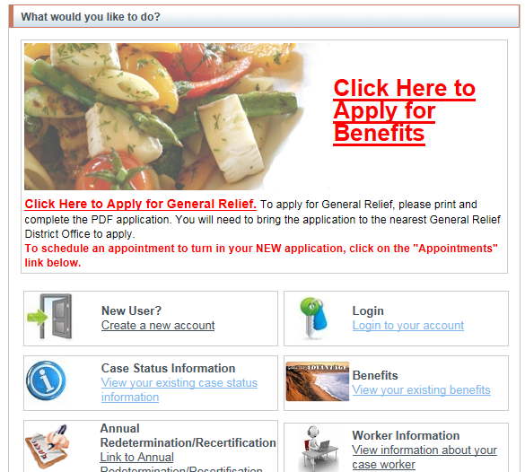
User shall log into their YBN account

Slide 3
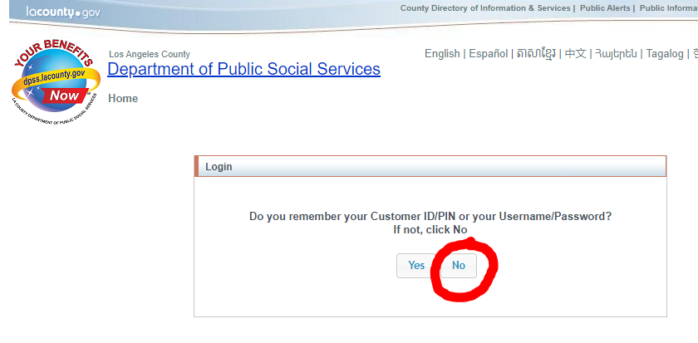
How to log in without a password

Slide 4
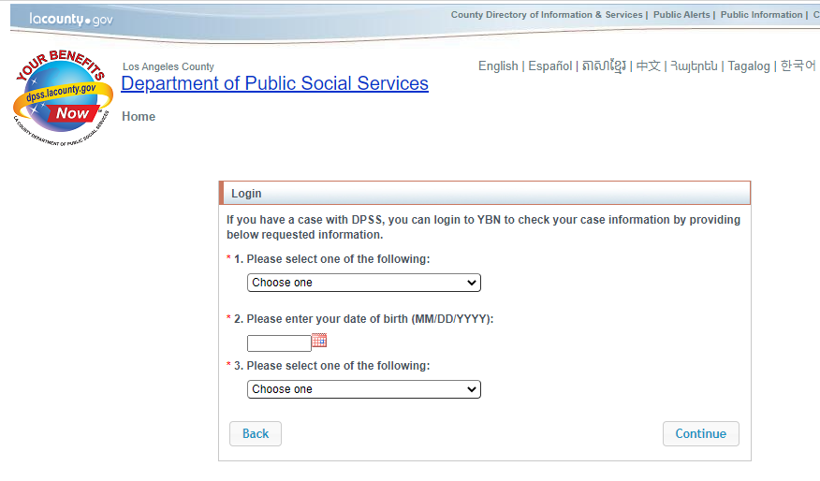
How to log in without a password

Slide 5
How to log in without a password

Slide 6
How to log in without a password

Slide 7
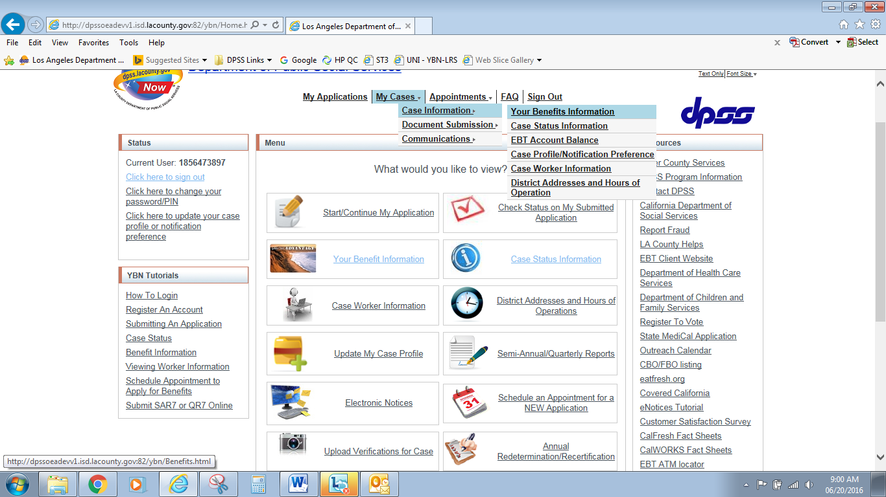
VERFICATION OF BENEFITS
1.
2.
3.
After the user logs into YBN,
the user can access the Verification of Benefits feature by selecting the following:
My Case
Case Information
Your Benefits Information
0000000001

Slide 8
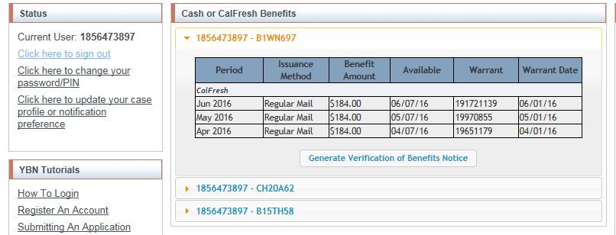
VERFICATION OF BENEFITS
User will select the “Generate Verification of Benefits Notice” to generate the Verification of Benefits (PA-1918).
0000000001
0000000001 – H123456
0000000002 – H123457
0000000003 – H123458

Slide 9
VERFICATION OF BENEFITS
User will type the agency or institution name which is requesting the Verification of Benefits.
Select the “Generate Notice” button.
0000000001
0000000001 – H123456
1.
2.
Generate Notice
0000000002 – H123457
0000000003 – H123458

Slide 10
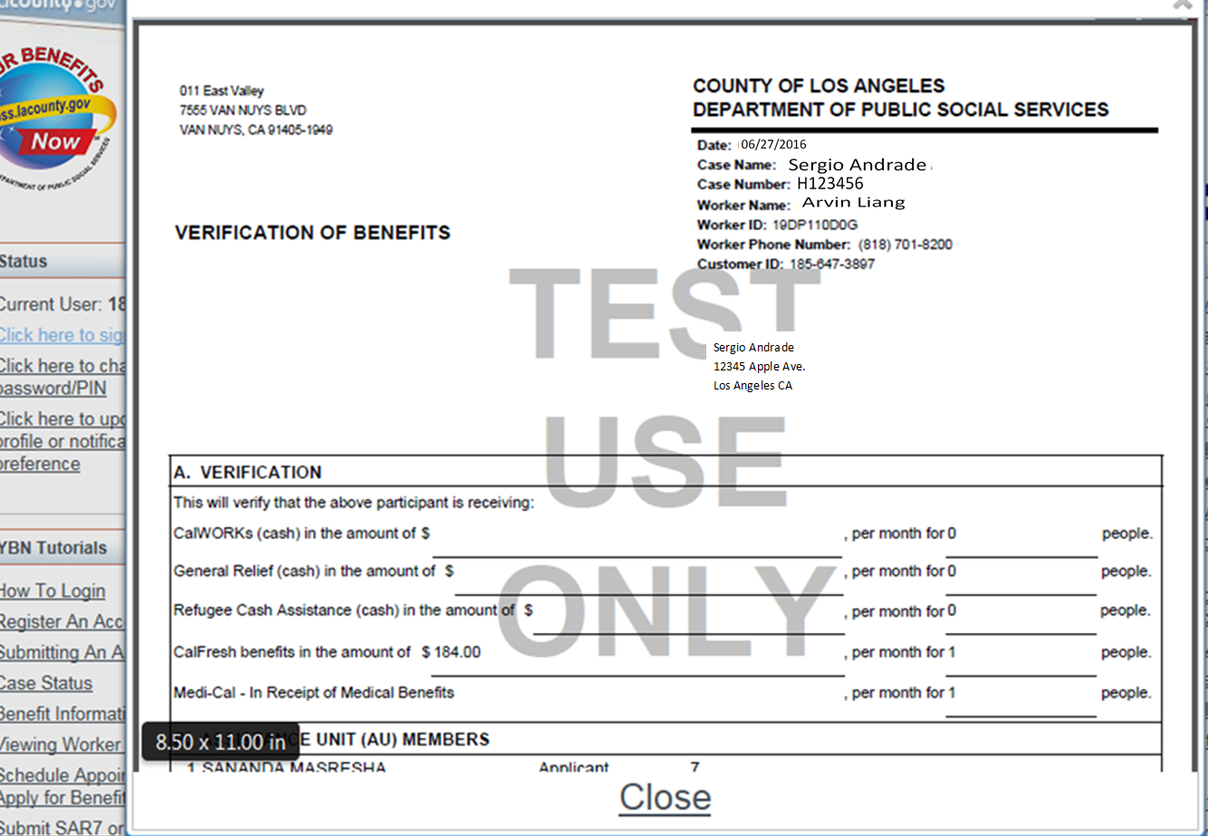
VERFICATION OF BENEFITS
User will be able to View/Print/Save a copy of the Verification of Benefits notice.
Once complete the user shall select the “Close’ button.
NOTE: The YBN Verification of Benefits notice shall be identical to the LRS generated notice.

Slide 11
VERFICATION OF BENEFITS
Requesting the YBN Verification is available in the Threshold Languages

