Slide 1


Skill Up Los Angeles
CalFresh Employment & Training Onboarding: Fiscal 101

Slide 2

Agenda
Welcome, Introductions
Skill Up LA 101
Funding Cycle
Budget Overview
  General Breakdown
  Line-Item Example
  Considerations
  Narrative Attachments
  Funding Sources
  Component Costs
  FTE Calc Resources/Tools
Invoice Preview
Resources to be shared
Questions

Slide 3




Welcome & Introductions
Program Administration
  Name, Organization, Role
Technical Assistance & Trainers
  Name, Organization, Role
Partner Attendees
  Name, Organization, Role
  Experience or background if you’d like to share

Slide 4
Skill Up Los Angeles: Overview
Skill Up Los Angeles is a flexible federally funded program intended to upskill and increase the employability of CalFresh recipients. Services include education, work-based learning, job readiness training, and job retention; as well as a variety of supportive services to assist participants in achieving their training goals.
LA County Strategic Goals:
Make Investments that Transform Lives by supporting job readiness and increasing employment opportunities.
Foster Vibrant, Resilient Communities by aligning workforce development programs to increase the employability of high-need, priority populations
Statewide, CalFresh E&T has five strategic goals:
Increase job placement, retention, and wages;
Increase CalFresh E&T participation across a dynamic mix of people, communities and cultures;
Increase employability by removing barriers to employment;
Increase skills attainment and credentialing; and
Lead an efficient and effective customer focused CalFresh E&T program.

Slide 5



Skill Up Los Angeles: Funding Flow
USDA FNS
CDSS (State Agency)
DPSS (CalFresh Agency)
DEO (Intermediary)
Providers (You!)
→
→
→
→
Skill Up // E&T is a contract, program, and reimbursement grant based on actual services performed using non-federal funds
Notes:
Mention Acronyms and what they are here

Slide 6
Skill Up Los Angeles: Funding Cycle
1. Your organization uses non-federal funds to provide Skill Up LA services such as LA RISE
Start with $1000 of Non- Federal Funds
FFY Starts October 1st
FFY Ends September 30th
$1,000
$450
4. Reinvest the reimbursement into the program
2. Invoice to DEO
$202.50
Federal reimbursement funds can be reinvested to draw further 45% reimbursement
$450
3. Receive 45% reimbursement

Slide 7


Skill Up Los Angeles: Budget Overview
Your budget can be thought of in two buckets:
Admin/Program costs
Support Services costs
Here are the common costs associated with running an employment program and the terms used to describe them
SNAP E&T funds are flexible by design, however there are unallowable costs. See CDSS handbook for more details
Food
Mental Health Services
Fundraising Costs
Bad debt, late fees
Membership costs
SALARIES, FRINGE BENEFITS AND INDIRECT
Personnel Salaries
Fringe Benefits
Indirect Admin Costs
Subsidized Wages and Fringe Benefits
OTHER PROGRAM COSTS
Non-Capital Equipment/Supplies
Supplies - Direct Program
Printing
Telephone
Travel
Building/Space
Equipment & Other Capital Expenditures
Subcontractors
Miscellaneous
SUPPORTIVE SERVICES
Dependent Care
Transportation
Ancillary
Notes:
State what ancillary services are/include

Slide 8
Skill Up Los Angeles: Budget Overview
Budget: For each line item in your budget, you will calculate the total cost (100%) you anticipate spending to serve Skill Up Participants
Think about how many participants you will serve
Remember: FFY Starts October 1st
The budget then breaks the total cost into:
federal share (50%) and
what you will be reimbursed by DEO (45%)
LINE ITEMS | TOTAL ANNUAL BUDGET | FEDERAL SHARE (50%) BUDGET | Skill Up REIMBURSEMENT (45%) BUDGET
Support Services/Participant Reimbursements
Dependant Care | $5,000.00 | $2,500.00 | $2,250.00
Transportation | $4,000.00 | $2,000.00 | $1,800.00
Ancilary | $9,500.00 | $4,750.00 | $4,275.00
Totals | $18,500.00 | $9,250.00 | $8,325.00

Slide 9
Skill Up Los Angeles: Budget Overview
Within admin/program costs there are some additional calculations you will estimate and things to note:
  Staffing: Cost allocated or direct
  Participant facing Staff: % based on # Skill Up Participants / Total # participants on case load
  Other Staff: Direct hours on project
  Timecard required for backup documentation
  Indirect Rate: covers costs not outlined explicitly for overhead
  De minimus 10% rate
  Federally Approved Rate
  Actual Costs
  Other Program Costs- Cost Allocation
  Building Costs: Cost allocated % based on # Skill Up Participants / Total # participants served org-wide
  rent includes square footage calculation- last tab in workbook

Slide 10
Skill Up Los Angeles: Budget Overview
Narrative Attachments: Each component you offer will have an attachment to fill out. You will describe in detail what is involved for each component. Each attachment has variation and is completed while you develop your budget and program
General Categories | Description
Summary | Describe activities and services offered in detail. Include objectives, skill gains, employer partners if applicable, curriculum used, length of program, etc.
Target Population | Select all that apply: list includes time limited SNAP recipients, unhoused individuals, underemployed individuals, single parents, etc
Critera for Participation | What skills or experience is needed for participation in component?
Enrollment Projection | Unduplicated estimate of annual enrollment
Cost of Component | Administrative costs only, do not include cost of supportive services. If this component is offered in combination with another component, please divide the administrative costs accordingly

Slide 11
Skill Up Los Angeles: Budget Overview
Component Costs: You will estimate what each component you anticipate offering will cost, broken down by program costs and support services. The goal is to understand how much each component costs to administer. Helpful Note: The amounts here should match your component narrative documents
 | Costs Other Than Supportive Services |  | Costs for Dependent Care Supportive Services |  | Costs for Transportation Supportive Services |  | Costs for Ancillary Supportive Services |  | Total Costs
Component | Component budget as % of total | Cost per component per year | Component budget as % of total | Cost per component per year | Component budget as % of total | Cost per component per year | Component budget as % of total | Cost per component per year
Work Experience | 80% | $ - | 80% | $ 4,000 |  | $ - |  | $ -
Supervised Job Search | 15% | $ - | 15% | $ 750 |  | $ - |  | $ -
Job Retention | 5% | $ - | 5% | $ 250 |  | $ - |  | $ -
Total | 100% | $ - | 100% | $ 5,000 | % | $ - | % | $ - | $5,000.00
Notes:
Using our earlier example with support services breakdown and distribution of case load as shown above, this is an example of how to think through these costs. Be mindful that:
You may have duplicated enrollments at the same time
You can think about this in more than one way
A good place to get started is the consider the distribution of enrollments by component and go from there

Slide 12
Skill Up Los Angeles: Budget Overview
Funding Sources: You are eligible for reimbursement for any program costs associated with serving Skill Up Participants that were funded with non-federal sources. These sources are what you list here in the Funding Sources budget tab
Name of Funding Source (be specific if possible) | Type (federal, private, etc) | Total $
LA RISE
Social Enterprise Revenue
Private donations
Total

Slide 13
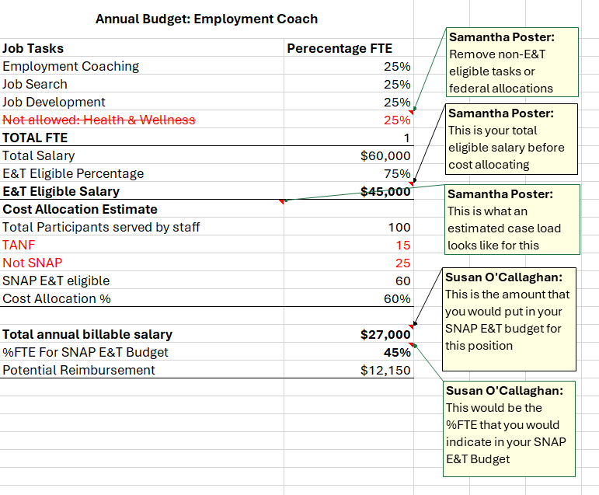
Skill Up Los Angeles: Resources
Staff Allocation Tools & Work Sheet
Annual Budget Exercise
Annual FTE Excel Breakdown Tool
Monthly FTE Excel Breakdown Tool

Slide 14
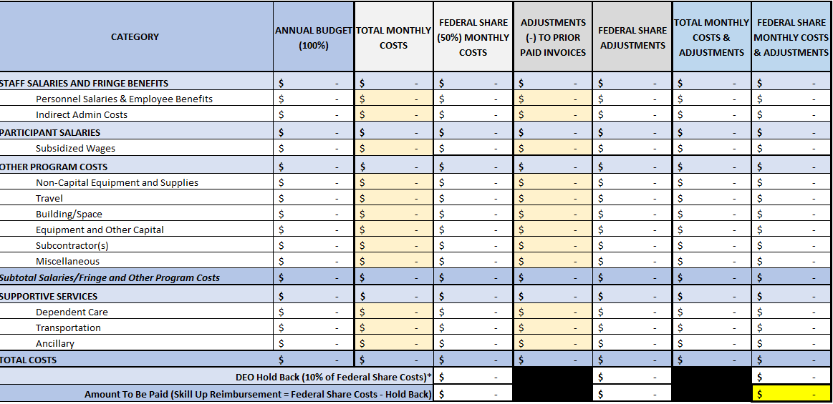
Skill Up Los Angeles: Invoice Preview
Invoices are due monthly to DEO. Enter total monthly costs into the cream colored cells.
Backup documentation such a timesheets, payroll records, invoices, etc are required during annual monitoring evaluations
Documentation requirements vary and can be discussed during TA

Slide 15
Skill Up Los Angeles: Resources
Documents we will send:
This deck
CDSS CalFresh E&T Handbook
Skill Up Los Angeles Handbook (currently under construction)
Budget template
Invoice and narrative templates
FTE Calculation tools
Helpful Links:
REDF Workshop – houses a lot of these forms
CalFresh E&T – more information about E&T across California
SNAP E&T – Federal lens and information

Slide 16
Questions?

