Slide 1
Building a Strong Workforce Program:
Mapping Partnerships &
Leveraging Core Strengths
Melanie Akwule, MBA

Slide 2
Melanie
Akwule
Workshop Facilitator
MINWO, Founder & CEO
BSBA, Georgia Tech
MBA, UC Berkeley
Former Sr. Technical Product Manager @
General Electric
4th at the 2012 Nigerian Olympic Trials
A B O U T M E

Slide 3
Continuing Education Week
April 7th to April 10th
Today:
Enhancing Employee Competitiveness for Quality Jobs
April 10th, 2025
Mapping Partnerships & Leveraging Core Strengths
1
2
3
4
Yesterday:
Tailoring your Success Program to your Focus Population
April 9th, 2025:
Designing a Quality Participant Worker Experience

Slide 4
Our 90-Minute Journey
Agenda Overview:
Objectives:
Core Competencies
& Internal Capacity
Identify core competencies and align them with
workforce program goals.
Understanding & Mapping
Partnership Ecosystems
Map and analyze partnership ecosystems to identify gaps.
Scan to Download Workbook
Developing a
Partnership Roadmap
Develop a roadmap for building sustainable, high-impact partnerships.

Slide 5
Why Strong Partnerships Matter
Why Partnerships Are Key for ESEs
-01-
-02-
-03-
Expand capacity and resources
Improve job retention and success rates
Enhance long-term program sustainability
Notes:
ESEs don’t just sell products and services:
They also provide paid employment and supportive services to individuals facing barriers to work
Resulting in:
An increase in your ability to provide meaningful employment opportunities to marginalized populations; therefore achieving social impact goals

Slide 6
‹#›
Quick Chat:
Identifying Valuable Partnerships
“Biggest challenge in building a sustainable workforce program?”

Slide 7
Core Competencies & Internal Capacity

Slide 8
What Are Core Competencies?
Step 1 to strong partnerships: Identifying core competencies
Unique strengths that drive workforce program success
Examples:
Workforce training & development
Wraparound support services
Employer engagement & industry alignment
Data-driven program evaluation
Notes:
. Workforce Training & Development
Providing job readiness programs (resume building, interview prep, soft skills training).
Offering industry-specific certifications (construction, hospitality, healthcare, IT, etc.).
Implementing on-the-job training for skill-building and career advancement.
2. Wraparound Support Services
Addressing barriers to employment such as housing, mental health, childcare, and transportation.
Offering case management and personalized support plans.
Connecting participants with financial literacy and coaching resources.
3. Case Management & Holistic Support
Providing personalized career coaching and goal-setting.
Helping participants navigate barriers like legal issues, health challenges, or addiction recovery.
Offering post-placement support to improve job retention.

Slide 9
Tying Core Competencies to Organizational Goals
Why It’s Important:
Ensures partnerships align with long-term impact goals
Identifies gaps where partnerships can enhance capacity
What to Consider:
How do your core strengths contribute to achieving your workforce program’s goals?
Identifying areas where partnerships can amplify your impact.

Slide 10
Identifying Your
Core Strengths
Criteria for defining core competencies:
- Value: Does this competency provide unique value?
- Rarity: Is it a distinguishing factor from other organizations?
- Sustainability: Can it be maintained and scaled over time?
Consider/Assess:
- People & Teams
- Technology
- Business Processes
Exercise 1 in Workbook (Page 1)

Slide 11
Core Competency Mapping
Quick Chat Activity:
Prompt: What are your top 3 core strengths, and how do they align with your mission?
Reflection Question:
How do your core strengths contribute to achieving your workforce program’s goals?
Share
Your Core Competencies
Share responses in chat or raise hand

Slide 12
Understanding & Mapping
Partnership Ecosytems

Slide 13
What Is a
Partnership Ecosystem?
Network of organizations that collaborate to drive collective workforce success
Includes:
Employer & industry partners
Wraparound support providers
Funding, government, and policy partners

Slide 14
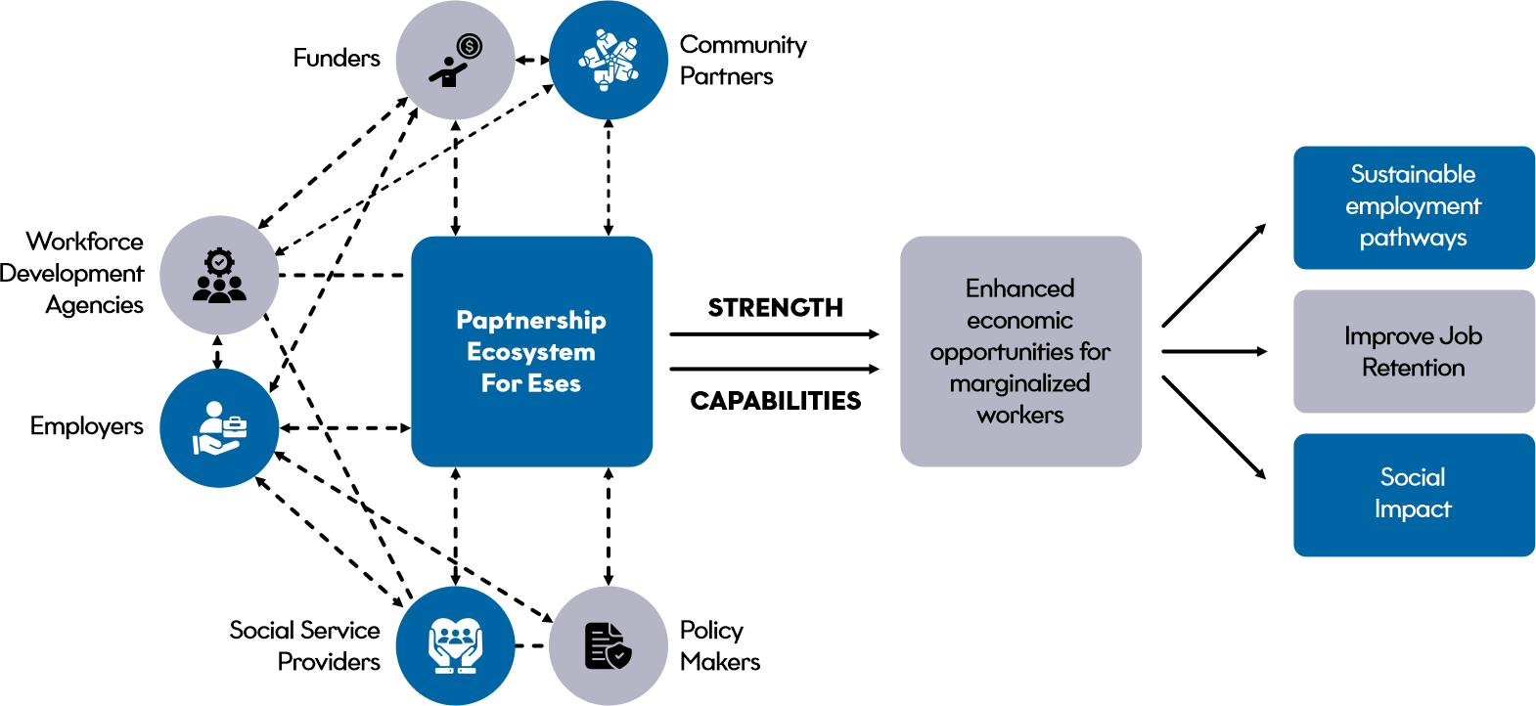
Partnership Ecosystems for ESEs

Slide 15
Key Partnership
Channels for ESEs

Slide 17
Evaluating Partnership Channels:
STRENGTHS
GAPS / OPPORTUNITIES
Our organization maintains 5 active partnerships for hiring workforce employees, with 70% of our corporate partners renewing their contracts. Additionally, we have achieved continuous growth in our corporate hiring pool year over year.
Our organization faces an upside-down ratio, where the number of applicants surpasses the available corporate hiring spots. This presents a significant opportunity for growth and expansion in our corporate partnerships.
Corporate hiring partnerships – job placements and upskilling
Social services – wraparound support (housing, mental health, etc.)
Government & funders – financial support and policy alignment
Exercise 2 in Workbook (Page 4)

Slide 18
Case Study

Slide 19
Introducing: Cara Collective, a Chicago-based ESE
Cara Collective provides workforce development programs for individuals experiencing homelessness, poverty, or other barriers to employment. Through a strong partnership ecosystem, Cara Collective connects participants with employers, social service providers, and training organizations to ensure long-term employment success.
Source: Cara Collective Performance Updates & Annual Reports;

Slide 20
Cara Collective Partnership Landscape
Employers
(Corporate & Small Businesses)
Workforce Development
Agencies
Social Service
Organizations
Key Partner: Advocate Aurora Health, Northwestern Medicine, Cushman & Wakefield
Role: Hiring trained participants, providing mentorship, and offering career advancement opportunities.
Impact: Over 70% of graduates remain employed one year after placement.
Key Partner: Chicago Cook Workforce Partnership
Role: Providing funding for skills training and connecting participants to broader workforce initiatives.
Impact: Expanded access to industry-recognized credentials and technical training.
Key Partner: Heartland Alliance, Housing Forward
Role: Offering housing support, mental health counseling, and financial literacy programs.
Impact: Holistic support addressing barriers beyond employment, leading to improved job retention.

Slide 21
Cara Collective:
The Results
Long-Term Employment Success: 70% of program participants stay employed after one year.
Ecosystem Alignment: Employers benefit from a steady pipeline of skilled workers, while social service agencies help stabilize employees' lives.
Scalability: The Cara Collective has expanded its model beyond Chicago, demonstrating the power of a well-integrated partnership ecosystem.
Source: Cara Collective Performance Updates & Annual Reports;

Slide 22
Quick Chat:
Evaluating Partnership Gaps & Opportunities
Are you missing key employer, service, or funding partners?
Do you have the right mix of partnerships to meet your goals?

Slide 23
Developing
A Partnership Roadmap

Slide 24
What is a Value Proposition?
A clear statement that explains the value your organization provides to partners.

Slide 25
What Makes a Strong
Value Proposition?
A clear statement that explains the value your organization provides to partners.
A strong value proposition clearly articulates why a collaboration is beneficial for all parties involved.
It ensures that both sides understand the unique contributions, expected outcomes, and mutual benefits, ultimately leading to more sustainable and high-impact partnerships.

Slide 26
The Components of a Strong Value Proposition
Aligns with partner priorities
Showcases core strengths and outcomes
Demonstrates mutual benefit

Slide 27
Considerations for ESEs Positioning Value to Partners
Understand Partner Pain Points → Position your ESE as a solution to employer challenges, not just a service provider.
Align Core Competencies with Partner Needs → Clearly show how your strengths help partners meet their goals.
Use Data to Demonstrate Impact → Provide retention rates, cost savings, and performance metrics to prove value.
Offer Post-Placement Support → Employers value wraparound services that help retain employees long-term.
Leverage CSR & DEI Goals → Many companies are looking for diverse hiring pipelines—ESEs can fill this gap.

Slide 28
Framework for Crafting a Value Proposition
“
Our organization helps [partner type] achieve [key outcome] by providing [unique capability] that results in [specific benefit].
Exercise 3 in Workbook (Page 7)

Slide 29
20-Minute Breakout Room Instructions
Self-Reflection: 5 Minutes
Guided Discussion: 15 Minutes
Identify a key partner or partner type
Draft a value proposition using the framework provided
Discuss how to refine it for clarity and impact

Slide 30
?
Reflections

Slide 31
‹#›
Click to add a note
Identifying the Core
Click to add a note
Click to add a note
Click to add a note
Key Takeaways
from Breakout Rooms
Click to add a note
Click to add a note
Click to add a note
Click to add a note

Slide 32
Integrating Partnerships for Long-Term Sustainability
How to Sustain Partnerships:
Embed partnership management in operations
Regularly assess outcomes and adapt as needed
Maintain ongoing communication and value alignment

Slide 33
01
Recap key takeaways
02
Action plan review:
What’s your first partnership-building step?
Recap
03
Resource list & follow-up opportunities

Slide 34
Melanie Akwule, MBA
Founder & CEO - MINWO Inc.
Melanie@minwo.co
www.linkedin.com/in/melakwule
www.melanuchi.com
Thank you! Any questions?

