Slide 1
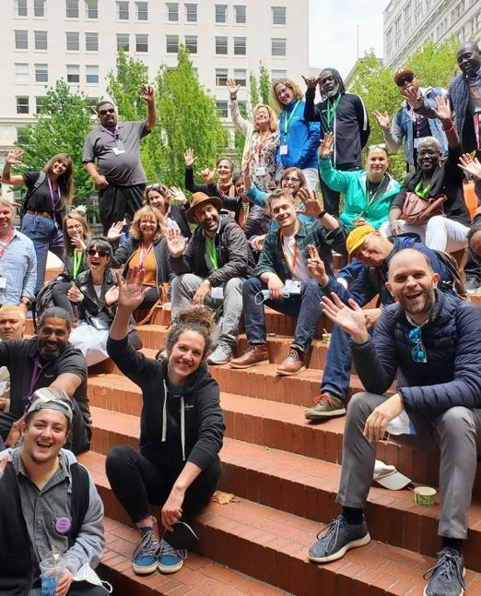
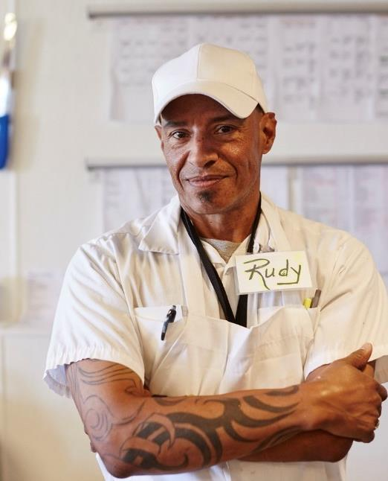
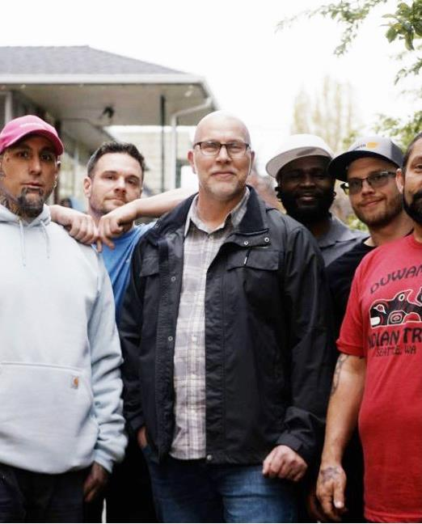
CA WIOA ESE Convenings
November 14, 2023

Slide 2

Agenda
REDF updates and reminders
ESE program updates
Goodwill Southern California WIOA app discussion
Discussion and dialogue

Slide 3
REDF’s Updates
REDF monthly Community of Practice is tentatively scheduled for the third Tuesday of every month at 11am. NO
EDD Office Hours on the second Tuesday of the month at 12pm.
REDF has hired a full-time project manager to oversee/manage the REDF contract. I will send you her bio and information in the next couple of weeks. She will be starting at REDF on December 11.

Slide 4
ESE Updates

Slide 5
Questions?

