Slide 1
Skill Up Los Angeles
CalFresh Employment & Training Onboarding: 101

Slide 2
Agenda
Welcome, Introductions
Skill Up LA goals, history
Skill Up LA Overview
Federal to Local language
Who-is eligible
What-services
When-timeline & important dates
Mechanics
Eligibility
Reports
Invoicing
Resources

Slide 3
Welcome & Introductions
Program Administration
Name, Organization, Role
Technical Assistance & Trainers
Name, Organization, Role
Partner Attendees
Name, Organization, Role
Experience or background if you’d like to share

Slide 4
Skill Up Los Angeles: Overview
Skill Up Los Angeles is a flexible federally funded program intended to upskill and increase the employability of CalFresh recipients. Services include education, work-based learning, job readiness training, and job retention; as well as a variety of supportive services to assist participants in achieving their training goals.
LA County Strategic Goals:
Make Investments that Transform Lives by supporting job readiness and increasing employment opportunities.
Foster Vibrant, Resilient Communities by aligning workforce development programs to increase the employability of high-need, priority populations
Statewide, CalFresh E&T has five strategic goals:
Increase job placement, retention, and wages;
Increase CalFresh E&T participation across a dynamic mix of people, communities and cultures;
Increase employability by removing barriers to employment;
Increase skills attainment and credentialing; and
Lead an efficient and effective customer focused CalFresh E&T program.

Slide 5
Skill Up Los Angeles: A history lesson
Key Accomplishments in FY19-20
Plan for Third Party Partner Onboarding & Training (started early 2021)
Draft Skill Up Los Angeles Handbook
Key Accomplishments in FY21
Goodwill & Chrysalis can claim for reimbursement starting October 2021 for FFY 21-22
In-person TA site visits by SJI/REDF
Quarterly Meetings with CDSS/FNS
Monthly Partnership Meetings with all Skill Up Partners & Providers
Key Accomplishments in FY22
Goodwill SoCal & Chrysalis are fully operational
DEO added four new third-party providers
Key Accomplishments in FY23
All 6 providers fully operational
959 total participants served
$1,834,731 in reimbursements back to providers
Key Accomplishments in FY24
Projected $3M in reimbursements back to providers
Projected 1542 participants served
Notes:
Nick

Slide 6
Skill Up Los Angeles: Today
Partner Department
Technical Assistance
Third-Party Providers

Slide 7
Skill Up Los Angeles: Federal to Local
Federal Lens:
Program name: SNAP E&T = Supplemental Nutrition Assistance Program Employment and Training.
Helps SNAP recipients gain skills and training they need to find and keep a job.
Provides education and training opportunities, job search assistance, support services to help SNAP recipients reach career and financial goals
Community based organizations (CBOs) and community colleges are of the most common providers nationally
Local & LA County Lens:
Program Name: CFET (CalFresh E&T statewide), Skill Up Los Angeles (local name)
It’s DPSS’s program, who contracts with DEO to administer
Technical Assistance: unique to Los Angeles, Skill Up. Funded by REDF in partnership with Seattle Jobs Initiative (SJI) providing all things E&T to… everybody.
California is a county- administered state, meaning that these funds transition as follows:
USDA, FNS (The feds) → CDSS (State Agency) → DPSS (LA SNAP agency) → DEO (LA workforce intermediary agency) → providers (you!)

Slide 8
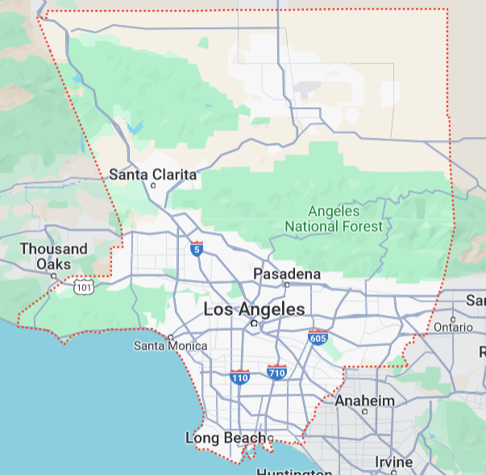
Skill Up Los Angeles: Who is eligible?
Skill Up Los Angeles participants must be:
Receiving federal CalFresh food assistance benefits (this is through DPSS)
At least 16 years of age
Reside in Los Angeles County
Not receiving Temporary Assistance for Needy Families (TANF) benefits
local program name: California Work Opportunity Responsibility to Kids (CalWORKs) program.
Willing and able to work upon completion of the program
Notes:
Time limited SNAP recipients (Able-Bodied Adults Without Dependents -ABAWDs)
People with employment gaps or inconsistent work experience
Formerly incarcerated individuals
General Assistance/General Relief (GA/GR) participants/recipients (local program)
Individuals and families experiencing homelessness
Timed-out CalWORKs participants

Slide 9
Skill Up Los Angeles: Services
Services provided under Skill Up Los Angeles are grouped into “components”. These services you are, and always have been, providing to your participants:
Component (Service) | Description & Information
Orientation | This is a required component. Orientation and assessment inform participants about available services and expectation of participation
Supervised Job Search | Must demonstrate a direct link to increasing the employment opportunities of individuals engaged in the activity. Must occur at approved locations where the activities of participants are directly supervised and tracked. Can Include: Job search training Master application Mock interviews Resume development
Work Experience | Designed to improve the employability of participants through actual work experience and/or training, and to enable individuals employed or trained under such programs to move promptly into regular public or private employment

Slide 10
Skill Up Los Angeles: Services
Services provided under Skill Up Los Angeles are grouped into “components”. These services you are, and always have been, providing to your participants:
Component (Service) | Description & Information
Education | A wide range of activities that improve basic skills, literacy, and employability that can include: Adult Basic Education (ABE) and/or Foundational Skills Instruction; Career and Technical Education (CTE) and/or Vocational Training; English Language Acquisition (ELA); Integrated Education and Training (IET) or Bridge Programs; and Work Readiness Training (WRT)
Self Employment Training | Improves participant employability by providing training in opening and operating a small business or other self-employment venture
Job Retention | Provides case management and supportive services to participants for a minimum of 30 days and a maximum of 90 days after employment is secured.

Slide 11
Skill Up Los Angeles: Services
Case Management
All Skill Up participants must receive case management services as part of the program. Case management may include comprehensive intake assessments, employability assessments, individualized service plans, progress monitoring, and coordination with other service providers. The purpose of case management services is to guide a participant toward appropriate components and activities based on the participant’s needs and interests and provide activities/ resources that help the participant achieve program goals.
Support Services Under Case Management
Dependent Care
Transportation
Ancillary (everything else)
Clothing & Tools
Identification
Housing
Digital Technology
Medical/Dental
Hygiene Supplies
Legal Services
Personal Protective Equipment
Textbooks, Training Materials

Slide 12
Skill Up Los Angeles: Timeline
Federal Fiscal Year: October-September
Quarter | Months
1 | October 1st - December 31st
2 | January 1st- March 31st
3 | April 1st – June 30th
4 | July 1st – September 30th
Recurring Deadlines:
Monthly: Confirmation of ongoing participant enrollment in CalFresh and non-CalWORKs status
5th of each month: Submission of Skill Up Referral and Enrollment Roster to DEO
15th of each month: Submission of invoice bundle to DEO
10th of first month in each quarter: Quarterly Progress Report due to DEO
10th of first month in each quarter: Quarterly Outcome Report due to DEO
Important Dates
April-May | Budget and Narrative drafting begins with providers
End of May | Budgets and Narratives due to DPSS from DEO
June 15th | CFET Plan due to CDSS from DPSS
June 30th | Deadline to submit current FFY plan amendments to CDSS from DEO/DPSS
August 15th | CFET Plan due to FNS from CDSS

Slide 13
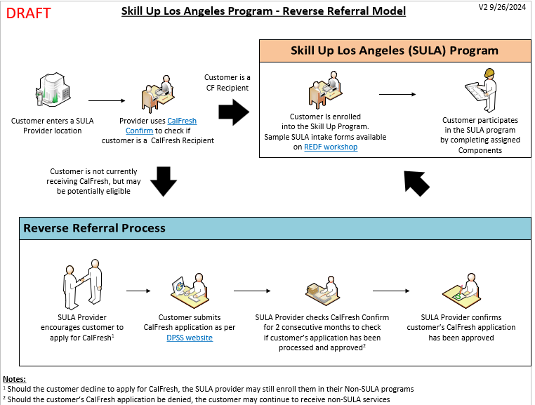
Skill Up Los Angeles: Mechanics Of Eligibility, Reverse Referral

Slide 14
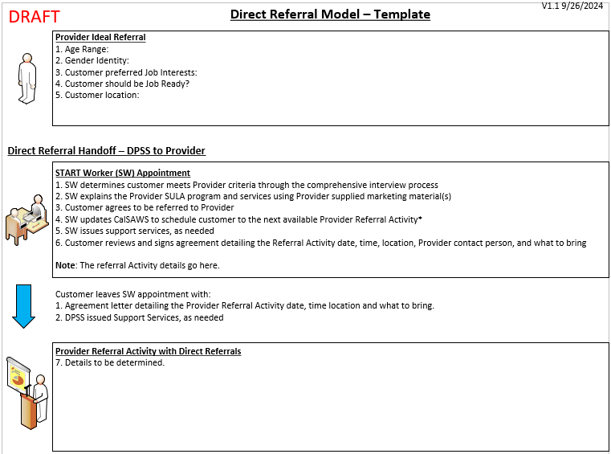
Skill Up Los Angeles: Mechanics Of Eligibility, Direct Referral

Slide 15
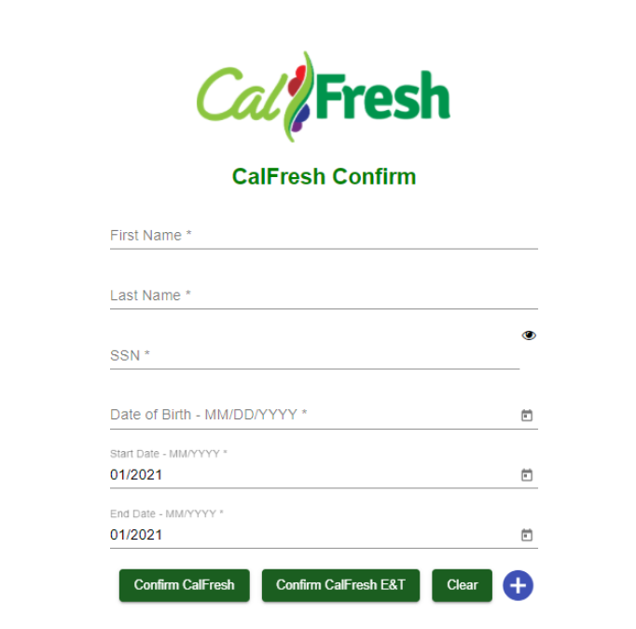
Skill Up Los Angeles: mechanics of eligibility
CalFresh confirm verifies an individual’s eligibility for CalFresh E&T / Skill Up Los Angeles anytime within the last year
Data is updated ~weekly

Slide 16
Skill Up Los Angeles: Referral and Enrollment Roster
Recurring Deadlines:
Monthly: Confirmation of ongoing participant enrollment in CalFresh and non-CalWORKs status
5th of each month: Submission of Skill Up Referral and Enrollment Roster to DEO
15th of each month: Submission of invoice bundle to DEO
10th of first month in each quarter: Quarterly Progress Report due to DEO
10th of first month in each quarter: Quarterly Outcome Report due to DEO
Roster Highlights:
Enroll into Skill Up Program
Check Program Eligibility
CF Verification
Demographics
Program and Component Start/End Dates
Program and Component Completion Status

Slide 17
Skill Up Los Angeles: Funding 101 Break!
1. Your organization uses non-federal funds to provide Skill Up LA services such as LA RISE
Start with $1000 of Non- Federal Funds
California is a county- administered state, meaning that these funds transition as follows:
USDA, FNS (The feds) -> CDSS (State Agency) -> DPSS (LA SNAP agency) -> DEO (LA workforce intermediary agency) -> providers (you!)
$1,000
$450
2. Invoice to DEO
4. Reinvest the reimbursement into the program
$202.50
$450
Federal reimbursement funds can be reinvested to draw further 45% reimbursement
3. Receive 45% reimbursement

Slide 18
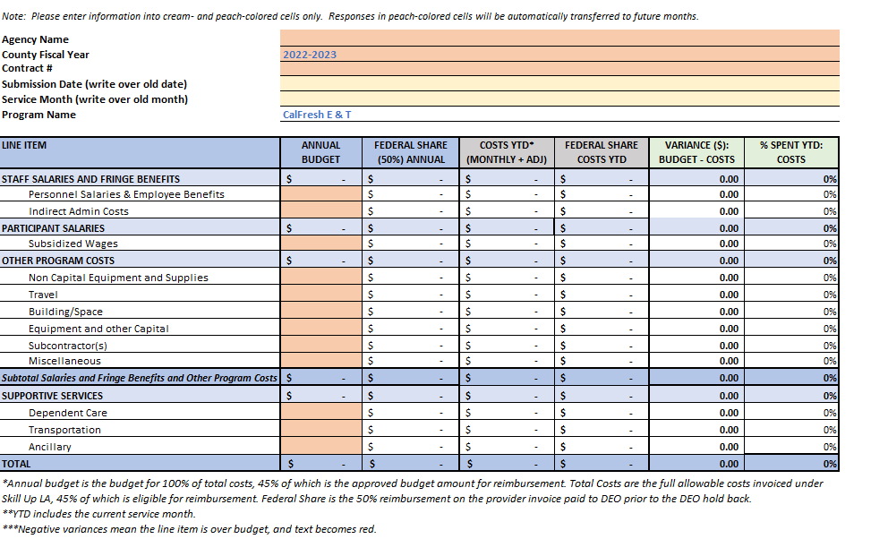
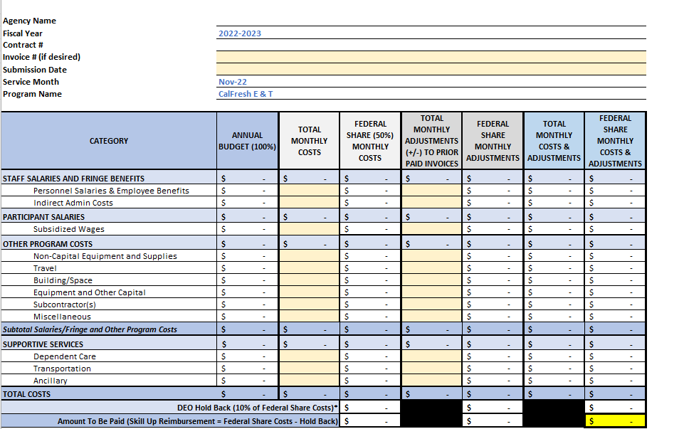
Skill Up Los Angeles: Invoice “Report”
Recurring Deadlines:
Monthly: Confirmation of ongoing participant enrollment in CalFresh and non-CalWORKs status
5th of each month: Submission of Skill Up Referral and Enrollment Roster to DEO
15th of each month: Submission of invoice bundle to DEO
10th of first month in each quarter: Quarterly Progress Report due to DEO
10th of first month in each quarter: Quarterly Outcome Report due to DEO
Report Highlights:
Total Budget
YTD Variance
Monthly Spenddown
Adjustments
Reimbursement

Slide 19
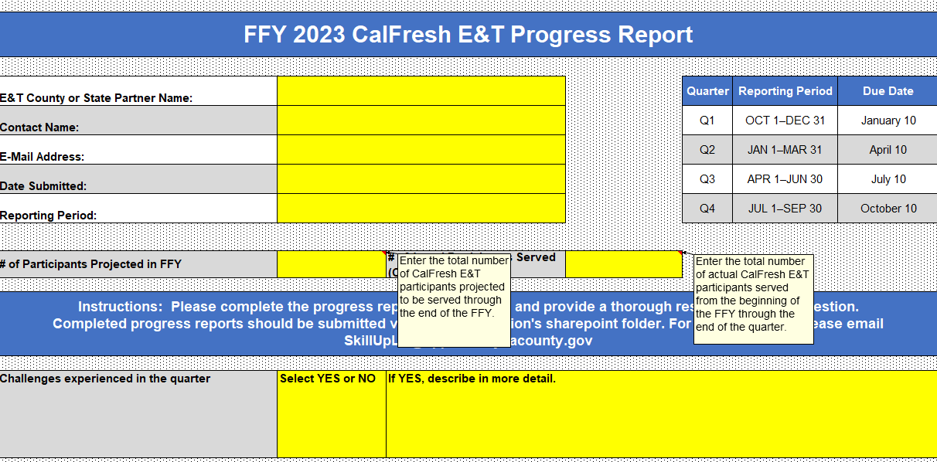
Skill Up Los Angeles: Quarterly Progress Report
Recurring Deadlines:
Monthly: Confirmation of ongoing participant enrollment in CalFresh and non-CalWORKs status
5th of each month: Submission of Skill Up Referral and Enrollment Roster to DEO
15th of each month: Submission of invoice bundle to DEO
10th of first month in each quarter: Quarterly Progress Report due to DEO -
10th of first month in each quarter: Quarterly Outcome Report due to DEO
Report Highlights:
Projected vs enrolled participants
Challenges
What TA or training needs do you have
Growth opportunities
Comments on performance

Slide 20
Skill Up Los Angeles: Quarterly Outcome Report
Recurring Deadlines:
Monthly: Confirmation of ongoing participant enrollment in CalFresh and non-CalWORKs status
5th of each month: Submission of Skill Up Referral and Enrollment Roster to DEO
15th of each month: Submission of invoice bundle to DEO
10th of first month in each quarter: Quarterly Progress Report due to DEO
10th of first month in each quarter: Quarterly Outcome Report due to DEO
Report Highlights:
Start/End Dates
Program Completion
Component Completion
Demographics

Slide 21
Skill Up Los Angeles: Resources
Organization/Role | Name | Contact | Title | How they can help
DEO- County Intermediary | Jorge Solorzano | jsolorzano@opportunity.lacounty.gov | Program Manager / Human Services Administrator | All things Skill Up, main contact for program go through Jorge S
DEO- County Intermediary | Chau Nguy | cnguy@opportunity.lacounty.gov | Management Analyst | All things Skill UP, Enrollment Roster and Reports
Technical Assistance Seattle Jobs Initiative | Nick Codd | ncodd@seattlejobsinit.com | Senior Consultant | All things Skill Up, or will find the right person
Technical Assistance Seattle Jobs Initiative | Deana Rader | drader@seattlejobsinit.com | Senior Consultant | All things Skill Up, or will find the right person
Technical Assistance REDF | Samantha Poster | sposter@redf.org | Manager, Government Partnerships & Policy | All things Skill Up, website management, partnership meeting agendas

Slide 22
Skill Up Los Angeles: Resources
Helpful Links and Resources
REDF Workshop – houses this and additional training decks, Skill Up handbook, resources and more. Password is SKILLUP
CDSS CFET Handbook
Benefits Cal – portal to apply for CalFresh, check status
CalFresh E&T – more information about E&T across California
SNAP E&T – Federal lens and information
Recurring Meetings:
Monthly TA Calls
Monthly SULA Partnership Meeting Link second Tuesday of each month at 1pm PST

Slide 23
Skill Up Los Angeles: Onboarding Next Steps
Skill Up Onboarding 101
Skill Up Onboarding: CalFresh Eligibility
Skill Up Onboarding: Support Services
Skill Up Onboarding: Fiscal 101
Skill Up Onboarding: Subsidized Work Based Learning
Skill Up Onboarding: Enrollment Roster & 90 Day Look Back
Skill Up Onboarding: Fiscal 210: Invoicing
Skill Up Onboarding: Reporting & Requirements

Slide 24
Questions?

