Slide 1
Skill Up Los Angeles
CalFresh Employment & Training Onboarding: CalFresh Information

Slide 2
CalFresh Information Session
October 17, 2024

Slide 3
What is CalFresh?
California’s State version of the Federal Supplemental Nutrition Assistance Program (SNAP) formerly known as Food Stamps.
Within Los Angeles County, the CalFresh program is administered by the Department of Public Social Services (DPSS)

Slide 4
SULA – Reverse Referral Overview

Slide 5
Applying for CalFresh
Potential Skill Up Los Angeles reverse referral participants can be directed to apply for CalFresh:
Online – BenefitsCal.com
Telephone – DPSS Call Center @ (866) 613-3777
In- Person at a local DPSS Office
By Mail or Fax
For more information, please visit the DPSS CalFresh Website or view the DPSS CalFresh Program Factsheet
DPSS has 30 days, from the Date of Application, to process the application

Slide 6
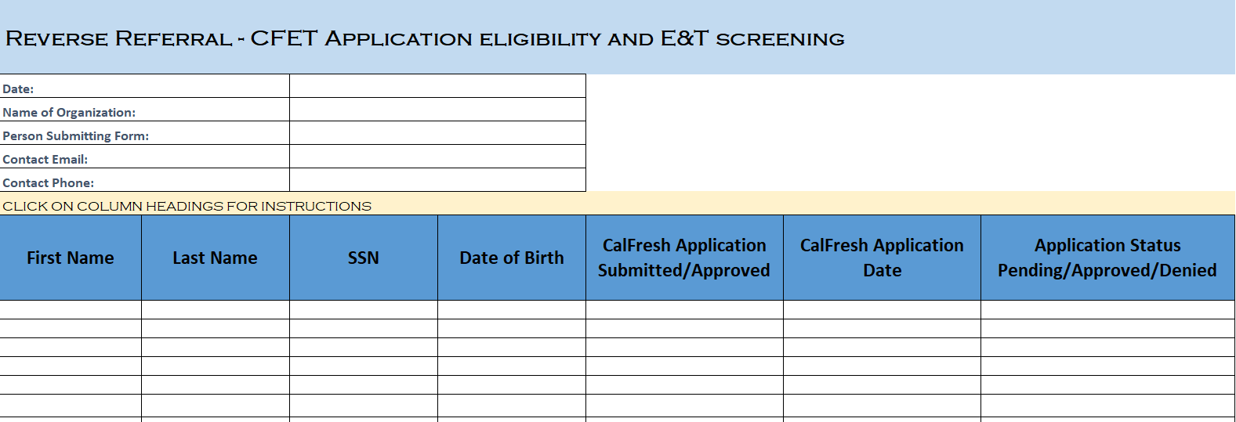
SULA Considerations
Providers are encouraged to use the Reverse Referral Log to request CalSAWS Eligibility Checks from DPSS
Notes:
1. Knowing the customer submitted an application
2. Knowing the customer was approved or denied through DPSS Eligibility Check
3. Completing the SULA intake process once SULA provider knows CalFresh Approval
4. Add customer information to the SULA Enrollment Roster

Slide 7
Lost of CalFresh Eligibility
CalFresh Recipients must comply with 2 reporting requirements through out the year.
At 6 months from Application – Semi-Annual Report (SAR 7)
At 1 year from Application – CalFresh Recertification
Most common cause of lost of CalFresh Eligibility
Customer does not submit the required reporting timely
CalFresh Recipients usually become aware of lost CF eligibility during the first 10 days of the Month

Slide 8
Re-Establishing CalFresh Eligibility
Discontinued CalFresh Eligibility is effective the 1st of the Month
Should the CalFresh Recipients comply with the reporting requirements within the first 30 days:
CalFresh would be Active without any Gap in benefits
SULA Providers will be able to bill without any Gaps

Slide 9
Re-Establishing CalFresh Eligibility
Due to CalFresh Confirm functionality, the SULA providers are encouraged to do additional eligibility batch run after the 3rd week of Month 1 through the 1st week of Month 2.
DPSS has until the end of the Month to process late report submissions.

Slide 10
Re-Establishing CalFresh Eligibility
If a CalFresh recipient does not comply within Month 1, the recipient would need to re-apply for CalFresh benefits.
Re-application would result in an eligibility gap during the SULA 90-day look back period.
Providers should continue checking recipient’s CF eligibility during the 90-day look back period.

Slide 11
Additional Resources
SULA Providers may connect CalFresh recipients to:
Online Assistance – BenefitsCal.com
DPSS Call Center @ (866) 613-3777
For more information, please visit the DPSS CalFresh Website

Slide 12
Thank you!
@EconOppLA
SkillUpLA@opportunity.lacounty.gov
Stay connected to us!

