Slide 1
Skill Up Los Angeles
CalFresh Employment & Training Onboarding: Fiscal 101

Slide 2
AGENDA
Welcome, Introductions
Skill Up LA 101
Funding Cycle
Budget Overview
General Breakdown
Line-Item Example
Considerations
Narrative Attachments
Funding Sources
Component Costs
FTE Calc Resources/Tools
Invoice Preview
Resources to be shared
Questions

Slide 3
WELCOME & INTRODUCTIONS
Program Administration
Name, Organization, Role
Technical Assistance & Trainers
Name, Organization, Role
Partner Attendees
Name, Organization, Role
Experience or background if you’d like to share

Slide 4
SKILL UP LOS ANGELES: OVERVIEW
Skill Up Los Angeles is a flexible federally funded program intended to upskill and increase the employability of CalFresh recipients. Services include education, work-based learning, job readiness training, and job retention; as well as a variety of supportive services to assist participants in achieving their training goals.
LA County Strategic Goals:
Make Investments that Transform Lives by supporting job readiness and increasing employment opportunities.
Foster Vibrant, Resilient Communities by aligning workforce development programs to increase the employability of high-need, priority populations
Statewide, CalFresh E&T has five strategic goals:
Increase job placement, retention, and wages;
Increase CalFresh E&T participation across a dynamic mix of people, communities and cultures;
Increase employability by removing barriers to employment;
Increase skills attainment and credentialing; and
Lead an efficient and effective customer focused CalFresh E&T program.

Slide 5
SKILL UP LOS ANGELES: FUNDING FLOW
USDA FNS
CDSS (State Agency)
DPSS (CalFresh Agency)
DEO (Intermediary)
Providers (You!)
→
→
→
→
Skill Up // E&T is a contract, program, and reimbursement grant based on actual services performed using non-federal funds
Notes:
Mention Acronyms and what they are here

Slide 6
SKILL UP LOS ANGELES: FUNDING CYCLE
1. Your organization uses non-federal funds to provide Skill Up LA services such as LA RISE
Start with $1000 of Non- Federal Funds
California is a county- administered state, meaning that these funds transition as follows:
USDA, FNS (The feds) -> CDSS (State Agency) -> DPSS (LA SNAP agency) -> DEO (LA workforce intermediary agency) -> providers (you!)
$1,000
$450
2. Invoice to DEO
4. Reinvest the reimbursement into the program
$202.50
$450
Federal reimbursement funds can be reinvested to draw further 45% reimbursement
3. Receive 45% reimbursement

Slide 7
SKILL UP LOS ANGELES: BUDGET OVERVIEW
Your budget can be thought of in two buckets:
Admin/Program costs
Support Services costs
Here are the common costs associated with running an employment program and the terms used to describe them
SNAP E&T funds are flexible by design, however there are unallowable costs. See CDSS handbook for more details
Food
Mental Health Services
Fundraising Costs
Bad debt, late fees
Membership costs
SALARIES, FRINGE BENEFITS AND INDIRECT
Personnel Salaries
Fringe Benefits
Indirect Admin Costs PARTICIPANT WAGES
Subsidized Wages and Fringe Benefits
OTHER PROGRAM COSTS
Non-Capital Equipment/Supplies
Supplies - Direct Program
Printing
Telephone
Travel
Building/Space
Equipment & Other Capital Expenditures
Subcontractors
Miscellaneous
SUPPORTIVE SERVICES
Dependent Care
Transportation
Ancillary
Updated budget templates can be found on Skill Up provider landing page
Notes:
State what ancillary services are/include

Slide 8
SKILL UP LOS ANGELES: BUDGET OVERVIEW
Within admin/program costs there are some additional calculations you will estimate and things to note:
Staffing: Cost allocated or direct see Skill Up provider page for this tool!
Participant facing Staff: % based on # Skill Up Participants / Total # participants on case load
Other Staff: Direct hours on project
Timecard required for backup documentation
Indirect Rate: covers costs not outlined explicitly for overhead
De minimus rate
Federally Approved Rate
Actual Costs
Other Program Costs- Cost Allocation
Building Costs: Cost allocated % based on # Skill Up Participants / Total # participants served org-wide
rent includes square footage calculation- last tab in workbook

Slide 9
SKILL UP LOS ANGELES: BUDGET OVERVIEW
Budget: For each line item in your budget, you will calculate the total cost (100%) you anticipate spending to serve Skill Up Participants
Think about how many participants you will serve
Remember: FFY Starts October 1st
The budget then breaks the total cost into:
Federal share (50%) and
Your FFY reimbursement potential from DEO

Slide 10
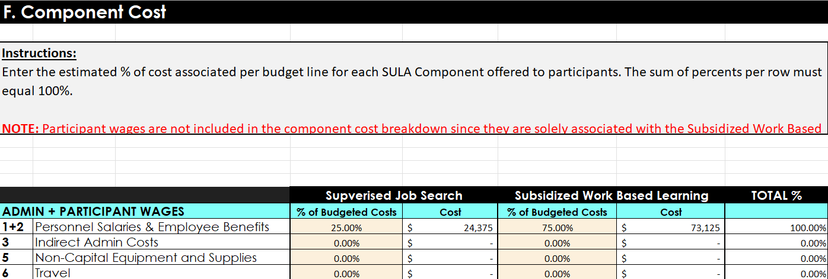
SKILL UP LOS ANGELES: BUDGET OVERVIEW
Component Costs: You will estimate what each component you anticipate offering will cost, broken down by program costs and support services. The goal is to understand how much each component costs to administer. Helpful Note: The amounts here should match your component narrative documents
Notes:
Using our earlier example with support services breakdown and distribution of case load as shown above, this is an example of how to think through these costs. Be mindful that:
You may have duplicated enrollments at the same time
You can think about this in more than one way
A good place to get started is the consider the distribution of enrollments by component and go from there

Slide 11
SKILL UP LOS ANGELES: BUDGET OVERVIEW
Funding Sources: You are eligible for reimbursement for any program costs associated with serving Skill Up Participants that were funded with non-federal sources. These sources are what you list here in the Funding Sources budget tab

Slide 12
SKILL UP LOS ANGELES: BUDGET OVERVIEW
Narrative Attachments: Each component you offer will have an attachment to fill out. You will describe in detail what is involved for each component. Each attachment has variation and is completed while you develop your budget and program
General Categories | Description
Summary | Describe activities and services offered in detail. Include objectives, skill gains, employer partners if applicable, curriculum used, length of program, etc.
Target Population | Select all that apply: list includes time limited SNAP recipients, unhoused individuals, underemployed individuals, single parents, etc
Critera for Participation | What skills or experience is needed for participation in component?
Enrollment Projection | Unduplicated estimate of annual enrollment
Cost of Component | Administrative costs only, do not include cost of supportive services. If this component is offered in combination with another component, please divide the administrative costs accordingly

Slide 13
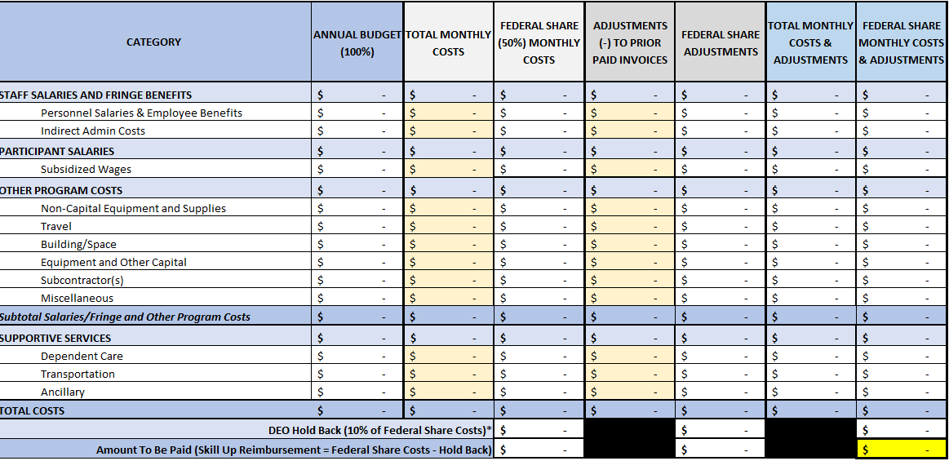
SKILL UP LOS ANGELES: INVOICE PREVIEW
Invoices are due monthly on the 15th to DEO. Enter total monthly costs into the cream colored cells.
Backup documentation such a timesheets, payroll records, invoices, etc are required during annual monitoring evaluations
Documentation requirements vary and can be discussed during TA

Slide 14
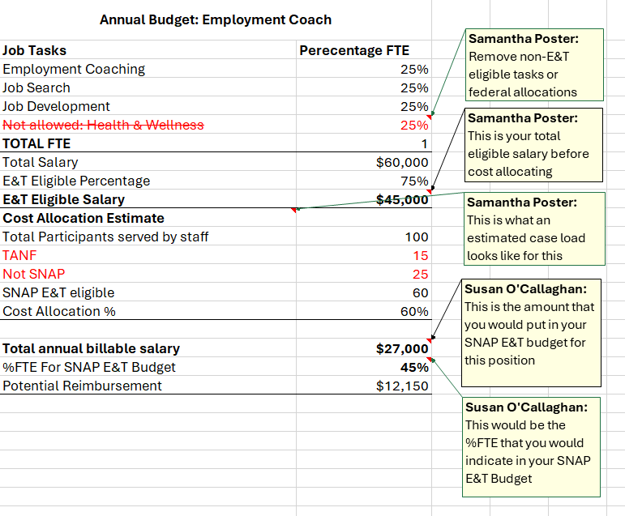
SKILL UP LOS ANGELES: RESOURCES
Staff Allocation Tools & Work Sheet
Annual Budget Exercise
Annual FTE Excel Breakdown Tool
Monthly FTE Excel Breakdown Tool
Allocations Methodologies
These tools can be found on the Skill Up provider landing page

Slide 15
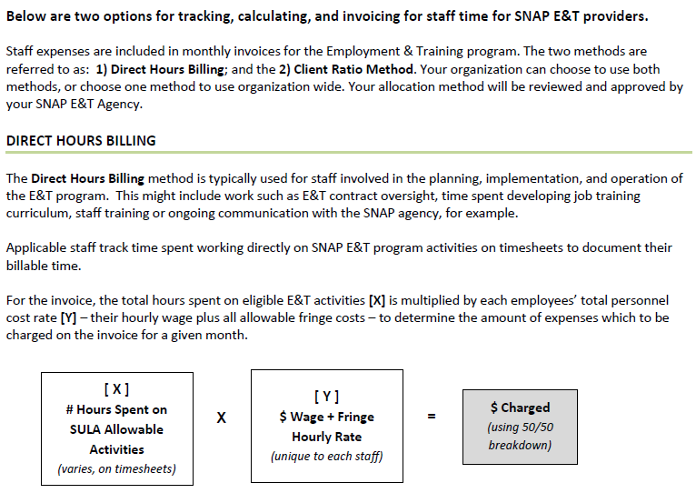
SKILL UP LOS ANGELES: RESOURCES
Staff Allocation Methodologies: Direct Billing
These tools can be found on the Skill Up provider landing page

Slide 16
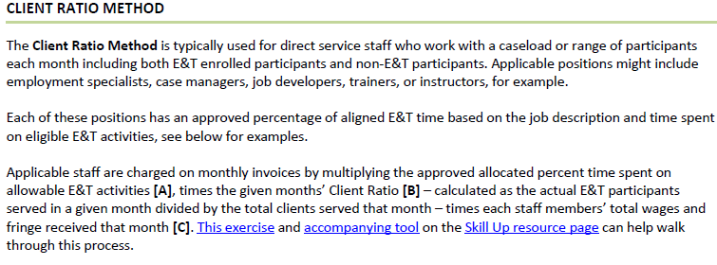
SKILL UP LOS ANGELES: RESOURCES
Staff Allocation Methodologies: Client Ratio
These tools can be found on the Skill Up provider landing page

Slide 17
Questions?

