Slide 1
Enabling Direct Deposits
to your Participant Workers through
Community Financial Resources
Focus Card
Notes:
After learn a little bit more about CFR
Review the benefits of DD for employees and employers
Hear from a long time partnership
Review the Focus Card benefits and ease of use
Slides and an overview of the Focus Card will be sent following the webinar

Slide 2
CFR Staff:
Christine Sadowski, Chief Impact Officer
Jeruel “JT” Taylor, Partner Program Mgr.
CFR Partner:
John Hess, President
Hess Workforce, Inc.
Notes:
Who’s involved in the presentation today

Slide 3
Community Financial Resources (CFR)
Mission: CFR provides pathways to financial well-being and economic justice with safe and reliable financial products for low-wealth communities
Founded in 2003
National nonprofit
100+ partners nationwide

Slide 4
Values
Principled. We have an enduring legacy of honesty, transparency, accountability, and reliability.
Solidarity. We believe that people should be the leaders in their own journey to financial wealth. We’re committed to co-creating solutions that support their choice and autonomy.
Transformative. We strive to challenge and change extractive financial industry practices with different approaches that benefit those impacted by economic inequality.

Slide 5
CFR’s Toolkit
Financial Products
Tools
Payment Facilitation
Behavior Based
Financial Education
CFR Focus Card
Credit Building Program
Fresh Start Loan
Secured Credit Card
MoneyGoals
Guaranteed Income
Direct Cash Transfers
Incentives
Stipends
Customized Curriculum
Trauma-informed
Train-the-Trainer
Notes:
Hear more about these later on in the presentation, but high level overview now

Slide 6
Survey Question
How many of you:
have never utilized direct deposit?
are using it currently?
have used the Focus Card in the past for direct deposit?

Slide 7
The Hard Road to Financial Stability
Don’t save for unexpected expenses
44% of individuals
Don’t follow a budget
47% of individuals
Don’t review bills or statements
30% of individuals
Don’t have credit access
28% of individuals
Financial Capability
Notes:
Participating in the workforce, while clearly the first step, is not enough
Knowing what to do with the money you earn is as important as having a job. Financial capability is also about building and applying skills.
And DD is clearly the first step in solid money management
CFR’s work is embedded in cognitive behavioral economics because we believe people learn best by doing - and then those lessons translate to better habits
Paying your employes through DD is one of the most impactful strategies employers can use to promote financial stability

Slide 8
The Financial State of the Workforce
72% of the US workforce are financially stressed.
3 out of 4 are sometimes living paycheck-to-paycheck.
46% of workers are distracted by their finances at work 3+hrs/wk.
Nearly half cannot cover an emergency expense costing $400.
Notes:
And why should employers be worried about and working to improve their employees financial stability and health?
Because it is inextricably lnked to the workforce and employers bottom line
Let’s look at the facts.

Slide 9
What Does This Mean for Productivity?
X
=
46% Distracted 3+hrs/wk
4.6 employees
10 employees
X
X
=
3 hrs/wk
46 avg
work wks/yr
634.8
hrs lost
4.6 employees
X
=
$10,499.59
lost per year
634.8
hrs lost
$16.54 federal
living wage
for every 10 employees
Notes:
So this is a major issue for employers but also for the programs preparing people to be productive workers.

Slide 10
Building Workforce Financial Capability
Store
Save
Borrow
Plan
Emergency fund
Short-term
Financial education
$Goal$
Direct deposit
Bank accounts
Payroll cards
Fresh Start loan
Secured credit card
Notes:
Good news is that building financial wellness among your employees can be a simple as adopting sound workforce business practices
Since people learn by doing, giving employees tools to build skills is the first step. These tools can be as simple as ensuring that everyone is paid through payroll direct deposit or as sophisticated as providing resources for workers to build or repair credit.
CFR can provide these tools w/ minimal need for HR resources or the need to build an elaborate employee wellness program

Slide 11
Benefits of Improving Financial Health
Increases Productivity
Improved Job Satisfaction
Higher Retention
Better Utilization of 401(k) FSA & HSA
Higher Retirement Readiness
Builds Brand Reputation
Lowered Stress
Reduced Distraction & Presenteeism
Lowered Absenteeism
Reduced Health Insurance Cost
Notes:
Many, many workforce studies confirm that prioritizing worker financial wellness has benefits for workers - see list on right
And let’s talk bottom line numbers: $8B paid to check cashing, payday lenders, bill pay centers; average cost of checking account $273/year
Fortunately, 81% of employers feel responsible for their employees’ financial wellness and that translates to significant business advantages as well in terms of employee productivity, retention, and workplace satisfaction.

Slide 12
Why Direct Deposit? Faster, safer, more convenient
Saves money: Direct fund transfers is less than the cost of printing and mailing checks, and paying staff to process payment checks and maintain accounting.
Saves time: Less time to process payroll. Reduces bookkeeping hours no need to write, mail and reconcile checks—or reissue lost checks. Minimizes payroll-related accounting issues like delays updating the general ledger and time spent on manual reconciliations.
Improves cash flow projections: Direct deposit gives you precision to when payments to employees will be withdrawn from your bank account. When paying by check, your cash flow will depend on when employees choose to cash their paychecks.
Avoids potential problems getting paper checks printed on time for payday
Enhances employee satisfaction
Direct deposit is a step toward increased financial security for employees.
Gets the funds into their account quickly, no holds or processing delays
Eliminates trips to the bank
More money stays in an employee’s account for a longer period of time
Provides a mechanism to boost savings
Account transaction provides expense tracking information
Indirectly, the money that the company saves is available for employee pay raises or other benefits
Notes:
A LOT on this slide, but details the many benefits to employers

Slide 13
Bottom Line for Employers
$2.87 - $3.15 average per check savings
$2,100 average yearly savings - 10 employees
$21,000 average yearly savings - 100 employees
($10,500) lost in productivity for every 10 employees
82% of employees paid through direct deposit
Notes:
And then there’s just the sheer numbers:

Slide 14
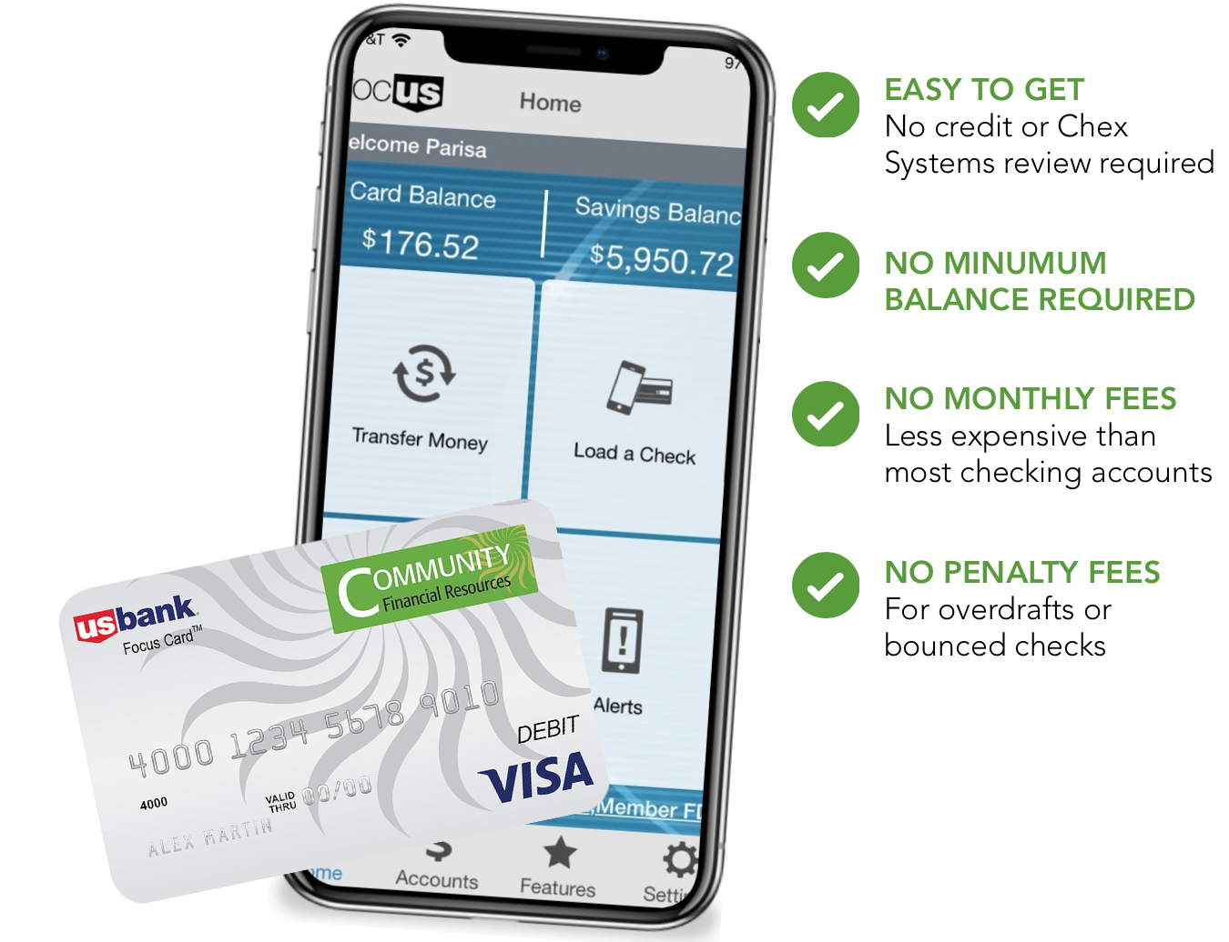
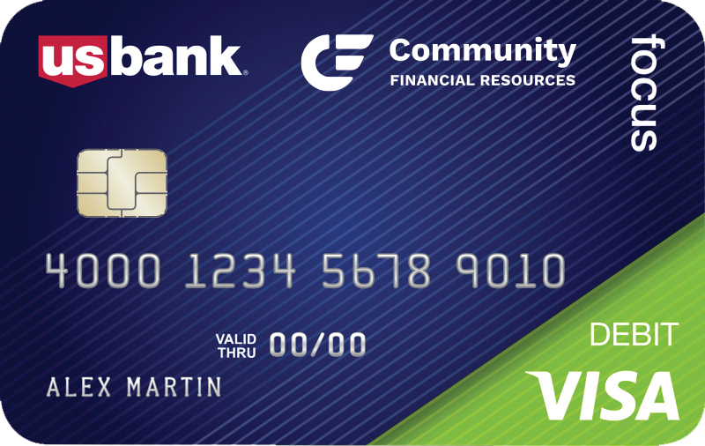
CFR Focus Payroll Card
Employer Benefits
Available to anyone
Looks like a regular bank account to payroll systems
Easy enrollment (5 mins or less)
CFR support
On-ramp preparation for moving into full-time work
Notes:
Let’s shift to talking specifically about how CFR can help you with the DD needs of your payroll and employees

Slide 15
Assumptive Phrasing for Direct Deposit
“Let’s go ahead and set up your direct deposit. Would you prefer it to go to your existing bank account, or would you like to use the CFR Focus Card for your payroll?”
“If you already have a bank account, are you experiencing any challenges with it that we should know about? If so, we can offer the Focus Card as an easy alternative to receive your paycheck”
“Direct deposit is the quickest and safest way to receive your paycheck. We’ll just need your account details or we can get you set up with a Focus Card if that works best for you.”
“To get your paycheck as quickly as possible, we’ll need your banking information. If you don’t have a bank account, no problem! We can set you up with the Focus Card today.”
Notes:
And before we hear from our partner about their experience using the Focus Card, just one more tip about direct deposit
If you have employees who have not had previous banking relationship or experience, they may need some additional information and encouragement to trust DD
Behavioral economics teaches us that the way we frame choices significantly influences decision-making. When talking to your employees about DD their paycheck, using assumptive language can make direct deposit feel like the natural and default choice. Instead of asking if they’d like to use direct deposit, try asking how they’d like their paycheck directly deposited. This small but impactful shift frames direct deposit as the standard - which we know it is for most employees - and reinforces it is the easiest and most logical choice.

Slide 16
John Hess, President
Hess Workforce, Inc
Hess Workforce delivers employer-of-record, back office admin services for Alternative Staffing Organizations, Social Enterprises and Workforce Development Organizations, as well as facilitate tax credit incentives for companies who hire their people with barriers to employment. Our very business model promotes an inclusive, full-employment U.S. economy for today, and tomorrow.
Notes:
Partner since 2005
John’s going to tell us a bit about his experience partnering with CFR and using the Focus Card
Then have a chance to ask him questions

Slide 17
How the Card Works for Employees
Functions like a bank Visa ATM/Check Card WITHOUT the Penalty Fees
Add Value
Use
Direct Deposit:
Payroll
Tax Refunds
Benefits
Load Cash
Purchasing
Bill Payment
Cash
Money Transfer
Savings Account
Notes:
So, let’s turn now to how the Focus Card works and the benefits of using it
Our card functions like a bank VISA ATM/Debit Card without the overdrafts
You add funds by direct deposit from payroll/tax refunds/benefits and you can load cash to our card
You can make purchases, pay bills and get cash from over 80K ATMS or with purchase
And we’ll talk more about this later, but the FC has an attached savings account to begin a saving
Our Partner Center on our website has training and written resources on how to load, use, and savings

Slide 18
A Consumer-Friendly Prepaid Debit Card
No credit or Chex System review to obtain
Basic ID requirements
14 or older, no custodial sig. required
No minimum balance requirements
No overdraft fees
No penalty fees
Online and mobile banking
80k+ In-network ATMs
Re-usable

Slide 19
Focus Savings Account
No monthly fees
Minimum Balance to open - $10.00
FDIC Insured
Interest Bearing at USB Retail Savings Rate
Interest accrues daily; paid quarterly
Build savings through automatic transfers feature
To spend funds, money must be moved back to card
Allows six transfers per month back to card
Notes:
And then the free savings account that is offered to all cardholders

Slide 20
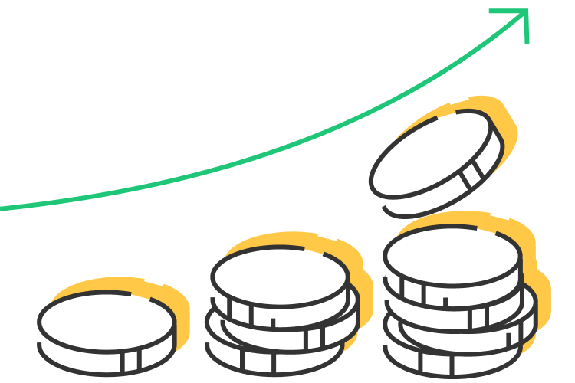
Set it & Forget it Savings
Employees can set-up an Automatic Savings Plan through their Focus Card to build emergency savings or save up for specific goals.
Cardholders can choose to move money to savings:
-with every direct deposit,
-whenever money is added to the card
--on the 1st of the month
--on the 15th of the month.
Any combination works, it’s the cardholder’s choice!
Notes:
To connect back to financial stability and wellness, savings is critical in this journey
Employees can set up automatic savings plans with the Focus Card

Slide 21
Fee Comparison
 | Focus Card | Other Banks*
Account opening initial deposit | $0 | $25 -100
Monthly maintenance | $0 | $5-15+
Overdraft fees | $0 | up to $35+
In-Network ATMs (Allpoint, US Bank, or MoneyPass) | $0 (includes balance inquiries) | $0-3.50
Card Replacement Fee | $0 (1 free per year) | $5-25
Savings Account | $0 | Up to $25/mo. (many require daily minimum to avoid monthly fee)
Joint Account/Money Transfer | $0 | $3-10
Out-of-Network ATM Withdrawal | $2.00 plus surcharge | $2-4 plus surcharge
Inactivity Fee (365 consecutive days of no transactions) | $2.00/month* | $2.00-$10.00/month
*avoidable if funds are in savings
*
Notes:
This comparison shows how the FC is the best option for your employees
See the only way to incur fees is OON ATMS and inactivity

Slide 22
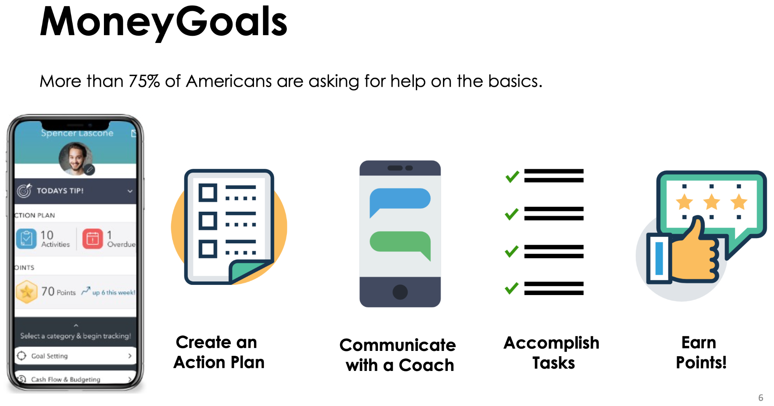
Notes:
Before we end, just want to very quickly talk about a couple of other CFR products that could be made available to your employees
Once again, we used a behavioral economics/cognitive behavior approach in development
Developed after years of working with partners on financial education and money management skills building
Customizable financial management plan
Gametized categories of tasks with rewards – earn points, badges, incentives; users can interact directly but coaches also engaged to oversee activity, can directly communicate with users through the app
D2C product

Slide 23
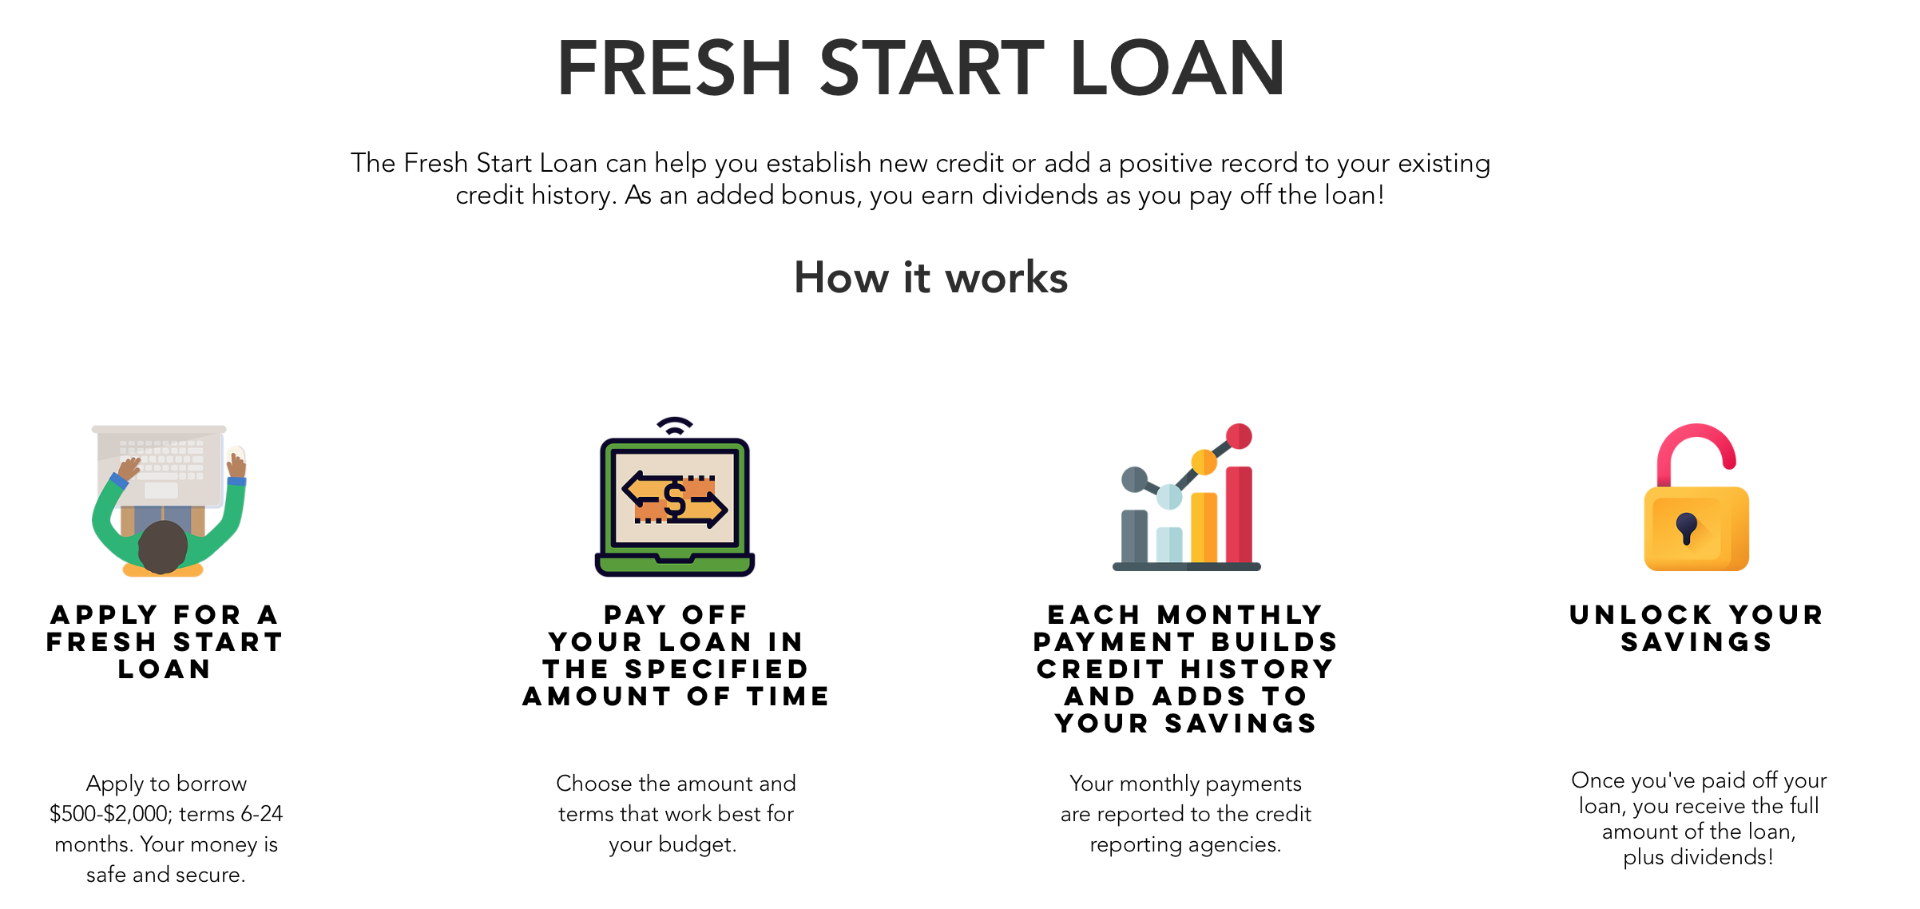
Credit Builder CD/Fresh Start Loan
Notes:
Credit Building products: CD/Fresh Start Loan and secured credit card
Use SurveyMonkey to assess credit readiness, includes questions about cash flow to really ascertain ability to take on debt; will recommend a next step to build toward credit readiness
Draw out terms as long as possible for best management
Is reported to credit bureaus to build credit score
Can adjust loan terms and will not be reported; can also end early and not incur negative report

Slide 24
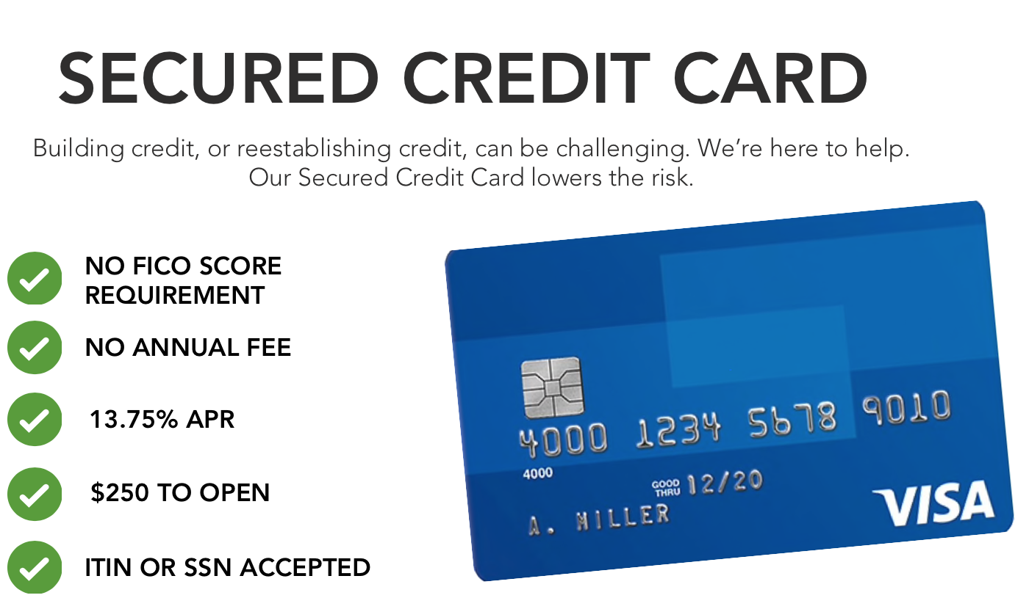
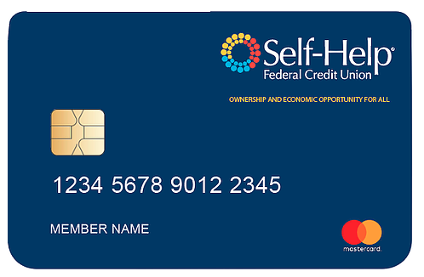
Notes:
Always recommend a graduated approach to credit building, so secondary step, or appropriate for those with slightly higher credit score

Slide 25
CFR Focus Card Resources for Employers
Product access & enrollment support
HR/Payroll staff training
Employee communications, marketing & outreach materials
Product usage reports
Communications, marketing & outreach materials
VITA / EITC expertise and partnerships
Notes:
Lastly, want to highlight how Community Financial Resources supports your work and your employees financial wellness

Slide 26
Questions? Comments?
Thank you for attending!

