Slide 1
Market Analysis Coaching Session
Sustainable Growth: Business Scaling and Expansion
March 18, 2025

Slide 2
Community Agreements
Stay engaged: We’ll be spending an intensive, albeit brief period of time together. It’s important that folks take care of their individual needs so that they can stay actively engaged in the entirety of the discussion. Please refrain from being on your phone or computer, unless using to take notes. When virtual, please try to limit other activities.
Listen to understand: As opposed to listening to respond, where we wait for someone to stop speaking so that we might speak, listening to understand invites us to actively take in what our peers are saying and ask follow-up questions to ensure we understand not just what a person says, but what they mean.
Take space, make space: If you’re someone who is typically comfortable speaking in group settings, consider paying attention to when and how frequently you share, giving space to those voices the group might hear from less frequently. If you’re someone who is typically quieter in group settings, consider taking a chance and sharing your questions, thoughts, concerns, and opinions.
Nobody knows everything, but together we know a lot: Everyone has expertise to contribute whether it be skills, resources, stories or insights. Our collective knowledge far exceeds our individual contributions.
Challenge assumptions: We’re here to learn from one another and that means asking difficult questions and challenging what we may assume to be best practice. Many of our assumptions are invisible in our culture and ways of working. How might we get curious about the things we assume to be true to explore if there are ways to innovate and evolve our practices?
Expect and accept non-closure: During our limited time together we will not be able to address and solve all open question. That’s ok! Prepare yourself in advance that decisions may remain under discussion, questions may remain open and we simply may not have time to address some topics. This is part of an ongoing conversation and there’s more to follow.
Center Participant Workers: Participant Workers are the heart of our work. Keep the resident experiences, perspectives, needs and desires front and center in all things
Embrace Diversity in All of its Forms: Acknowledge and value the diversity of perspectives and opinions within the group, specifically how they may be informed by folks lived vs. learned experiences.
Create a Safer Space for Sharing / Refrain from Attribution: We want people to feel comfortable sharing experiences, observations, and ideas - even if those are ideas aren’t yet fully baked. Let’s help people be vulnerable and feel comfortable sharing by not attributing specifics.

Slide 3
Sustainable Growth: Business Scaling and Expansion Roadmap
August 8th, 2024
Venture Criteria
December 10th, 2024
Feasibility Overview
April 15, 2025
Operational and Organizational Analysis
1
2
3
4
5
6
October 15th, 2024
New Business Canvas
February 11th, 2025
Market Analysis
June 10th, 2025
Financial Projections

Slide 4
Stoplight Analysis - Market Opportunity Feasibility Milestones
Category | Feasibility Milestone Name | Feasibility Milestone Description
Market Opportunity | Market Demand | There is sufficient demand from key customers in the target market.
 | Competitive Advantage | We can establish competitive advantage to gain market share.
 | Industry Growth | Our target industry for expansion shows positive market and job growth trends.

Slide 5
How to Conduct Market Analysis
Identify assumptions about your customers, competitors, and industry that need to be validated.
Conduct research to prove or disprove your assumptions.
Assess & adapt by identifying opportunities to refine, or pivot, your growth initiative based on your findings.

Slide 6
Independent Reflection
What key question do you have about conducting or assessing your growth initiative’s:
market demand (identifying your customers and the problem they’ll pay you to solve)
competitive advantage (why customers choose you over the competitors)
industry growth (positioning your business in a growing market)

Slide 7
Hive Mind Round
Organization shares market analysis key question
Group asks clarifying questions
Everyone independently brainstorms ideas
Everyone shares ideas verbally or in the chat
Repeat!

Slide 8
What’s Next?
After this session:
Keep working on your market analysis tool and share the tool with stakeholders.
Schedule a 30-minute 1:1 coaching session! Email us team@nearby.consulting
Our next track session is Tuesday, April 15th from 11 AM -12:30 PM PST. The session is VIRTUAL.

Slide 9
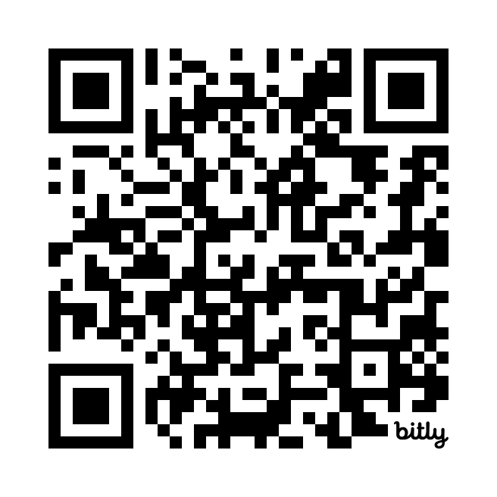
Feedback Survey
Please take a few minutes to fill out our Survey on this session.
https://bit.ly/SGTScaleAll
This feedback helps us improve your experience and plan adjustments to make moving forward.
Thank you!

