Slide 1
Financial Fundamentals Series – Financial Health Metrics 201
Notes:
Today we will be going through some tips and tricks for how to keep a pulse on the financial health of your organizations – esp. with an eye towards ESE

Slide 2
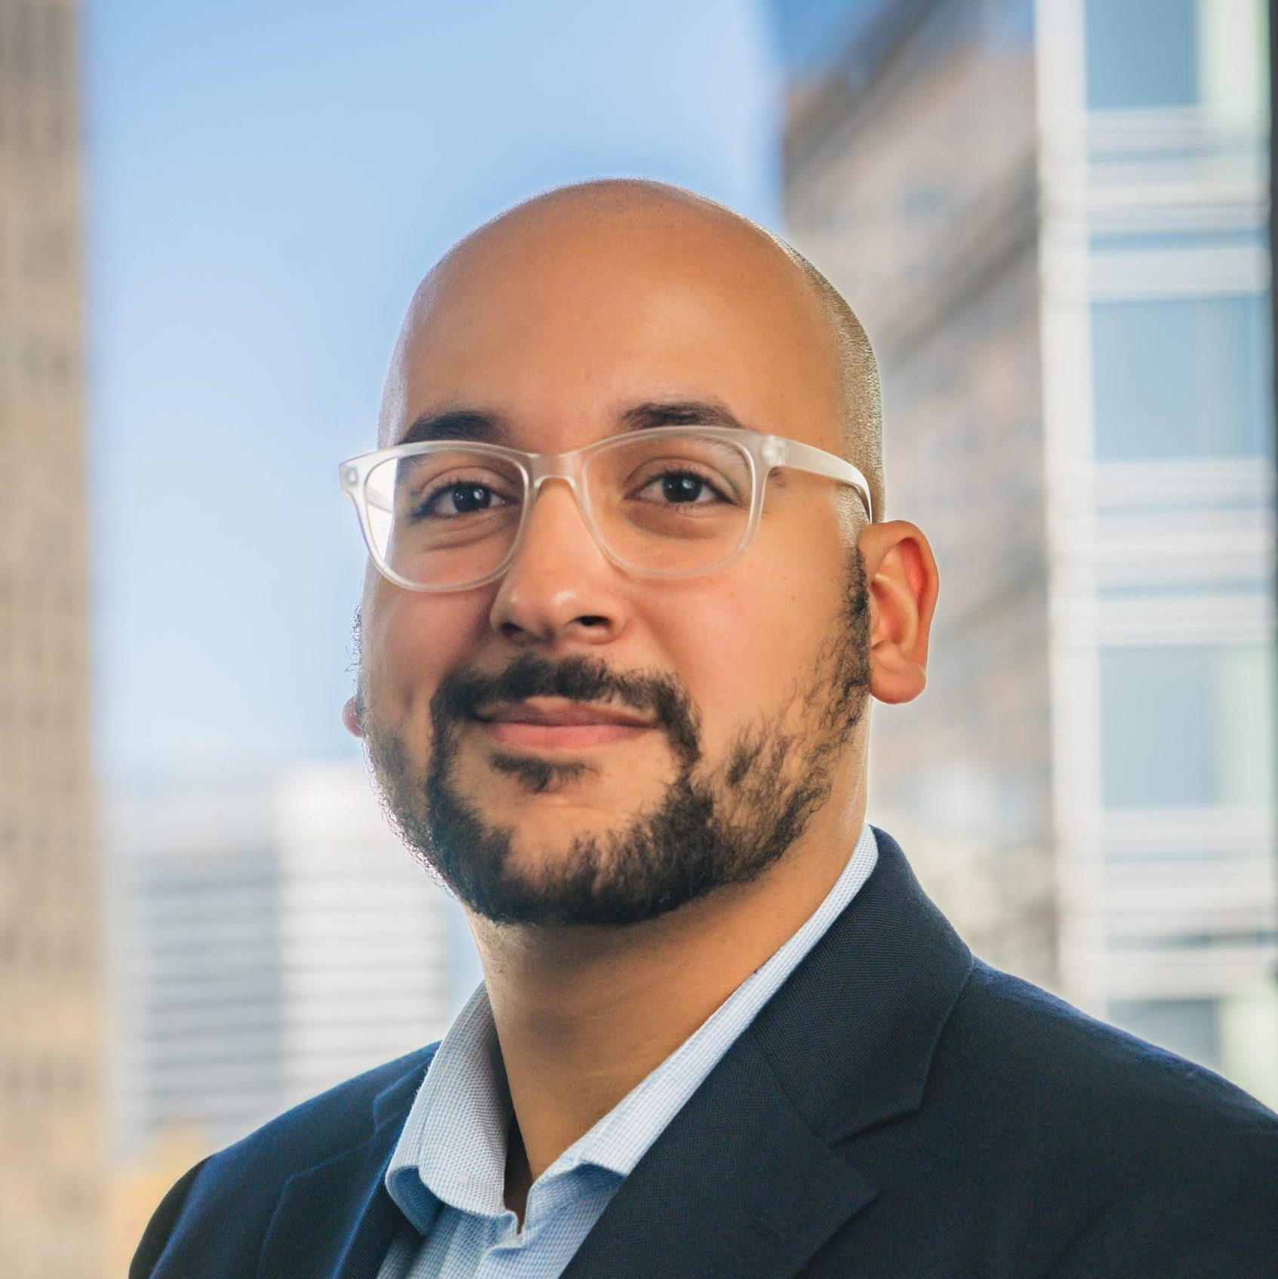
Introductions
Rony Cepeda Mekosh
Senior Manager Capacity Building

Slide 3
Optional CA RISE – Financial Fundamental Series
TODAY:
Financial Health Metrics 201
April 3rd, 2025:
Liquidity Understanding & Management Pt. 2
1
2
3
4
Financial Health Metrics 101
April 3rd, 2025:
Liquidity Understanding & Management Pt. 1
Notes:
Katie

Slide 4
How would you describe your feelings or confidence with managing the financial health of an organization?
Positive
Neutral
Negative
Notes:
We all have different relationship with finance – even within the 201 group
Lean on each other
Let’s learn together

Slide 5
Let’s warm up together!
Open the example income statement
Reflect individually (5 mins.)
Where are they doing well?
What calls your attention or concerns you?
What questions would you ask this ESE?
Share with us your reflections and how you got there.
No wrong answers. This is not a “gotcha”. We are just warming up our critical thinking.
Notes:
Cue music.
There’s a lot of collective knowledge in this room – so let’s flip the classroom.
https://drive.google.com/uc?export=download&id=13W4yDpyxpQ3Fi4dNejYzJSgrisa_cXC1

Slide 6
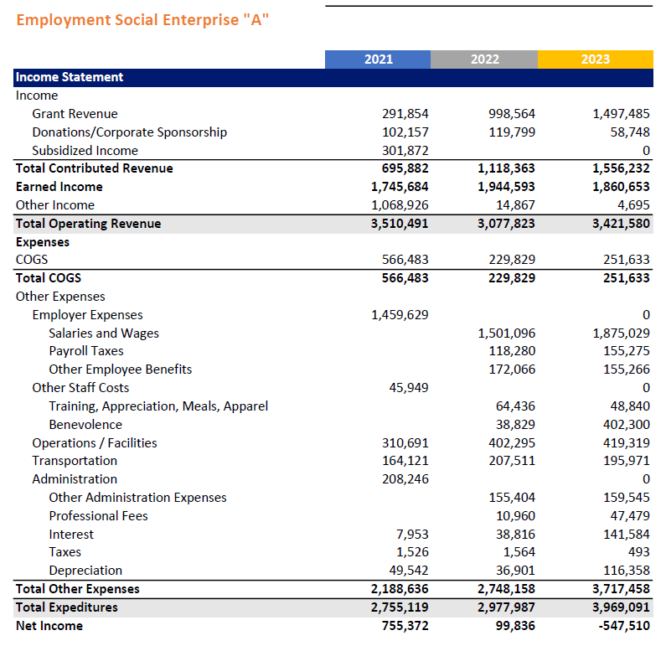
Making sense of financial statements is hard!
So many moving pieces!
ESEs have mission-related revenue (contributed) as-well as business revenue (earned).
Lots of different opinions on what to look.
Notes:
Mention REDF’s expertise in this field

Slide 7
Today’s objectives
By the end of today, you will walk away…
Understanding six financial metrics for monitoring ESE financial health that REDF has learned as the most important through its 25+ years of working with ESEs.
With real hands-on experience at using these metrics to understand a case study ESE.
Having prioritized 2-3 financial metrics to calculate for your own ESE.

Slide 8
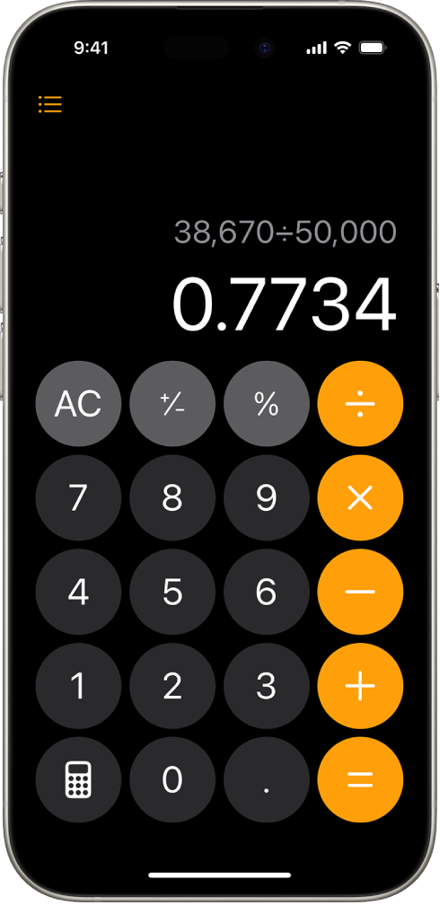
For today, you might find it useful to use your phone’s calculator

Slide 9
The Six ESE Financial Metrics

Slide 10
Caveat: Day-to-day operations vs. overall financial health
Notes:
Explain that these metrics are more for measuring overall financial health of an ESE rather than day-to-day financial operations. Not for a financial controller. Key decisions around which part of our organization might need attention. Should we be increasing revenue? Should we be assessing our costs? How future proof are we?

Slide 11
The metrics cover three financial area…
Profitability
Liquidity
Leverage
Do our revenues exceed expenses?
How quickly can we get our hands on cash (and savings) when we need it?
Is our organization financed more by debt or by equity?

Slide 12
Drumroll please….the six core financial metrics
Profitability
Liquidity
Leverage
1
% Change in (Unrestricted) Operating Revenue
5
Days of Cash on Hand
6
Debt-to-Equity Ratio
2
% Change in Expenses
3
Net Margin
4
Earned Revenue Cost Coverage
Notes:
https://drive.google.com/uc?export=download&id=1dnsWPJ7Jck6xxavpp3-Hm4OTkuXLTQcX

Slide 13
The Good News: you already have the data to calculate these metrics
Income Statement
Balance sheet
aka Profit & Loss Statement, P&L, Statement of Activities
aka statement of financial position, B/S
Answers the question, 'How did we get here?'
Reports financial performance over a specific period of time
Answers the question, 'What do we own and what do we owe?'
A snapshot in time of a company’s assets and how they are financed

Slide 14
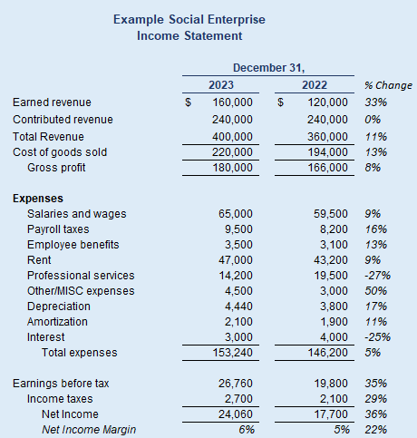
Income Statement Refresher
Specific accounting period (ending December 31, 2023)
Shows total revenues…
…then subtracts direct costs, or COGS…
…and other expenses
…to result in a net profit or loss

Slide 15
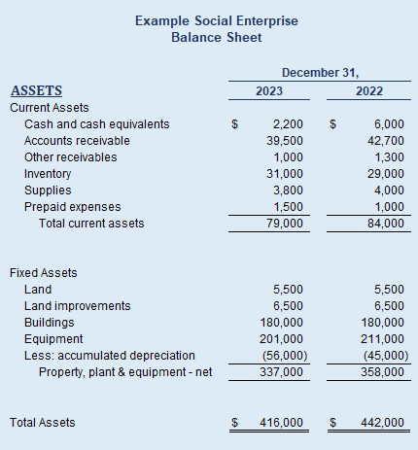
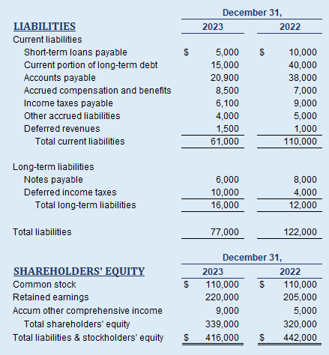
Balance Sheet Refresher
Assets: What the organization OWNS
Liabilities: What the organization OWES
Equity: what the organization OWNS OUTRIGHT
Assets = Liabilities + Equity
Notes:
https://drive.google.com/uc?export=download&id=1dnsWPJ7Jck6xxavpp3-Hm4OTkuXLTQcX

Slide 16
Profitability: Changes in Revenue and Expenses
1
% Change in (Unrestricted) Operating Revenue
Doesn't include revenue restricted for future years' operations
related to day-to-day operations
400,000 - 360,000
360,0000
= 11% change in unrestricted operation revenue
2
% Change in Expenses
direct costs, or COGS +
indirect costs, or other operating expenses
(220,000 + 153,240) – (194,000 + 146,200)
(194,000 + 146,200)
= 10% increase in expenses

Slide 17
What can these numbers tell you?
Is the business growing (or contracting)?
Do changes in revenue correspond to changes in expenses?
4 Different Scenarios to Consider:
Revenue Growing & Costs Growing
Revenue Decreasing & Costs Decreasing
Revenue Decreasing & Costs Decreasing
Revenue Growing & Costs Decreasing
Notes:
-Decision: Should I focus on more revenue or should I look into controlling my costs?

Slide 18
Let’s give it a try!
Try calculating 1.) % Change in (Unrestricted) Operating Revenue & 2.) % Change in Expenses for Employment Social Enterprise “A”.
Year 2022 to 2023
Assume all operating revenue is unrestricted
Use your phone’s calculator or your laptop
Don’t worry about getting the number exactly right
% Change in (Unrestricted) Operating
=(current op. revenue – past op. revenue) / past op. revenue
= (3,421,580 – 3,077,823) / 3,077,823
= 11% growth in op. revenue
% Change in Expenses =
= (current op. expenses – past op. expenses) / past op. expenses
= (3,969,091 – 2,977,987) / 2,977,987
= 33% growth in op. expenses
Notes:
NOTE: Not all ESEs separate unrestricted revenue

Slide 19
The six core financial metrics
Profitability
Liquidity
Leverage
1
% Change in (Unrestricted) Operating Revenue
5
Days of Cash on Hand
6
Debt-to-Equity Ratio
2
% Change in Expenses
3
Net Margin
4
Earned Revenue Cost Coverage

Slide 20
Profitability: Net Margin and Earned Revenue Cost Coverage
Earned Revenue
Revenue
COGS
3
Net Margin: How profitable is the ESE? How much do I have left over to reinvest?
4
Earned Revenue Cost Coverage: How much of the ESE’s costs are covered by earned revenue?
Example:
24,060 / 400,000
= 6%
Example:
160,000 / (220,000 + 153,240)
=
43%
Operating Expenses
Net Income
Notes:
Note: Most ESEs don’t separate earned revenue

Slide 21
What can these numbers tell you?
Net Margin
How ‘efficient’ is the organization is at converting sales into profit?
After covering costs, how much does the ESE have left to invest back into the organization (to afford things like expansion) or to afford debt?
Compare to average industry net margin: https://www.venasolutions.com/blog/average-profit-margin-by-industry
Use 990s to understand nonprofit net margin averages of similar organizations

Slide 22
What can these numbers tell you?
Earned Revenue Cost Coverage
Indicates how reliant organization is on contributed revenue to cover costs
Lower cost coverage = means you rely more on contributed revenue (which isn’t necessarily bad)
This is helpful to track over time

Slide 23
Let’s give it a try!
Try calculating 3.) Net Margin & 4.) Earned Revenue Cost Coverage for Employment Social Enterprise “A”.
Year 2023
Assume all earned income is operational
Use your phone’s calculator or your laptop
Don’t worry about getting the number exactly right
Net Margin
= Net Income / Total Revenue
= -547,510 / 3,421,580
= -16% Net Margin
Earned Revenue Cost Coverage
= Earned Revenue / Total Expenses
= 1,860,653 / 3,969,091
= 47% Earned Revenue Cost Coverage

Slide 24
The six core financial metrics
Profitability
Liquidity
Leverage
1
% Change in (Unrestricted) Operating Revenue
5
Days of Cash on Hand
6
Debt-to-Equity Ratio
2
% Change in Expenses
3
Net Margin
4
Earned Revenue Cost Coverage

Slide 25
Break Time

Slide 26
The six core financial metrics
Profitability
Liquidity
Leverage
1
% Change in (Unrestricted) Operating Revenue
5
Days of Cash on Hand
6
Debt-to-Equity Ratio
2
% Change in Expenses
3
Net Margin
4
Earned Revenue Cost Coverage

Slide 27
Liquidity: Days Cash and Days Liquid Equity
This metric answers the question, how long can the ESE keep operating if there’s an interruption in revenue?
5
Days of Cash on Hand: includes cash and cash equivalents on balance sheet
Balance Sheet
Income Statement (P&L)
Notes:
A note here on “liquidity”

Slide 28
Liquidity: Days Cash
5
Days of Cash on Hand
Cash
2,200 / (153,240 / 365)
= 5 days cash on hand
Other Expenses

Slide 29
What can these numbers tell you?
Can the organization make payroll?!
How much cash does the organization keep on hand relative to the size of their operations?
How much of a 'safety net' (aka liquid savings and reserves) does the organization have relative to the size of their operations?
Can the organization afford to invest in its own growth using reserves?

Slide 30
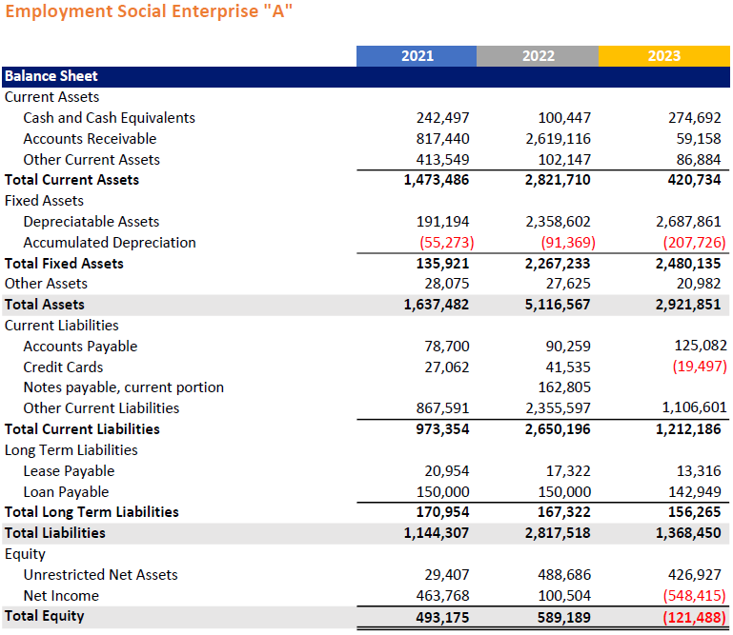
Let’s give it a try!
Try calculating 5.) Days of Cash on Hand for Employment Social Enterprise “A”.
Year 2023
Remember to use the balance sheet to find cash and cash equivalents
Use your phone’s calculator or your laptop
Don’t worry about getting the number exactly right
Days of Cash on Hand
= Cash and Cash Equivalents / (Total Operating Expenses / 365)
= 274,692 /

Slide 31
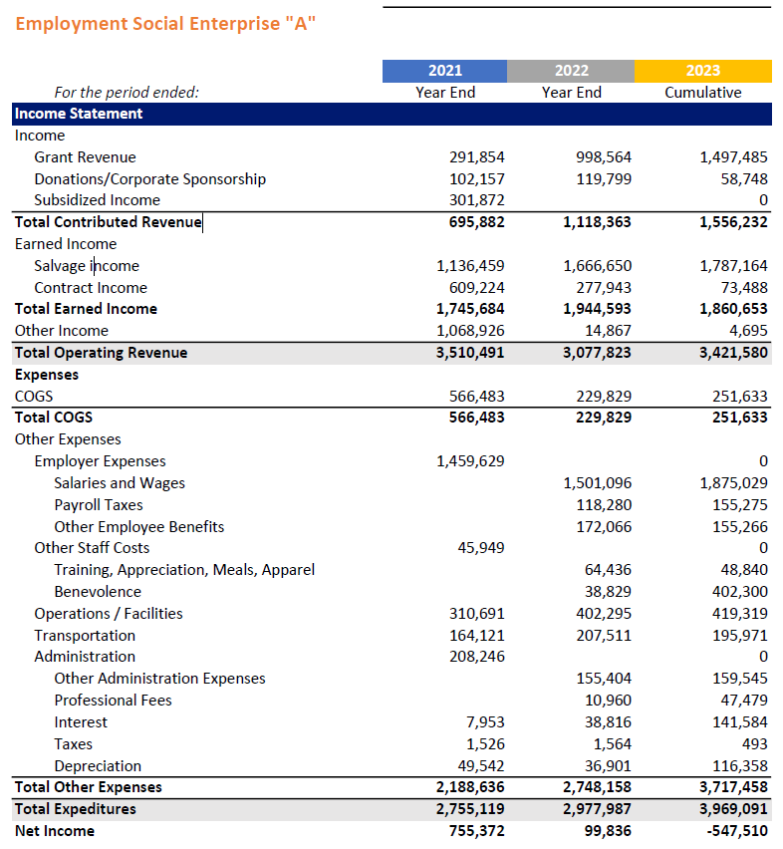
Remember that operating expenses will be in the income statement!
Days of Cash on Hand
= Cash and Cash Equivalents / (Total Operating Expenses / 365)
= 274,692 / (3,717,458 / 365 days)
= 27 days cash on hand

Slide 32
The six core financial metrics
Profitability
Liquidity
Leverage
1
% Change in (Unrestricted) Operating Revenue
5
Days of Cash on Hand
6
Debt-to-Equity Ratio
2
% Change in Expenses
3
Net Margin
4
Earned Revenue Cost Coverage

Slide 33
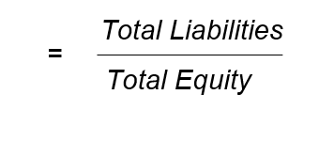
Leverage: Debt-to-Equity Ratio
6
Debt-to-Equity Ratio: Is the organization financed more by debt or by equity?
Total Liabilities
= 77,000 / 339,000
= 0.23x Debt to Equity Ratio
Total Equity

Slide 34
What can this number tell you?
How much of the organization's assets are financed by liabilities?
Is the organization in a good position to take on debt (or more debt)?
Lower risk: 0x – 3x
Higher risk: <0x (negative equity) OR >3x (lots of debt)
In combination with other metrics – what kind of risk profile does this organization have?

Slide 35
Case Study Activity
Let’s divide into groups of 3 (by industry)
Situation - Imagine you just joined this ESE as their finance director
Take 10 mins. to examine historical financial metrics
Discuss as a group:
What trends do you notice?
What areas would you want to dig into more and why?
Be ready to share back with the larger group!
Notes:
https://drive.google.com/uc?export=download&id=1JcKSYk9F0WDIMTyqUwUbVN83e6b3GBx5

Slide 36
Employment Social Enterprise “A” Key Financial Metrics
 | 2018 | 2019 | 2020 | 2021 | 2022 | 2023
% Change in (Unrestricted) Operating Revenue | N/A | 4% | 94% | 30% | -12% | 11%
% Change in Expenses | N/A | -1% | 94% | 4% | 8% | 33%
Net Margin | -3% | 2% | 2% | 22% | 3% | -16%
Earned Revenue Cost Coverage | 70% | 72% | 81% | 63% | 65% | 47%
Days of Cash on Hand | N/A | 1 days | 28 days | 32 days | 12 days | 24 days
Debt-to-Equity Ratio | 275.3x | 7.5x | 15.8x | 2.3x | 7.7x | -25.1x
Discuss:
What trends do you notice?
What areas would you want to dig into more and why?
Notes:
Debbie (Handout)
Ask the groups to share out the trends they noticed and where they would want to dig in to learn more

Slide 37
Making sense of financial statements is hard!
So many moving pieces!
ESEs have mission-related revenue (contributed) as-well as business revenue (earned).
Lots of different opinions on what to look.
Notes:
Mention REDF’s expertise in this field

Slide 38
Today’s objectives
By the end of today, you will walk away…
Understanding six financial metrics for monitoring ESE financial health that REDF has learned as the most important through its 25+ years of working with ESEs.
With real hands-on experience at using these metrics to understand a case study ESE.
Having prioritized 2-3 financial metrics to calculate for your own ESE.

Slide 39
Optional CA RISE – Financial Fundamental Series
TODAY:
Financial Health Metrics 201
April 3rd, 2025:
Liquidity Understanding & Management Pt. 2
1
2
3
4
Financial Health Metrics 101
April 3rd, 2025:
Liquidity Understanding & Management Pt. 1
Notes:
Katie

Slide 40
Feedback Survey
https://bit.ly/OptionalWorkshops
This feedback helps us improve your experience and plan adjustments to make moving forward.
Notes:
Galiana

Slide 41
Thank you!
You can reach me at rcepeda@redf.org
linkedin.com/in/cepedarony

