Slide 1

Financial Fundamentals Series –
Liquidity Understanding & Management Part 1

Slide 2

Introductions
Rony Cepeda Mekosh
Senior Manager
Capacity Building

Slide 3
Optional CA RISE – Financial Fundamental Series
April 2nd, 2025:
Financial Health Metrics 201
April 3rd, 2025:
Liquidity Understanding & Management Pt. 2
1
2
3
4
TODAY:
Financial Health Metrics 101
NOW:
Liquidity Understanding & Management Pt. 1
Notes:
This is around how to read financial statements – this is beginner level and we are purposely starting here. Later on we will dive deeper.

Slide 4


Slide 5

Group Discussion and Share-out
Break into groups of 3-4
Discuss:
What in this video resonated with you personally?
This video is about personal / family finance – but how could these lessons be applied to organizational finance as well?
Notes:
b. We all have different relationship with finance.

Slide 6
Here are some of my takeaways on how this relates to organizational finance
Organizations also need to be prepared to deal with a cash emergency
Important to know whether I can pay my bills and how much I have left over
Visualize (dare I say “forecast”?) the future
Talking about money is hard whether personal or organizational

Slide 7

“82 percent of business failures are due to poor cash flow management, or poor understanding of how cash flow contributes to business.”
— Jessie Hagen, U.S. Bank
Notes:
1 Min. Source: https://www.forbes.com/sites/melissahouston/2020/12/22/how-this-cash-collector-turns-outdated-accounts-into-cash-quickly/?sh=86f4ac7d7a31
This is a concern that we see in ESEs as well.

Slide 8
Today’s objectives
By the end of today, you will walk away…
Understanding the strategies that can be put in practice in order to mitigate a cash emergency
Having applied a simple cash flow projection tool to understand your organization’s cash need in a short-term period (~3 months)
With an understanding of how your cash position affects your growth goals

Slide 9

But first…a quick detour!

Slide 10
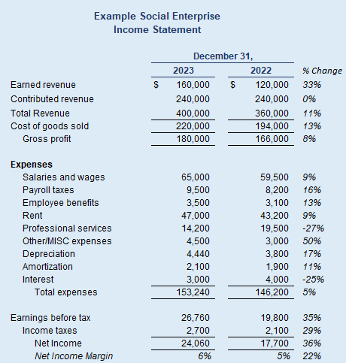
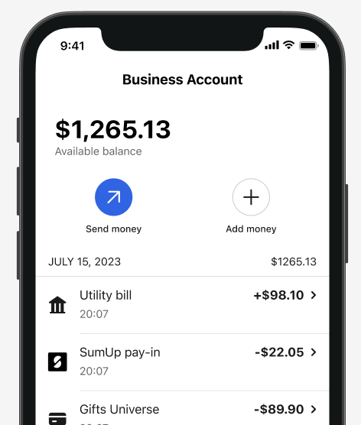
Net income is NOT the same as cash in your bank account.

Slide 11


Slide 12
One quick example of how net income is not the same as cash
“Account Receivables” is revenue that folks have promised to pay you (i.e. an IOU)
This is considered as revenue in your income statement → which brings up your net income.
BUT since this is NOT money that you have actually received, it won’t be in your bank account until it gets paid.

Slide 13
Detour Complete!

Slide 14

Imagine this hypothetical scenario…
FreshRise Cafe, a small social enterprise employing individuals transitioning out of homelessness, faces a cash crisis after a catering client delays a $10,000 payment. With just $3,000 in the bank, the cafe can’t cover $4,500 rent, rising supply costs, or payroll, putting operations and its mission at risk.
What could they have done to weatherproof their organization?

Slide 15



Strategies for preventing and managing a cash risk
Rainy Day Strategies
Cost & Revenue Management
Cash reserves
Line of Credit
Emergency Funders
Get better at collecting payments
Negotiate and bring down costs
Refinance and pay down debt
Foresight
Project your monthly (or biweekly) cash needs and prepare accordingly for any downfall.

Slide 16
Rainy day strategies for preventing and managing a cash risk
Rainy Day Strategies
Cash reserves
Aim to be able to cover at least 14-30 days of operations
Clear alignment of how and when the reserve can be used
Separate bank account than your day-to-day operations
Line of Credit
Recall from our Raising Impact Capital session – this is sort of like a business credit card (but better terms)
Very helpful if you have customers that don’t pay you right away
Emergency Funders
This shouldn’t be your first line of defense but helpful to have funders who can help in an emergency

Slide 17
Cost & revenue strategies for preventing and managing a cash risk
Cost & Revenue Management
Get better at collecting payments
If you have account receivables (customers who don’t pay right away), think about whether you can have those customers pay you sooner through more streamlined invoicing and reminders.
Negotiate and bring down costs
Negotiate with supplies to delay payments in the short-term and/or bring down costs in the long-term.
Refinance (or restructure) and pay down debt
If you have large monthly loan payments, see if you can refinance or restructure to lower your payments.

Slide 18
Foresight strategies for preventing and managing a cash risk
Foresight
Project your monthly (or biweekly) cash needs and prepare accordingly for any downfall
Avoid any surprises – try to foresee what will be coming in and out of your organization’s bank account to be prepared.
Helps you get ahead of any cash emergencies and take action with more time.

Slide 19

Break Time

Slide 20

Coming back to our hypothetical scenario…
FreshRise Cafe, a small social enterprise employing individuals transitioning out of homelessness, faces a cash crisis after a catering client delays a $10,000 payment. With just $3,000 in the bank, the cafe can’t cover $4,500 rent, rising supply costs, or payroll, putting operations and its mission at risk.
Pair & Share: What could they do?

Slide 21
Strategies for preventing and managing a cash risk
Rainy Day Strategies
Cost & Revenue Management
Cash reserves
Line of Credit
Emergency Funders
Get better at collecting payments
Negotiate and bring down costs
Refinance and pay down debt
Foresight
Project your monthly (or biweekly) cash needs and prepare accordingly for any downfall.

Slide 22
Strategies for preventing and managing a cash risk
Rainy Day Strategies
Cost & Revenue Management
Cash reserves
Line of Credit
Emergency Funders
Get better at collecting payments
Negotiate and bring down costs
Refinance and pay down debt
Foresight
Project your monthly (or biweekly) cash needs and prepare accordingly for any downfall.

Slide 23
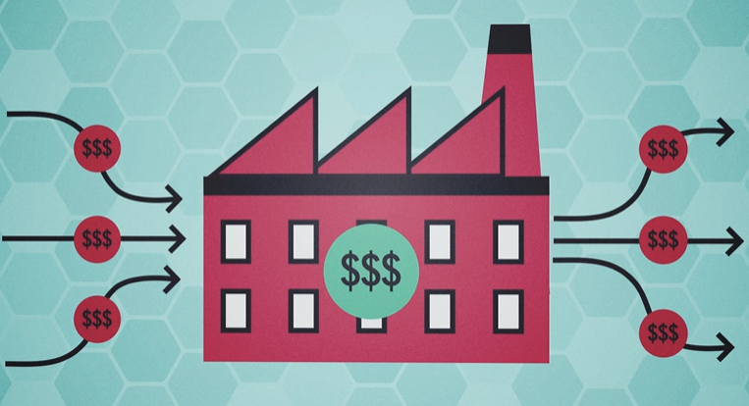
A cash flow projection is knowing how much cash is going IN and how much is going OUT

Slide 24
Today’s objectives
By the end of today, you will walk away…
Understanding the strategies that can be put in practice in order to mitigate a cash emergency
Having applied a simple cash flow projection tool to understand your organization’s cash need in a short-term period (~3 months)
With an understanding of how your cash position affects your growth goals

Slide 25
Optional CA RISE – Financial Fundamental Series
April 2nd, 2025:
Financial Health Metrics 201
April 3rd, 2025:
Liquidity Understanding & Management Pt. 2
1
2
3
4
TODAY:
Financial Health Metrics 101
NOW:
Liquidity Understanding & Management Pt. 1
Notes:
This is around how to read financial statements – this is beginner level and we are purposely starting here. Later on we will dive deeper.

Slide 26

Feedback Survey
https://bit.ly/OptionalWorkshops
This feedback helps us improve your experience and plan adjustments to make moving forward.
Notes:
Galiana

Slide 27
Thank you!
Notes:
Close!

Slide 28
Financial Fundamentals Series –
Liquidity Understanding & Management Part II

Slide 29
Introductions
Rony Cepeda Mekosh
Senior Manager
Capacity Building

Slide 30
Optional CA RISE – Financial Fundamental Series
April 2nd, 2025:
Financial Health Metrics 201
NOW:
Liquidity Understanding & Management Pt. 2
1
2
3
4
TODAY:
Financial Health Metrics 101
Today:
Liquidity Understanding & Management Pt. 1
Notes:
This is around how to read financial statements – this is beginner level and we are purposely starting here. Later on we will dive deeper.

Slide 31
Today’s objectives
By the end of today, you will walk away…
Understanding the strategies that can be put in practice in order to mitigate a cash emergency
Having applied a simple cash flow projection tool to understand your organization’s cash need in a short-term period (~3 months)
With an understanding of how your cash position affects your growth goals

Slide 32
Together we will practice filling out a simple cash flow projection tool

Slide 33


Side Note: Use your intuition and try to be directionally correct!
Intuition
Detailed Calculations

Slide 34
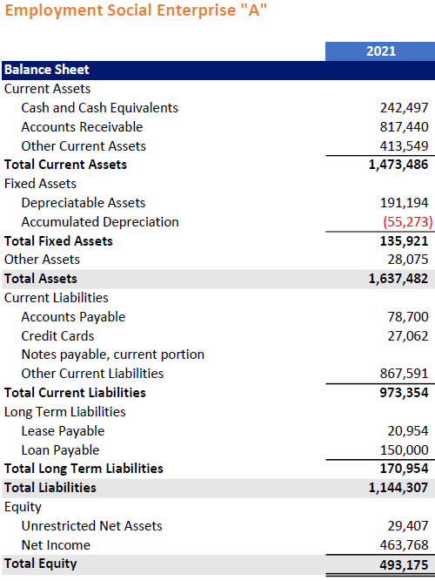
Step 1: Insert your cash and cash equivalents from your balance sheet
Notes:
https://drive.google.com/file/d/1g_HyvUcABqrKIvCjXkBO94fu8CCRch2A/view?usp=sharing

Slide 35
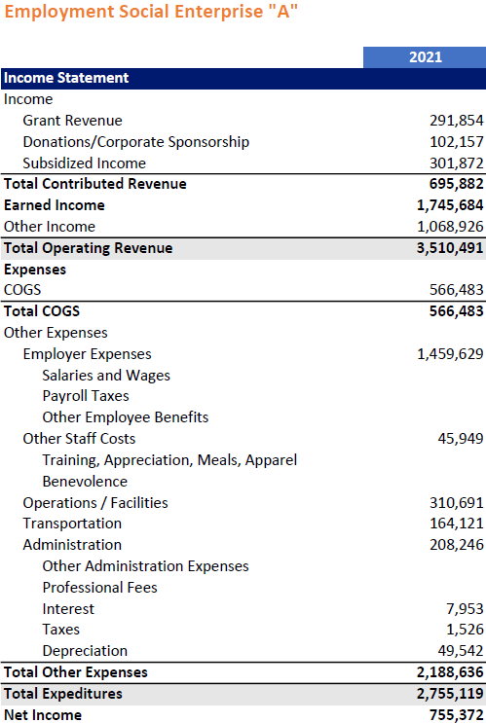
Step 2: Use your income statement to fill out the cash inflow section
Income from Sales
Look at your yearly income in your income statement (P&L). Divide by 12 to get an avg. monthly income.
Do you expect the next month to be the same, less, or more than your monthly average? Why?
      For example: “We are a landscaping business and our business slows down in winter…so I expect sales in January to be half of our usual”
      Only account for money that you will be paid for
      Use your intuition – no need for perfection.
Divide by 12 to get monthly:
1,745,684 / 12 = $145,474
I only expect half since January is a slow month for us
= $72,500

Slide 36
Step 3: Project how these sales will change for month #2 & #3
Income from Sales
My landscaping business is still slow in February so I expect sales to be the same
Things start picking up in March due to the warming weather, I expect it to be higher

Slide 37
Step 4: Repeat steps #2 & #3 but for grants/donations and other cash inflows
Grants and other cash
Don’t forget to think in monthly terms an account for seasonality
For example: My monthly average in grants is 695,882 / 12 = $60,000 BUT I know most of them come year-end

Slide 38
Step 5: Fill out the account receivables you expect to collect using your balance sheet
How much of your account receivables (money owed to you), do you expect you will collect next month? 90%? 80%? 75%?
This depends on your customers and how soon they pay you. Some of this may never be collected.
For this organization, I am going to assume 100% of this is a one-time gran that will be paid in March.

Slide 39
Congratulations! You should have a completed cash inflow!

Slide 40
Step 6: Fill out investing activities by considering any capital purchases
Do you expect to make any purchases in property, plant, and equipment (PPE) in the next coming months?
Any big inventory purchases not related to your cost-of-goods sold?
In this example, I will assume this ESE is purchasing a new $1 million production space in March.

Slide 41
Step 7: Repeat steps 2-3 but for your operating costs
Remember to divide by 12 to get a monthly sense AND also to account for seasonality where it makes sense.
Do not include depreciation in any of your cash flow numbers!

Slide 42
Step 8: Account for any monthly loan payments and other financing costs
Does your organization have any monthly loan payments it must make? Include those in financing activities.
I will assume this organization makes a $1000 monthly loan payment

Slide 43
Congratulations! You have accounted for cash IN and cash OUT.
You now have an estimated net cash flow at the end of each month.

Slide 44
How to read your free cash flow:
Positive Free Cash Flow:
This means your organization has cash left over to invest in future growth such as:
  Hiring more employees
  Paying down debt
  Acquiring another business
  Opening another office
  Opening another location
Alternatively, you could also contribute to your reserves!
Negative Free Cash Flow:
This means your organization is using up more cash than what’s going in.
This could hinder being able to make investments in growth
Consider some of the cash management strategies we discussed earlier.

Slide 45


Always Compare Forecast to Actuals

Slide 46
Break Time

Slide 47
Group Discussion and Share-out
Break into groups of 3-4
Discuss:
What questions do you have about your organization’s finances going through this exercise?
What did you learn?
Based on your cash flow projections, do you have money to invest in growth or should you focus on “weatherproofing”?
Notes:
b. We all have different relationship with finance.

Slide 48


Slide 50
Today’s objectives
By the end of today, you will walk away…
Understanding the strategies that can be put in practice in order to mitigate a cash emergency
Having applied a simple cash flow projection tool to understand your organization’s cash need in a short-term period (~3 months)
With an understanding of how your cash position affects your growth goals

Slide 51
Optional CA RISE – Financial Fundamental Series
April 2nd, 2025:
Financial Health Metrics 201
NOW:
Liquidity Understanding & Management Pt. 2
1
2
3
4
TODAY:
Financial Health Metrics 101
Today:
Liquidity Understanding & Management Pt. 1
Notes:
This is around how to read financial statements – this is beginner level and we are purposely starting here. Later on we will dive deeper.

Slide 52
Feedback Survey
https://bit.ly/OptionalWorkshops
This feedback helps us improve your experience and plan adjustments to make moving forward.
Notes:
Galiana

Slide 53
Thank you!
You can reach me at rcepeda@redf.org
linkedin.com/in/cepedarony

