Slide 1
Financial Fundamentals Series – Financial Health Metrics 101

Slide 2
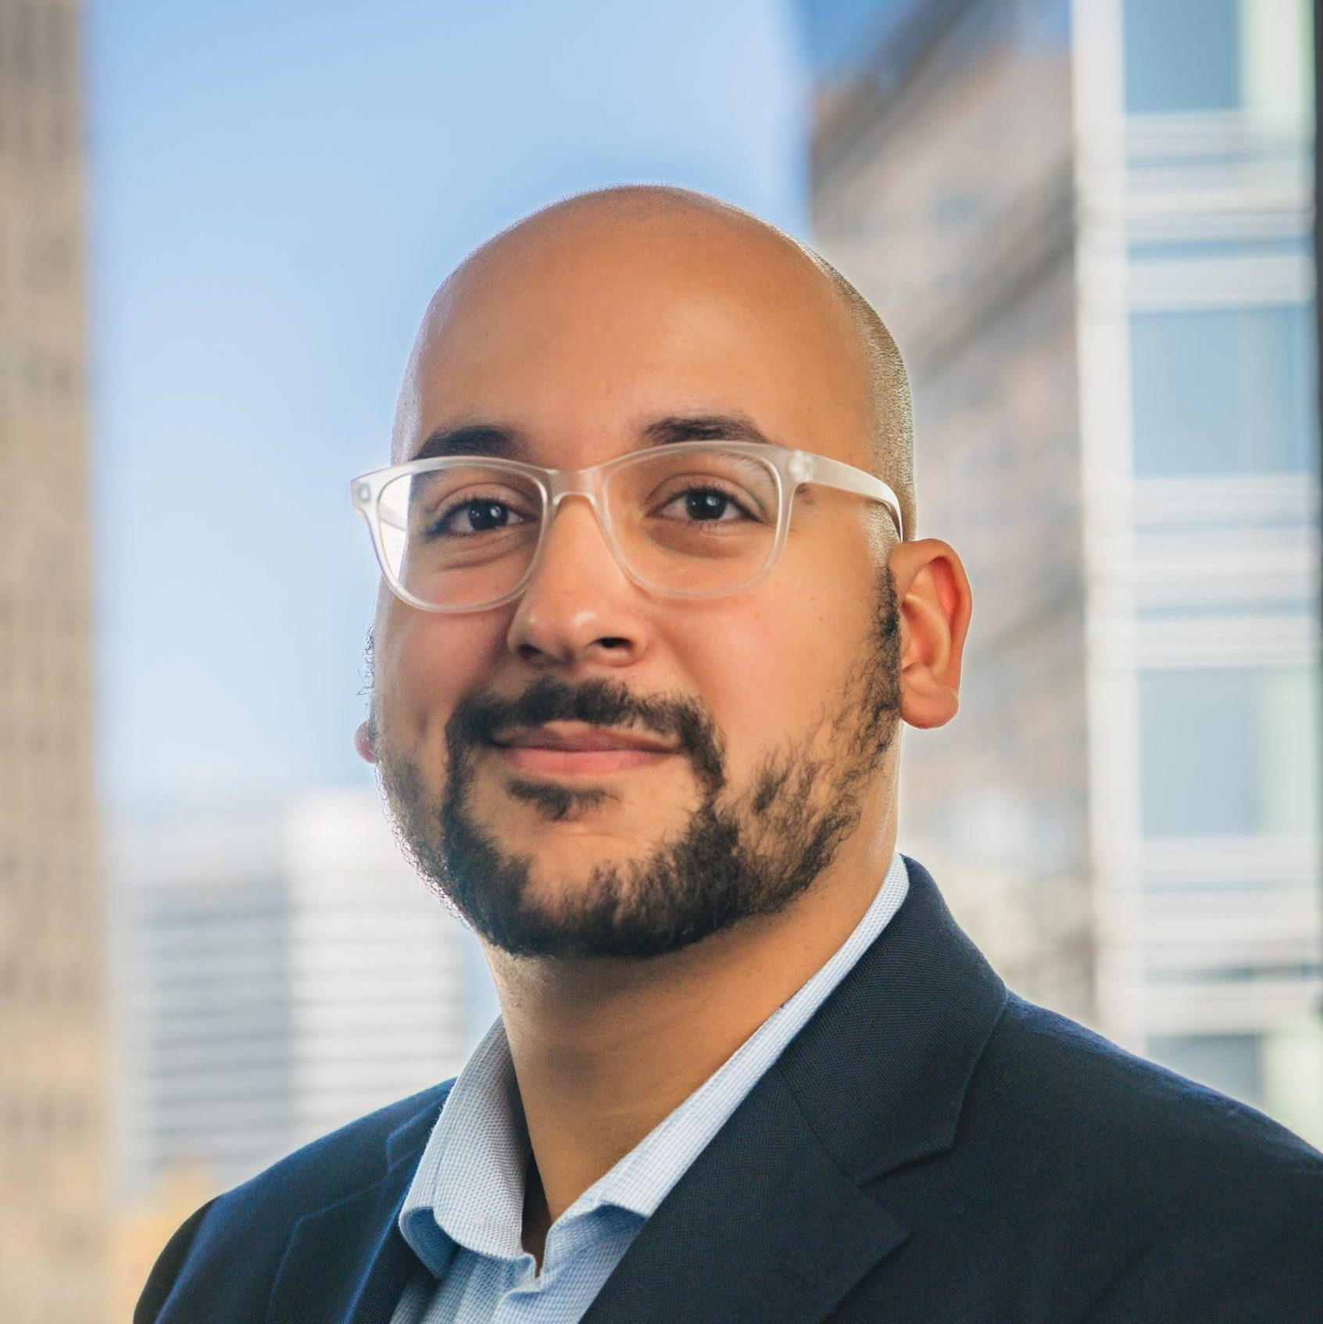
Introductions
Rony Cepeda Mekosh
Senior Manager Capacity Building

Slide 3
Optional CA RISE – Financial Fundamental Series
April 2nd, 2025:
Financial Health Metrics 201
April 3rd, 2025:
Liquidity Understanding & Management Pt. 2
1
2
3
4
TODAY:
Financial Health Metrics 101
April 3rd, 2025:
Liquidity Understanding & Management Pt. 1
Notes:
Katie

Slide 4
Caveat: Day-to-day operations vs. overall financial health
Notes:
Explain that these metrics are more for measuring overall financial health of an ESE rather than day-to-day financial operations. Not for a financial controller. Key decisions around which part of our organization might need attention. Should we be increasing revenue? Should we be assessing our costs? How future proof are we?

Slide 5
How do you feel about financial management? Is your relationship —
Positive
Neutral
Negative
Notes:
10 mins -
I’m oversharing here, so let’s make me feel not alone and all be honest - we each have different relationships and comfort levels with money and financial management. So let’s start by just naming how we feel and getting any “finance gremlins” into the light.
How would you describe your feelings about financial management of your organization?
[Take stock of thumbs in the room] We’re here today to hopefully bring those negatives to neutral and perhaps those neutrals to positives.

Slide 6
We all have different relationships to finance within our ESEs -
Some manage all finance
Some co-manage finance
Some finance is managed by the parent org
Depending on your role, the pieces of the finance picture that matter to you will be different.
However, we can all benefit from getting more comfortable monitoring and analyzing finances and using what we learn from the process to guide strategic decision making.
Notes:
15 mins (no need to read slide)
We all have different relationships to finance within our ESEs and I want us to leave here today with great respect for two things: 1) That finances are a great indicator of the health of our organizations, so finance is one important tool for any leader. And 2) I want us to realize we are extremely capable of getting even more comfortable analyzing finances, than we already are.
TEASER STORY - Neighborhood Industries
A few years ago, one of REDF’s partner organizations had a sudden warehouse fire that burned a ton of inventory and damaged the building. No one was hurt, it was after hours. In the moment, beyond the immediate priority of attending to the fire and the clean-up, the biggest question on the CEO’s mind was “how are we going to rebuild, and survive through this?” He was actually asking a financial question - “do we have the monetary resources to to get through this?”
When our REDF team asked this CEO how we could support, guess what he asked for? It’s not what you’re thinking.
He asked us to help him create a real time cash flow model. A dashboard of what money is coming in from where, and what the money is being spent on as it leaves the account.
His cash flow statement was being updated on a quarterly basis as part of his financial statements, but because of the fire, there was a lot more cash going out for new costs and he wanted to keep a closer pulse on whether they could pay their bills. Because he was monitoring his finances more closely, he could then use that information to make smarter decisions about cash-in and cash-out whether or not it was related to the fire.
He later told us that the most helpful thing he got from three years of working with REDF was that cash flow model!

Slide 7
Workshop Objectives
Analyze our financial statements to determine the most impactful drivers of revenue, costs, profit, and cash
Prioritize 1-3 financial indicators that you want to increase, decrease, or maintain
Develop a monitoring plan and process to regularly review this financial indicator with someone at your organization
Notes:
20 mins
{Cover first objective}
You might be asking, what are drivers? Drivers are just the things that are influencing your revenue, expense, profit, or cash numbers to a significant degree. If we can know our drivers, then we can also change the way they move, or drive. That brings me to the second objective….
{Cover second objective}
You’re going to leave here with tangible things to look for. More often than not, increasing / decreasing / maintaining a financial number will mean you have to ask for help from colleagues at your org. This makes objective three important:
{Cover third objective} That means finding an accountability buddy! You do not have to go at this alone.
Let’s do a poll - Raise your hand if you already do most of this at your organization or in your role? Could be looking at the numbers, setting a priority to influence one of the numbers, and coming together with someone to discuss the number(s). Ask 2 people to share.

Slide 8
Candle Co.
Employ justice-impacted adults
Our employment program subsidizes our candle business
Organization-wide goal to optimize our business so that it can be self-sufficient; we don’t want to generate a profit, but we want to cover our business costs with business revenue
For us, focusing in on earned revenue is really important if we want to meet this goal
Notes:
23 mins - Let me give you an example of where we’re going in today’s workshop. Imagine my fake business here, called - Candle Co.
{Click through bullet points}
I’d like to have a plan to monitor earned revenue and a sense for what within earned revenue can really help improve Candle Co’s finances, so I’m going to fill out a little “mad libs” where I make a plan and commitment to focus on one financial driver.

Slide 9
Our organization’s __________________ is _________________.
(number you want to monitor) (number from financial statement)
This number is driven by ________________________________
_______________________________________________________.
(your hypothesis for why the number is what it is)
To meet our organization’s goals, we want to see ___________ _______________________________________________________.
(increase / stay the same / decrease)
Every __________________________________, I’d like to talk to
(week / month / quarter)
______________________________________________ about this
(name of person who works on or is responsible for this number)
so that together we can achieve our goal.
earned revenue
$152,000
one wholesale customer
who purchases 30 candle gift boxes every month
revenue from wholesale customers increase
month
JoJo, who is responsible for wholesale customers
Notes:
{20 mins}
In the example of my fake business Candle Co, … {read through mad lib, pretend I’m just writing in the dark blue font now}
By the end of this session you all will have a similar template filled out that’s customized for your organization and the financial number you think is most important to focus on.

Slide 10
Let’s jump in.
Analyzing numbers on our financial statements, prioritizing which ones we want to influence, and setting up a plan to regularly review the number(s) is called “financial monitoring and analysis.”
Financial monitoring and analysis can help you keep a pulse on how your organization is doing and tell your story better.
The key is to build familiarity and comfort with your financial statements and to unpack the numbers you’re seeing on the page.
Today, we’re going to practice!
Notes:
- Let’s Jump in. (read slide slowly)
….Today we’re going to practice with some foundational pieces from your financial statements. Many will be already familiar to you from previous sessions.
The goal here is not necessarily to learn something new, but to grow our own comfort with the financial statement building blocks so that, down the line, you can tackle the more complex things. And maybe you’re already maxxed out on confidence for financial monitoring and analysis, but then I promise going through this methodically can help you teach and explain better to your colleagues who you want to get more involved in financial management.
This workshop is about simple financial management practices. There’s no elaborate model you’ll be working with. Just pencil, paper, and your own business’ financial statements.

Slide 11
We’ll practice with some core questions we can ask of our financial statements.
How much earned revenue do we generate?
How much contributed revenue do we fundraise?
How much do we spend on COGS?
Do our products/services have a healthy gross profit margin?
How much do we spend on OPEX?
Will we end the year with a profit?
Notes:
{25 MINS}
These are the questions we’ll be using your financial statements to answer today. We’ll go through these step by step, but we wanted to give you a preview so that you can start thinking about your priorities and what question you’ll want to use for your mad lib.
{Click through and read each question…}
Quick reference for definitions:
earned revenue: sales of any kind, not fundraised dollars.
Contributed revenue: money donated
COGS: Cost of Goods and Services (direct costs, can include hourly wages not salary)
Gross profit margin: Earned revenue - COGS. Sometimes it’s divided by revenue to write as a percentage.
OPEX: Operating Expenses (or sometimes operational expenditure), which is a company's costs to do business. Includes salaries, rent, marketing, etc. Considered indirect costs.

Slide 12
How much earned revenue do we generate? - 10 mins
Go to your P&L statement.
Find your revenue number.
What is your earned revenue?
Write this number down.
Now let’s do a quick brainstorm: what drives the amount of earned revenue you’re generating or what are the biggest success factors in you earning the revenue you do?
Is there a contract or customer in there that’s bigger than the others?
Is there a product(s) or service(s) that you know is very popular?
Is there a difference between wholesale and retail sales?
Is this earned revenue in line with your goals? Is there something you’d want to increase, decrease, or maintain?
How often do you think this earned revenue number changes?
Is it weekly because customers are continuously walking into your storefront?
Is it monthly because you invoice on a monthly basis?
Is it quarterly because contracts are renewed quarterly?
Who at your org is already working on or responsible for earned revenue?
Notes:
{30 MINS}
Reminder: earned revenue: sales of any kind, not donated dollars.
For this first set of questions – 4 in total – we’re going to stay in the top portion of your Profit & Loss or P&L statement.
{Optional if more advanced group:} Think throughout these four slides:
Do you already think about this metric a bunch?
Do you already feel comfortable talking about how this metric changes and why it changes?
Do you already track this?
If so maybe then a different question will be more valuable for your mad lib later.
{Recognize that people may already be doing what we recommend! Affirm them if they are already doing it. When folks are already doing something, say “Great, we’re going to lean on you more in the breakouts and I hope you can share your experience and advice with your table.”}

Slide 13
How much contributed revenue do we fundraise? - 10 mins
Stick with your P&L statement.
Find your revenue number again.
What is your contributed revenue?
Write this number down.
Now let’s do a quick brainstorm: what drives the amount of contributed revenue you fundraise?
Is there a grant that’s particularly big?
Is most of this fundraised money from major donors?
Is most of this fundraised money from special events?
Is this contributed revenue in line with your goals? Is there something you’d want to increase, decrease, or maintain?
How often do you think this contributed revenue number changes?
Is it monthly because individual donors are continuously making online contributions?
Is it quarterly because major donations are setup to come in four times per year?
Is it annually because grants are disbursed to your organization annually?
Who at your org is already working on or responsible for fundraising?
Notes:
{40 MINS}
Reminder: Contributed revenue: donated money only
{Affrim, when folks are already doing something, say “Great, we’re going to lean on you more in the breakouts and I hope you can share your experience and advice with your table.”}

Slide 14
How much do we spend on Cost of Goods Sold / COGS? - 10 mins
Stay on your P&L statement.
Find the line for Cost of Goods Sold or COGS. COGS tells you about the direct costs of delivering your products or services to paying customers.
Write this number down.
Now let’s do a quick brainstorm: what drives the amount you spend on COGS?
Is it the cost of materials?
Is it the cost of direct labor?
Is this COGS in line with your goals? Is there something you’d want to increase, decrease, or maintain?
How often do you think COGS changes?
Is it weekly because you have a production line that’s running a lot of the time?
Is it monthly because you account for labor hours on a monthly basis?
Who at your org is already working on or responsible for COGS expenses?
Notes:
{50 MINS}

Slide 15
Do our products/services have a healthy gross profit margin? - 10 mins
Stay on your P&L statement.
Find the Gross Profit. Gross Profit is Earned Revenue minus COGS.
Write this number down.
Is Gross Profit positive or negative? If it’s negative, why do you think that is?
Are you selling your products / services for more than it costs to make or deliver them? If so, do you need to think about pricing?
Are you controlling your materials and labor costs to keep them in line with prices? If no, do you need to think about managing costs more tightly?
Who at your org is already working on or responsible for pricing? Who’s responsible for materials and labor costs?
Notes:
{60 MINS}

Slide 16
Break
Notes:
5 Min Break

Slide 17
How much do we spend on operating costs or OPEX? - 10 mins
Stay on your P&L statement.
Find the line for operating expenses or OPEX. OPEX tells you about the indirect expenditures needed to keep up day-to-day operations. These costs can be one-time (like an equipment purchase) or recurring (like staff salaries).
Write this number down.
Now let’s do a quick brainstorm: what drives the amount you spend on OPEX?
Is it the facilities and utilities expenses?
Is it the staff salaries?
Is this OPEX in line with your goals? Is there something you’d want to increase, decrease, or maintain?
How often do you think OPEX changes?
Is it monthly because you have to pay staff salaries every month?
Is it annually because you prepay your lease expense for the whole year?
Who at your org is already working on or responsible for OPEX expenses?
Notes:
{65 MINS}
• We’re now moving to the bottom portion of your Profit & Loss or P&L statement.
• Let’s talk about operating expenses or OPEX.
Definition: OpEx or Operating Expenses are indirect, and they don’t include the COGS.

Slide 18
Will we end the year profitable? - 10 mins
Stay on your P&L statement.
Find the Net Income. Net Income is Earned Revenue - (COGS + OPEX)
Is Net Income positive or negative? If it’s negative, why do you think that is?
How are you managing OPEX? Is OPEX the reason why Net Income is negative?
Is this Net Income in line with your goals? Is there something you’d want to increase, decrease, or maintain?
Notes:
{75 MINS}

Slide 19
Workshop Objectives
Analyze our financial statements to determine the most impactful drivers of revenue, costs, profit, and cash
Prioritize 1-3 financial indicators that you want to increase, decrease, or maintain
Develop a monitoring plan and process to regularly review this financial indicator with someone at your organization
Notes:
This section is a wrap! Did we meet our first objective to determine financial drivers? (next slide) Yes!

Slide 20
Workshop Objectives
Analyze our financial statements to determine the most impactful drivers of revenue, costs, profit, and cash
Prioritize 1-3 financial indicators that you want to increase, decrease, or maintain
Develop a monitoring plan and process to regularly review this financial indicator with someone at your organization
Notes:
…Yes!
All the questions we went through can be useful, so the question now is “Which one of these do you think is most important for you to be working on at this point in time?”
In this next part of the workshop, we’ll have a little conversation in our small groups to discuss your answer to that question - “which of these metrics or numbers that we’ve worked on so far do you want to keep working on when you go back to your org?”
Remember there is no right answer, we’re just making this big mass of details into one action step for when we’re back at work. It’s ok if you can’t pick just one and want to write 2 or 3 instead, I just like to prioritize so it’s easy to focus.

Slide 21
Let’s share in groups - 10 mins
Which of the financial metrics / numbers we worked on is most important for you to work on at this moment in time?
Why did you select that metric?
Do you want to see that metric increase, decrease, or stay more or less as is? Why?
Notes:
{85 MINS}
Read questions out loud and send folks to breakout pairs.
You might need a few minutes at the start to look through what we just wrote down, so take two minutes then start sharing in your small groups.
Please make sure everyone has equal time! Staff may prod the conversation if people don’t seem to get equal time.

Slide 22
Workshop Objectives
Analyze our financial statements to determine the most impactful drivers of revenue, costs, profit, and cash
Prioritize 1-3 financial indicators that you want to increase, decrease, or maintain
Develop a monitoring plan and process to regularly review this financial indicator with someone at your organization
Notes:
Wrap-up the small group share-out
(read second objective, then click to next slide when answered)

Slide 23
Workshop Objectives
Analyze our financial statements to determine the most impactful drivers of revenue, costs, profit, and cash
Prioritize 1-3 financial indicators that you want to increase, decrease, or maintain
Develop a monitoring plan and process to regularly review this financial indicator with someone at your organization
Notes:
The conversations you just had were actually a step in the direction of prioritization. You identified at least one financial metric or number that you want to influence somehow - either increase, decrease, and maintain and you articulated why you think this matters.

Slide 24
Our organization’s __________________ is _________________.
(number you want to monitor) (number from financial statement)
This number is driven by ________________________________
_______________________________________________________.
(your hypothesis for why the number is what it is)
To meet our organization’s goals, we want to see ___________ _______________________________________________________.
(increase / stay the same / decrease)
Every __________________________________, I’d like to talk to
(week / month / quarter)
______________________________________________ about this
(name of person who works on or is responsible for this number)
so that together we can achieve our goal.
Notes:
155 mins - (20 mins total for this exercise)
• Right before the break you selected one or maybe two financial indicators you think you want to focus your attention on or prioritize
• The next piece of our work will be to commit to looking at just one financial indicator regularly and discussing it with someone at your organization
• Remember that when you look at these numbers regularly, you can begin to understand the pattern of what makes the number increase or decrease
• And then, if you need to, you can begin to think about influencing that number through the actions and initiatives you and your team come up with
• To help us write-out a commitment, we have two options for a template to fill out:
o This slide shows the first option is for those of us who are maybe doing something like this for the first time and want to form the critical building blocks of this practice (click to new slide)
o The second option is for those of us who already do some version of financial monitoring and analysis, but want to step back and see how it’s working and where it can be improved; you want to build on what you already have
We’ll start with 10 minutes to fill out our own mad libs, like my Candle Co. example from the beginning. Just one of of the two slides, pick which one feels right, the first one if it’s newer to you, the second if you’ve been doing this already.

Slide 25
Our organization’s __________________ is _________________.
(number you want to monitor) (number from financial statement)
This number is driven by ________________________________
_______________________________________________________.
(your hypothesis for why the number is what it is)
To meet our organization’s goals, we want to see ___________ _______________________________________________________.
(increase / stay the same / decrease)
Every __________________________________, I’d like to talk to
(week / month / quarter)
______________________________________________ about this
(name of person who works on or is responsible for this number)
so that together we can achieve our goal.
earned revenue
$152,000
one wholesale customer
who purchases 30 candle gift boxes every month
revenue from wholesale customers increase
month
JoJo, who is responsible for wholesale customers
Notes:
Here’s my Candle Co. example from earlier, if you want to see an example of the first of the two options.
Remember, you only need to fill out one of them, should be on Page 57 and 58 of your binder.

Slide 26
Let’s discuss with our partners - 10 minutes
Share your written commitment.
When you bring this plan back to your organization:
Who can you immediately enlist as a champion?
Are there any obstacles that might prevent you from implementing this? What can you do about those?
Ask for feedback on your plan.
I like…
I wish…
I wonder…
Notes:
{95 MINS}
• Let’s get into our pairs or groups again and read our mad libs, our commitments out loud. Each take 6-7 minutes to share back and forth.
• So we’re going to share what we wrote with our partner, and I want you to write down {read questions from slide}
• Partners, after the other person shares, you can respond constructively by using statements such as “I like, I wish, I wonder”

Slide 27
Workshop Objectives
Analyze our financial statements to determine the most impactful drivers of revenue, costs, profit, and cash
Prioritize 1-3 financial indicators that you want to increase, decrease, or maintain
Develop a monitoring plan and process to regularly review this financial indicator with someone at your organization
Notes:
190 mins - Ok we’re nearing the end of this whole workshop, let’s wrap up and see that we completed all of our objectives!
{Next slide}

Slide 28
Workshop Objectives
Analyze our financial statements to determine the most impactful drivers of revenue, costs, profit, and cash
Prioritize 1-3 financial indicators that you want to increase, decrease, or maintain
Develop a monitoring plan and process to regularly review this financial indicator with someone at your organization
Notes:
The commitment template you just completed and shared in your small group is a “blueprint” for a monitoring plan and process for the metric or number you prioritized.
You can take that template and build out a similar monitoring plan for any financial metric that you think is interesting and important, and then use that plan to make sure you track the number regularly.
By the way, you can choose ANY financial metric! You can use this mad libs template with any of the other numbers we talked about today, or a financial metric we didn’t cover today. They key is to define some routine or practice you think is valuable and then do it over and over again until that becomes a part of how your organization operates.

Slide 29
What can you do next?
Take your commitment back to your organization, share it with the folks involved, and start holding regular time for conversations about your chosen financial indicator.
As you make the commitment a regular practice, seek out feedback from the folks you’re collaborating with to improve and adapt it to really fit your organization’s unique needs.
Look for opportunities to get more colleagues to buy in to the process - perhaps you can use this practice in weekly leadership team meetings or monthly all staff meetings.
Notes:
195 mins – (Read: Here are three options for What you can do next)
Remember my story at the beginning of this workshop about how little I knew about finances until it all blew up in my face? I hope you feel more confident now, than I was then. This stuff is easy if you just put in the time and have an accountability buddy. Organizations with healthy finances can do more of the things we know we need to do in this world. Right now federal funding which affects a lot, just life in general are chaotic and up in the air. One way we can try to grow and protect our staff and our mission, is to have stronger social enterprises, to have healthier business financials. And you’re not on your own, everyone in this room is a peer resource and mentor for one another.
I hope you leave with least one tangible step to work on in reading your numbers more often, with at least one specific colleague.

Slide 30
Thank you!
Notes:
Close!

