Slide 1
PAY PRACTICES AND PROTOCOLS: Compliance with CA Law
Spring 2025
PRESENTED BY
Judith Droz Keyes
Davis Wright Tremaine, LLP

Slide 2

Presenter
Judith Droz Keyes
Partner, San Francisco | Los Angeles
jkeyes@dwt.com
P: 415.276.6512

Slide 3

TODAY’S PROGRAM – Second in the 4-Part Series
Agenda
  Payment methods
  Lawful Deductions
  Paycheck requirements
  Reporting Time Pay
  Split Shift Pay
  Stand By Pay
  Uniforms and Tools
  Expense Reimbursement

Slide 4

Payroll Timing and Other Considerations
At least twice/month
Lag time cannot exceed 10 days when semi-monthly pay
Weekly pay cannot lag more than 7 days
Cannot require direct deposit or alternate forms of payment

Slide 5
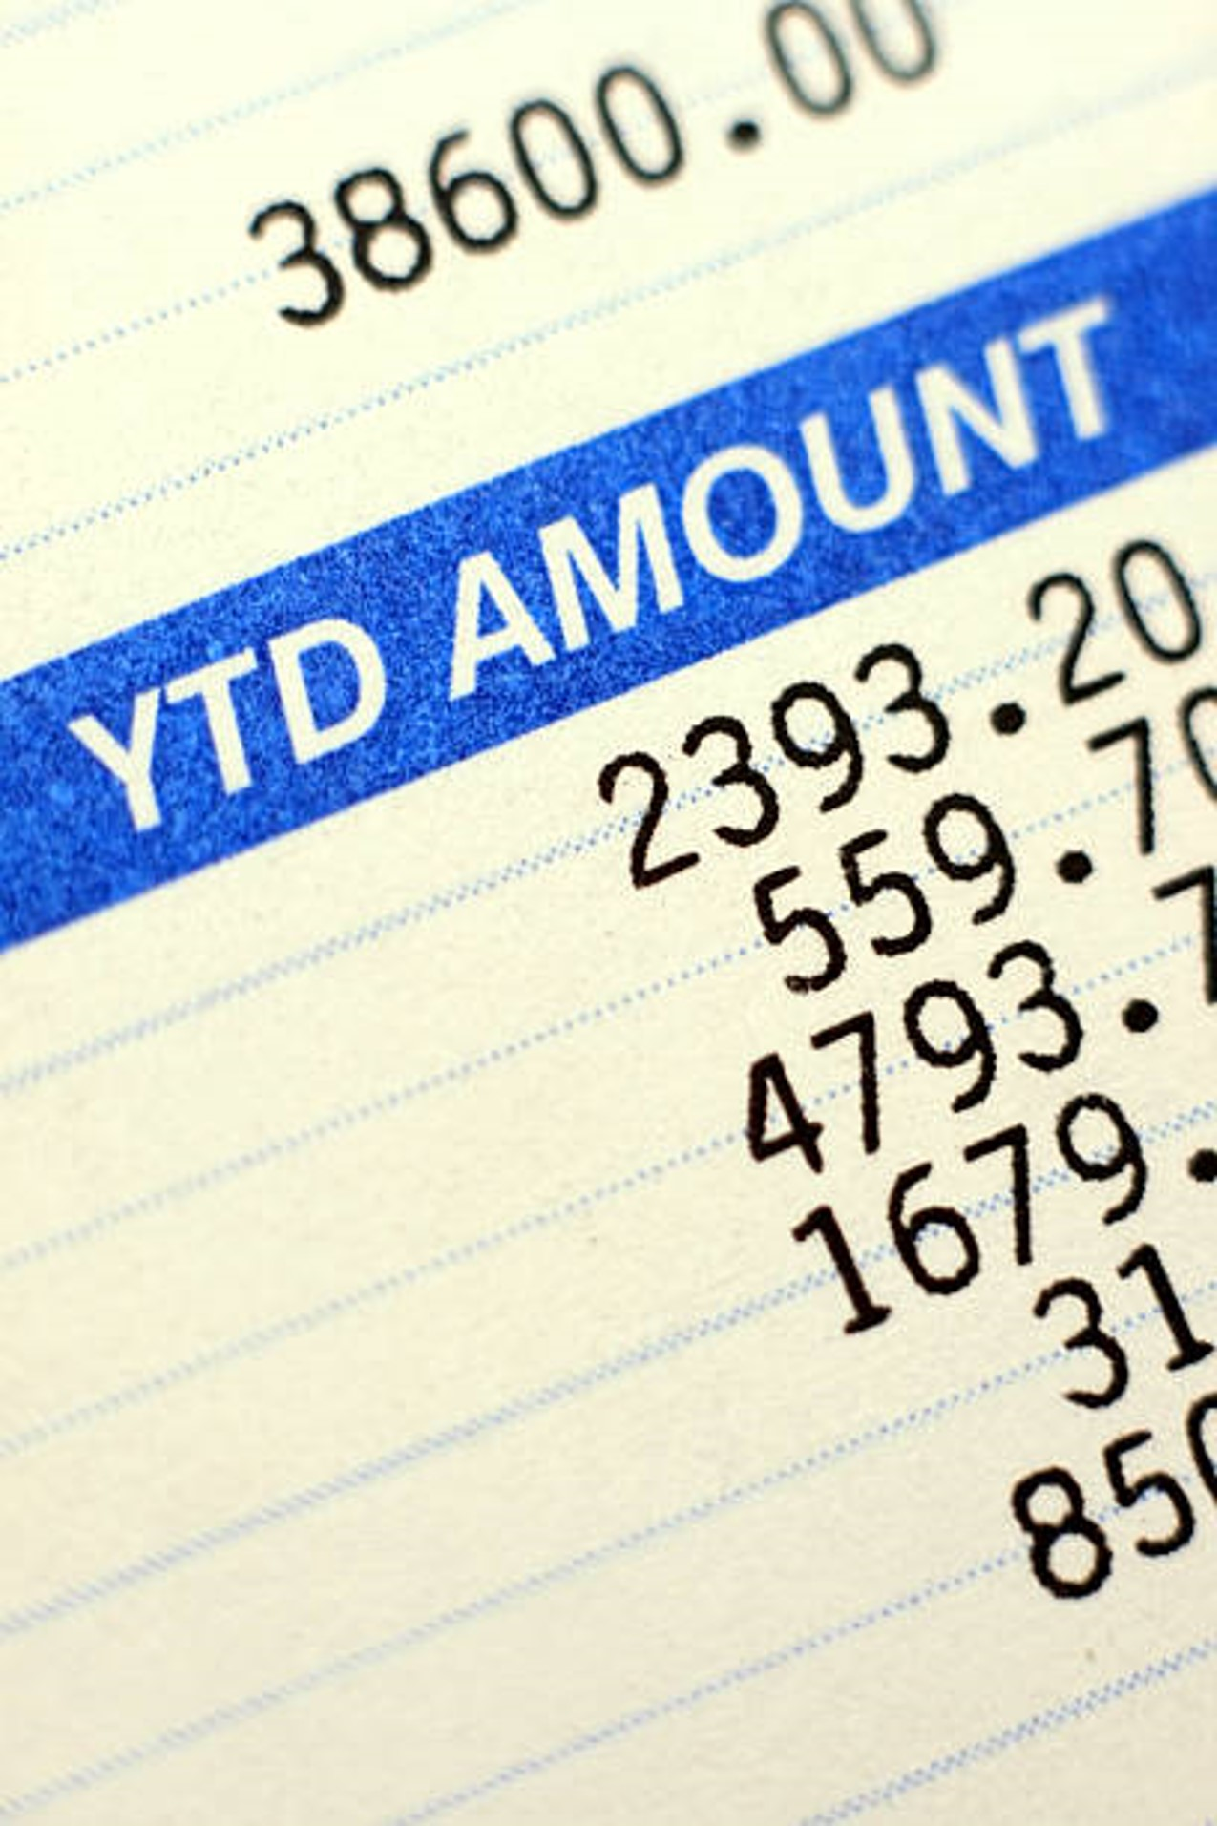
Pay Stubs/Wage Statements
Precise name and address of the Employer and information to personally identify employee (SSN or employee ID no.)
All pay rates
Pay period dates
Gross and net pay
Total hours worked
Statement of accrued sick leave “available for use”
On wage statement or separate accompanying document

Slide 6

Final Pay
On the last day if involuntary termination or if resignation with 72 hours’ notice
All earned compensation, including --
  Bonuses/commissions (if capable of calculation)
  Accrued, unused vacation (or PTO)
“Waiting Time Penalties” of up to 6 weeks’ wages if any portion is late

Slide 7

Strict No-Forfeiture Rule in California
Vacation is earned as the employee works
  Cannot have a “lump sum” award in arrears
  Once earned, can never be forfeited
  Can cap accrual at no lower than 1.5 times employee’s accrual rate
PTO is all vacation (or all sick leave)
Floating holiday = vacation (unless designated day)
  No forfeiture, but can cap annual award

Slide 8

Reporting Time Pay
Each workday when an employee is required to report for work but is not put to work or is given less than half the usual or scheduled day’s work
  Pay is ½ the scheduled day’s work, at least 2 hours’ but no more than 4 hours’ pay.
It is okay to schedule a short day, e.g., for training
Exceptions are –
  When there are threats to employees or property
  When public utilities fail
  Interruption of work is an Act of God

Slide 9


Split Shift Pay
Workers who earn the minimum wage per hour, or higher in some situations
Split shift = work schedule interrupted by non-paid and non-working time periods established by the employer.
  The time period between shifts needs to be longer than a bona fide meal period and needs to be within the same workday.
  The break between shifts cannot be a meal or rest break and must be to the benefit of the employer
Split shift premium is one hour at the state minimum wage ($16.50), or local minimum wage, whichever is greater.
  Any money earned over and above the state, or local, minimum wage will be credited towards the employer’s obligation to pay the split shift premium.

Slide 10

Stand By Pay
Controlled v. Uncontrolled
  Uncontrolled “on call”: Not work time, no need to pay
  Controlled: Work time and must be paid (at least minimum wage)
    Excessive geographic restrictions on the employee’s movements
    Whether the frequency of calls is unduly restrictive;
    Whether a fixed time limit for response is unduly restrictive
    Whether the on-call employee can easily trade on-call responsibilities with another employee
    Whether and to what extent the employee can engage in personal activities

Slide 11

Strict Expense Reimbursement Requirement in California
Any expenditure an employee necessarily incurs in order to perform their job
  Cell phone/internet usage
  Remote work vs. hybrid work
Must reimburse regardless of receipts, approvals, or late submission.
Need not be included in final paycheck – but must be paid within a reasonable time

Slide 12

Tools and Uniforms
  Uniforms and tools and equipment must be provided by, and maintained by, the employer
    Unless providing own tools is common in the trade or craft (e.g., construction) and the employee is paid at least 2 times the state minimum wage
  Can’t deduct for loss or damage due to simple negligence or ordinary wear and tear

Slide 13

THANK YOU!

