Slide 1
Policy Creation, Implementation, and Enforcement:
Compliance with CA Law
Spring 2025
PRESENTED BY
Judith Droz Keyes
Davis Wright Tremaine, LLP

Slide 2

Presenter
Judith Droz Keyes
Partner, San Francisco | Los Angeles
jkeyes@dwt.com
P: 415.276.6512

Slide 3

TODAY’S PROGRAM – Third in the 4-Part Series
Agenda
  Written Policies
  Training
  Supervision
  Enforcement

Slide 4
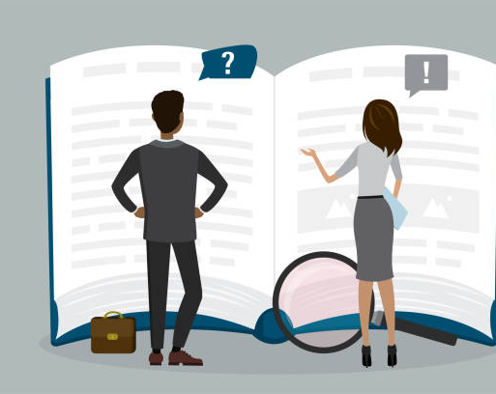
PURPOSE OF EMPLOYEE HANDBOOKS
Not a supervisor’s manual
Not a training guide
Not a permission slip
Not a substitute for supervision or HR
Therefore, include only:
Legally mandated policies
Policies that help protect the company
Policies that are actually useful

Slide 5

MANDATORY HANDBOOK POLICIES
Nothing mandated for wage/hour law
Equal Employment Opportunity
Complaint and investigation procedure
Lactation
Bereavement leave
Etc.

Slide 6

STRONGLY ADVISED WAGE/HOUR POLICIES
Definitions
  Exempt vs. non-exempt
“Non-exempt” employees are paid extra for overtime work whereas “exempt” employees are not. These classifications are not defined by the Company but by federal and state law. The definitions are technical and have no bearing on an employee’s skill or value to the Company. Employees are told whether their position is exempt or non-exempt, and the designation may be changed from time to time based on changes in job duties or the law. An employee who thinks their job has been misclassified as exempt when it should be treated as non-exempt, should advise Human Resources of the concern.

Slide 7

STRONGLY ADVISED WAGE/HOUR POLICIES
Definitions
  Workday and Workweek
Regular business hours are from 9:00 a.m. to 6:00 p.m. Monday through Friday. The official workday is midnight to midnight and the workweek is Sunday through Saturday. The standard workweek for regular full-time non-exempt employees is 40 hours, 8 hours per day, exclusive of the meal period.

Slide 8

STRONGLY ADVISED WAGE/HOUR POLICIES
Nonexempt employees are paid at time-and-one-half their regular wage rate for any hours worked in excess of 40 hours in a workweek or 8 hours in a workday and for the first 8 hours worked on the seventh consecutive day in a workweek, and at double their regular rate for any hours worked in excess of 12 hours in a workday or beyond 8 hours on the seventh consecutive day in a workweek. All overtime must be approved in advance by the employee’s supervisor.
Definitions
  Overtime

Slide 9

STRONGLY ADVISED WAGE/HOUR POLICIES
When a nonexempt employee is required to travel, “hours worked” will include time spent: (1) traveling from home to and from the destination to the extent that it exceeds the employee’s regular daily commute; (2) waiting to board a flight, train, or bus; (3) on a flight, train, or bus; (4) retrieving luggage and obtaining a rental car or ride service; (5) driving between the airport and the destination (meeting, hotel, etc.); and (6) eating required meals. “Off duty” meals, sleeping hours, and free time will not be considered hours worked.
Definitions
  Work Time

Slide 10

STRONGLY ADVISED WAGE/HOUR POLICIES
Expectations
  Meal Periods and Rest Periods
Non-exempt employees who work more than 5 hours in a workday will receive an unpaid meal period which will begin no later than the end of the fifth hour of work, except when an employee works no more than 6 hours in the workday and voluntarily waives the meal period. Nonexempt employees who work more than 10 hours in a workday will receive a second unpaid meal period which will begin no later than the end of the tenth hour of work, except that an employee may voluntarily waive (in writing) the second meal period so long as the first meal period was taken, and the employee works fewer than 12 hours in the workday. Each meal period will be at least 30 minutes long but no longer than one hour, at the discretion of the employee’s supervisor.
Nonexempt employees who work more than 3-1/2 hours in a workday are authorized to take one 10-minute paid rest break approximately mid-way through each work period of between 2 and 4 hours. Rest breaks are paid and are considered time worked.
Employees are relieved of all duty, and are not to be interrupted, during their meal periods and rest breaks. Employees may leave the worksite but are expected to be back at work at the conclusion of their meal periods and rest breaks.

Slide 11
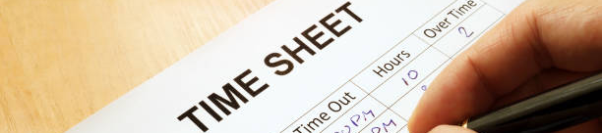
STRONGLY ADVISED WAGE/HOUR POLICIES
Expectations
  Timekeeping
Federal and state law require the Company to keep an accurate record of all time nonexempt employees work. The Company uses the Replicon system for this purpose. Nonexempt employees must enter their time in the Replicon system daily, including the time the employee starts and ends the workday, and the time the employee leaves for and returns from a meal period. Employee time records are official Company records and must be accurately maintained. Modifying another employee’s time record or intentionally falsifying a time record is a serious violation. If a time entry needs to be corrected, both the employee and the supervisor must document the change to verify its accuracy.

Slide 12
ACKNOWLEDGEMENT
I have received and read the Employee Handbook of XYZ Company (the “Company”) effective May 2023 and have had an opportunity to ask for clarification of anything I do not understand, I affirm that I do understand each of the policies contained in the Handbook I agree to abide by them..
I understand and agree that my employment is at-will. This means that either the Company or I may terminate my employment at any time, with or without cause or advance notice. I understand that only the Executive Director of the Company may change this at-will employment relationship, and then only if it is in writing.
I accept that the Company may, at its discretion, change, delete, or add to any policy, benefit, or practice described in the Employee Handbook with or without prior notice, except for its policy of at-will employment.
Signature Date
Print Name
Kept as a Personnel Record

Slide 13

SUPERVISOR TRAINING
Go through policies and posters
Give tips on enforcement
Explain accountability/discipline
Discuss the importance of documentation
Explain liability (including potential for individual liability)

Slide 14

EMPLOYEE TRAINING
Go through policies and posters
Emphasize responsibility
Introduce available resources

Slide 15

SUPERVISION
Not “check the box”
Reward what should be rewarded
Be careful of “avoid overtime”
Supervising isn’t for everyone
Nobody’s perfect

Slide 16

ENFORCEMENT
Beware the “but she’s so good” trap
Beware the “but everyone is happy” trap
The law isn’t a hint or a suggestion
Enforced by:
  The “Labor Commissioner” (DLSE)
  PAGA and Class Actions
  Individual lawsuits (or claims in arbitration
  And by YOU!

Slide 17

THANK YOU!

