Slide 1
Auditing for Compliance: Compliance with CA Law
Spring 2025
PRESENTED BY
Judith Droz Keyes
Davis Wright Tremaine LLP

Slide 2
Presenter
Judith Droz Keyes
Partner, San Francisco | Los Angeles
jkeyes@dwt.com
P: 415.276.6512

Slide 3
TODAY’S PROGRAM – Fourth in the 4-Part Series
Agenda
Reprise on Requirements
Enforcement Agencies
Self-Audits
Remediation

Slide 4
Wage/Hour (Labor Code) Compliance – Reprise
Classification
Regular Rate
“Hours Worked”
Meal and Rest Breaks
Time Tracking
Wage Statements
Overtime
Expense Reimbursement

Slide 5
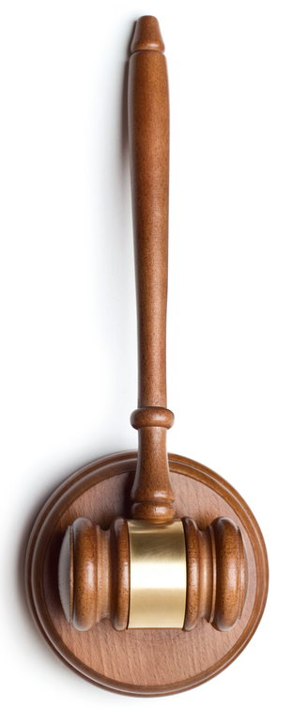
Enforcement Agencies
Division of Labor Standards Enforcement (DLSE)
“Labor Commissioner”
Employment Development Department (EDD)
Department of Labor (DOL)
National Labor Relations Board (NLRB)
Civil Rights Department (CRD, formerly the DFEH)
Equal Employment Opportunity Commission (EEOC)
IRS and FTB
Cal OSHA
Local agencies (e.g., SF Office of Labor Standards Enforcement (OLSE)

Slide 6
Other Enforcement Mechanisms
Individual Lawsuits
No duty to exhaust before filing a wage claim
4-year statute of limitations
Class Action Lawsuits
With a named plaintiff
4-year statute of limitations
Must satisfy court standards (e.g., class rep., settlement)
PAGA (Private Attorney General Action) Lawsuits

Slide 7
Private Attorney General Act
Added to California Labor Code in 2004
Allows representative action by an “aggrieved” person
Current or former employee
On behalf of all allegedly “aggrieved” employees
No opportunity for such employees to opt out
Claimant must notify the State and the employer of the intention to sue and wait 65 days before filing
Statute of limitations: 1 year from most recent violation

Slide 8
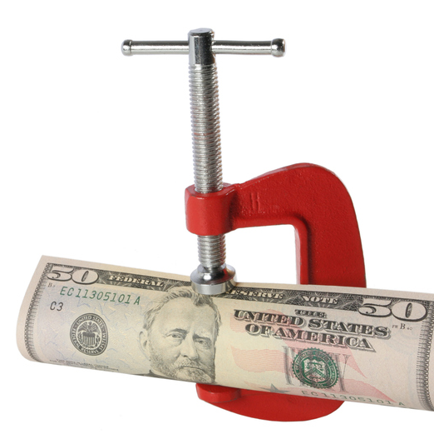
PAGA Penalties
$100 per employee per pay period for first violations and twice that for further violations in some cases
$250 per violation in other cases
PAGA penalties are in addition to statutory penalties (e.g., meal and rest penalties)
75% to the state, 25% to the PAGA members
Attorneys’ fees
Usually filed as both PAGA and class action claims

Slide 9
PAGA Reform
Effective June 19, 2024
Cap on penalties for “good” employers
15% cap when the employer has taken “all reasonable steps to be in compliance” before receiving a notice of violation or request for employee records
30% cap after receiving a PAGA notice
“Reasonable steps” =
Payroll audit
Lawful policies
Compliance training
Corrective action for violations
Penalty reduced to $100/employee/pay period unless a repeat offender ($50 for isolated and nonrecurring violations)

Slide 10
Self-Audits
Time Records
Facial accuracy
Completeness
Is it real?
Wage Statements
Everything accurate?
Double check the math
Exit Interviews
Meal and rest breaks?

Slide 11
Self-Enforcement
Interview Employees
Missed meal periods – why?
Rest breaks – scheduled?
Discipline Offenders
Hold Supervisors Accountable
On the performance review
In bonus or salary increase eligibility
Wage Statements
Exit Interviews
Meal and rest breaks

Slide 12
Remediation
Misclassification
Estimate overtime (perhaps meal periods)
Consider time period
Consider former employees
Improper Regular Rate Calculation or Application
Consider the time period over which it was earned
For meal and rest period penalties, sick leave
Improper Meal or Rest Period Waiver or Schedule
Pay the penalty
Pay the hours worked

Slide 13
Remediation
Interest = 10%
Release only if good faith dispute
Or additional consideration provided
Waiting time penalties are waivable
Re-training
Policy re-publication

Slide 14
THANK YOU!

