Slide 1
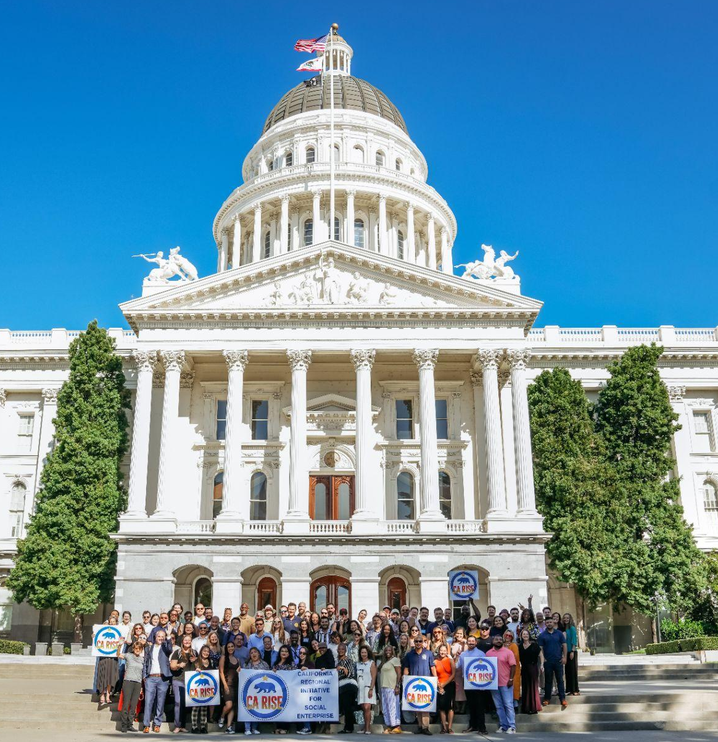
Empowering ESE Impact with AI: AI Toolkit
Practical toolkits and guidance for ESEs to operationalize AI

Slide 2
The ESE Opportunity with AI
Small teams. Big missions. Limited time. AI can help.
Your teams are stretched: ESE staff often wear multiple hats. AI can take on repetitive or administrative tasks, freeing up time for what matters most - advancing your mission.
You already innovate under pressure: ESEs are used to doing more with less. AI is just one more tool in your toolbox that can help you move faster, experiment cheaply, and improve efficiency without needing big investments.
AI can amplify your impact: Use it to get a head start on writing tasks, organizing messy data, or brainstorming ideas, while keeping your voice and judgment front and center.

Slide 3
ESE AI Toolkit
A curated set of resources to empower ESE impact with AI
Note: These resources are a starting point. Feedback is encouraged and these resources will be periodically updated
🧰 AI Tools Repository
✅ AI Do’s and Don’ts
📊 AI Use Case Library
🎓 AI Learning Resources

Slide 4
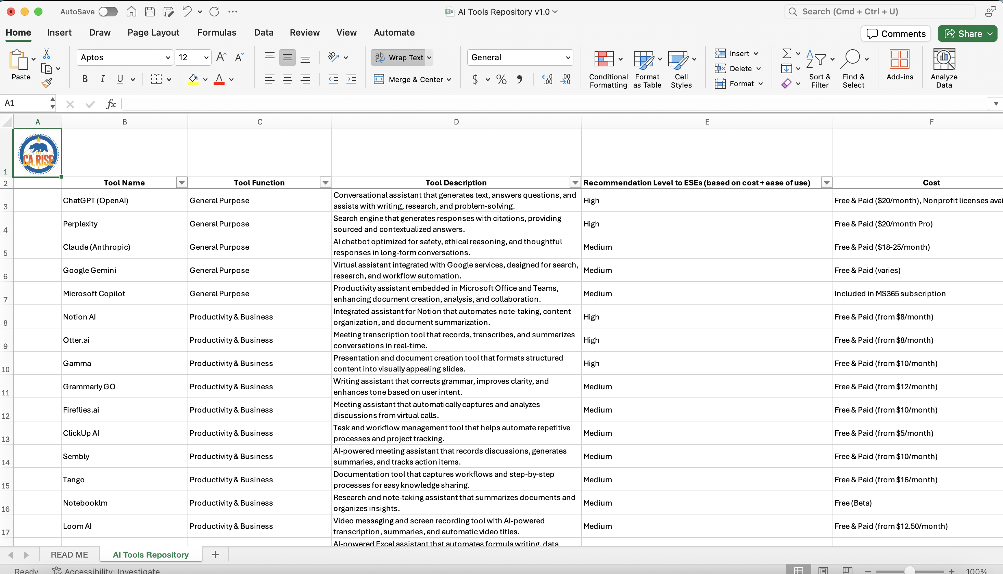
🧰 AI Tools Repository
Your starting point to explore what’s possible and what’s practical
What it is:
A curated spreadsheet of AI tools organized by tool function (e.g., writing, design, analysis, automation), with notes on cost, ease of use, and ESE relevance.
How to use it:
Use this as a searchable menu to find tools aligned with specific tasks across function areas. Great for identifying free or low-cost tools to try within your team. Use alongside AI Use Case Library.
Notes:
Terri

Slide 5
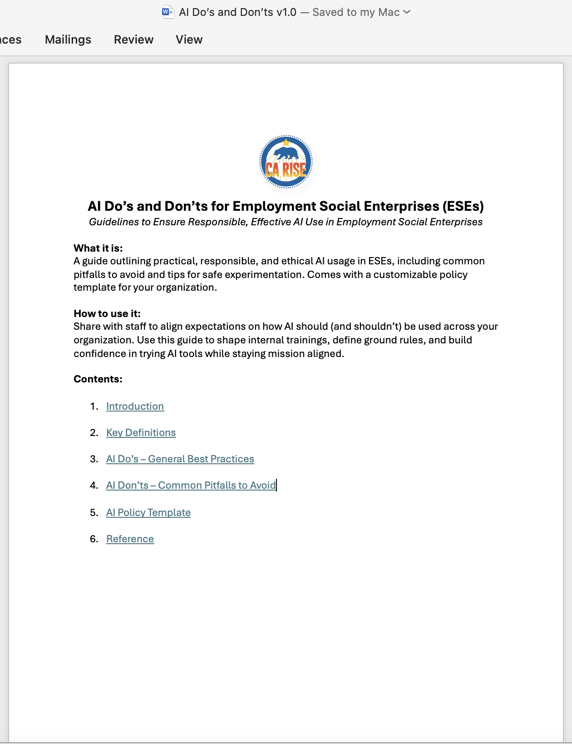
✅ AI Do’s and Don’ts
A quick guide to using AI responsibly, ethically, and effectively
What it is:
A guide outlining practical, responsible, and ethical AI usage in ESEs, including common pitfalls to avoid and tips for safe experimentation. Comes with a customizable policy template.
How to use it:
Share with staff to align expectations on how AI should (and shouldn’t) be used across your organization. Use this guide to shape internal trainings, define ground rules, and build confidence in trying AI tools while staying mission aligned.
Notes:
Terri

Slide 6
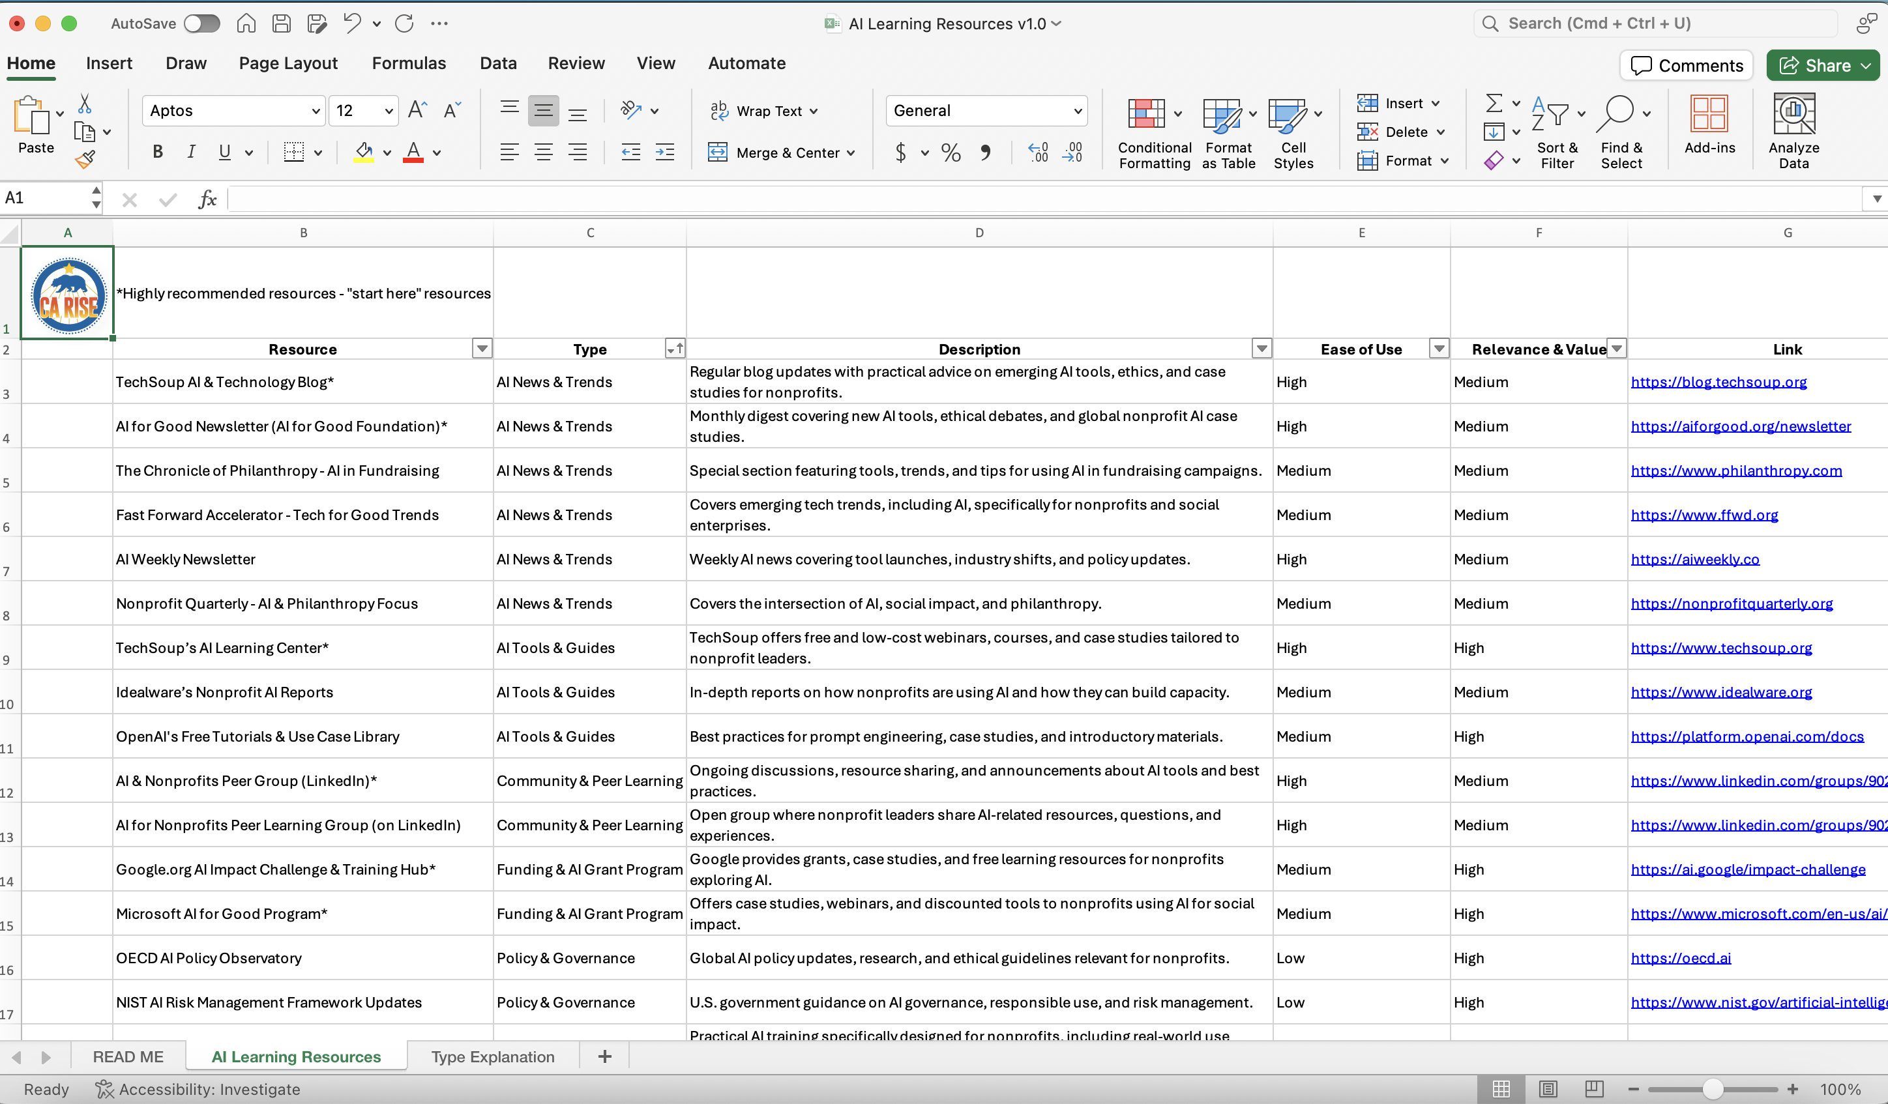
🎓 AI Learning Resources
Stay current, stay confident and keep learning as AI keeps evolving
What it is:
A list of free and beginner-friendly resources to help ESE staff upskill in AI sorted by resource type.
How to use it:
Use this to support professional development or peer-led learning . Great for staff or leadership at any stage of their AI journey, especially those new to the tools.
Notes:
Terri

Slide 7
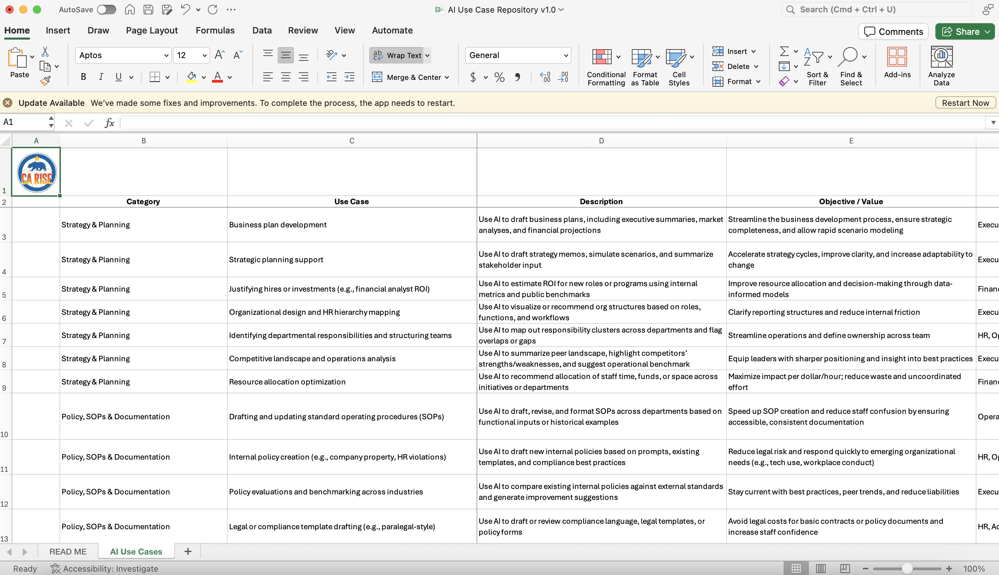
📊 AI Use Case Library
Real examples to help you move from curiosity to action
What it is:
A library of real and potential AI use cases across ESE functional areas organized to avoid duplication and encourage cross-functional inspiration.
Use Case = “task + how AI helps + tool recommendation”
How to use it:
Scan by function to find quick wins and high-impact opportunities. Use to potentially pilot new ideas, start internal discussions, or guide planning for team workflows and experiments.
Notes:
Terri

Slide 8
AI Use Case Library:
Functional Area Deep-dives

Slide 9
Strategy & Planning
AI to support big-picture thinking, resource planning, and org design
HIGHLIGHTED USE CASES
HOW AI IS USED
BUSINESS PLAN DEVELOPMENT
Use AI to draft business plans, including executive summaries, market analyses, and financial projections
AI tools generate section-by-section drafts using structured prompts or templates
STRATEGIC PLANNING SUPPORT
Use AI to draft strategy memos, simulate scenarios, and summarize stakeholder input
AI can structure plans, analyze historical data, and support scenario generation
RESOURCE ALLOCATION OPTIMIZATION
Use AI to recommend allocation of staff time, funds, or space across initiatives or departments
Based on goals and constraints, AI suggests optimal distribution scenarios

Slide 10
Policy, SOPs, & Documentation
AI to create, update, and benchmark internal policies and procedures
HIGHLIGHTED USE CASES
HOW AI IS USED
DRAFTING AND UPDATING SOPs
Use AI to draft, revise, and format SOPs across departments based on functional inputs or historical examples
AI processes bulleted workflows or transcripts to generate SOPs in standardized formats
INTERNAL POLICY CREATION
Use AI to draft new internal policies based on prompts, existing templates, and compliance best practices
Staff describe the issue; AI drafts a policy outline with rationale, definitions, enforcement
POLICY EVALUATIONS AND BENCHMARKING
Use AI to compare existing internal policies against external standards and generate improvement suggestions
Upload a policy and prompt the AI to compare it against known standards in similar orgs

Slide 11
Finance & Accounting
AI to streamline financial analysis, budgeting, and payroll functions
HIGHLIGHTED USE CASES
HOW AI IS USED
BUDGET CREATION AND REVIEW
Use AI to create, review, and summarize budgets based on historical data, program needs, and financial goals
Input revenue/expense data and AI proposes budget forecasts, reallocations, or summaries
FINANCIAL ANALYSIS & REPORTING
Use AI to analyze financial trends, variances, and generate reports or visual summaries
AI evaluates spending patterns, forecasts trends, or creates visual reports
PAYROLL AND GENERAL LEDGER SUPPORT
Use AI to streamline payroll processing, check for anomalies, and assist with ledger entries
AI validates recurring transactions, identifies discrepancies, or suggests ledger classifications

Slide 12
Training & Workforce Development
AI to create personalized learning paths, training plans, and performance tools
HIGHLIGHTED USE CASES
HOW AI IS USED
CURRICULUM, GENERATION
Use AI to generate modular training content for skills like digital literacy, resume writing, carpentry, or communication
AI builds lesson plans, quizzes, and resource lists based on learning objectives
PERFORMANCE EVALUATION FRAMEWORK
Use AI to co-create evaluation frameworks, competency models, and check-in templates
AI proposes evaluation criteria, phrasing for feedback, and auto-summarizes check-ins
PERSONALIZED UPSKILLING
Tailor training or tool recommendations based on an employee’s role, strengths, or past performance
AI suggests courses, prompts, or micro-lessons adapted to individual profiles

Slide 13
Grantwriting & Fundraising
AI to enhance research, drafting, and personalization for funding activities
HIGHLIGHTED USE CASES
HOW AI IS USED
DRAFTING GRANTS & RFPS
Use AI to generate first drafts of proposals using structured prompts and past submissions
Upload prompts (e.g., problem statement, program model) then AI generates narrative in grant format
DONOR SEGMENTATION AND OUTREACH
Use AI to segment donors by history, behavior, or interest and generate personalized email/text copy
AI creates segments (e.g., first-time donors, lapsed donors) and tailors messaging per persona
GRANT RESEARCH AND PLANNING
Use AI to identify relevant grant opportunities and help align program language with funder priorities
AI searches public grant databases and analyzes RFPs to surface high-potential matches

Slide 14
HR & Talent Management
AI to aide recruiting, evaluations, and HR planning processes
HIGHLIGHTED USE CASES
HOW AI IS USED
RECRUITING SUPPORT
Use AI to draft job descriptions, create outreach emails, or summarize candidate profiles
AI generates tailored postings, outreach messaging, and resume summaries
AI-ASSISTED PERFORMANCE EVALUATION
Use AI to analyze feedback, summarize self-evaluations, and draft performance review narratives
Input evaluation forms or 360 feedback → AI drafts structured evaluations with coaching tips
AI-DRIVEN RECRUITMENT TOOLS
Use AI to evaluate resumes against role requirements and rank candidates
AI scans resumes and scores alignment with job criteria or cultural fit

Slide 15
Marketing & Communications
AI to support internal messaging, marketing campaigns, and content creation
HIGHLIGHTED USE CASES
HOW AI IS USED
SOCIAL MEDIA CONTENT
Use AI to draft captions, image prompts, and scripts for social platforms.
AI generates post ideas, visual prompts, or short-form text content.
MARKETING AND SEO SUPPORT
Use AI to optimize web and blog content for search rankings and visibility.
AI suggests keywords, meta descriptions, and headlines; analyzes competition.
WRITING (EMAILS, BLOGS, MEMOS)
Use AI to draft newsletters, internal budget memos, blog posts, or announcements.
Prompt-based content generation tailored to specific tone, length, and audience.

Slide 16
Operations & Automation
AI to automate workflows, app development, and internal task execution
HIGHLIGHTED USE CASES
HOW AI IS USED
AUTOMATING FOLLOW-UPS AND TASKS
Use AI to automate recurring emails, reminders, or form submissions based on triggers.
AI triggers workflows using time-based or data-based conditions.
AI-POWERED BENEFICIARY CHATBOTS
Use AI bots to answer participant questions, screen needs, or connect to human staff.
AI-powered chat interface responds to common questions or escalates when needed.
SUPPORT TO NAVIGATE OTHER PLATFORMS
Use AI to provide contextual help, shortcuts, and explainers within tools like Asana or Salesforce.
AI guides users with walkthroughs, definitions, and task automation prompts.

Slide 17
Participant Services
AI to enhance client-facing support, communication, and engagement
HIGHLIGHTED USE CASES
HOW AI IS USED
CHATBOT ON PROGRAM FAQS
Use AI chatbots to address frequent participant questions about program structure, eligibility, etc.
Preloaded chatbot surfaces answers to common questions from a FAQ database.
LANGUAGE TRANSLATION AND LITERACY SUPPORT
Use AI to translate program materials and support multilingual communication with participants.
AI translates documents, forms, and even live speech or videos.
PERSONALIZED GOAL TRACKING AND NUDGES
Use AI to support participants in tracking personal goals (e.g., employment, housing) and nudging progress.
AI creates custom goal trackers and sends reminders or encouragement.

