Slide 1

Executive Skills 101
June 3, 2025
Dana Emanuel & Devin Redmond
CA RISE Skills Development Series
Notes:
Welcome! We are so glad you are here today with us to learn about the brain and behavioral science of Executive Skills!
We are from New Moms second social enterprise – recently rebranded to Bright Path -- and over the past five years we have learned so much about the power of Executive Skills knowledge and how that knowledge can improve our own individual goal achievement, goals that families set for themselves, and our overall program and organizational goals. We get to share what we’ve learned with peer workforce dev and ESE programs and partners like you all and REDF.
Before we get started, some housekeeping notes:
Please join us via video as you are able and comfortable.
Take a minute to close your other tabs, silence your notifications, and make sure your environment is free from distractions.
We will take two planned breaks. In the interim feel free to get up, move around, honor your body’s needs
We will record this meeting and share directly with this group, but will not store it anywhere else so your confidentiality is protected.
Take space, make space – please engage fully and be mindful if you’re speaking a lot to invite others to speak up, too
Don’t forget to start the recording ☺

Slide 2

Workshop A: Executive Skills
What are ES? Why do they matter? How do they show up in my job?
Set a foundation of Executive Skills knowledge for Pathway 1 or 2
  Wednesday 6/4
  Workshop 1a: Lived Experience & Career Readiness
  Explore the concepts of one’s lived experience in relation to career readiness and labor market dynamics. Understand how your personal identity impacts your role as a facilitator
  + Post-Workshop Coaching
Thursday 6/5
Workshop 1b: Curriculum Deep Dive
Walk through curriculum and its
unique components; practice core lessons
+Post-Workshop Coaching
Tuesday 6/17
Workshop 2a: Executive Skills 201: Moving from knowledge into practice
Deepen your ability to use ES to enhance goal achievement for yourself, with your teams, and your ESE employees
+Post-Workshop Coaching
Tuesday 7/1
Workshop 2b: Designing Executive Skills-based practices for your ESE
Leverage implementation science to design and sustain Executive Skills-informed practices in your ESE
+Post-Workshop Coaching
Pathway 1: Career Readiness Curriculum
Pathway 2: Executive Skills Implementation
For ESEs that do not have a job readiness curriculum, are unhappy with what they currently have, or are looking for new material to enhance current offerings.
For ESEs that have a job readiness curriculum and are looking to shift their culture toward strengths-based, Executive Skills Coaching.
Notes:
Introduce Ellen and Tanvi – share a bit about their work and pathway

Slide 3
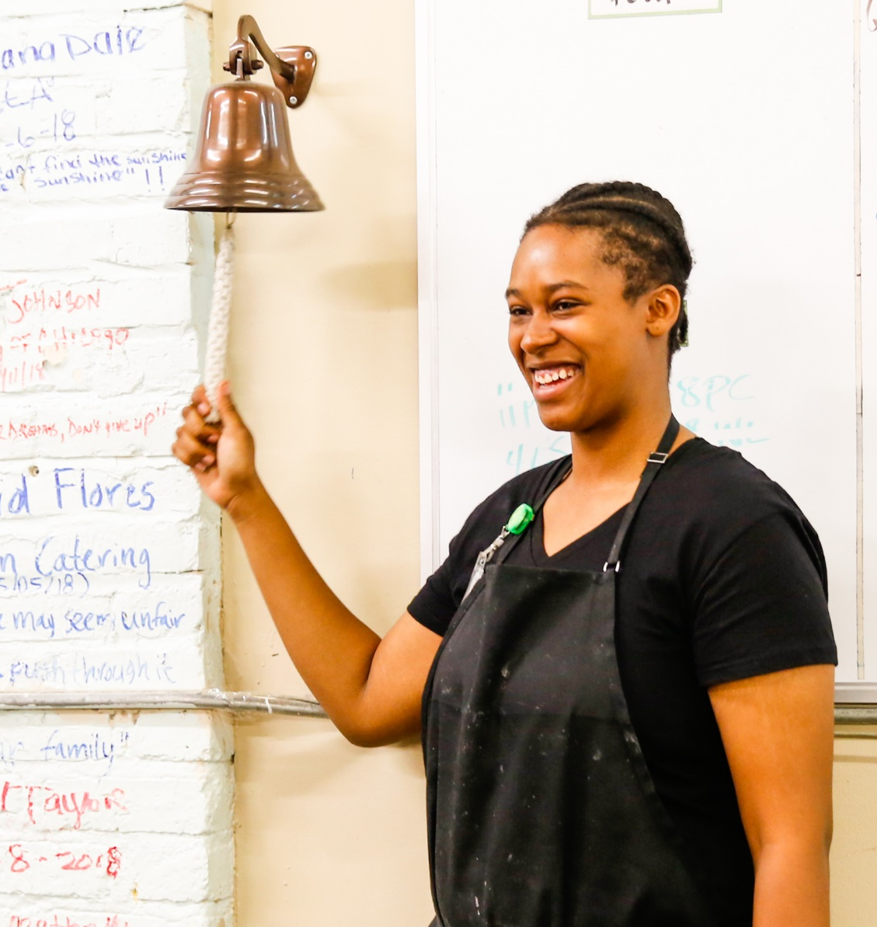

Workshop Goals
Learn what Executive Skills are and why they matter.
Reflect on the impact of Executive Skills on your work and goals.
Begin to consider how ES could apply to your role, ESE environment, and work relationships.
Notes:
What is your goal? Let’s start there – add to the chat.

Slide 4
Agenda
Set the Context
Executive Skills & Why they Matter
Environmental Modifications
Executive Skills in Employment Social Enterprise Design
Wrap Up

Slide 5
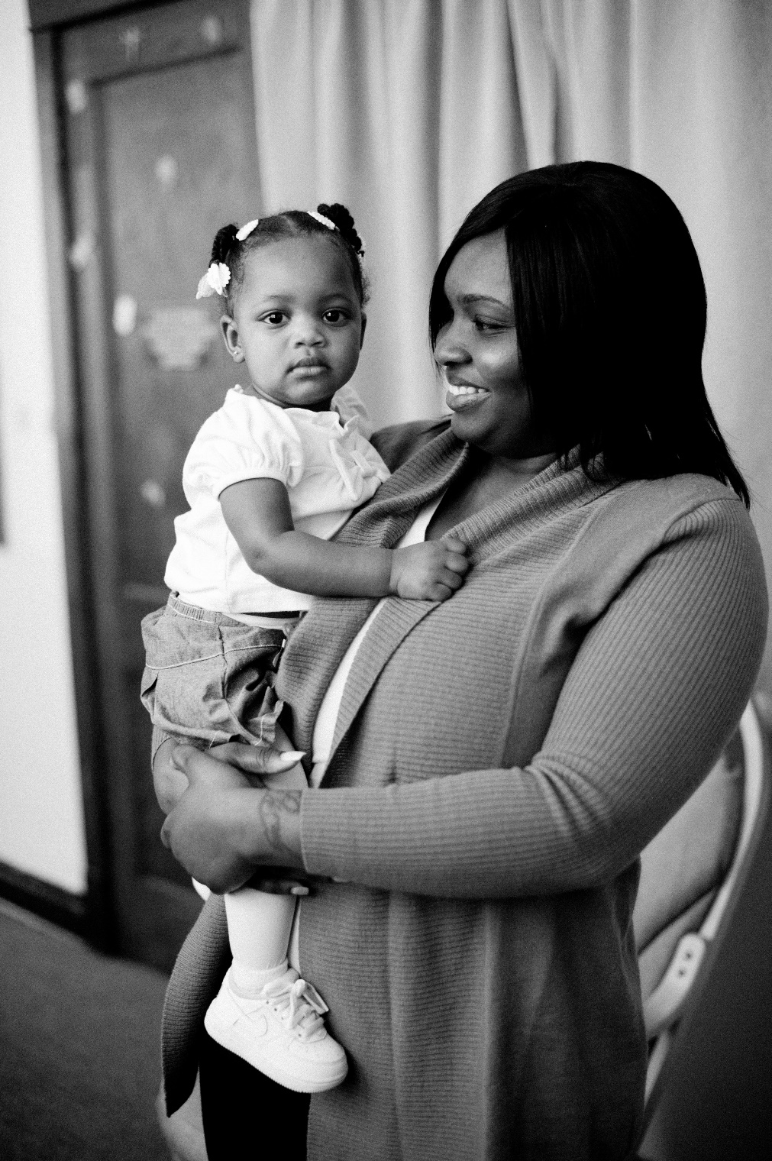

We believe in the strength, skills, and potential of young families.
Their goals are at the center of our work together.
Notes:
New Moms provides housing, job training and family support programming for young moms who seek the same things every family seeks: safe homes, financial security, and well-being. This wheel of life shows the various aspects of our programming, which is all grounded in racial equity, understanding how institutional racism and discrimination creates conditions of poverty that can impact how someone progresses towards and achieves goals. Understanding these barriers is important to coaching alongside families.
We take a strengths-based mindset – all of our programming is founded on the true belief that young moms have the strength, skills, and potential they need to set and achieve their goals. We use Executive Skills coaching mindset and practice – the goal is goal achievement.
And at the core of this are the voices of young moms – so here, to get us started today talking about ES are two young moms who graduated from our job training program.

Slide 6



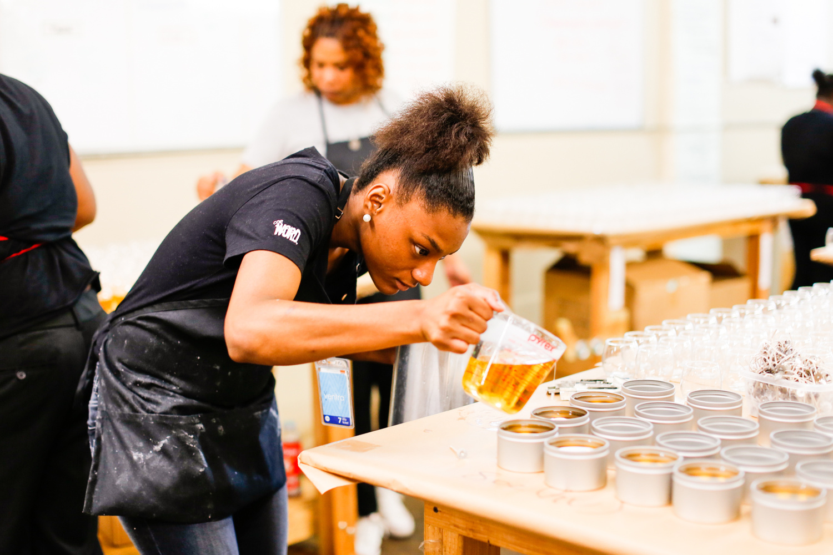





Notes:
- Bright Endeavors is the social enterprise of New Moms and exists to provide job training for young moms.
- Blend of in-class training & hands on experience at our social enterprise candle company, Bright Endeavors.
- Young moms gain the job experience they need to find and keep a job – all while engaging with coaches who support their future planning and goal tracking

Slide 7

High-Quality Connection (HQC)
Notes:
According to researchers, it takes only about 40 seconds to establish a high-quality connection, and these HQCs are very, very good for our health.
High-Quality Connections are the DNA of positive and healthy relationships. They are the building blocks of these positive correlations in our physical and psychological health.

Slide 8



3 Defining Features of HQC
VITALITY
POSITIVE REGARD
MUTUALITY
Notes:
There are 3 defining features of High Quality Connections:
Vitality: You FEEL it. You walk away energized, a pep in your step, like a light switch that got flipped on, this helps you feel productive and alive.
Positive Regard: You FEEL this too, this is micromoments of mattering. You feel that you are valued for who you are, no judgment, in body language, tone, or words. You feel seen.
Mutuality: This is a subjective experience, it’s a moment where you feel like you’re dancing, like either of you could lead and either could follow. In these moments a sense of power over becomes a strong sense of power WITH.
Why does this matter?

Slide 9

Mattering is a combination of
Feeling Valued and Adding Value
Notes:
This leads to a sense of mattering – and this is the core of belonging, equity, and dignity. So yes while ESEs are here to help folks build skills and increase their economic mobility, it’s also so much more. It’s about demonstrating that people MATTER.
(Prilleltensky, 2021)

Slide 10
Technical
Skills
Technical
Skills
Workplace Navigation Skills
Workplace/“Soft” Skills
Executive Skills
Notes:
Workplace: Communication skills, interpersonal skills, problem-solving skills, creative and strategic thinking skills, teamwork/organizational
Technical skills: Certifications, frontlift operation, project management

Slide 11

The Goal is Goal Achievement
Notes:
And goal progression counts! We leave a lot of impact – and self-confidence, self-worth, and self-efficacy – on the table when we don’t also account for the successes of goal progression
This is especially true when people are experiencing scarcity, when environmental factors make it more challenging to set, progress toward, and achieve longer term and complex goals.

Slide 12
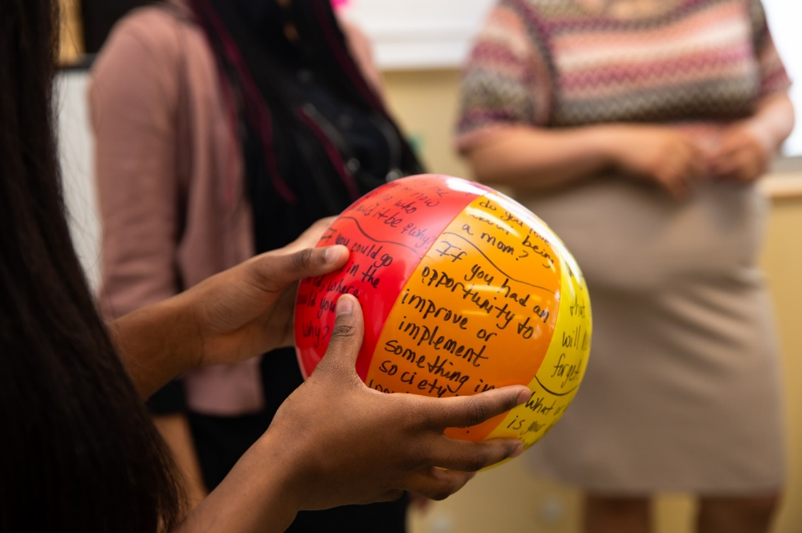
Step 1: Set Your Goal
What goal do you want to achieve by the end of the month?
Why is it important to
you?
Notes:
Take a couple of minutes to write it on your sheet. One way to build momentum towards goals is by sharing them with others – so please type your goal into the chat.

Slide 13


What are Executive Skills?
How do Executive Skills develop?
Why do Executive Skills matter?

Slide 14
How We Organize
  Organization
  Time Management
  Planning/Prioritization
How We React
  Response Inhibition
  Flexibility
  Emotional Control
  Stress Tolerance
  Metacognition
How We Get Things Done
  Task Initiation
  Sustained Attention
  Goal-directed Persistence
  Working Memory
Notes:
ES are twelve brain-based abilities that govern how we organize things, how we react to things, and how we get things done. They act like an air traffic control system for our brain!
We ALL have Executive Skills strengths and struggles. My strengths are xyz, my struggles are xyz. When you look at this list, do you immediately see areas you know are your strengths? Or your struggles?

Slide 15

Step 2: Executive Skills Profile
What are your top 3 ES strengths?
What are your 3 biggest ES struggles?

Slide 16
How We Organize
  Organization: Knowing where I put things.
  Time Management: Know about how long a task will take and what the deadline is.
  Planning/ Prioritization: Deciding what steps to take.

Slide 17
How We React
  Response Inhibition: Seeing the consequence before I say or do something.
  Flexibility: Going with the flow, accepting change.
  Emotional Control: Keeping my cool when frustrated.
  Stress Tolerance: Managing my stress.
  Metacognition: Stepping back and evaluating how I’m doing.

Slide 18
How We Get Things Done
  Task Initiation: Getting started without a delay.
  Sustained Attention: Paying attention, even when I don’t feel like it.
  Goal-Directed Persistence: Sticking with my goal.
  Working Memory: Remembering what I did and what I need to do.

Slide 19


Executive Skills Behaviors
Our Executive Skills are normal in the context of our life experiences, institutional barriers we might face, and resources we have.
Strengthening skills and mitigating unhelpful behaviors means we can tackle more and more complex tasks and goals.
Notes:
We can take on more complex tasks with stronger Executive Skills, or ones that we know how to mitigate for!
When we set and achieve short term goals, we build the muscle for and confidence and motivation in our ability to set and progress towards longer-term, complicated goals – such as buying a house, getting a degree, or improving our health – we need to have the strong brain “muscle” and confidence built up to tackle and persist towards those bigger goals.
But instead of CHANGING SOMEONE’S EXECUTIVE SKILLS – especially when we’re working with older adolescents and adults - The goal is goal achievement!

Slide 20

Breakout Room Discussion
Share your top 3/bottom 3 ES.
How do you think your ES strengths & struggles show up as behaviors at work?
How do you think your ES will help or hinder your progression to your June goal?
Notes:
Breakout rooms – 7 minutes
3 people each
Dana to share example
Put prompt in chat:
Share your top 3 and bottom 3 Executive Skills with your group.
How do you think your ES strengths & struggles show up as behaviors at work?
How do you think your ES help or hinder your progression to your June goal? Feel free to share examples.
When we come back ask: how was it for you to name your strengths, identify your struggles with peers?

Slide 21

Toxic stress makes it harder to use our Executive Skills
High-quality connections and positive relationships can buffer this toxic stress
Notes:
Brains are built over time, from the bottom up. Our ES lives in the prefrontal cortex that coordinates and integrates our thoughts, memory, emotions, and motor movement. Early childhood, from about 0-5, is peak neural connectivity development. Another peak period is adolescence, from 13-26 years old.
(guess the third stage of ES development)
New research shows that when someone becomes a new parent, their brains have a third period of peak elasticity – it’s like a permit to rewire the brain!
Although in adulthood our brains do not develop ES as rapidly, we can more easily modify our environments and our own behaviors to mitigate our ES struggles.
Experiences of scarcity, systemic racism or other traumas, or lack of supportive relationships can affect development of Executive Skills and can stymie our efforts to achieve a goal. When we experience scarcity, our brains “tunnel” and focus on that one thing we are lacking. makes it harder for us to use these intentional skills and it prunes away the neural connections made from early childhood.

Slide 22
Reframe obstacles with Executive Skills
Every time you meet with a participant, they ask for more bus cards.
  Their Goal-Directed Persistence is strong, and they are tunneling on their basic needs. What else can I do to reduce their stress?
New colleague doesn’t seem engaged or energetic about work.
  He struggles with Task Initiation and there’s so much to learn when new, that it’s overwhelming. What can I do to help him get going on a task?
I have a tense conversation with a colleague.
  I can rely on my Emotional Control in this situation to stay calm in the moment, and my Metacognition to reflect on how I can do better next time.
Notes:
We do two key things to help alleviate the impact of toxic stress and ensure every staff member and participant can leverage their Executive Skills as much as possible. The first is that we reframe deficit narratives with Executive Skills. This is a trauma-informed reframe that moves away from what’s wrong with the person to what is going on with the person?
Reframing helps alleviate negative self-talk and improves the connection between people.
How might you use this type of reframe with participants?

Slide 23
ES-based Powerful Questions
Executive Skills-based Powerful Questions
What Executive Skill strength did you leverage this week?
What Executive Skills struggle got in your way?
You achieved that goal/task! What Executive Skills did you use to accomplish that?
What is creating undue friction in the environment?
How do you think someone with a strength in [specific ES] would do it?
Notes:
You don’t have to be an Executive Skills knowledge expert to reframe – you can just ask open ended, powerful questions which demonstrates to people that their expertise and experience is of value to you

Slide 24
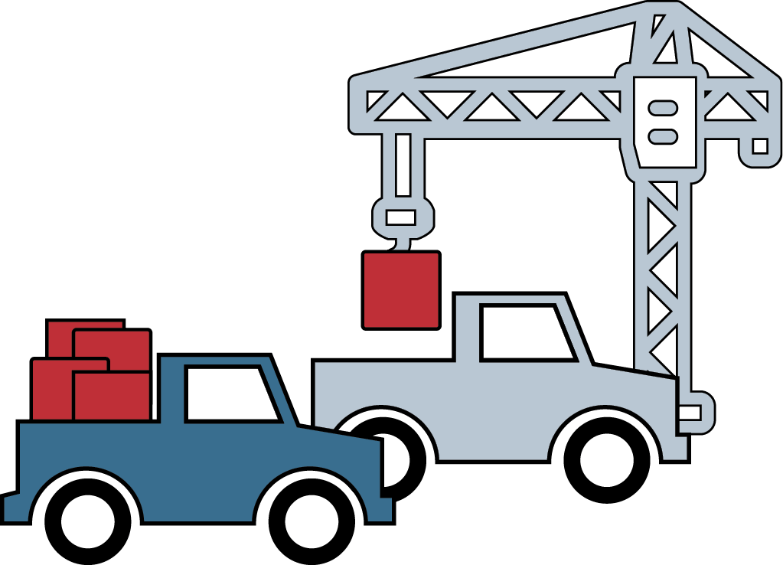
Unloading our Trucks
Notes:
But that’s not all we can do to help one another leverage their Executive Skills when they are facing stress or scarcity.
So even though we may not control the stressful environments or certainly not the trauma we experience – relationships can buffer the deleterious impact and help us be resilient. But as ESEs we also have a responsibility to ensure the environment we create is less stressful – we do our best to reduce the sources of stress. It’s like unloading an overloaded truck, so its engine isn’t revving just to stay in place, but rather to accelerate towards its destination.
We can start by unloading our trucks. At New Moms this means, while people are coming to our ESE Bright Endeavors, we are reducing stress by providing diapers, helping participants access their SNAP, TANF, WIC, and Medicaid benefits, reduce debt, secure stable housing and transportation and child care.
Type in the chat 1 way that you unload the truck with or for your ESE employees/participants? Do you provide stipends? Tax filing support? Job connections?

Slide 25
Environmental Modifications
Reduce stress and friction points by modifying:
Policies and procedures
Written materials/documents
Physical environment
Technology
Tasks themselves
…to decrease barriers to goal progression!
Notes:
Environmental Modifications pave the way to goal progression
Environmental Modifications: modify tasks, technology, physical environment, process and materials to pave a pathway towards goal progression. In our social enterprise this also improved production and efficiency.
Example: Shortening our intake form from 8 pages to 4 pages, handbook from 8th grade reading level to 4th. Adding an automatic notification on a calendar invite. Or…turning off text notifications to focus on a task!

Slide 26
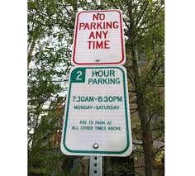
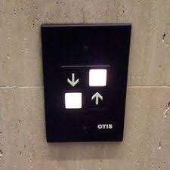
The Environment Influences Our Behavior

Slide 27
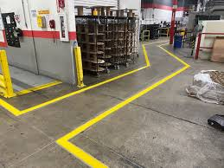
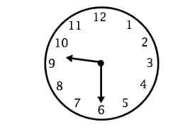
Environmental Design for Good
Notes:
But it’s not just the physical design it’s the policies and procedures, written docs, tech, design, logistics, even tasks.

Slide 28
Executive Skills-based
“Environmental Modifications”
How We Organize
Organization | Establish & label a set place for an item
Time Management | Ask a coworker to help you estimate a reasonable amount of time for the task
Planning/Prioritization | Use a backwards-mapping template
Notes:
And it’s something we can do for ourselves to, now that we have learned about Executive Skills. You look at the Executive Skills where you struggle, and identify an Environmental Modification. The way it works is to look at your goal, and say “my goal is to finish my donor report tomorrow. I struggle with time management and do not have a great grasp on how long this should take so I will ask my Supervisor to help me estimate it.”
This is part of coaching and part of program design. It’s also something we talk about openly with participants so they build the muscle and know-how for creating their own environmental modifications to mitigate their struggles.
Put in chat the Environmental Modifications tip sheet

Slide 29
Executive Skills-based
“Environmental Modifications”
Response Inhibition | 5-second rule
Flexibility | Create an if…then plan upfront
Emotional Control | Eliminate the activation
Stress Tolerance | Repeat a mantra or prayer
Metacognition | Create a set routine for self-reflection (ie, Sunday journaling)
How We React

Slide 30
Executive Skills-based
“Environmental Modifications”
How We Get Things Done
Task Initiation | Temptation Bundle
Sustained Attention | Set timer for 25 minutes on/5 mins off
Goal-Directed Persistence | Tell someone else your deadline
Working Memory | Set automatic reminders

Slide 31
Step 3:
Environmental Modifications
Identify 1-2 modifications from the list that you could use to reduce barriers to your goal
    physical environment
    process
    people around you
    tools or technology
    the task itself

Slide 32
Put it all together
Set a Goal
ES strengths & struggles
Identify environmental modification
Take Action!

Slide 33

Q
A
Notes:
What questions do you have for us?

Slide 34
Wrap Up
Choose one from below, then share in the chat:
1. What one new concept resonated most with you and why?
2. What one environmental modification may reduce friction in your ESE?

Slide 35
Workshop A: Executive Skills
What are ES? Why do they matter? How do they show up in my job?
Set a foundation of Executive Skills knowledge for Pathway 1 or 2
  Wednesday 6/4
  Workshop 1a: Lived Experience & Career Readiness
  Explore the concepts of one’s lived experience in relation to career readiness and labor market dynamics. Understand how your personal identity impacts your role as a facilitator
  + Post-Workshop Coaching
Thursday 6/5
Workshop 1b: Curriculum Deep Dive
Walk through curriculum and its
unique components; practice core lessons
+Post-Workshop Coaching
Tuesday 6/17
Workshop 2a: Executive Skills 201: Moving from knowledge into practice
Deepen your ability to use ES to enhance goal achievement for yourself, with your teams, and your ESE employees
+Post-Workshop Coaching
Tuesday 7/1
Workshop 2b: Designing Executive Skills-based practices for your ESE
Leverage implementation science to design and sustain Executive Skills-informed practices in your ESE
+Post-Workshop Coaching
Pathway 1: Career Readiness Curriculum
Pathway 2: Executive Skills Implementation
For ESEs that do not have a job readiness curriculum, are unhappy with what they currently have, or are looking for new material to enhance current offerings.
For ESEs that have a job readiness curriculum and are looking to shift their culture toward strengths-based, Executive Skills Coaching.
Notes:
Introduce Ellen and Tanvi – share a bit about their work and pathway

Slide 36
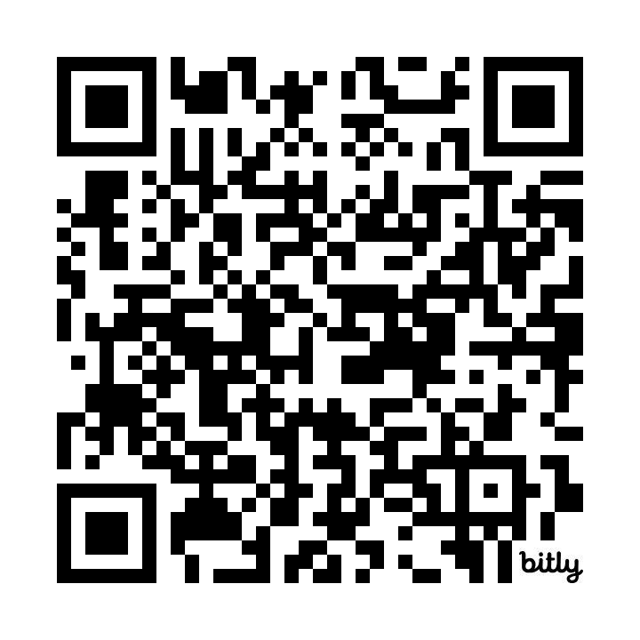

Feedback Survey
https://bit.ly/OptionalWorkshops
This feedback helps us improve your experience and plan adjustments to make moving forward.
Notes:
Galiana

Slide 37
Bibliography/Additional Resources
Positive Organizational Scholarship/High Quality Connections: https://positiveorgs.bus.umich.edu/an-introduction/
Ascend at Aspen Institute: https://ascend.aspeninstitute.org/
EFWorks Library: https://www.efworkslibrary.org/
EmPath: https://empathways.org/research-policy
Harvard Center on the Developing Child: https://developingchild.harvard.edu/
UCLA Center on Adolescent Development: https://developingadolescent.semel.ucla.edu/

Slide 38
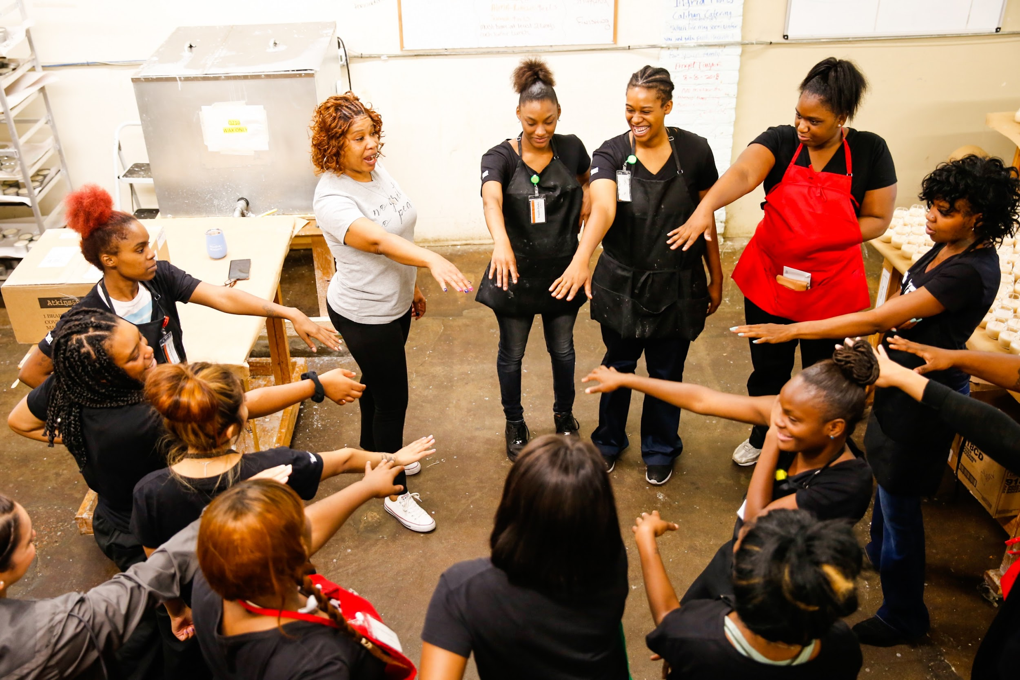

You Matter

