Slide 1

Executive Skills 201: From Mindset to Practice
June 17, 2025
Dana Emanuel & Devin Redmond
CA RISE Skills Development Series
Notes:
Welcome! We are so glad you are here today with us to learn about the brain and behavioral science of Executive Skills!
We are from New Moms second social enterprise – recently rebranded to Bright Path -- and over the past five years we have learned so much about the power of Executive Skills knowledge and how that knowledge can improve our own individual goal achievement, goals that families set for themselves, and our overall program and organizational goals. We get to share what we’ve learned with peer workforce dev and ESE programs and partners like you all and REDF.
Before we get started, some housekeeping notes:
Please join us via video as you are able and comfortable.
Take a minute to close your other tabs, silence your notifications, and make sure your environment is free from distractions.
We will take two planned breaks. In the interim feel free to get up, move around, honor your body’s needs
We will record this meeting and share directly with this group, but will not store it anywhere else so your confidentiality is protected.
Take space, make space – please engage fully and be mindful if you’re speaking a lot to invite others to speak up, too
Don’t forget to start the recording ☺

Slide 2

Workshop A: Executive Skills
What are ES? Why do they matter? How do they show up in my job?
Set a foundation of Executive Skills knowledge for Pathway 1 or 2
  Wednesday 6/4
  Workshop 1a: Lived Experience & Career Readiness
  Explore the concepts of one’s lived experience in relation to career readiness and labor market dynamics. Understand how your personal identity impacts your role as a facilitator
  Thursday 6/5
Workshop 1b: Curriculum Deep Dive
Walk through curriculum and its
unique components; practice core lessons
+Post-Workshop Coaching
Tuesday 6/17
Workshop 2a: Executive Skills 201: Moving from knowledge into practice
Deepen your ability to use ES to enhance goal achievement for yourself, with your teams, and your ESE employees
Tuesday 7/1
Workshop 2b: Designing Executive Skills-based practices for your ESE
Leverage implementation science to design and sustain Executive Skills-informed practices in your ESE
+Post-Workshop Coaching Wed. 7/9 from 11-12p PT
Pathway 1: Career Readiness Curriculum
Pathway 2: Executive Skills Implementation
For ESEs that do not have a job readiness curriculum, are unhappy with what they currently have, or are looking for new material to enhance current offerings.
For ESEs that have a job readiness curriculum and are looking to shift their culture toward strengths-based, Executive Skills Coaching.

Slide 3
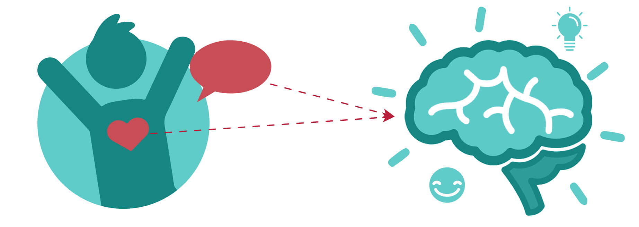

High-Quality Connection (HQC)
Notes:
According to researchers, it takes only about 40 seconds to establish a high-quality connection, and these HQCs are very, very good for our health.
High-Quality Connections are the DNA of positive and healthy relationships. They are the building blocks of these positive correlations in our physical and psychological health.

Slide 4
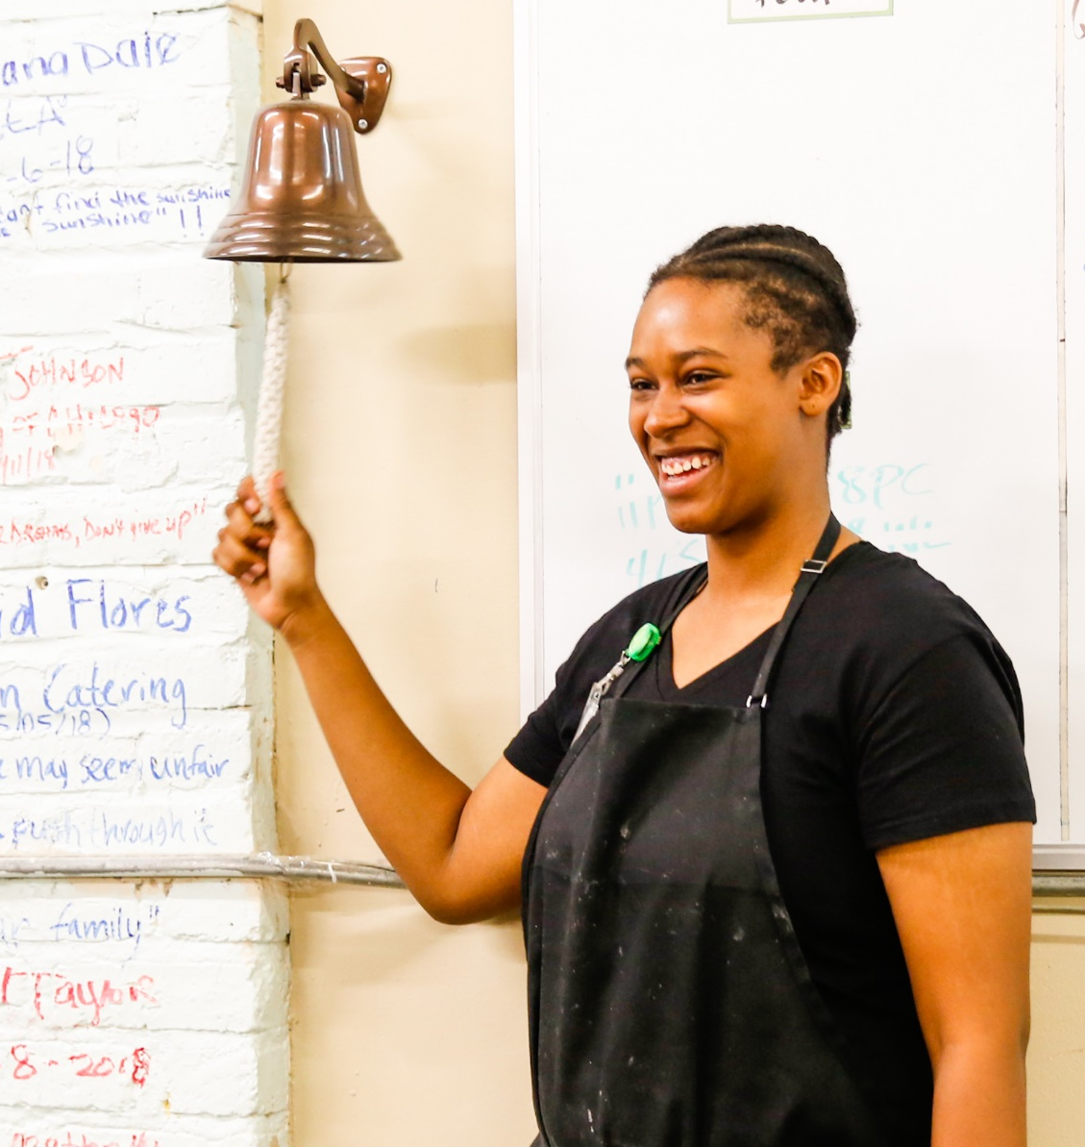
Workshop Goals
Reflect on Executive Skills learning;
Deepen understanding of Executive Skills and goal achievement;
Explore ESE components that can leverage Executive Skills mindset.
Notes:
What is your goal? Let’s start there – add to the chat.

Slide 5
Agenda
Executive Skills refresher
Executive Skills and Goal Achievement
Executive Skills in ESE core components
Q&A
Wrap Up

Slide 6
Technical
Skills
Technical
Skills
Workplace Navigation Skills
Workplace/“Soft” Skills
Executive Skills
Notes:
Workplace: Communication skills, interpersonal skills, problem-solving skills, creative and strategic thinking skills, teamwork/organizational
Technical skills: Certifications, frontlift operation, project management

Slide 7

The Goal is Goal Achievement
Notes:
And goal progression counts! We leave a lot of impact – and self-confidence, self-worth, and self-efficacy – on the table when we don’t also account for the successes of goal progression
This is especially true when people are experiencing scarcity, when environmental factors make it more challenging to set, progress toward, and achieve longer term and complex goals.

Slide 8
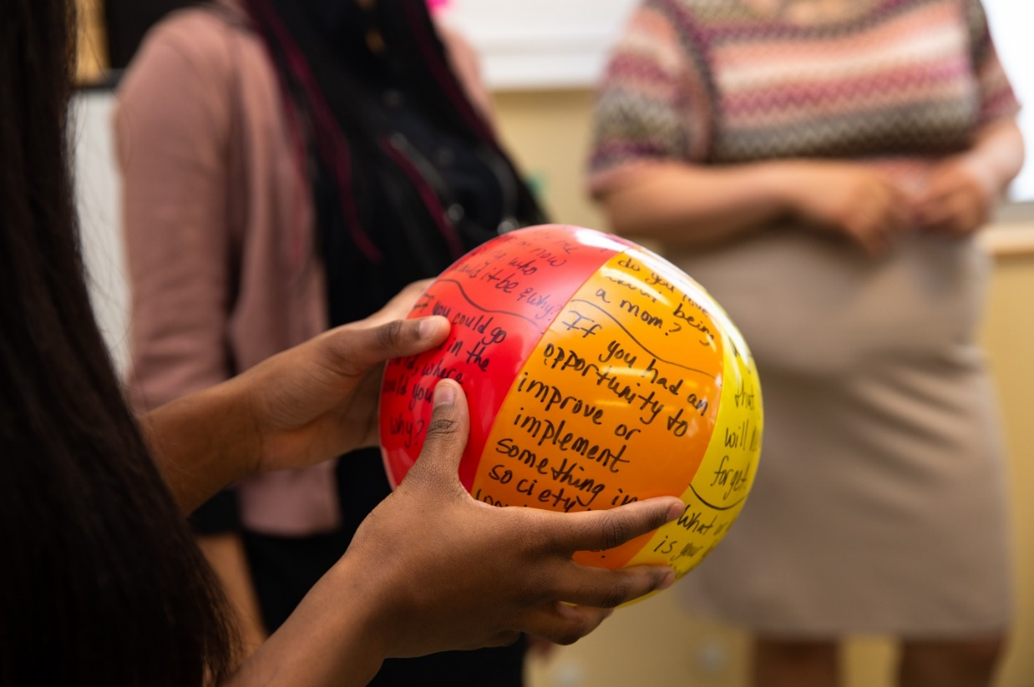
Revisit (or Reset) Your Goal
What goal do you want to achieve by the end of the month?
Why is it important to
you?
Notes:
Take a couple of minutes to write it on your sheet. One way to build momentum towards goals is by sharing them with others – so please type your goal into the chat.

Slide 9
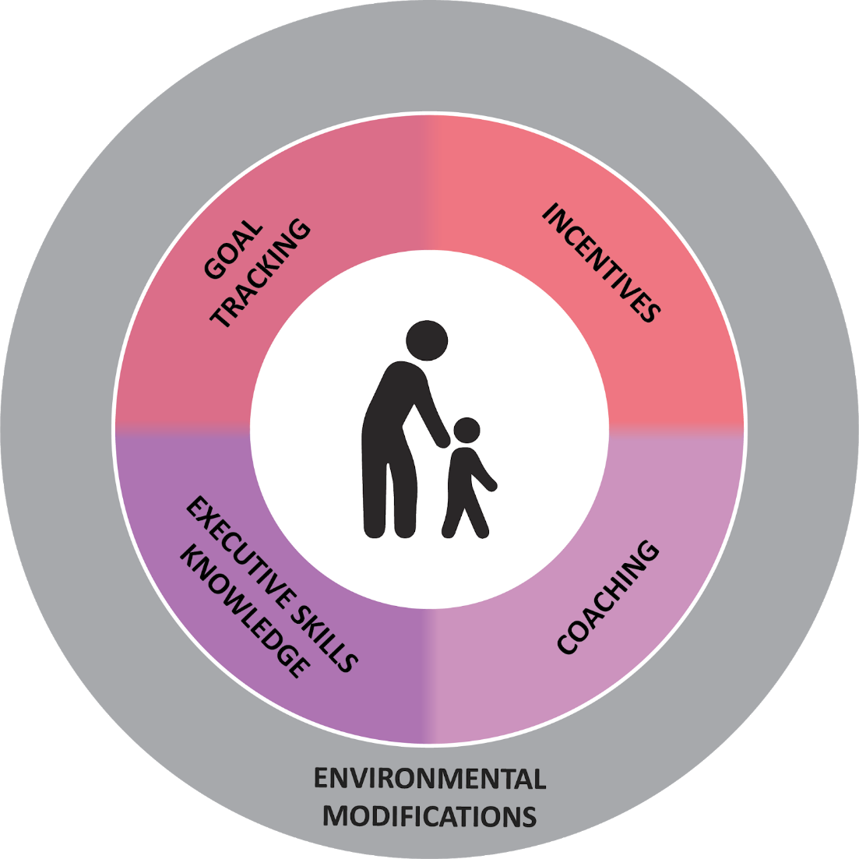
Five Components of Executive Skills for Goal Achievement
Your goal here!
Notes:
Now that we’ve focused on the Executive Skills knowledge we’ll go through the other four elements. Remember that the whole goal of the Executive Skills coaching approach is to increase goal progression and goal achievement.
We use this approach at New Moms not just in our direct work with families but also in our supervising, and in our own individual learning & development at New Moms. When a staff member sets a professional goal, they might use elements of this approach to support their own goal progression, and their supervisor might as well.

Slide 10
How We Organize
  Organization
  Time Management
  Planning/Prioritization
How We React
  Response Inhibition
  Flexibility
  Emotional Control
  Stress Tolerance
  Metacognition
How We Get Things Done
  Task Initiation
  Sustained Attention
  Goal-directed Persistence
  Working Memory
Notes:
ES are twelve brain-based abilities that govern how we organize things, how we react to things, and how we get things done. They act like an air traffic control system for our brain!
We ALL have Executive Skills strengths and struggles. My strengths are xyz, my struggles are xyz. When you look at this list, do you immediately see areas you know are your strengths? Or your struggles?

Slide 11

Review: Executive Skills Profile
What are your top 2 ES strengths?
What are your 2 biggest ES struggles?
Notes:
Share in the chat

Slide 12


Executive Skills Behaviors
Our Executive Skills are normal in the context of our life experiences, institutional barriers we might face, and resources we have.
Strengthening skills and mitigating unhelpful behaviors means we can tackle more and more complex tasks and goals.
Notes:
We can take on more complex tasks with stronger Executive Skills, or ones that we know how to mitigate for!
When we set and achieve short term goals, we build the muscle for and confidence and motivation in our ability to set and progress towards longer-term, complicated goals – such as buying a house, getting a degree, or improving our health – we need to have the strong brain “muscle” and confidence built up to tackle and persist towards those bigger goals.
But instead of CHANGING SOMEONE’S EXECUTIVE SKILLS – especially when we’re working with older adolescents and adults - The goal is goal achievement!

Slide 13
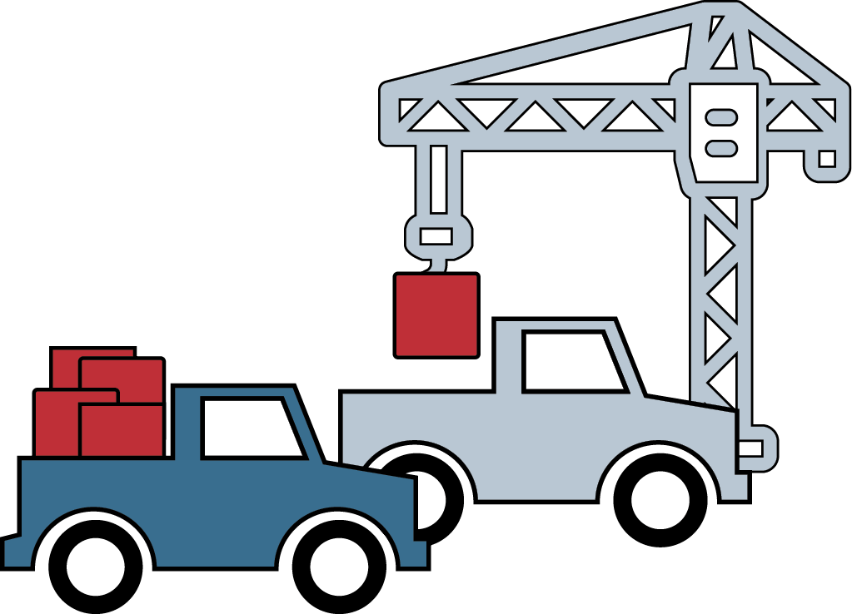
Unloading our Trucks
Notes:
But that’s not all we can do to help one another leverage their Executive Skills when they are facing stress or scarcity.
So even though we may not control the stressful environments or certainly not the trauma we experience – relationships can buffer the deleterious impact and help us be resilient. But as ESEs we also have a responsibility to ensure the environment we create is less stressful – we do our best to reduce the sources of stress. It’s like unloading an overloaded truck, so its engine isn’t revving just to stay in place, but rather to accelerate towards its destination.
We can start by unloading our trucks. At New Moms this means, while people are coming to our ESE Bright Endeavors, we are reducing stress by providing diapers, helping participants access their SNAP, TANF, WIC, and Medicaid benefits, reduce debt, secure stable housing and transportation and child care.
Type in the chat 1 way that you unload the truck with or for your ESE employees/participants? Do you provide stipends? Tax filing support? Job connections?

Slide 14
Environmental Modifications
Reduce stress and friction points by modifying:
Policies and procedures
Written materials/documents
Physical environment
Technology
Tasks themselves
…to decrease barriers to goal progression!
Your goal
Notes:
Environmental Modifications pave the way to goal progression
Environmental Modifications: modify tasks, technology, physical environment, process and materials to pave a pathway towards goal progression. In our social enterprise this also improved production and efficiency.
Example: Shortening our intake form from 8 pages to 4 pages, handbook from 8th grade reading level to 4th. Adding an automatic notification on a calendar invite. Or…turning off text notifications to focus on a task!

Slide 15
Executive Skills-based
“Environmental Modifications”
How We Organize
Organization | Establish & label a set place for an item
Time Management | Ask a coworker to help you estimate a reasonable amount of time for the task
Planning/Prioritization | Use a backwards-mapping template
Notes:
And it’s something we can do for ourselves to, now that we have learned about Executive Skills. You look at the Executive Skills where you struggle, and identify an Environmental Modification. The way it works is to look at your goal, and say “my goal is to finish my donor report tomorrow. I struggle with time management and do not have a great grasp on how long this should take so I will ask my Supervisor to help me estimate it.”
This is part of coaching and part of program design. It’s also something we talk about openly with participants so they build the muscle and know-how for creating their own environmental modifications to mitigate their struggles.
Put in chat the Environmental Modifications tip sheet

Slide 16
Executive Skills-based
“Environmental Modifications”
Response Inhibition | 5-second rule
Flexibility | Create an if…then plan upfront
Emotional Control | Eliminate the activation
Stress Tolerance | Repeat a mantra or prayer
Metacognition | Create a set routine for self-reflection (ie, Sunday journaling)
How We React

Slide 17
Executive Skills-based
“Environmental Modifications”
How We Get Things Done
Task Initiation | Temptation Bundle
Sustained Attention | Set timer for 25 minutes on/5 mins off
Goal-Directed Persistence | Tell someone else your deadline
Working Memory | Set automatic reminders

Slide 18
Goal Tracking
Short-term SMART Goals that are a “good fit” for ES Strengths, timeline, motivation, confidence, and environment
Help identify mitigation strategies for obstacles, nudge progression, and celebrate success
Scaffold goals over time to build muscle, confidence, and motivation for more complex goals
Your goal
Notes:
Goals are a source of motivation only if they are chosen by the participant and if the participant believes that the goal is really achievable.
Coaches’ responsibility is to help participant craft her goal into a very achievable and realistic goal that is well matched for her strengths, and modifies the environment to mitigate ES struggles.
It’s important to start small – just like with any new strength training program at the gym!
This is so people really see themselves as capable and become motivated by their early successes in goal achievement. As someone achieves small SMART Goals they begin to build the confidence and the muscle for achieving more complex, longer term goals. Coaches help participants “scaffold up” to working on larger goals over time. Goal achievement is possible through the step-by-step process that we set up at New Moms…and practice, practice, practice. Everyone has the ability and potential to achieve goals – no matter how many times they may not have achieved their goals in the past.

Slide 19
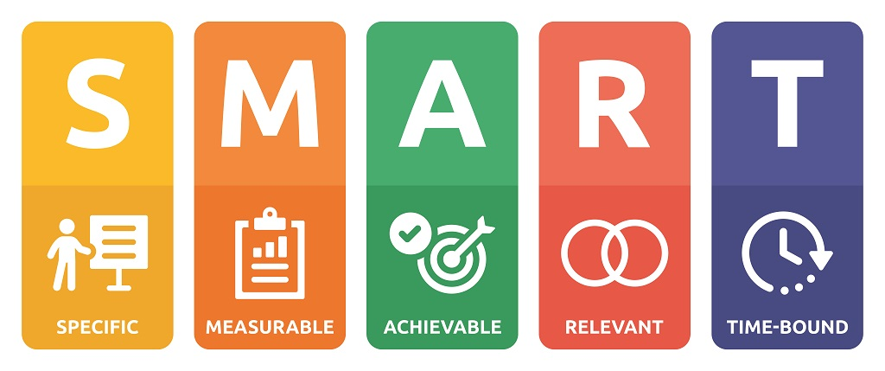
Goals must be a “Good Fit”
…and use Executive Skills strengths AND
mitigate for struggles!

Slide 20
Goal: Finish monthly paperwork.
Good-Fit SMART Goal: Print and file this month’s intake paperwork by Thursday at 5pm.
Environmental Modification: If I notice I’m procrastinating, then I will turn on the new Taylor Swift song and start before the song ends.
Notes:
Don’t forget to connect with why it matters to you

Slide 21

Activity: Your Good Fit Goal
    Re-work your Goal to be a good fit goal, including:
    *SMART
    *Uses your Executive Skills strengths
    2. Share your good fit goal in your breakout
    3. What might get in your way? What modification will help?
Notes:
Re-work your Goal to be a good fit goal, including:
*SMART
*Uses your Executive Skills strengths
2. Share your good fit goal in your breakout
3. What might get in your way? What modification will help?

Slide 22
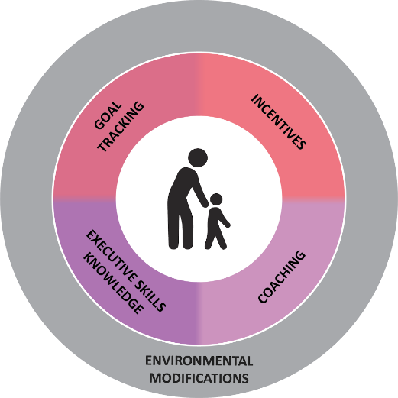
Incentives
Rewards acknowledge and celebrate goal attainment (party, public acknowledgement, ring a bell)
Incentives nudge towards and celebrate goal progression (“you can do it!,” take a break after 5 mins of work, a tasty treat)
Your goal here!
Notes:
Barrier removal is the foundation on which our incentives at New Moms lives
We first remove barriers that cut costs. We do this not because it primary serves as a motivator but because at its core, it creates equity.
Afterwards we are able to support moms with incentives that nudge toward and celebrate their goal progression and bigger rewards that acknowledge and celebrate their attainment. Ideally, hopefully, over time these extrinsic motivators give moms the feeling of capability and skill that builds intrinsic drivers for their goal progression and achievement. But in the meantime, we help to reduce their stress, support them on the way to a goal, and celebrate when they achieve it – over and over again!
We don’t use negative or avoidance motivators- like public shaming, taking away freedoms or choices, removing access, etc. This is in the spirit of growth mindset, treating people with dignity and not judging decisions made in context of others life experiences, brain development, and chronic scarcity.

Slide 23

Your Reward
When I accomplish my Good-Fit Goal, I will celebrate by…
Consider:
Have you chosen it?
Is this reward big enough to help you feel motivated when an obstacle comes up?
Who will you tell when you’ve achieved your goal?
Notes:
Share in the chat

Slide 24
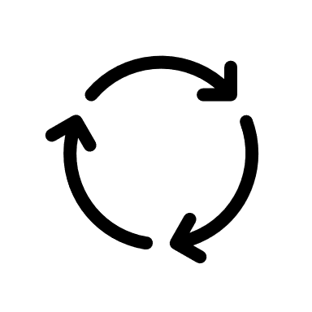
Goal Progression Cycles Build Muscle & Momentum
Notes:
Now you’ve completed the first portion of the goal setting cycle. You identified your Executive Skills, set a goal, identified environmental modifications to mitigate your weaker ES, thought about incentives, and assessed your motivation in relationship to the goal’s goodness of fit.
That’s like doing one repetition at the gym. That’s great! And it takes more than one rep to build the muscle over time. You practice a small goal today and make progress, you review and revise the goal and make more progress, and over time your goal setting muscle builds and your confidence in your goal-setting skills build too.
The same is true for students in your programs – starting with smaller goals means builds skills, muscle, pride, and intrinsic motivation that scaffolds up into more complex, effortful, and long-term goals.

Slide 25
Executive Skills in Written Documents & Visuals
ES posters or team visuals
Clear language with images
Written documentation:
  Most important for audience first
  Simplify documents: fewer words, more images
  Strengths-based

Slide 26
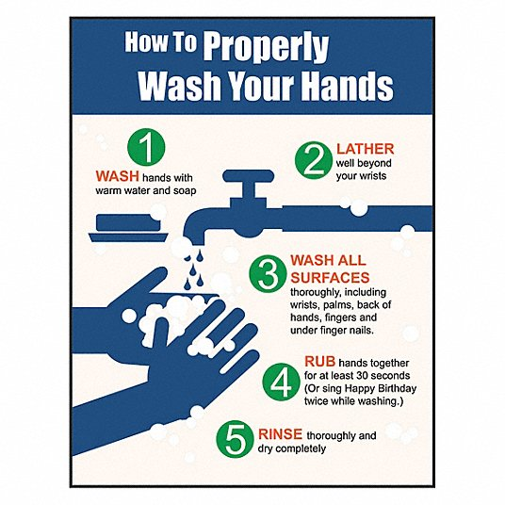
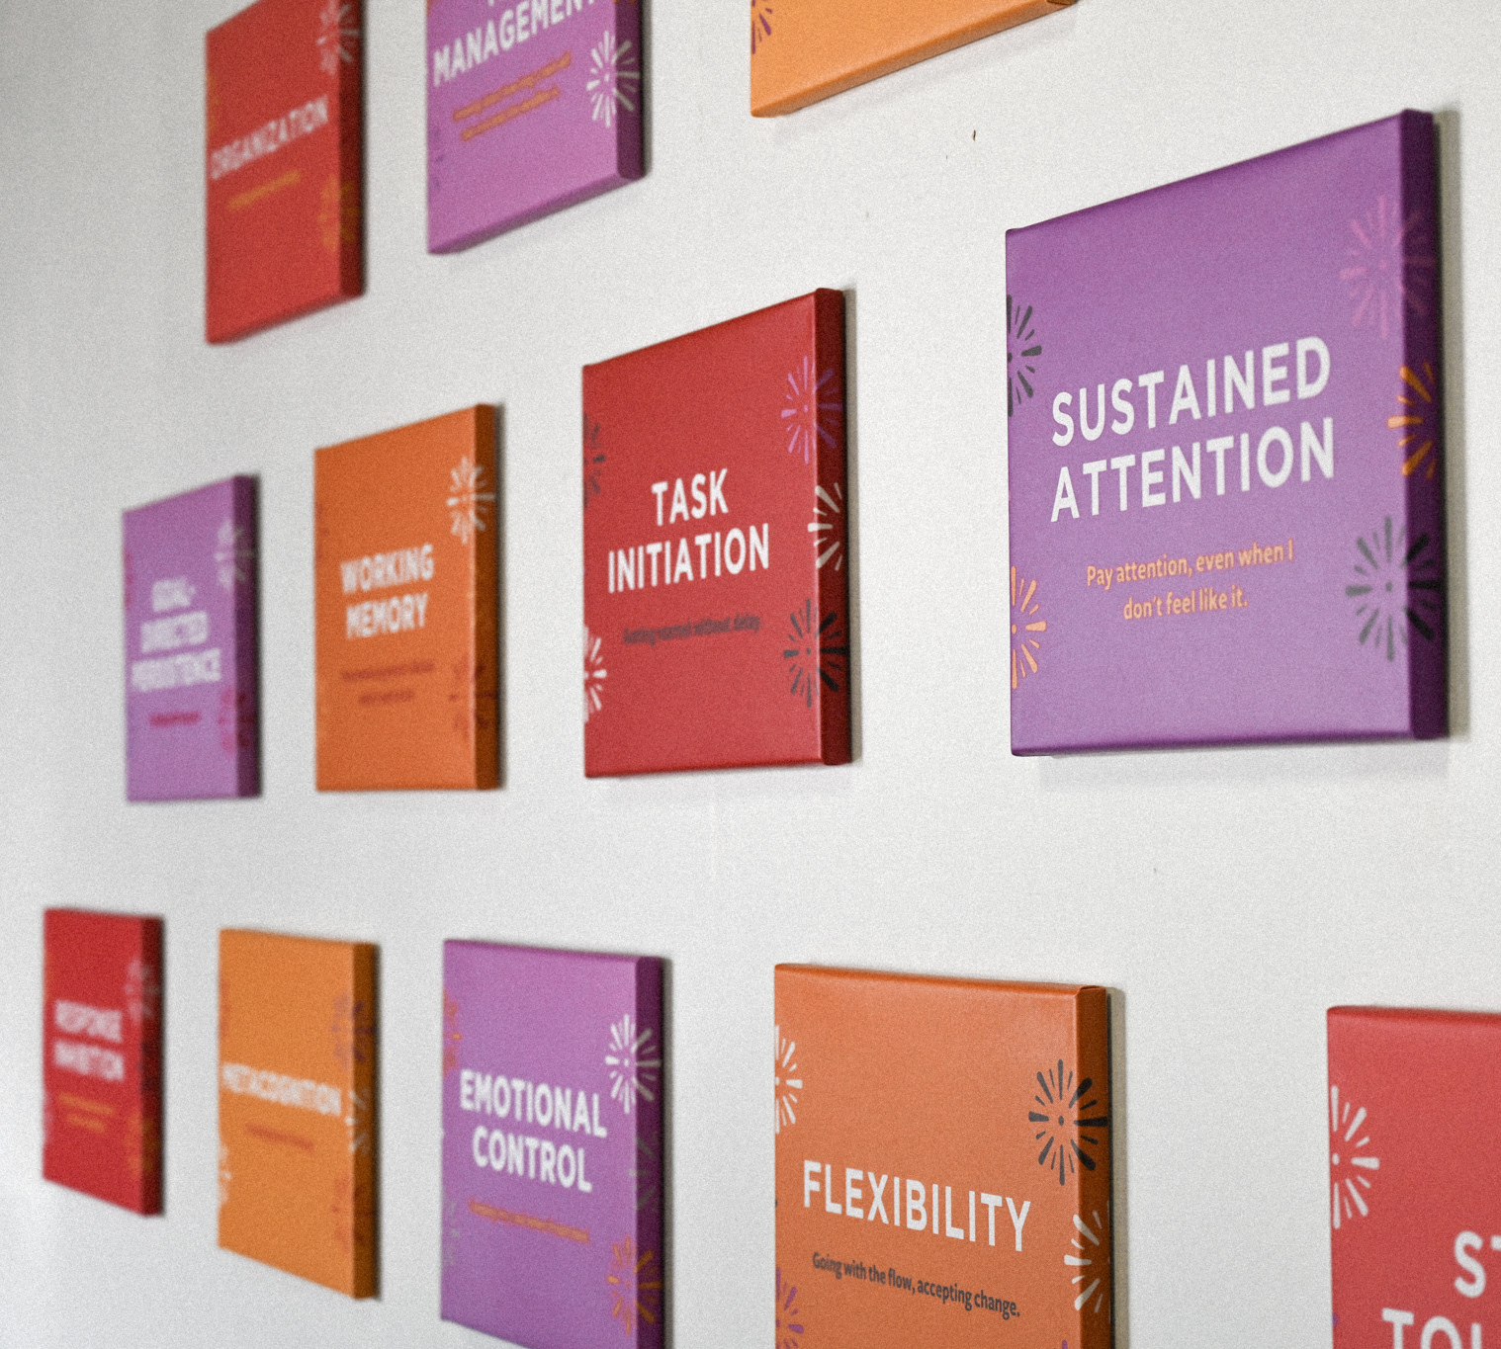

Slide 27
Executive Skills in Team Communication
Open-ended, ES-based powerful questions
Strengths-based descriptions & reframes
Express appreciation with specific Executive Skills-based behaviors

Slide 28

Executive Skills-based Powerful Questions
What Executive Skill strength did you leverage this week?
What Executive Skills struggle got in your way?
You achieved that goal/report/task! What Executive Skills did you use to accomplish that?
What is creating undue friction in the environment?
How do you think someone with a strength in [identify ES] would do it?

Slide 29
Executive Skills in Celebration & Ritual
Public acknowledgement that connects the celebration and the effort
Build rituals (daily, weekly, beginnings/ending)
Incorporate play!
Goal progression AND goal achievement

Slide 30
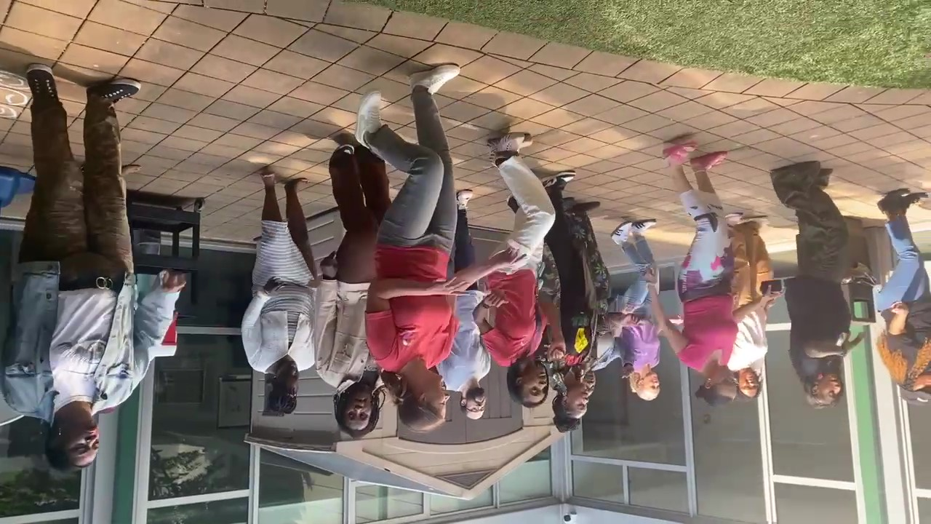
Core Values Rockstar
Notes:
For example, actively engaging in DEI conversations, celebrating goals achieved, awarding a Rockstar or Champion certificate to someone who shows a lot of effort and influence with ESC.

Slide 31

Q
A
Notes:
What questions do you have for us?

Slide 32
Wrap Up
Share in the chat:
What one new concept resonated most with you and why?

Slide 33
Workshop A: Executive Skills
What are ES? Why do they matter? How do they show up in my job?
Set a foundation of Executive Skills knowledge for Pathway 1 or 2
  Wednesday 6/4
  Workshop 1a: Lived Experience & Career Readiness
  Explore the concepts of one’s lived experience in relation to career readiness and labor market dynamics. Understand how your personal identity impacts your role as a facilitator
  Thursday 6/5
Workshop 1b: Curriculum Deep Dive
Walk through curriculum and its
unique components; practice core lessons
+Post-Workshop Coaching
Tuesday 6/17
Workshop 2a: Executive Skills 201: Moving from knowledge into practice
Deepen your ability to use ES to enhance goal achievement for yourself, with your teams, and your ESE employees
Tuesday 7/1
Workshop 2b: Designing Executive Skills-based practices for your ESE
Leverage implementation science to design and sustain Executive Skills-informed practices in your ESE
+Post-Workshop Coaching Wed. 7/9 from 11-12p PT
Pathway 1: Career Readiness Curriculum
Pathway 2: Executive Skills Implementation
For ESEs that do not have a job readiness curriculum, are unhappy with what they currently have, or are looking for new material to enhance current offerings.
For ESEs that have a job readiness curriculum and are looking to shift their culture toward strengths-based, Executive Skills Coaching.
Notes:
Introduce Ellen and Tanvi – share a bit about their work and pathway

Slide 34
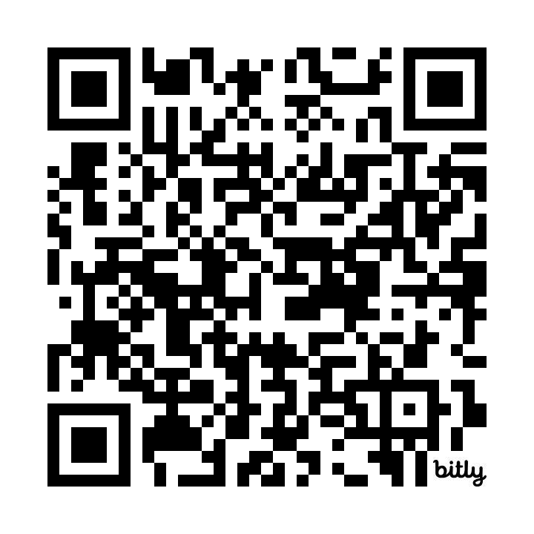

Feedback Survey
https://bit.ly/OptionalWorkshops
This feedback helps us improve your experience and plan adjustments to make moving forward.

Slide 35
Bibliography/Additional Resources
Positive Organizational Scholarship/High Quality Connections: https://positiveorgs.bus.umich.edu/an-introduction/
Ascend at Aspen Institute: https://ascend.aspeninstitute.org/
EFWorks Library: https://www.efworkslibrary.org/
EmPath: https://empathways.org/research-policy
Harvard Center on the Developing Child: https://developingchild.harvard.edu/
UCLA Center on Adolescent Development: https://developingadolescent.semel.ucla.edu/

Slide 36
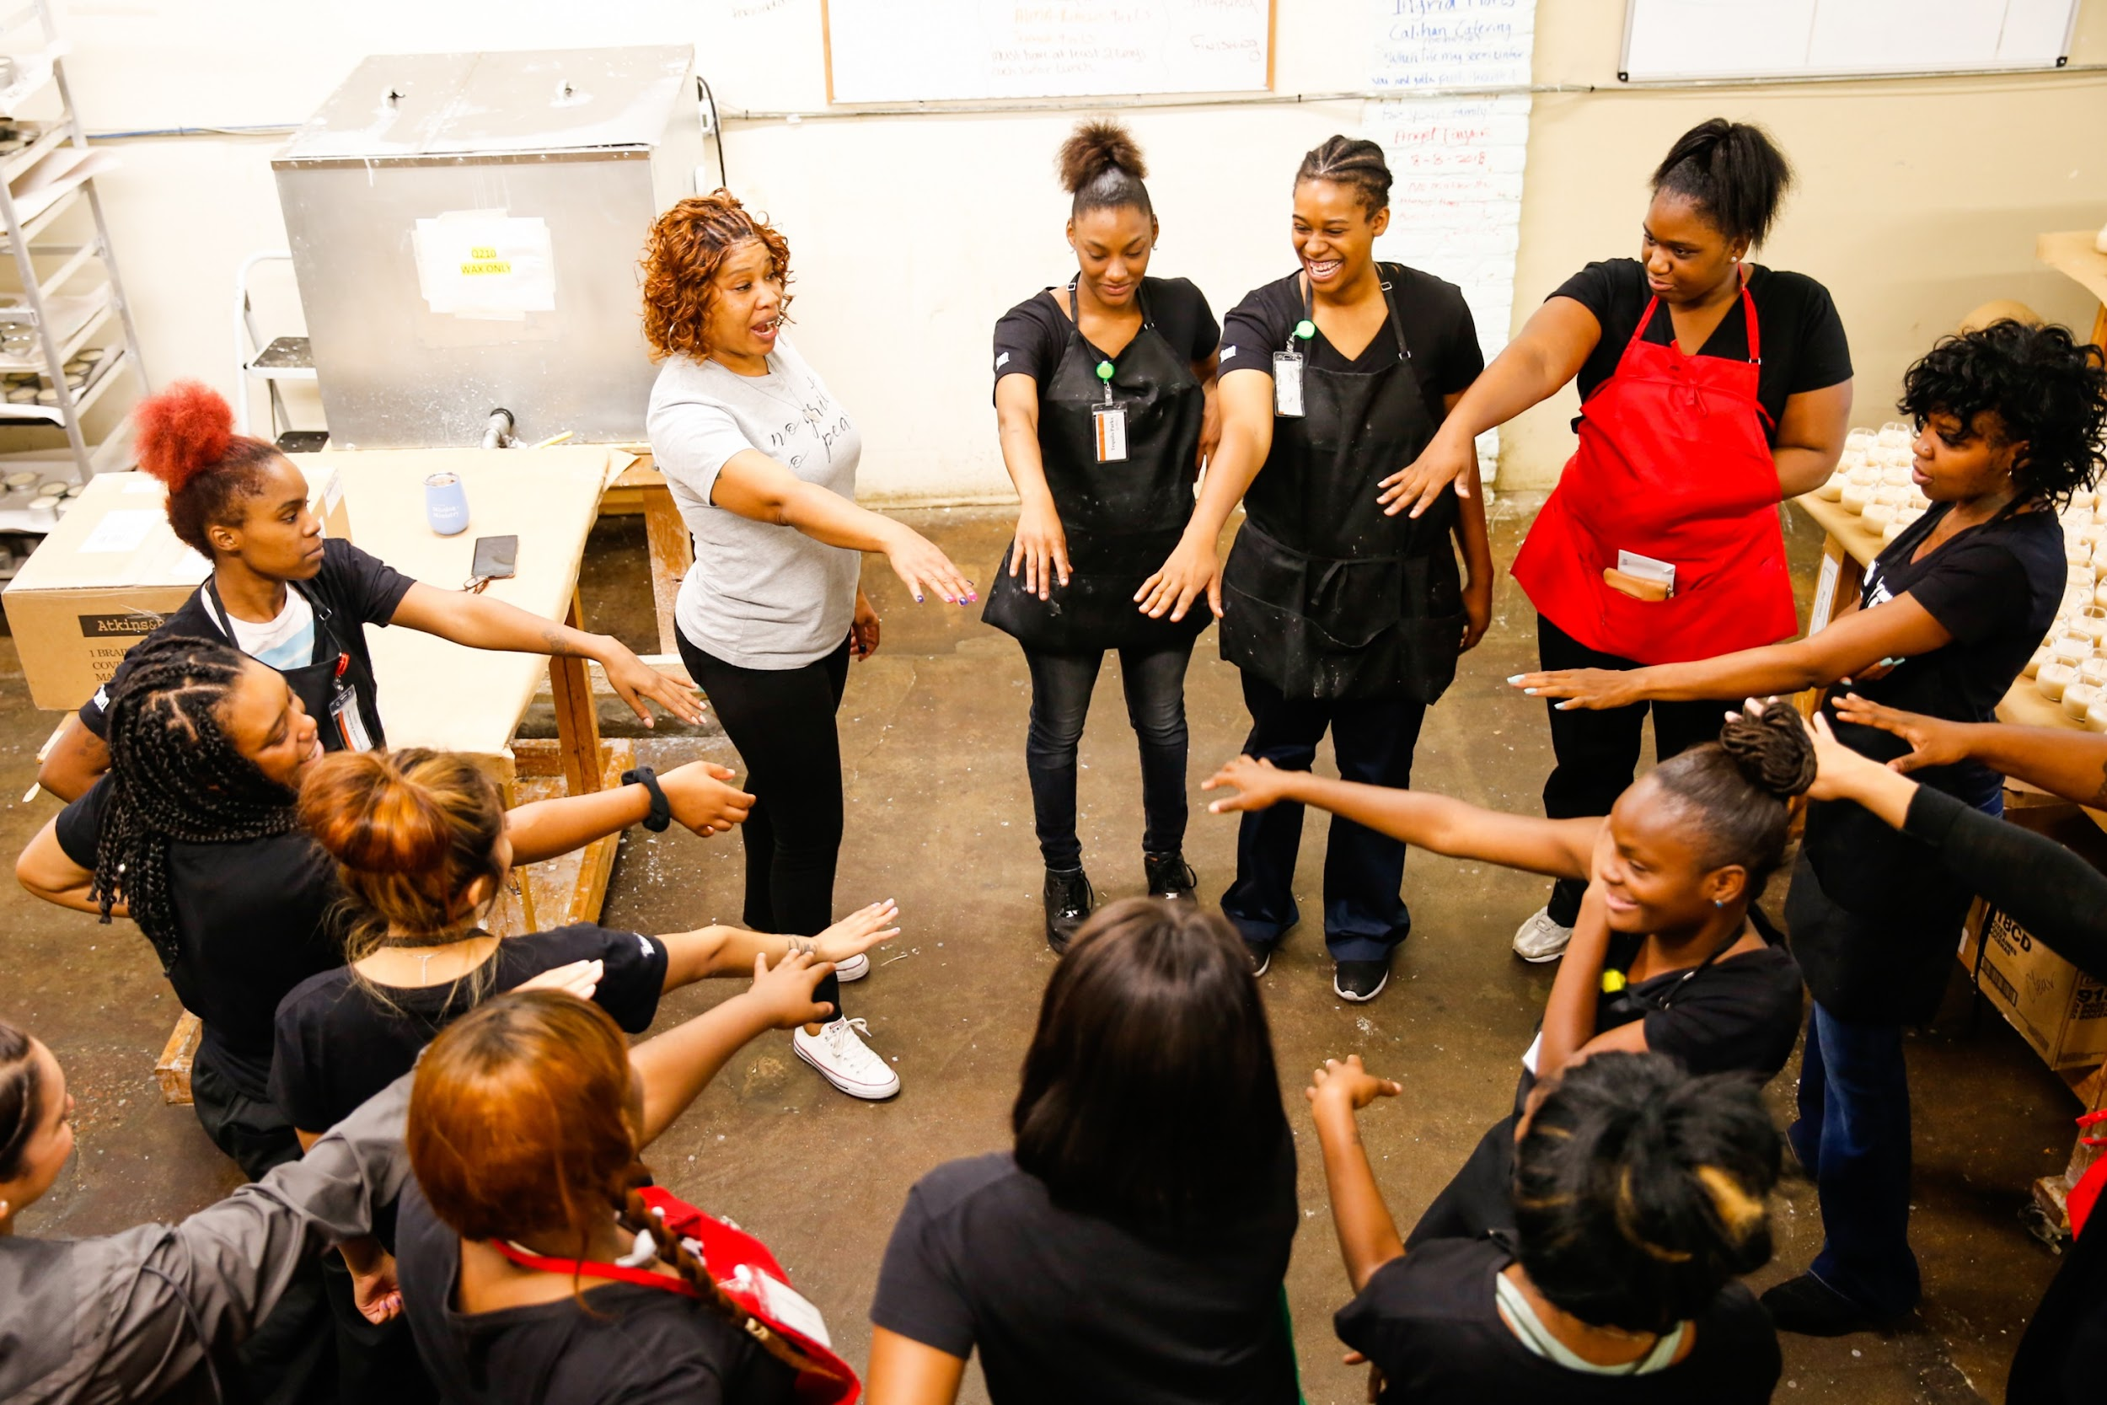

You Matter

