Slide 1
Empowering ESE Impact with AI
Optional Workshop

Slide 2
In the chat please indicate: 1 – 5 your existing comfort level with / knowledge about AI
1 = very uncomfortable / little to no knowledge or familiarity
5 = very comfortable / lots of knowledge or familiarity

Slide 3
Why AI, Why Now
AI is the new Industrial Revolution
We’re at an inflection point: Like electricity, the internet, or cellphones, AI is reshaping society.
It’s already changing everyday tools: From Gmail to Canva to Zoom, AI is becoming embedded in the tools we use daily even if we don’t notice.
This shift is accelerating: What seemed impossible a year ago is now possible and constantly getting better.
AI literacy will be crucial: Just like using email or Excel once was, knowing how to use AI will be essential.
You don’t need to master it, just start learning: You don’t need to become an expert. But experimenting now will help you adapt, lead, and stay ahead of the curve.
Notes:
Terri

Slide 4
What is AI?
AI is a super-powered assistant that uses data to learn, make decisions, and solve problems.
Are there other ways you’ve heard AI explained / defined? Tell us in the chat!
Notes:
Terri

Slide 5
Common concerns about AI
What we often hear, and why it’s not the whole story
Use AI to save time and be capacity building, not replace people - so staff can focus on human-centered work.
Job Loss / Automation
You shape the message- AI gives you a first draft, not a final voice. Keep humans in the loop to reflect your ESE’s values.
Not Human Enough
Light, everyday use has low impact - use it mindfully to drive mission impact.
Climate Impact
Start small - many tools are easy to use and made for non-technical teams.
Too Technical
With the right mindset, AI becomes a partner not a threat.
AI isn’t here to replace you, it’s here to support you
Notes:
Terri

Slide 6
Today’s Agenda
What we’ll cover today
AI & ESEs
AI Toolkit
Peer Learning
The ESE opportunity with AI
Walkthrough of curated resources
Peer breakouts
What’s next & Q&A
Notes:
Terri

Slide 7
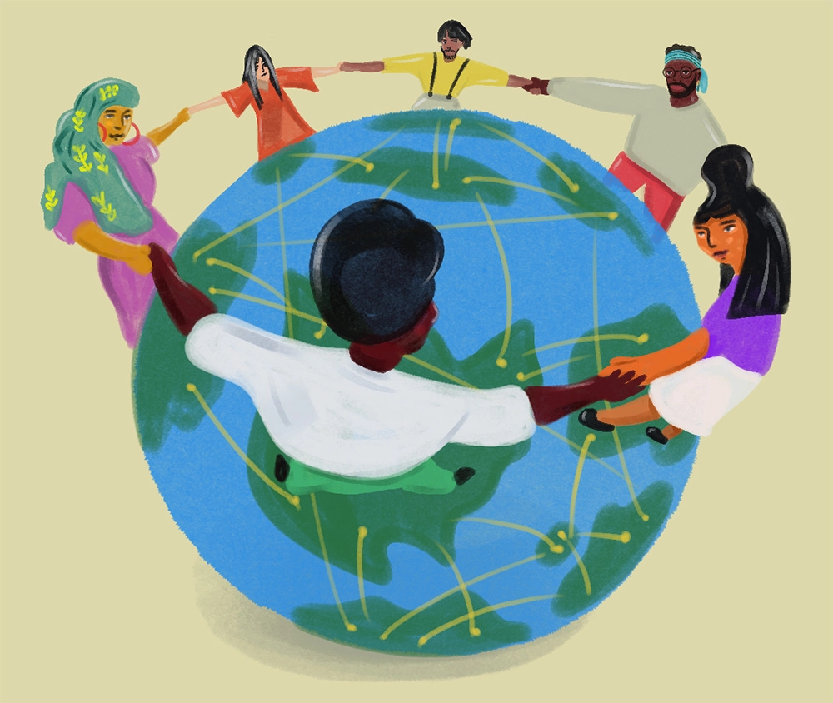
The ESE Opportunity with AI
Small teams. Big missions. Limited time. AI can help.
Your teams are stretched: ESE staff often wear multiple hats. AI can take on repetitive or administrative tasks, freeing up time for what matters most - advancing your mission.
You already innovate under pressure: ESEs are used to doing more with less. AI is just one more tool in your toolbox that can help you move faster, experiment cheaply, and improve efficiency without needing big investments.
AI can amplify your impact: Use it to get a head start on writing tasks, organizing messy data, or brainstorming ideas, while keeping your voice and judgment front and center.
Notes:
Terri

Slide 8
AI in Action
Real examples of how ESEs are already using AI
Grantwriting
Leveraging ChatGPT to draft first versions of grant proposals, intro paragraphs, or need statements for grant applications.
SOP Generation
Quickly generating internal Standard Operating Procedures (SOPs) from bullet points, meeting transcripts, or examples
Program FAQ Chatbot
Developing a custom AI-powered chatbot to answer participant worker FAQs (e.g., hours, eligibility, services).
Notes:
Terri

Slide 9
In the chat please share: How you or your ESE has already tried using AI (or how you want to use it in the future!)

Slide 10
ESE AI Toolkit
A curated set of resources to empower ESE impact with AI
Note: These resources are a starting point. Feedback is encouraged and these resources will be periodically updated
🧰 AI Tools Repository
✅ AI Do’s and Don’ts
📊 AI Use Case Library
🎓 AI Learning Resources
Notes:
Terri

Slide 11
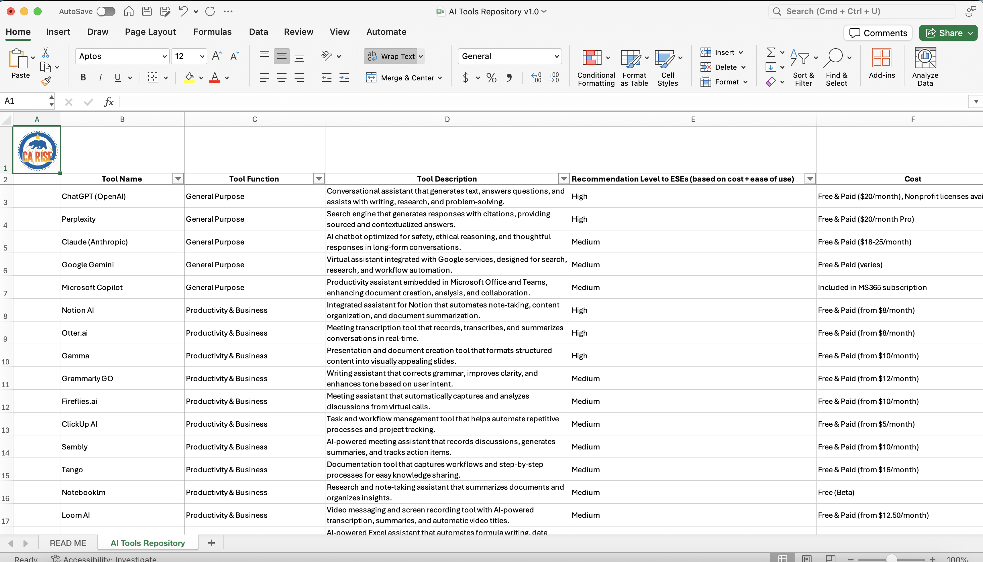
🧰 AI Tools Repository
Your starting point to explore what’s possible and what’s practical
What it is:
A curated spreadsheet of AI tools organized by tool function (e.g., writing, design, analysis, automation), with notes on cost, ease of use, and ESE relevance.
How to use it:
Use this as a searchable menu to find tools aligned with specific tasks across function areas. Great for identifying free or low-cost tools to try within your team. Use alongside AI Use Case Library.
Notes:
Terri

Slide 12
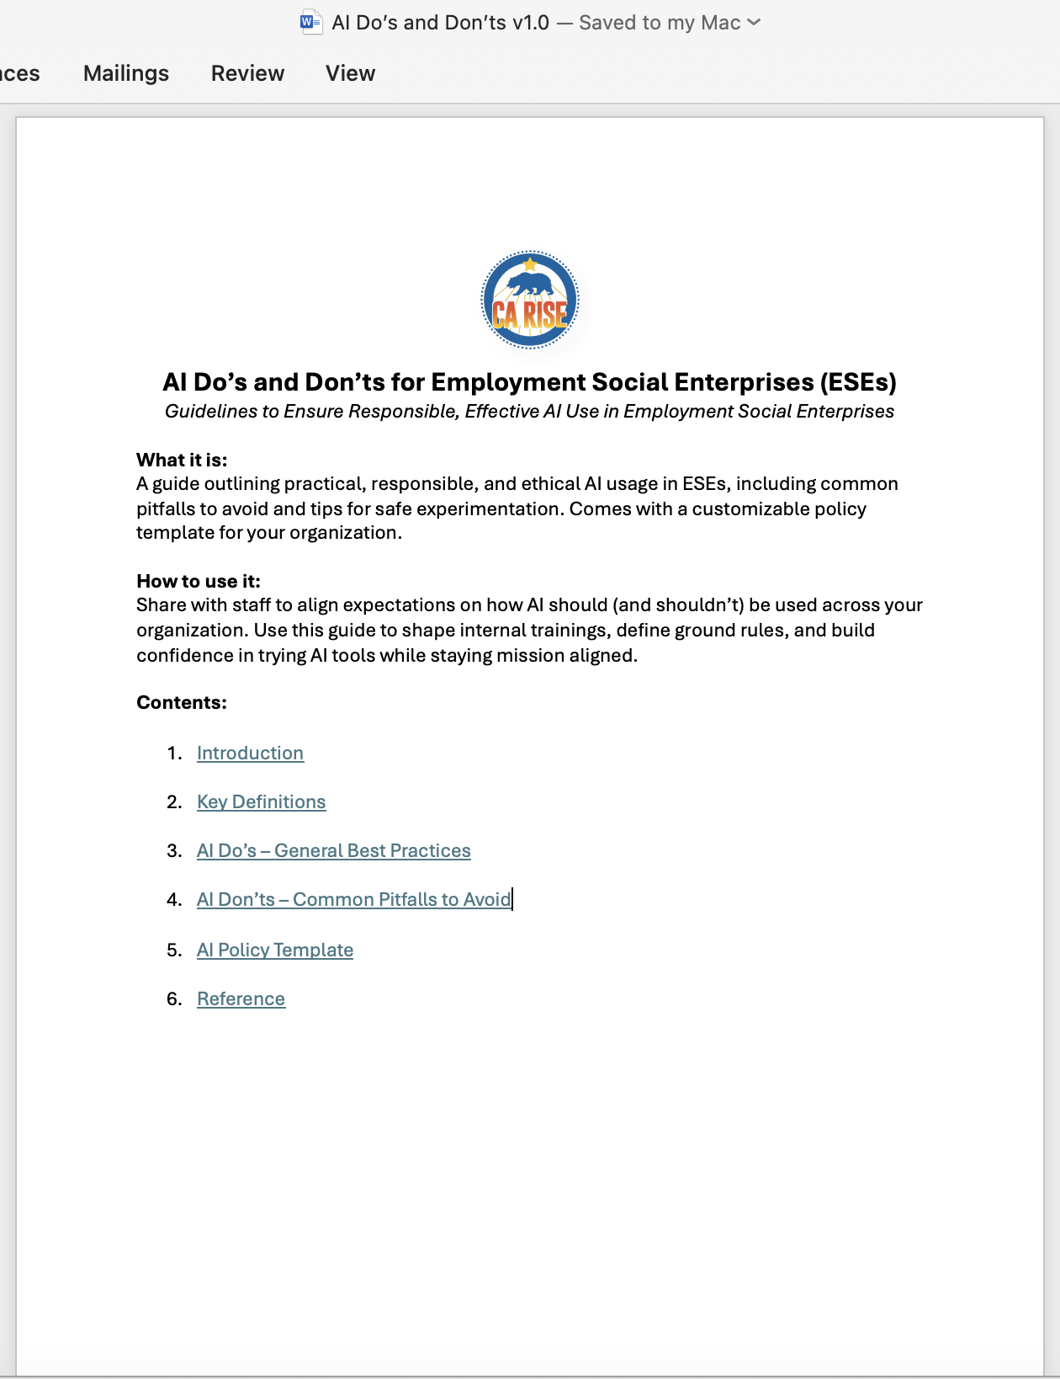
✅ AI Do’s and Don’ts
A quick guide to using AI responsibly, ethically, and effectively
What it is:
A guide outlining practical, responsible, and ethical AI usage in ESEs, including common pitfalls to avoid and tips for safe experimentation. Comes with a customizable policy template.
How to use it:
Share with staff to align expectations on how AI should (and shouldn’t) be used across your organization. Use this guide to shape internal trainings, define ground rules, and build confidence in trying AI tools while staying mission aligned.
Notes:
Terri

Slide 13
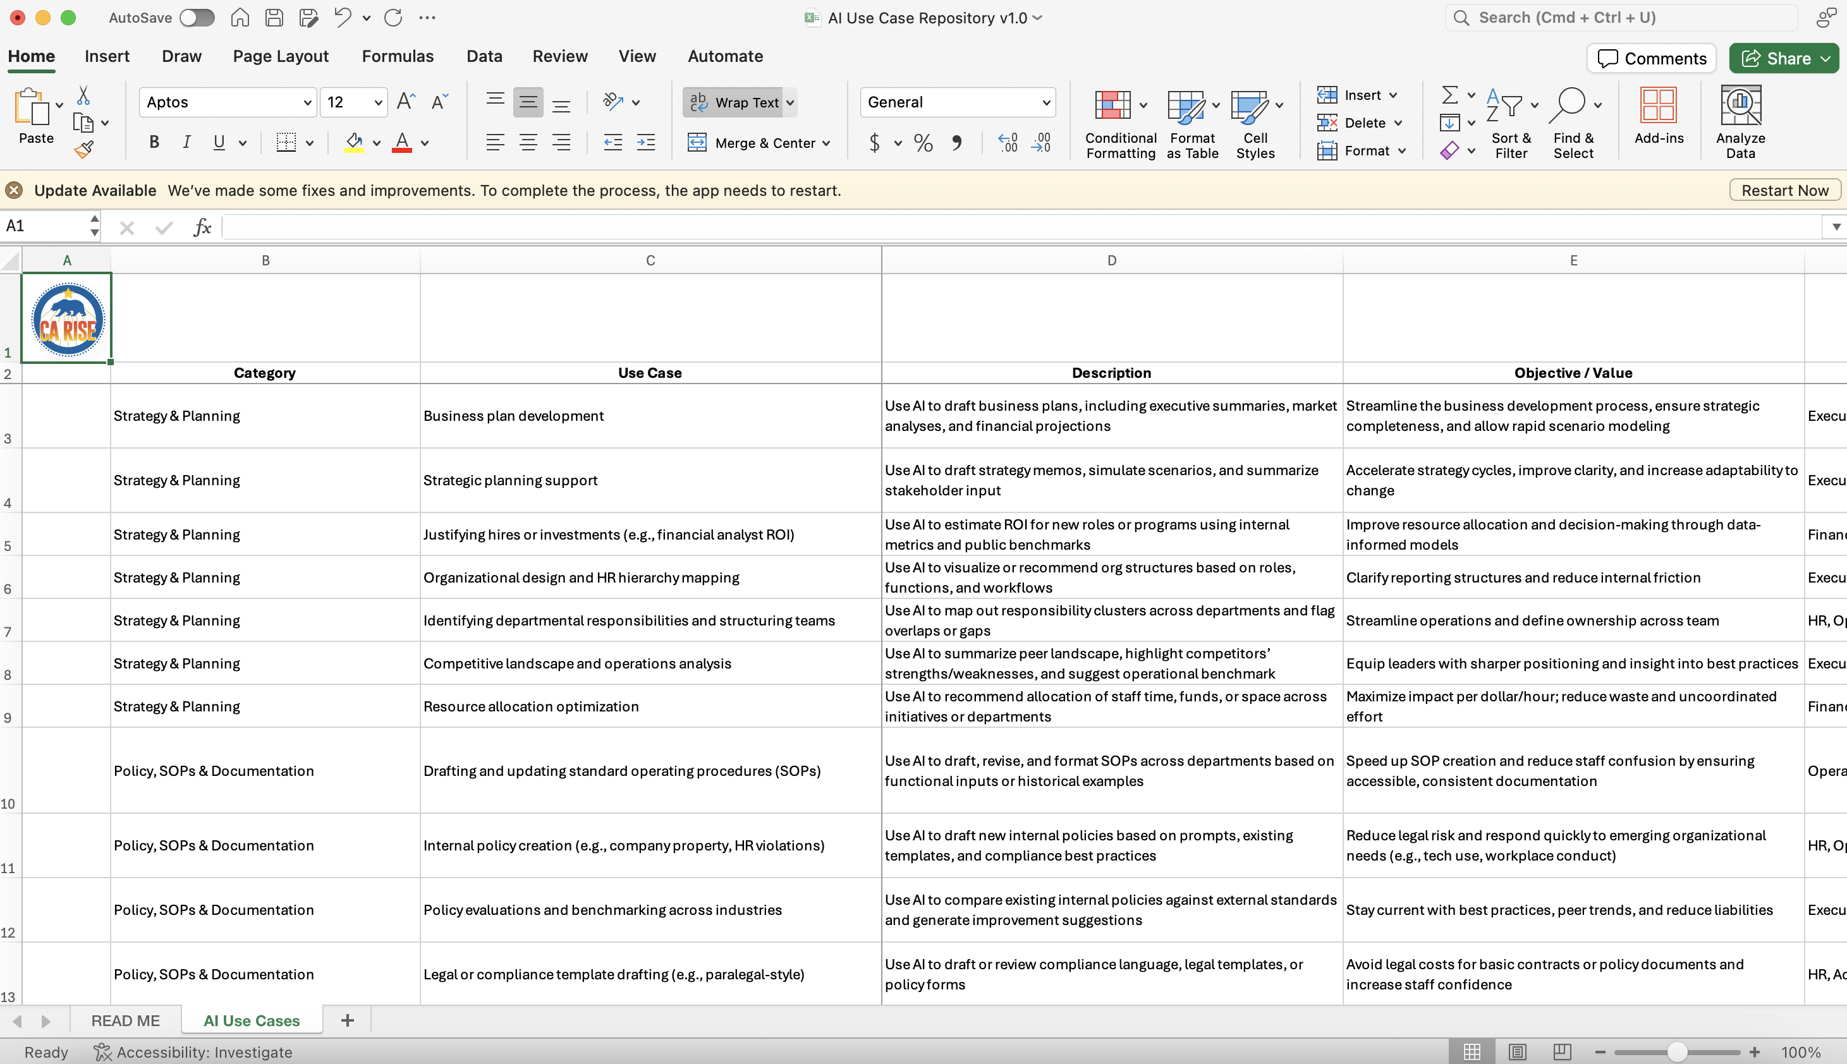
📊 AI Use Case Library
Real examples to help you move from curiosity to action
What it is:
A library of real and potential AI use cases across ESE functions organized to avoid duplication and encourage cross-functional inspiration.
How to use it:
Scan by function to find quick wins and high-impact opportunities. Use to potentially pilot new ideas, start internal discussions, or guide planning for team workflows and experiments.
Notes:
Terri

Slide 14
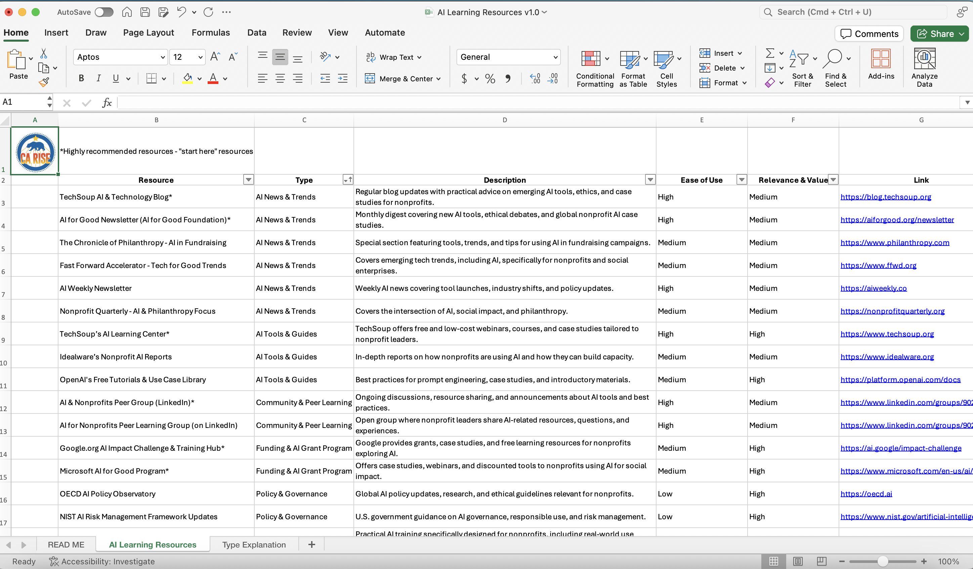
🎓 AI Learning Resources
Stay current, stay confident and keep learning as AI keeps evolving
What it is:
A list of free and beginner-friendly resources to help ESE staff upskill in AI sorted by resource type.
How to use it:
Use this to support professional development or peer-led learning . Great for staff or leadership at any stage of their AI journey, especially those new to the tools.
Notes:
Terri

Slide 15
Small Group Discussion
How is your ESE currently using or planning to use AI?
What are you excited (or nervous) about with AI?
What’s one new AI use case you are interested in trying?

Slide 16
A personal gem or takeaway from my small group was . . .

Slide 17
What’s Next?
Join upcoming AI Office Hours (to be scheduled)
Review the AI Toolkit Resources and give us feedback!
Continue to share AI learnings with the community (new use cases attempted, prompt engineering strategies, upskilling opportunities, etc.)
How can REDF and your peers best support you with AI? Tell us in the chat!
Notes:
Terri

Slide 18
THANK YOU!
Any Questions?

