Slide 1
Career Readiness Pathway
A Comprehensive Career Readiness Framework
Presenters:
Tanvi Shah, Chief Diversity, Equity, and Inclusion Officer, Illinois Power Agency
Ellen Johnson, Senior Director, Afton Partners
CA RISE Virtual Training Series - Career Readiness Pathway
June 3-5, 2025
Notes:
Tanvi

Slide 3
Lived Experience & Career Readiness
Career Readiness Pathway
June 4th, 2025

Slide 4
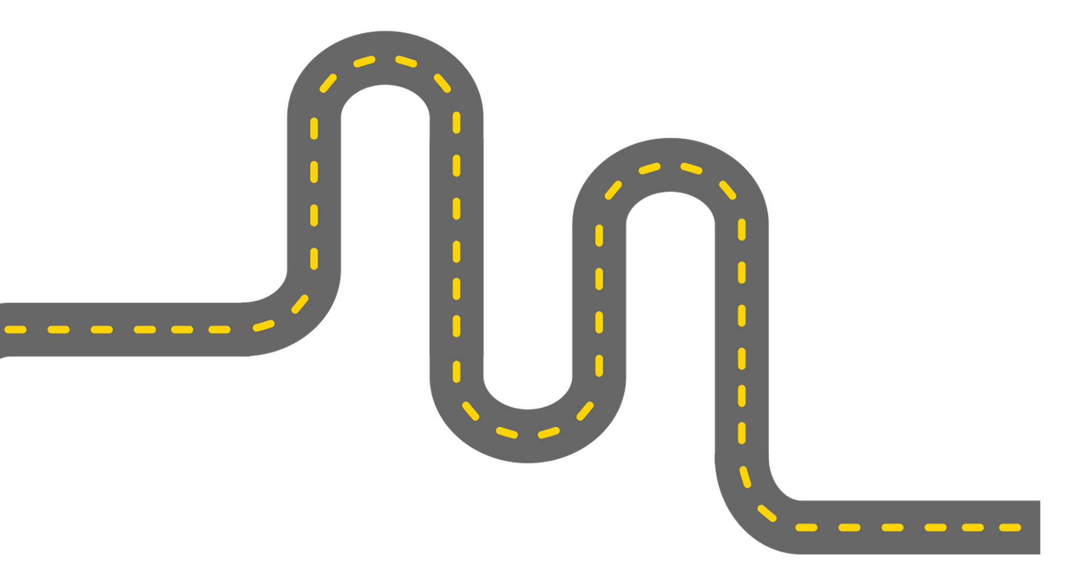
Agenda
Objectives
Welcome & Introductions
Career Readiness Framework Overview
‘Professionalism’ Discussion
Social Identity Wheel Activity
Facilitation Strategies to Create Safe Spaces
Final Reflection & Wrap-up
Elevate and address equity and social justice topics with participants
Establish the enabling conditions of safety and trust to be built among participants.
Value the voices and experiences of all participants
Show up responsibly as your authentic self
Increase your own comfort and ability to lead difficult conversations

Slide 5
Why the focus on
Career Readiness?
Job readiness instruction is required
and funded by nearly every public and private funder of workforce services
Job readiness programs vary drastically from organization to organization, though most adopt a one-size-fits-all approach and require job seekers to complete training before placement
Job seekers report both inconsistent experiences and outcomes
Program hopping occurs due to dissatisfaction and frustration
Increased research on executive functioning, coaching, nudging, behavioral economics, and trauma-informed-care
Notes:
What are the essential skills people need to succeed and thrive in life?
What workplace navigation skills are valued by employers in today’s labor market?
How can the workforce development field support that skill development?

Slide 6
What We Learned
Executive Function Skills are Essential
Effective job readiness programs must focus on building and strengthening executive functioning skills
A Goal Attainment Process that is Client-Led is Most Impactful
Allowing job seekers to set and pursue their own goals improves long-term outcomes
A Coaching Approach Leads to Lasting Change
A coaching approach is the most effective way to actively build executive functioning skills and affect goal attainment
Notes:
Tanvi
In many ways, the how of job readiness training is more important than the what

Slide 7
Name, Role, Organization
What is the first job you ever had?

Slide 8
White Supremacy Culture, the Labor Market, and Workforce Development
History of labor in America is rooted in racism
Workforce development operates within these racist labor market realities
Traditional job readiness training is predicated on the idea that job seekers are to blame for their unemployment
Thinking of job seekers as empty vessels that need to be made “employable”
Blaming job seekers for the systemic barriers that act as roadblocks
Pervasive deficit-based mindset, narrative, and language we use
These narratives are rooted in white supremacy culture
White Supremacy Culture:
The idea that white people and the ideas, thoughts, beliefs, and actions of white people are superior to People of Color and their ideas, thoughts, beliefs, and actions.
Notes:
Ellen
We name and attribute disparities and inequities in the labor market to white supremacy culture
We recognize we are all swimming in the waters of white supremacy culture and push job seekers towards empowerment
We move away from individualistic narratives of failure to understand the job search process in a more nuanced way
The history of labor in America is rooted in racism. Overtly exploitative practices and policies like slavery, sharecropping, and indentured servitude have given way to more insidious ones like occupational segregation, tipped minimum wage, and criminal history bans for certain industries and roles. Throughout history, while workers have pushed back and fought for more equality in their work, their victories have continued to be undermined by systemic inequities, individual and institutional discrimination, structural racism, implicit bias, and stereotyping in the workplace. Workers of color continue to be disproportionately impacted, pushed into low-wage work that reinforces the cycle of poverty. And it is within these racist labor market realities that the field of workforce development also operates.

Slide 9
Equity Issues in the Job Search Process
Social Identities
Code Switching
Professionalism
Social Capital
Giving job seekers an outlet to discuss how their social identities have influenced and impacted their job search process and the emotional toll it can take to navigate between different identities.
Helping participants reflect on when, where, and why they code-switch, acknowledge and name the practice, interrogate the impact it’s had on their life, and share examples and stories of times they’ve code-switched.
Encouraging job seekers to name and unpack professionalism ”standards”, critique and evaluate the pros and cons of adhering to the standards, and make more informed choices about how they want to show up in the job search process and workplace.
Acknowledging the diverse and valuable networks job seekers have access to, including family, friends, community organizations, and faith groups and providing ways for them to expand their professional networks.
Social capital
Social capital refers to the networks and relationships individuals have within their social circles.professional networks often prioritize connections over qualifications, perpetuating systemic inequalities and maintaining the status quo. Therefore it is critical to help job seekers understand and leverage their social capital by acknowledging the diverse and valuable networks they have access to, including family, friends, community organizations, and faith groups. Additionally, encouraging job seekers to build relationships with people who have diverse backgrounds and experiences, can broaden a job seeker's network and increase their access to opportunities.
As an instructor, if you don’t feel comfortable, we have lots of resources for how to prepare yourself
Notes:
Ellen

Slide 10
“The Bias of Professionalism Standards”
By Aysa Gray
June 4, 2019 | Stanford Social Innovation Review
Notes:
Tanvi

Slide 11
Professionalism & White Supremacy Culture
The standards of professionalism are heavily defined by white supremacy culture.
Influence of white supremacy culture on organizations:
The belief that traditional standards and values are objective and unbiased;
The emphasis on a sense of urgency and quantity over quality;
Perfectionism that leaves little room for mistakes; and
Binary thinking
Notes:
In the workplace, white supremacy culture explicitly and implicitly privileges whiteness and discriminates against non-Western and non-white professionalism standards related to dress code, speech, work style, and timeliness.

Slide 12
How does White ‘Professionalism’ Influence Hiring and Retention?
Category | Example(s)
Implicit Bias | People with non-white sounding names getting fewer responses to their job applications Over-monitoring workers of color based on perceptions of incompetence Preferring white and Western standards of dress and hairstyle (e.g., straightened hair, suits but not saris, etc.)
Media | Reinforces stereotypes about who is deserving and equipped for leadership roles by featuring white, Western men as company leaders
“Coded” Requirements | Requiring high levels of education unnecessary to actual job requirements Screening applicants for “cultural fit” Dismissing applicants based on resumes that don’t “look polished”
Language | Showing emotion is frowned upon Privileging workers who use “insider” vocabulary and syntax or who speak without an accent Influences who is promoted into leadership roles
Timeliness | Centers productivity over people Equates a lack of timeliness with laziness
Notes:
This is not an exhaustive list

Slide 13
Reflection Questions
Instructions
Professionalism:
Think, Share, Discuss
What is your personal relationship with the standards of professionalism discussed in this article?
How have you seen these standards of professionalism play out in your workplace? How have you contributed?
What are some ways you have seen others challenge professionalism standards at an organizational or individual level?
Reflect individually (3-5 mins)
In groups of 3, share your reflections (10 mins)
Large group debrief (10 mins)

Slide 14
Social Identity Wheel
Notes:
Tanvi

Slide 15
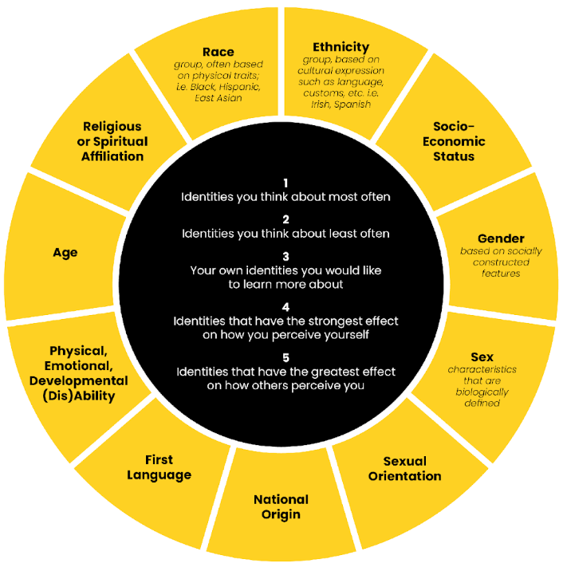
Social Identity Wheel
Adapted for use by the Program on Intergroup Relations and the Spectrum Center, University of Michigan.

Slide 16
Facilitation Strategies
Creating Safe, Accountable, and Brave Spaces
Notes:
Tanvi

Slide 17
Conversation Comfort Level Self-Reflection
Do you feel ill-prepared to talk about inequities, race, and/or racism? What additional learning will help you facilitate equity-focused conversations (e.g., literature, podcasts, films, workshops, events, conferences, training, community of practice)?
Do you divert conversation when you sense discomfort about inequities, race, and/or racism? What facilitation skills and methods can support you and the group to stay with discomfort?
Do you feel isolated in facilitating on topics of inequities, race, and/or racism? Who can you co-plan, co-facilitate, or debrief with?
Do you feel concerned about your ability to answer participant questions about inequities, race, and/or racism? How can you respond to support shared and collective learning (e.g., accepting we do not have all the answers and embracing an opportunity to learn and evolve together)?
Pulled from: Facilitating Effective Community System Development Meetings: A Handbook for Collaboration Leaders

Slide 18
Self-Care Strategies
Trust your own inner readiness, willingness, and ability when it comes to facilitating equity-focused conversations. Meet yourself where you are and consider what added reflection, learning, or skill-building might be needed.
Clarify your own experiences, motivations, and commitments before the conversation.
Show up as your authentic self and be willing to reflect your own humanity and truth if it feels helpful to you and the group.
Check-in with yourself on what thoughts, feelings, and body sensations are coming up before, during, and after the conversation.
Consider your own needs and what you need to facilitate difficult conversations (e.g., space for inner work, historical learning, additional skills, and/or practice facilitating and being with discomfort)
Invite a co-planner and co-facilitator for the conversation
Practice with peers or others to be able to stay present with discomfort as it surfaces.
Create space to reflect on the conversation and consider what worked well, how to improve, and how to support the group forward
Give grace and self-compassion to yourself on your inner journey and facilitation journey.
Pulled from: Facilitating Effective Community System Development Meetings: A Handbook for Collaboration Leaders

Slide 19
Taking Care of Others
Provide preparation for the conversation, when it feels appropriate
Agree on shared goals and agreements for the conversation.
Meet people where they are on their equity journeys.
Space out or pace the conversation to support participants and their diverse perspectives, emotions, and awareness.
Take breaks during the conversation to give people time to slow down and take care of their own needs.
Check-in with each other if emotions come up or if the conversation gets heated.
Consider the benefit of a co-facilitator or third-party facilitator.
Create a sense of closing by doing a check-out.
Follow up with participants and ask how they are doing, what they need to feel supported, what their experience was like, and for any feedback.
Offer compassion and empathy to individuals and the group for sharing their experiences and perspectives.
Provide additional tools and resources to support individuals and the collective in reflecting, learning, and healing.
Pulled from: Facilitating Effective Community System Development Meetings: A Handbook for Collaboration Leaders

Slide 20
Final Reflection
Something that surprised you
Something that you learned or (re)learned
Something that you hope to take with you

Slide 22
Contact Information
Ellen Johnson
Senior Director
Afton Partners
ejohnson@aftonpartners.com
Tanvi Shah
Chief Diversity, Equity & Inclusion Officer
Illinois Power Agency
tanvi.shah@illinois.gov

Slide 23
Career Readiness Pathway
A Comprehensive Career Readiness Framework
Presenters:
Tanvi Shah, Chief Diversity, Equity, and Inclusion Officer, Illinois Power Agency
Ellen Johnson, Senior Director, Afton Partners
CA RISE Virtual Training Series - Career Readiness Pathway
June 3-5, 2025
Notes:
Tanvi

Slide 24
Career Readiness Framework Deep Dive
Career Readiness Pathway
June 4th, 2025

Slide 25
Agenda
Objectives
Welcome & Introductions
Curriculum Overview & Walkthrough
Code Switching Activity
Coaching Practice
Workplace Navigation Skills Checklist
Final Reflection & Wrap-up
Elevate and address equity and social justice topics with participants
Establish the enabling conditions of safety and trust to be built among participants.
Value the voices and experiences of all participants
Show up responsibly as your authentic self
Increase your own comfort and ability to lead difficult conversations

Slide 26
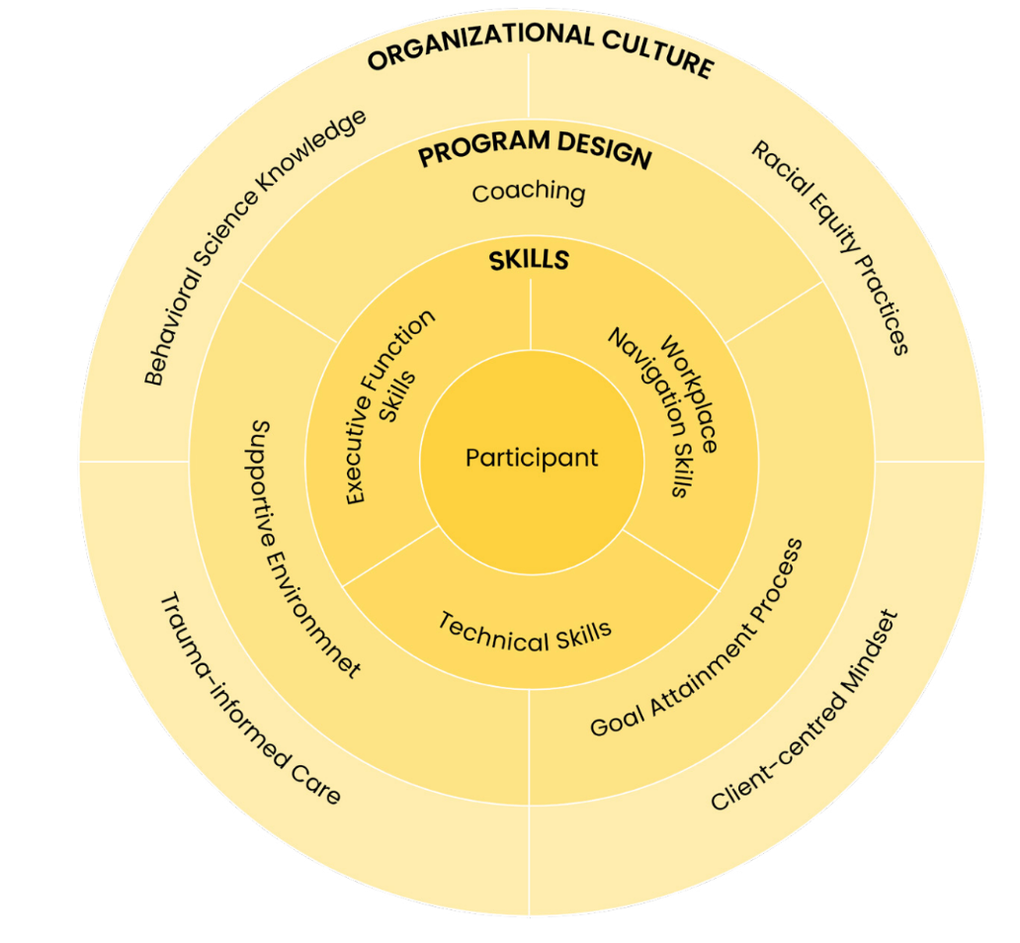
Career Readiness Framework
Theory of Change
Notes:
Tanvi
The graphic outlines our theory of change.
First, we center the job seeker. What all job seekers need in order to advance their careers is an understanding and mastery of their executive functioning, workplace navigation, and technical skills. These are the skills typically taught, to varying degrees, in job readiness programming across the workforce development system.
The next layer, how these skills are developed, is where our intervention diverges from “business as usual.” Through coaching, the goal attainment process, and the establishment of a supportive environment, the assets job seekers already have can be strengthened, and new capabilities can emerge. Intentional program design that incorporates all of these elements takes a significant investment of time and resources. It requires more individualization, a move away from “one size fits all.”
However, none of the programmatic shifts an organization might make will be successful unless the following have been woven into the fabric of the organizational culture:
Knowledge and adoption of behavioral science research
Racial equity practices
Trauma-informed approach
Client-centered mindset
Depending on the organization, this cultural shift might be a massive undertaking or a smaller endeavor. Regardless, it depends on the willingness of executive leadership to push their organizations and staff towards this new way of thinking and doing business. This is not easy. In some cases, staff will be required to change their hearts, minds, and behavior. However, without all of these elements in place, the workforce field is in danger of doing the same old things and hoping for a different result.

Slide 27
Curriculum Goals and Objectives
The curriculum will build confidence and empower job seekers to:
Recognize and speak to their executive function, workplace navigation, and technical skills
Advocate for themselves, particularly in situations where they have traditionally felt powerless
Make career decisions/choices that allow them to show up as their authentic selves
Value one’s full range of skills brings to the labor market, particularly the skills that are not recognized in a labor market rooted in white supremacy
Identify and center their own career goals and overcome obstacles to achieving those goals
Recognize they have assets and networks that can be used in pursuit of their career goals
Navigate the job search process
Notes:
Ellen

Slide 28
Curriculum Overview
Beginning the process of searching and applying for jobs.
Learning to craft resumes, cover letters, personal pitches and networking.
Discovering personal interests, skills, and values.
Understanding the perceptions, assumptions and identities involved in the job search.
Get the Job
Core Lessons
All About You
Get Ready
The Search
Mastering the art of the interview to land the job.
1
2
3
4
5
Facilitator Note: The core lessons form the essence of this curriculum, providing the necessary groundwork to orient job seekers to the unique aspects of the curriculum. This includes integrating executive function and workplace navigation skills, the goal attainment process, and discussions on equity throughout the curriculum.
Notes:
Ellen

Slide 29
Unique Curriculum Features
01
Each lesson highlights the executive function and workplace navigation skills that will be practiced
02
It can be used in its entirety as a stand-alone curriculum or lessons can be used a la carte
03
It is designed for both group classroom delivery and/or individual coaching sessions
04
It is open source and built on existing curricula
Notes:
Ellen

Slide 30
Curriculum Example | Core Lesson
Notes:
Tanvi

Slide 31
Curriculum
Example
Topic Title Page
Notes:
Ellen

Slide 32
Curriculum
Example
Topic Table of Contents
Notes:
Ellen

Slide 33
Curriculum
Example
Topic Intro
Notes:
Tanvi

Slide 34
Curriculum
Example
Facilitation & Coaching Tips
Notes:
Tanvi

Slide 35
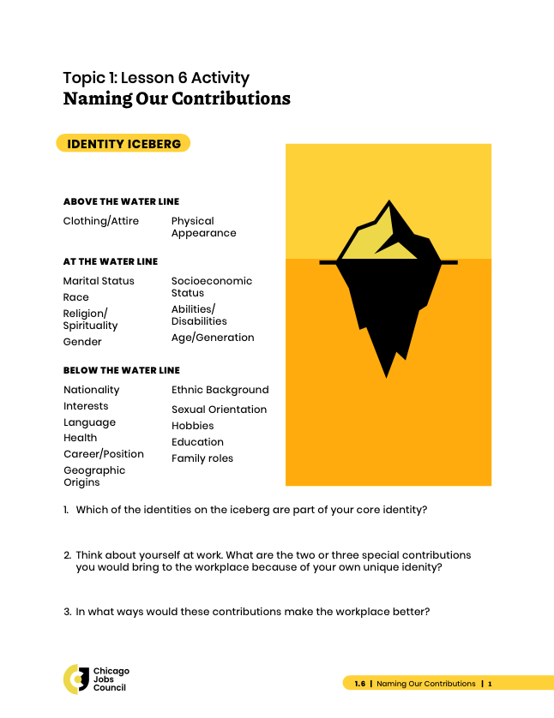
Curriculum
Example
Handout
Notes:
Tanvi

Slide 36
Curriculum
Example
Topic Table of Contents
Notes:
Ellen

Slide 37
Curriculum
Example
Topic Table of Contents
Notes:
Ellen

Slide 38
Curriculum
Example
Topic Table of Contents
Notes:
Ellen

Slide 39
Curriculum
Example
Topic Table of Contents
Notes:
Ellen

Slide 40
Code Switching | Discussion Activity
Notes:
Tanvi

Slide 41
The Code Switch
Source: Inclusologists - Racism: The Code Switch
Notes:
Tanvi
The graphic outlines our theory of change.
First, we center the job seeker. What all job seekers need in order to advance their careers is an understanding and mastery of their executive functioning, workplace navigation, and technical skills. These are the skills typically taught, to varying degrees, in job readiness programming across the workforce development system.
The next layer, how these skills are developed, is where our intervention diverges from “business as usual.” Through coaching, the goal attainment process, and the establishment of a supportive environment, the assets job seekers already have can be strengthened, and new capabilities can emerge. Intentional program design that incorporates all of these elements takes a significant investment of time and resources. It requires more individualization, a move away from “one size fits all.”
However, none of the programmatic shifts an organization might make will be successful unless the following have been woven into the fabric of the organizational culture:
Knowledge and adoption of behavioral science research
Racial equity practices
Trauma-informed approach
Client-centered mindset
Depending on the organization, this cultural shift might be a massive undertaking or a smaller endeavor. Regardless, it depends on the willingness of executive leadership to push their organizations and staff towards this new way of thinking and doing business. This is not easy. In some cases, staff will be required to change their hearts, minds, and behavior. However, without all of these elements in place, the workforce field is in danger of doing the same old things and hoping for a different result.

Slide 42
Code Switching | Coaching Practice
Notes:
Tanvi

Slide 43
Coaching Practice
Coaching Scenario:
A participant comes to you and shares that they don’t think they can be hired due to something about their personal identity after a first interview.
How do you coach them through a second interview or next steps?
Notes:
Tanvi
The graphic outlines our theory of change.
First, we center the job seeker. What all job seekers need in order to advance their careers is an understanding and mastery of their executive functioning, workplace navigation, and technical skills. These are the skills typically taught, to varying degrees, in job readiness programming across the workforce development system.
The next layer, how these skills are developed, is where our intervention diverges from “business as usual.” Through coaching, the goal attainment process, and the establishment of a supportive environment, the assets job seekers already have can be strengthened, and new capabilities can emerge. Intentional program design that incorporates all of these elements takes a significant investment of time and resources. It requires more individualization, a move away from “one size fits all.”
However, none of the programmatic shifts an organization might make will be successful unless the following have been woven into the fabric of the organizational culture:
Knowledge and adoption of behavioral science research
Racial equity practices
Trauma-informed approach
Client-centered mindset
Depending on the organization, this cultural shift might be a massive undertaking or a smaller endeavor. Regardless, it depends on the willingness of executive leadership to push their organizations and staff towards this new way of thinking and doing business. This is not easy. In some cases, staff will be required to change their hearts, minds, and behavior. However, without all of these elements in place, the workforce field is in danger of doing the same old things and hoping for a different result.

Slide 44
Coaching Practice
Instructions:
Divided into pairs for coaching practice in breakout rooms.
Round 1 (5 min): One partner is the coach, the other is the participant.
1 min - Prep
Coach - Review coaching questions and your approach.
Participant - Reflect on the scenario and personal experience.
4 min - Coaching
Round 2 (5 min): Switch roles & repeat.
1 min - Prep
4 min - Coaching
Notes:
Tanvi
The graphic outlines our theory of change.
First, we center the job seeker. What all job seekers need in order to advance their careers is an understanding and mastery of their executive functioning, workplace navigation, and technical skills. These are the skills typically taught, to varying degrees, in job readiness programming across the workforce development system.
The next layer, how these skills are developed, is where our intervention diverges from “business as usual.” Through coaching, the goal attainment process, and the establishment of a supportive environment, the assets job seekers already have can be strengthened, and new capabilities can emerge. Intentional program design that incorporates all of these elements takes a significant investment of time and resources. It requires more individualization, a move away from “one size fits all.”
However, none of the programmatic shifts an organization might make will be successful unless the following have been woven into the fabric of the organizational culture:
Knowledge and adoption of behavioral science research
Racial equity practices
Trauma-informed approach
Client-centered mindset
Depending on the organization, this cultural shift might be a massive undertaking or a smaller endeavor. Regardless, it depends on the willingness of executive leadership to push their organizations and staff towards this new way of thinking and doing business. This is not easy. In some cases, staff will be required to change their hearts, minds, and behavior. However, without all of these elements in place, the workforce field is in danger of doing the same old things and hoping for a different result.

Slide 45
Workplace Navigation Skills
Notes:
Tanvi

Slide 46
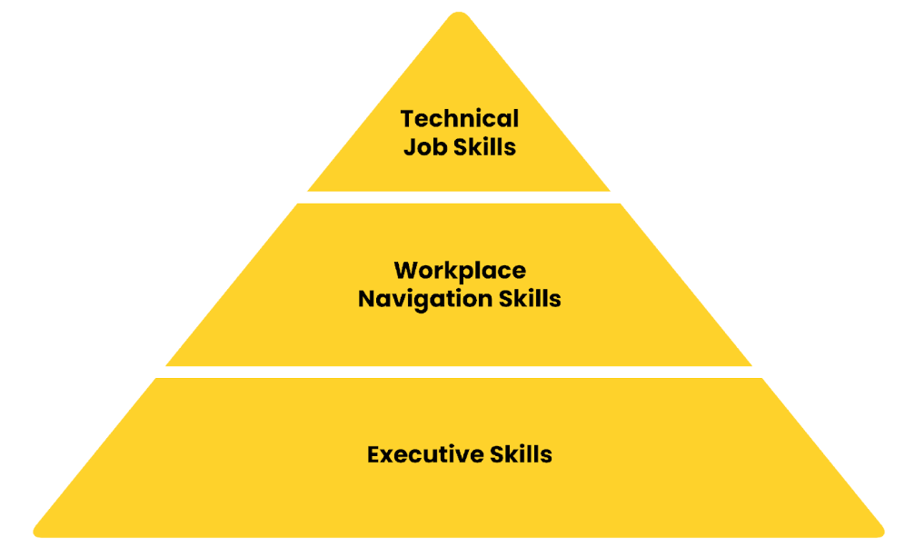
Workplace Navigation Skills
Notes:
Tanvi
The graphic outlines our theory of change.
First, we center the job seeker. What all job seekers need in order to advance their careers is an understanding and mastery of their executive functioning, workplace navigation, and technical skills. These are the skills typically taught, to varying degrees, in job readiness programming across the workforce development system.
The next layer, how these skills are developed, is where our intervention diverges from “business as usual.” Through coaching, the goal attainment process, and the establishment of a supportive environment, the assets job seekers already have can be strengthened, and new capabilities can emerge. Intentional program design that incorporates all of these elements takes a significant investment of time and resources. It requires more individualization, a move away from “one size fits all.”
However, none of the programmatic shifts an organization might make will be successful unless the following have been woven into the fabric of the organizational culture:
Knowledge and adoption of behavioral science research
Racial equity practices
Trauma-informed approach
Client-centered mindset
Depending on the organization, this cultural shift might be a massive undertaking or a smaller endeavor. Regardless, it depends on the willingness of executive leadership to push their organizations and staff towards this new way of thinking and doing business. This is not easy. In some cases, staff will be required to change their hearts, minds, and behavior. However, without all of these elements in place, the workforce field is in danger of doing the same old things and hoping for a different result.

Slide 47
Workplace Navigation Skills
Personal Mindset: Focuses on self-motivation, resilience, adaptability, and maintaining focus despite challenges. Encourages proactive problem-solving and managing stress. Aliases: Adaptable, Resilient, Strong Work Ethic.
Social Awareness: Involves recognizing and respecting others' perspectives and navigating diverse social and cultural norms. Includes self-advocacy, understanding roles, and ensuring personal safety in the workplace. Aliases: Empathetic, Culturally Competent, Socially Aware.
Planning for Success: Emphasizes goal-setting, time management, organization, and strategic thinking. Encourages reflection, progress monitoring, and realistic self-assessment. Aliases: Organized, Self-Aware, Planful.
Communication: Covers clear, organized, and adaptable messaging in verbal, written, or non-verbal forms. Includes listening, feedback-seeking, and asking clarifying questions. Aliases: Articulate, Active Listener, Persuasive.
Collaboration: Focuses on teamwork, shared task completion, conflict resolution, and constructive feedback. Highlights contributing to group goals and valuing others' ideas and contributions. Aliases: Team Player, Reliable, Cooperative.
Problem Solving: Involves defining problems, gathering information, generating and evaluating solutions, and making decisions. Encourages creative and critical thinking to resolve workplace challenges. Aliases: Analytical, Critical Thinker, Innovative.
Notes:
Tanvi
The graphic outlines our theory of change.
First, we center the job seeker. What all job seekers need in order to advance their careers is an understanding and mastery of their executive functioning, workplace navigation, and technical skills. These are the skills typically taught, to varying degrees, in job readiness programming across the workforce development system.
The next layer, how these skills are developed, is where our intervention diverges from “business as usual.” Through coaching, the goal attainment process, and the establishment of a supportive environment, the assets job seekers already have can be strengthened, and new capabilities can emerge. Intentional program design that incorporates all of these elements takes a significant investment of time and resources. It requires more individualization, a move away from “one size fits all.”
However, none of the programmatic shifts an organization might make will be successful unless the following have been woven into the fabric of the organizational culture:
Knowledge and adoption of behavioral science research
Racial equity practices
Trauma-informed approach
Client-centered mindset
Depending on the organization, this cultural shift might be a massive undertaking or a smaller endeavor. Regardless, it depends on the willingness of executive leadership to push their organizations and staff towards this new way of thinking and doing business. This is not easy. In some cases, staff will be required to change their hearts, minds, and behavior. However, without all of these elements in place, the workforce field is in danger of doing the same old things and hoping for a different result.

Slide 48
Final Reflection
Something that surprised you
Something that you learned or (re)learned
Something that you hope to take with you

Slide 49
Career Readiness Framework
Download the Career Readiness Framework curriculum at
https://www.cjc.net/resources-library.
Notes:
Ellen

Slide 51
Contact Information
Ellen Johnson
Senior Director
Afton Partners
ejohnson@aftonpartners.com
Tanvi Shah
Chief Diversity, Equity & Inclusion Officer
Illinois Power Agency
tanvi.shah@illinois.gov

