Slide 1
Lightcast for CA RISE ESEs

Slide 2
What is Lightcast?
A global leader in labor market analytics
Focused on collecting and analyzing Big Data to provide the most detailed information about industries, occupations, skills in demand, and career pathways
Compiles data from many data sources including Bureau of Labor Statistics, Census, 1 Billion job postings, and employee LinkedIn profiles
Allows users to generate reports and analyze labor market trends
See Lightcast website
See the following slides for examples of how you might be able to utilize Lightcast for your ESE.
If you’d like to learn more about Lightcast and/or start to build labor market data reports, reach out to Walter Chacon at wchacon@redf.org!

Slide 3
CA RISE ESEs can utilize Lightcast in two ways
Resource | Description | Deliverables
Labor Market Data | Provide reports to each ESE on geographies, industries, occupations, and/or companies Reports would support decision-making on business growth and/or program improvements | Customized report(s) with key labor market data for a geography, industry, occupation, and/or company
Career Pathways Tables | Provides a prioritized list of occupations participant workers have skills/experience to enter after successful program completion Data would enable decision-making on program improvements | For a given occupation, a list of feeder, lateral, and next-step jobs with data about number of job postings and potential wage increases

Slide 4
Labor Market Data

Slide 5
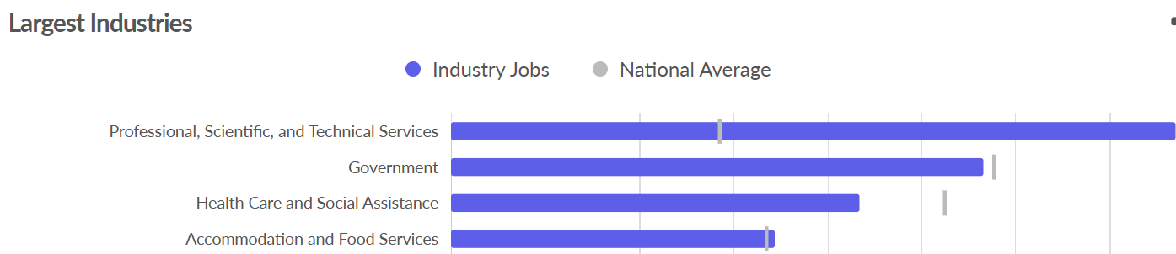
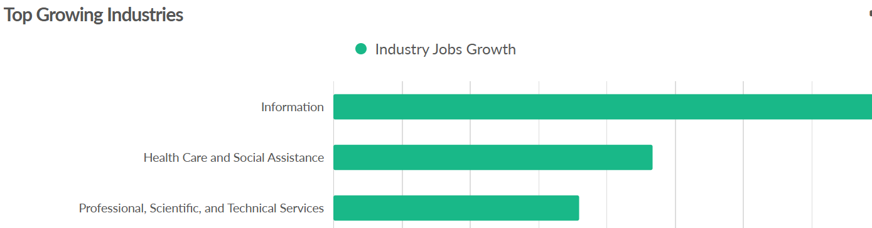
Use Case 1: ESEs considering building, scaling, or expanding their businesses can use Economy Overviews
  What industries are largest, fastest growing, and/or disproportionately represented?
  Regional Comparison Reports can compare demographics, industries, and occupations in different
  places e.g. food service job growth in San Francisco vs Los Angeles

Slide 6
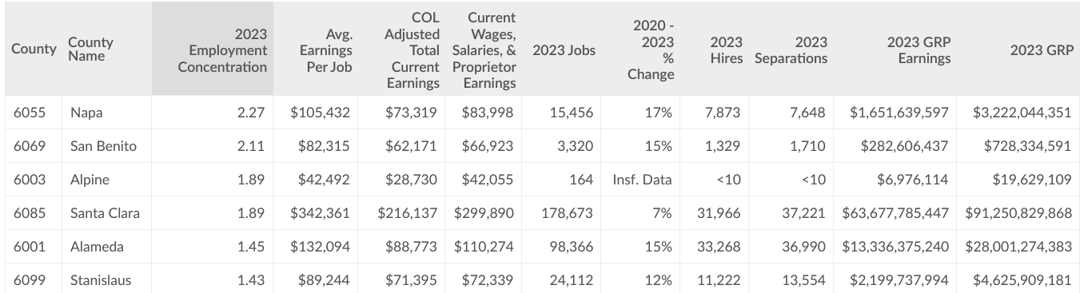
Use Case 1: ESEs considering building, scaling, or expanding their businesses can use Industry Map Tables
  How does industry representation and economic activity vary across counties, cities, and zip codes?

Slide 7
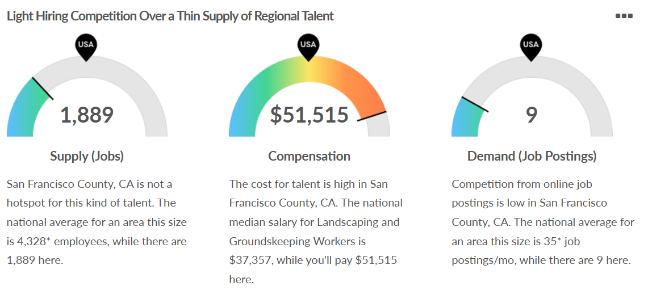
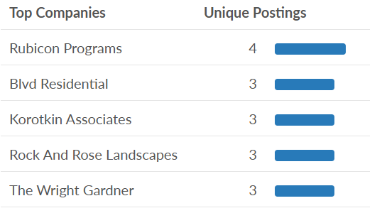
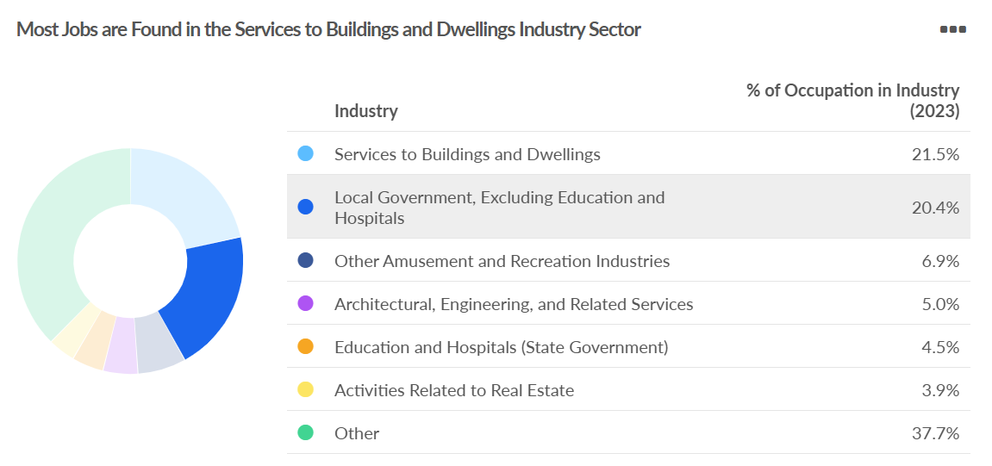
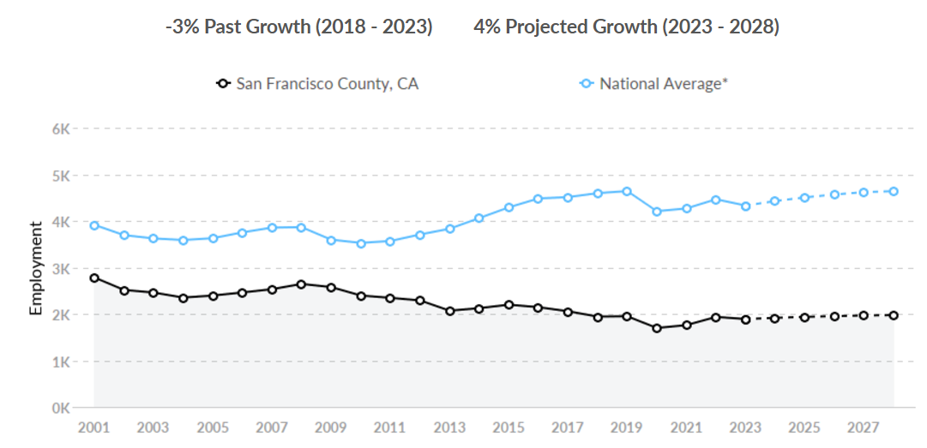
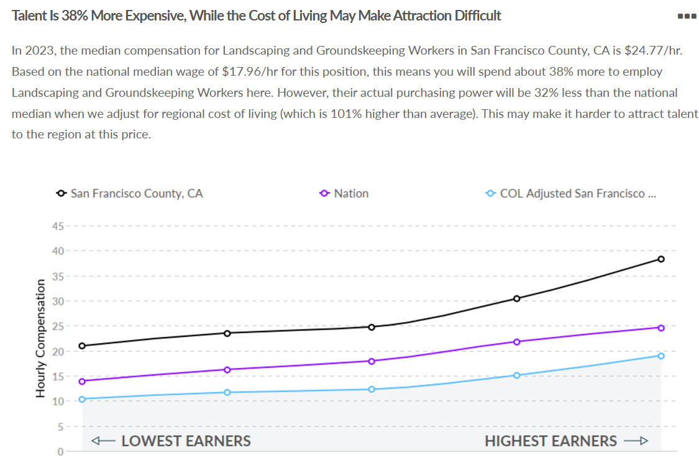
Use Case 1: ESEs considering building, scaling, or expanding their businesses can use Occupation Snapshots
  What is the supply and demand for this occupation?
  How much does labor cost for this occupation?
  What companies hire for this occupation?
  What industries hire for this occupation?
  Compare Occupations Reports can compare multiple occupations with key data like wages and growth

Slide 8
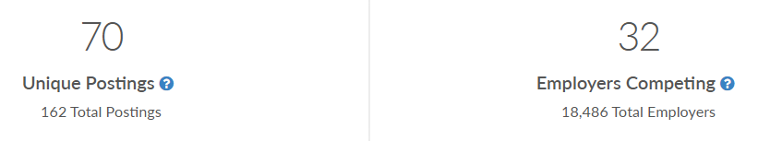
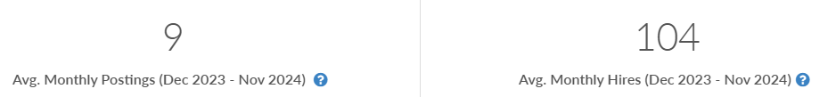
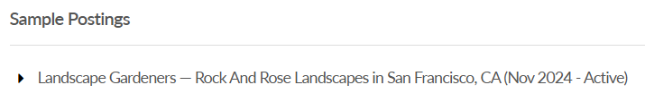
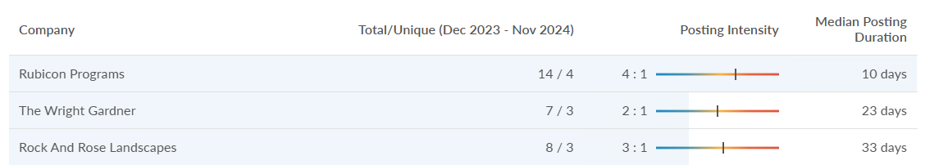
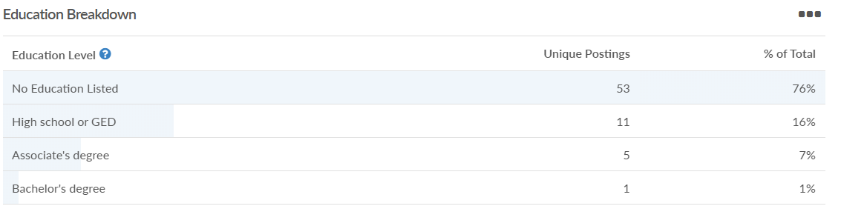
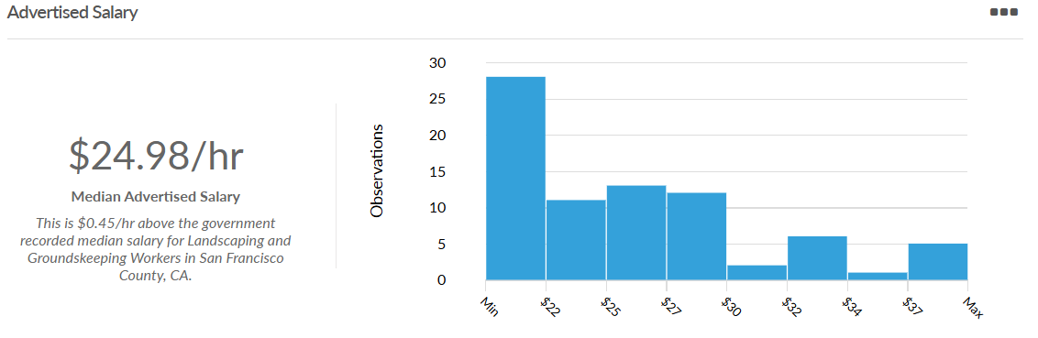
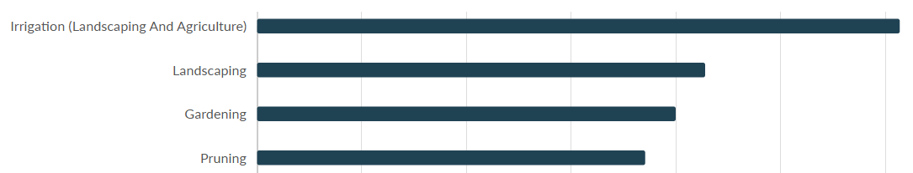
Use Case 2: ESEs considering designing or expanding their program can use Job Posting Analytics
  Which employers are hiring for this job?
  How many unique postings are there for this job?
  What is the pay range for these jobs?
  What skills and qualifications do sample job postings request?

Slide 9
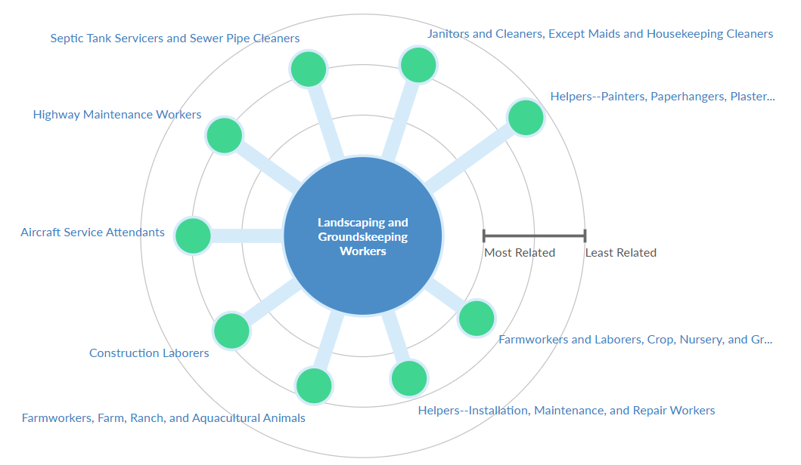
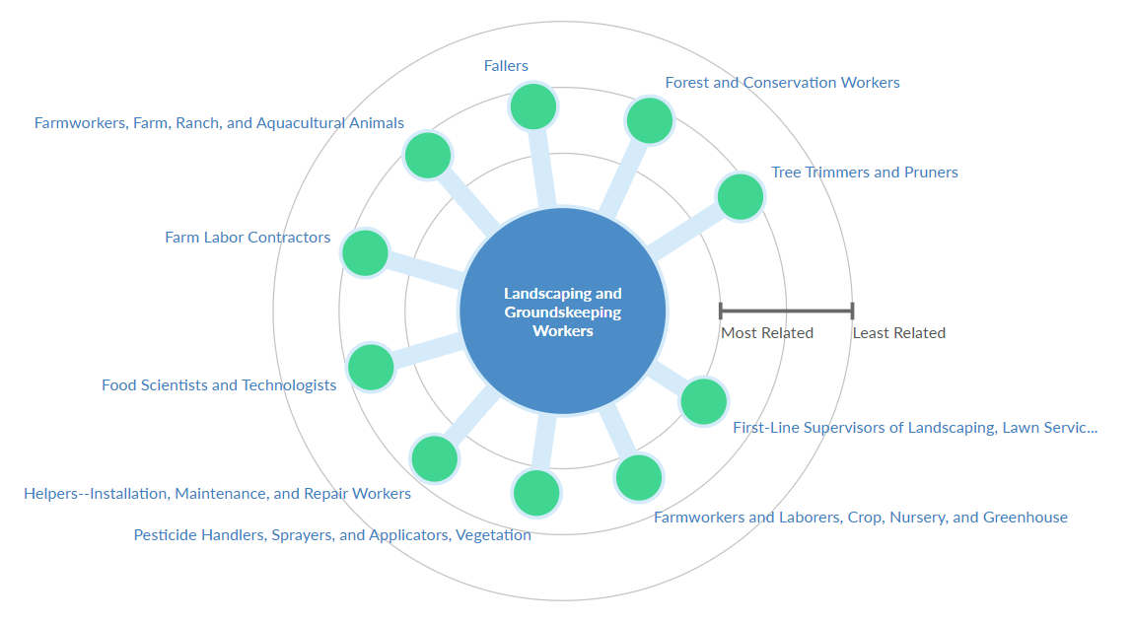
Use Case 2: ESEs considering designing or expanding their program can use Career Pathways
  What are the most common feeder jobs for this job?
  What are the most common next-step jobs for this job?

Slide 10
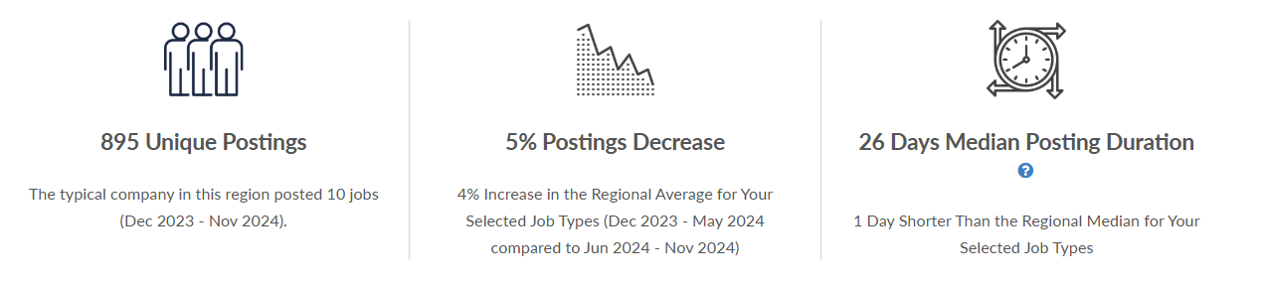
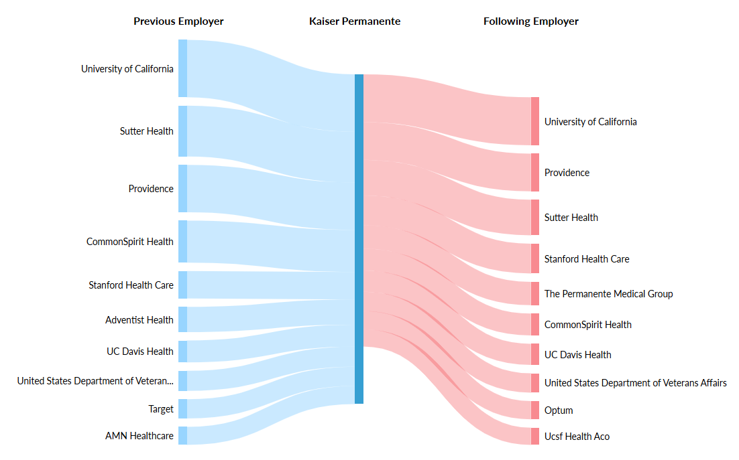
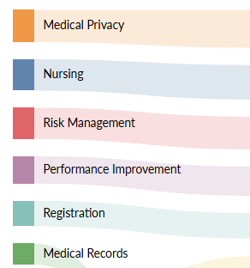
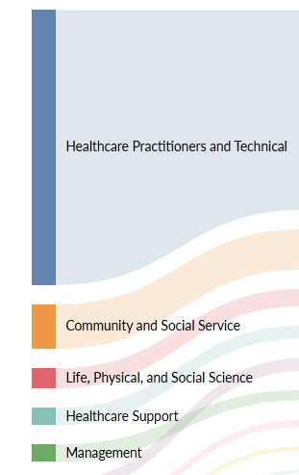
Use Case 2: ESEs considering designing or expanding their program can use Company Talent Profiles
  How many job postings does this company advertise?
  What types of skills and functions is the company hiring for?
  Which organizations compete for the same talent?

Slide 11
Career Pathways Tables

Slide 12
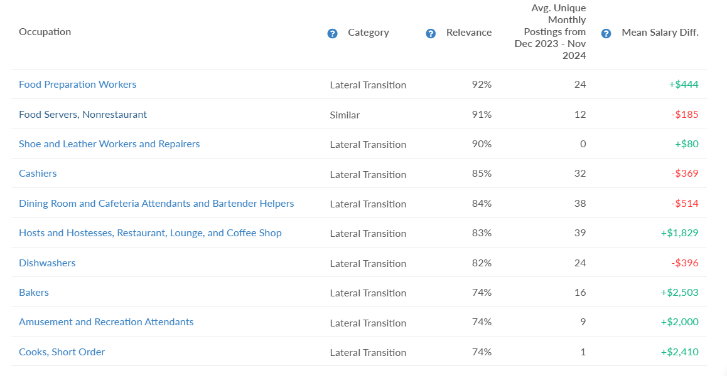
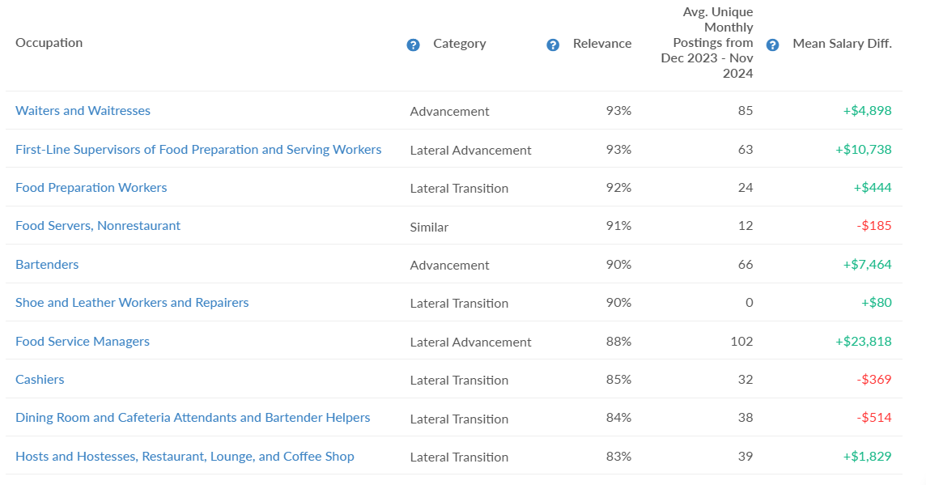
Lightcast can provide a prioritized list of lateral and upward opportunities for any given occupation CA RISE ESEs train
  What lateral opportunities exist for participant workers with Barista skills and which pay higher wages?
  What advancement opportunities exist for participant workers with Barista skills and which pay higher wages?

Slide 13
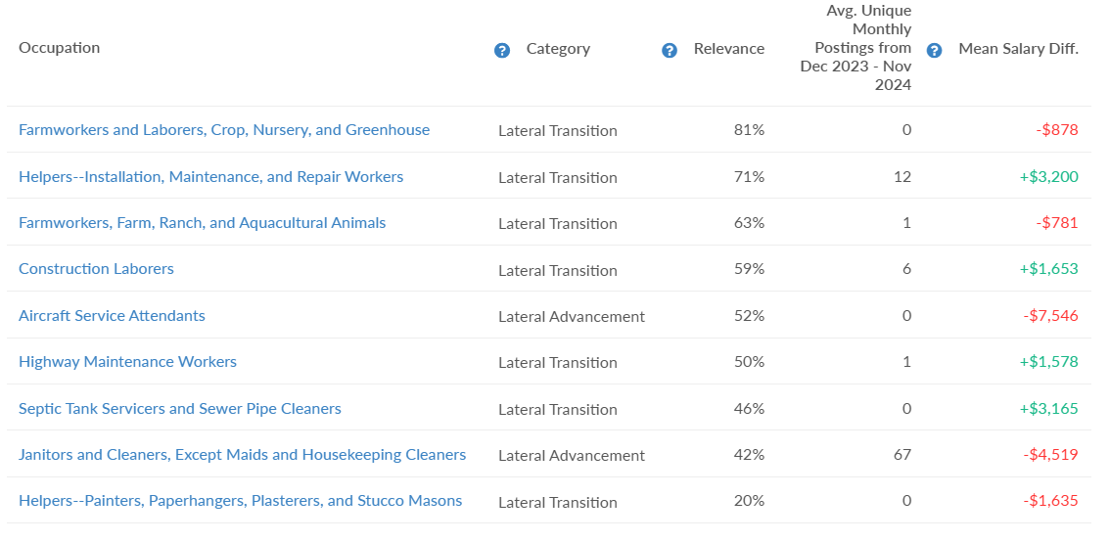
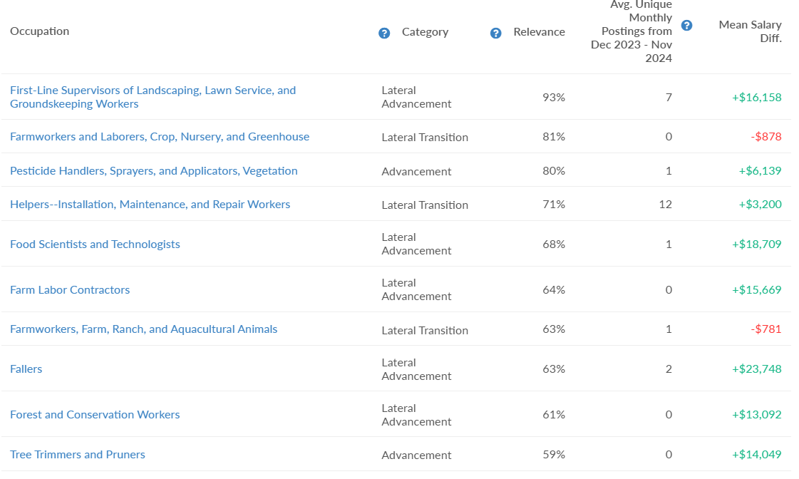
For the most common occupations within CA RISE ESEs, Lightcast can identify opportunities for lateral movement and upward advancement with potential for wage increases
  What lateral opportunities exist for participant workers with Landscaping/Groundskeeping skills and which pay higher wages?
  What advancement opportunities exist for participant workers with Landscaping/Groundskeeping skills and which pay higher wages?

Slide 14
CA RISE is here to support you in using labor market data
If you’d like to learn more about Lightcast and/or start to build labor market data reports, reach out to Walter Chacon at wchacon@redf.org!

