Slide 1
MISSION & VALUES FOR LEADERS
The Supervisor Success Series | New Supervisor Training & Onboarding | Module 1
NOTE:
This presentation should be heavily edited by the facilitator to ensure that the mission and values match the organization
Notes:
Last Updated by REDF on 9/30
- Theme: “What is our purpose? How will you build this into your leadership style and represent our organization?”
- Tailor this for your organization
- Use this presentation along with the facilitator guide for module one, the first out of six modules for new supervisor training

Slide 2


What is the Supervisor Success Series?
What is the supervisor success series? | This is a starting place for (you!) our ESE partners to map out onboarding and training for frontline supervisors from a trauma informed lens.
Why is this important? | The frontline supervisor role is critical to participant-employee success. The better equipped supervisors are to be good people leaders, the more your business and workforce will thrive. The better you are at promoting individuals with lived experience, the better off your ESE!
How does it work? | This is a living curriculum of 8+ custom (edit and update these presentations heavily to fit the needs of your supervisors at your organization) training modules to help you get started on training your new supervisors as soon as they are promoted to frontline supervisor.
Who is it for? | Any facilitator (but also ESE leader, HR staff, trainer) involved in teaching, training, and shaping the role of the frontline supervisor at your organization.
Goal? | Help make your organization/ESE supervisor training as simple and comprehensive (as your ESE participant-employee training) as possible so participant-employees can be promoted and thrive, and external hires can feel welcomed and supported!
Notes:
What is the Supervisor Success Series?

Slide 3
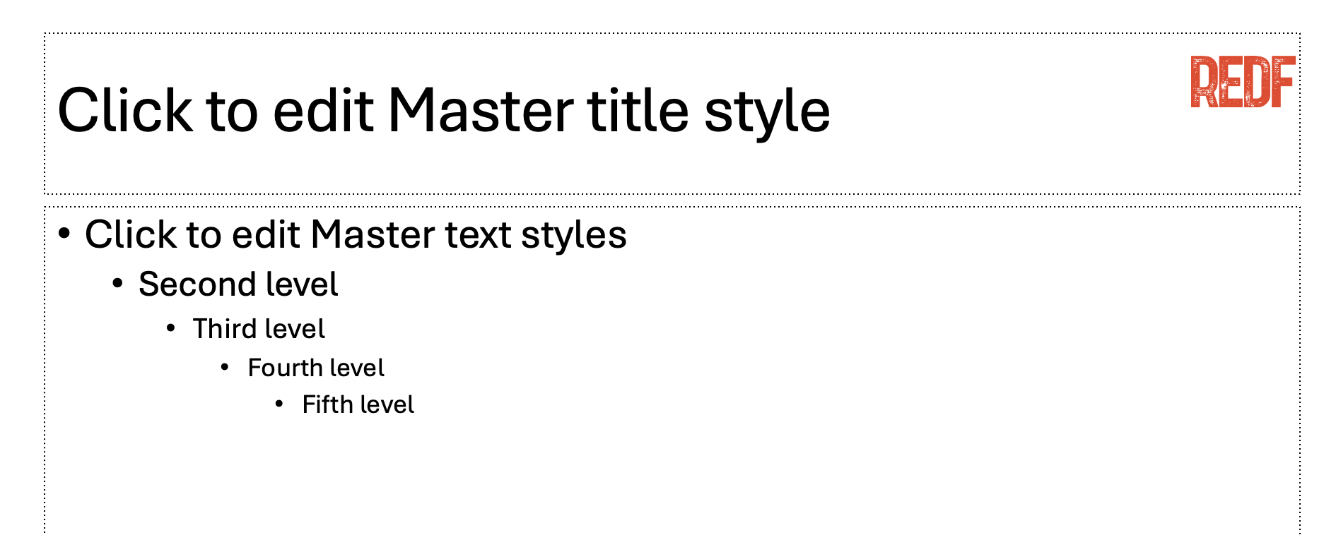

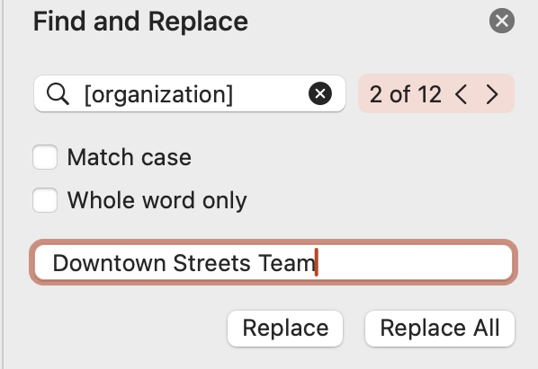
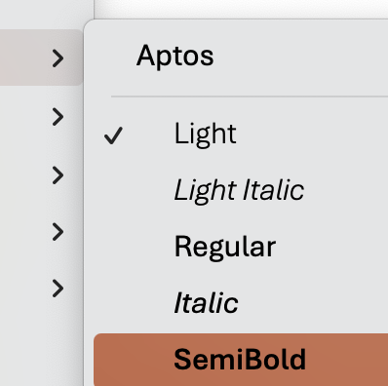
How to Use and Edit the Supervisor Success Series Modules
1. Update the content to your ESE’s branding, replace the REDF logo by searching in the top right for ‘Slide Master ‘→ delete the REDF logo from the Master title style slide, and replace it with your organization’s logo, click ‘close Master’ to save.
2. Update the colors throughout the presentation to match your organization’s color scheme by selecting the top red bar on each slide, Home tab → paint can → and selecting a fill color that works best for your branding.
Update the name of your organization by using the top right search bar again, selecting ‘Find and replace,’ type [organization] into the find bar and your ESE/ organization name into the replace bar, select ‘replace all.’ Anything content highlighted in gray
should be updated.
4. Editing Pro Tips… Use the font Aptos light to edit text on the slide and Aptos semibold to edit the titles. EDIT EVERY SLIDE to make sure it reflect your organization’s style and culture.
Need help? Reach out to a REDF staff member

Slide 4
Facilitator Best Practices Checklist
DAY ONE
Timing is everything! The roles and expectations training and conversation on the “first day” they become officially promoted to full-time supervisor is critical. Having clear context and understand on what their role is explicitly at the start = smooth transition.
In-Person
Training time should be spent engaging and learning together in-person at your main building. It should be a dynamic and engaging discussion that fully involves the trainer and the participants. There should be ample time for activities and reflection.
Intensive and Intentional
A 1 hr. intensive session at the start is better than 15-minute or even 2 hr. one-off trainings throughout their launch. Make it structured intentional. Take the time upfront for all-hands-on-deck training capitalizing on the new supervisor momentum!
Open Discussion + Reflection
Your leadership training should not be a lecture, it should be a seminar: a full-fledged open-ended discussion with active reflection, and goal setting. Ask good questions – understand how they will show up as leaders, share wisdom and stories.
45-Minutes Max Rule
Break up your content heavy modules into 45-minute segments max. Try not to do more than 3 modules in one day. Stick to the AM and give ample time for snacks, bio breaks, and a chance to get to know each other as humans!
Meetings as Refresher Trainings
Use the time you already have set aside during supervisor and leadership meetings to go through an example of something that happened in the field that can be used as a refresher or a case study. Did someone give feedback? De-escalate? Talk about it!
Dynamic and Engaging Teacher
Who is your most memorable teacher? Chances are they were engaging, dynamic, made you laugh and made it FUN. Make your training content stick – train well-respected mentors with loads of personality, wisdom, and energy to lead sup. courses.
Cohort Model
Whenever possible, try to promote more than one supervisor at the same time on the same day. The ideal “class” size is 3-8 to encourage a community of leaders that can go through the supervisor program together. If this is not possible pair up with another ESE!
Notes:
Facilitator Best Practices Checklist

Slide 5

Supervisor Success Series: Why is Training Important?
Short Intensive Programs = Large Improvements *Especially for ESEs
TRAINING RETENTION
Want a 1.4% Turnover Rate?
Try 120+ hours of training!
Up to 400% Return
$4 back for every $1 spent training
29% ROI 3-months post leadership training
400% one-year post training
Based on a leadership training delivered to 2,000 first time managers at Verizon to help transition from individual contributors to people leaders.
Pal’s, a fast-food restaurant, boasts 3x lower than industry standard turnover due to 120+ hours of rigorous training and prioritizing emotional intelligence.
What Makes Leadership Development Programs Succeed? (HBR 2023)
“Shorter programs often yielded surprisingly large improvements. In some cases, we found that a two- or four-day intensive had the same or greater impact than a 4-wk, and even led to increases in wellbeing on par with therapeutic mental health interventions.”
*“Leaders with chronic stress experienced even greater reductions in stress, suggesting employers should prioritize leadership dev. when personal challenges are particularly high, as these initiatives can bolster their psychological resources.”
Leaders are required to spend 10% of their time every week teaching an employee a topic they need to learn and have a required leader reading list.
$2k lost in 3 months
$4k lost in 6 months
Why This Fast-Food Chain Has a Lower Turnover Than Your Company (Inc. 2016)
HIRE FROM WITHIN
$8k lost in a year
    “It is more cost effective to activate that talent than “buy” it (hire) externally.”
    Elevate your “hidden talent” and promote lived expertise through participants.
Loss in performance cost of delaying first time manager leadership training
From a 3, 6, and 12-month perspective in Verizon study.
Hillary Frances, Flying Whale
Notes:
We want our ESEs to understand we know it is a major investment in your business to promote from within
They cannot afford to not do it
CITATIONS:
Verizon Study: https://1huddle.co/blog/frontline-managers-key-success/
What Makes Leadership Development Programs Succeed HBR 2023 https://hbr.org/2023/02/what-makes-leadership-development-programs-succeed
Fast Food Chain Case Study https://www.inc.com/will-yakowicz/fast-food-company-has-less-turnover-than-you.html
Hillary Frances Flying Whale Leadership Training

Slide 6
Supervisor Success Series | Mission & Values for Leaders
[OUR ORGANIZATION] Module 1 [ DATE]
Notes:
Edit for your organization and the date
Use this presentation along with the facilitator guide for module 1

Slide 7
Supervisor Success Series: Mission & Values for Leaders
I
Review: Our Mission & Values
II
Why Leadership Matters
III
Shared Values
IV
Personal Leadership Style
Notes:
1. Review Mission and Values
2. Understand Why Leadership Matters
3. Talk through our shared values
4. Discuss your personal leadership style
5. Activity:

Slide 8
Mission | Our [ORGANIZATION]’s mission is…
OVERVIEW
Values | Our [ORGANIZATION]’s values are…
As a Leader | Why is our mission important to those you serve?
Notes:
“What is our purpose? How will you build this into your leadership style and represent our organization?”

Slide 9
Review the core values and mission of [organization]
Reflect on how your lived expertise connects to our purpose
Define how you will represent [organization] as a team leader
Begin shaping your leadership identity through reflection and discussion
GOALS
Notes:
Explore the core values and mission of [Organization]
Reflect on how your lived experience connects to the organization’s purpose
Define how you will represent [Organization] as a team leader
Begin shaping your leadership identity through reflection and discussion
FACILITATION GUIDE:
Walk your leaders through the following questions through a guided discussion
Note: this is not to be edited or tailored for you, it is for your new supervisors

Slide 10
Setting the Stage: Why Leadership Matters
Who was a supervisor that was important to you during your time as a participant? WHY?
Supervisors shape culture, trust, and who stays at an organization
50-75% of staff (participants at a higher risk) leave because of their manager
Leadership starts with aligning organizational values and mission to your personal style
Notes:
Setting the Stage
- Supervisors shape culture, trust, and retention
- 50–75% of staff leave because of manager influence (source: HBR)
- Mission alignment improves supervisor performance
Leadership starts with internal alignment to values

Slide 11
Warm Up: Leadership Kudos Board
Write it on the board! What did your supervisor do that made them so great?
Notes:
- Supervisors shape culture, trust, and retention
- 50–75% of staff leave because of manager influence (source: HBR)
- Mission alignment improves supervisor performance
- Leadership starts with internal alignment to values

Slide 12
Our Mission
What stands out to you in this statement?
“
INSERT MISSION STATEMENT
- [ORGANIZATION]
”
Notes:
Review of org’s mission

Slide 13
Activity: Aligning with Mission
Reflect individually and as a team
What part of the mission resonates with you most?
How do you demonstrate this at our organization?
What behaviors represent our mission in practice?
Notes:
1. Read [Organization]’s mission aloud
2. Reflect individually:
- What part of the mission resonates most?
- Where have you already demonstrated this?
3. In pairs or small groups, discuss:
- What behaviors represent the mission?
- What challenges do you anticipate?

Slide 14
Our Values
What stands out to you? What is missing from this list?
“
ORGANIZATION VALUES (OPTIONAL)
- [ORGANIZATION]
”
Notes:
VALUES statement

Slide 15
Defining Values & Lived Expertise
What are your values? How is your lived expertise a source of wisdom as a leader?
Examples: Empathy, accountability, service, honesty
Notes:
- What are values?
- Examples: Empathy, accountability, integrity, service
- Why values matter in frontline leadership
- Lived experience is a source of leadership wisdom
Facilitator Notes:
This can be tailored to your organization based on your existing values. Refer to the train the trainer to understand if an update is needed. Aka: Does your organization really align and enact its values every day?

Slide 16
Being a Leader is Hard!
What challenges will you face? What are you most worried about?
What are you worried about when it comes to living our mission?
How do you model your values even when things are hard?
How can values help you respond to conflict, pressure, or stress?
How did it feel if someone treated you NOT in alignment with our values ?
Notes:
What does it look like to lead with [insert value]?
- How do you model values when things are hard?
- How can values help you respond to conflict, pressure, or stress?
FACILTATOR:
Optional discussion:
- When have you seen a supervisor embody a value?
- When have you seen a value ignored?
- What’s one way you want to lead differently than past supervisors?
Facilitator Guide:
Note that this is a very complex role.
Ask: Hey if you don’t lead by our values, but you say you do, if you’re being hypocritical, how do you think your employees are going to feel?
How did you feel when someone treated you not in alignment with the values

Slide 17
Activity: Commitments to Values-Based Leadership
Write down your commitment and keep it with you!
Write down one commitment: "As a leader, I will…”
Share it aloud
What’s one way we can hold you accountable to this?
Notes:
- Write one commitment: 'As a leader, I will...'
- Post or share aloud
- Optional: Add to your supervisor journal or onboarding folder

Slide 18
Closing Reflection
How do you view the mission and values of [organization] differently as a new supervisor?
What is one takeaway you have from reviewing our mission & values?
What is one question you still have?
Reminder: Your leadership story & your perspective and input matters!
Notes:
What is one takeaway from today?
- What is one question you still have?
- Reminder: Your leadership story matters here.
Facilitator Note:
Centering lived experience vs. coming as they are

Slide 19
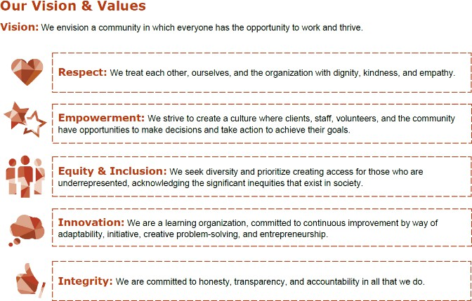
Sample Slide: Mission, Vision, & Values
Our Mission
Our ESE is dedicated to creating a pathway to self-sufficiency for homeless and low-income individuals by providing the resources and support needed to prepare for, find, and retain employment.
Notes:
Sample mission & values slide

Slide 20
Sample Slide: Considerations for Employers
Need for patience and understanding that client is facing many restrictions, requirements, and a sense of
limited control over their own life.
Potential for trauma and stress from incarceration and the reentry process.
Check for basic documents (Right to Work): ID, license, social security card, healthcare. If they do not
have these, help them start the process!
Client and Employment Specialist should know requirements of Probation or Parole involvement. Pull all related documents for a background check, including RAP sheet*, obtain a sense of requirements via PO or PA. Include this on client’s Service Plan.
There is confusion about whether ESE is considered proof of search for work by DPSS. Employment Specialist should call and talk to case worker directly to explain Chrysalis program. Sometimes clients are having to make the choice between ESE and General Relief (or other basic support).
Use the Nature-Time-Nature approach when thinking about jobs that could work well for the client.
*Record of Arrests and Prosecution
Notes:
Sample reviewing basics of target population for employers

