Slide 1
THE ROLE OF THE SUPERVISOR & PERFORMANCE MANAGEMENT
Supervisor Success Series | New Supervisor Training & Onboarding | Module 2
NOTE:
This presentation should be heavily edited by the facilitator to ensure that the roles and responsibilities match the organization
Notes:
Last updated by REDF 9/30
Description: What do we expect of supervisors from Day one? What are their goals? How will we measure their success?

Slide 2
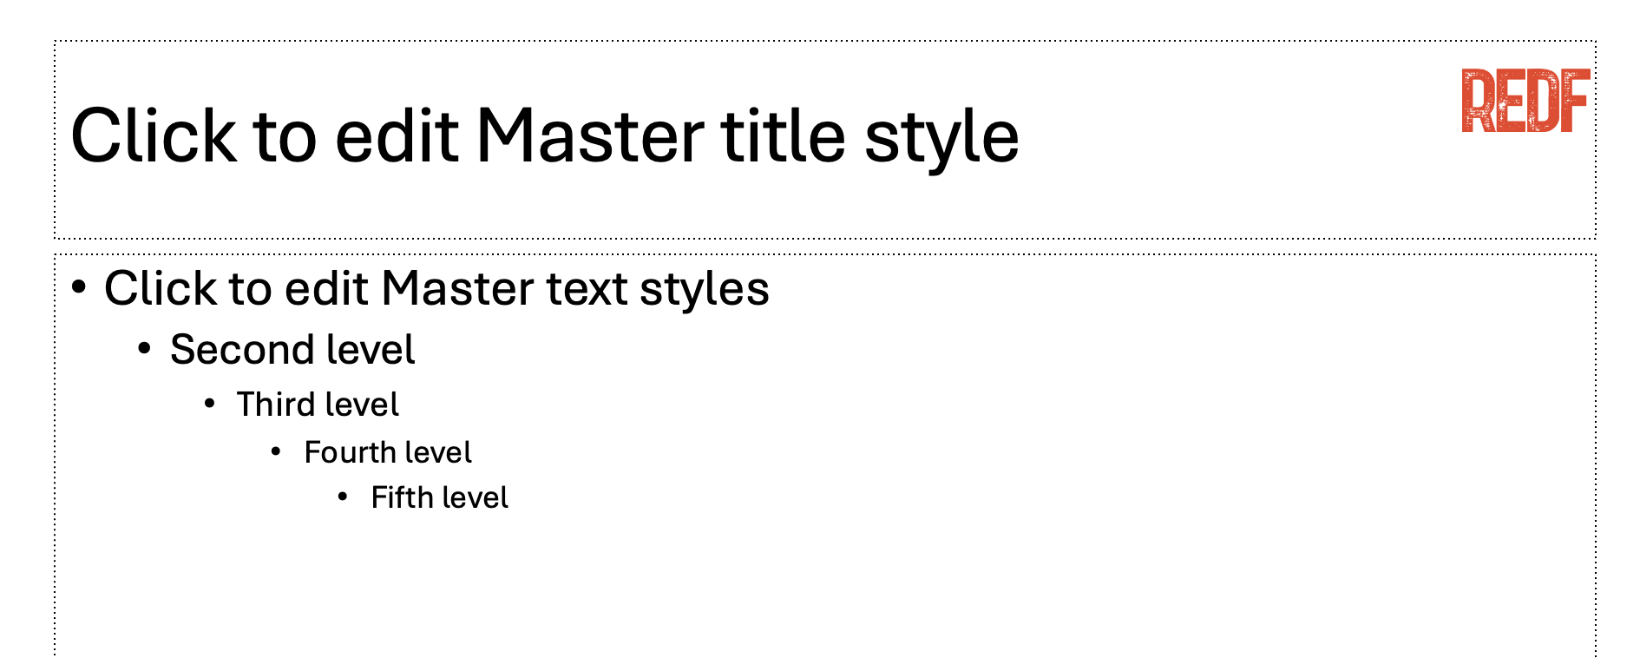

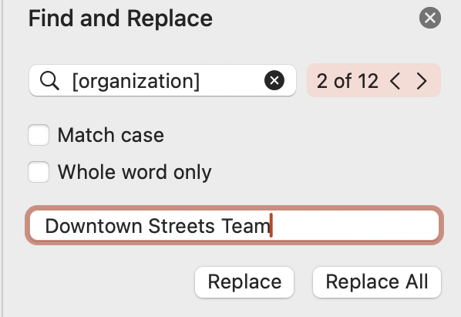
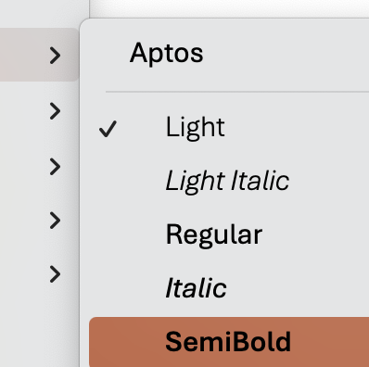
How to Use and Edit the Supervisor Success Series Modules
1. Update the content to your ESE’s branding, replace the REDF logo by searching in the top right for ‘Slide Master ‘→ delete the REDF logo from the Master title style slide, and replace it with your organization’s logo, click ‘close Master’ to save.
2. Update the colors throughout the presentation to match your organization’s color scheme by selecting the top red bar on each slide, Home tab → paint can → and selecting a fill color that works best for your branding.
Update the name of your organization by using the top right search bar again, selecting ‘Find and replace,’ type [organization] into the find bar and your ESE/ organization name into the replace bar, select ‘replace all.’ Anything content highlighted in gray
should be updated.
4. Editing Pro Tips… Use the font Aptos light to edit text on the slide and Aptos semibold to edit the titles. EDIT EVERY SLIDE to make sure it reflect your organization’s style and culture.
Need help? Reach out to a REDF staff member

Slide 3
Supervisor Success Series | The Role of the Supervisor & Performance Management
[OUR ORGANIZATION] Module 2 [DATE]
Notes:
What do we expect from you on Day One? What are your goals? How will we measure your success?

Slide 4
Supervisor Success Series: The Role of the Supervisor
I
Defining the Supervisor Role
II
What Do We Expect From You?
III
Your Day One Responsibilities
IV
Personal Goal Setting for Leaders

Slide 5
Understand the responsibilities of a frontline supervisor
Clarify what is expected of you from the start
Explore how your performance will be measured and how you will be supported
Begin setting goals that align with your role and your team
GOALS
Notes:
- Understand the responsibilities of a frontline supervisor
- Clarify what’s expected of you from the start
- Explore how performance is measured and supported
- Begin setting goals that align with your role and team

Slide 6
Warm-Up
Pick one and share with the group!
What is one thing you are you grateful for right now?
What will your supervisor walk-in song or catch-phrase be?
What made you laugh this week?
Notes:
Optional: Warm-up/icebreaker

Slide 7
Setting the Stage: Defining the Supervisor Role
What are some of the qualities and skills our supervisors are expected to have?
Your primary job is to FIRST make sure everyone stays safe… SECOND make sure the work gets done
You are the bridge between participants, leadership, and the community
You set the tone, hold boundaries, and model expectations!
Notes:
Frontline supervisor = Team leader for participant-employees
- Bridge between participants and leadership
- Sets tone, holds boundaries, models expectations
EXAMPLE Facilitator Guide
As a supervisor, you are a crucial part of the enterprise team, providing frontline leadership:
You are the first tier of management, overseeing operations in the field and managing day-to-day issues.
You are where the rubber meets the road, carrying out’ two goals – serving our mission of creating pathways to self-sufficiency for clients, and providing technical expertise and excellent customer service to achieve business goals
As our leader on the ground, you will be more visible to customers and external parties, serving as an ambassador for (org); you will also be the key link to internal teams supporting (org) Enterprises operations
(Org) will be held accountable for the decisions that you make, so it is important to always maintain professionalism
You will be the primary person coaching and giving feedback to your team, understanding what their needs are and supporting their learning and development
Through your actions and decisions, you play a significant role in shaping the culture of your team and demonstrating (org)’s values

Slide 8
[EXAMPLE] What Do We Expect From You?
Review these key responsibilities you will take on. What makes sense? What doesn’t make sense?
Professionalism and Consistency: Showing up on time or being early every single day. Creating a safe space.
Communication and Active Listening: Holding a team meeting every morning, reporting to your manager every day, checking-in with your participant-employees face to face every day.
Modeling Good Behavior: Safety first, show don’t tell, being calm and curious, maintaining composure even when your participant workers might be overly agitated or stressed.
Accountability with Empathy: Hold your participants to a high standard but also understand they are humans first! Work with them to achieve their goals and make sure they understand their role.
INSERT YOUR OWN PERFORMANCE GOALS
INSERT YOUR OWN PERFORMANCE GOALS
Notes:
Facilitator Note: Edit this list significantly, print it out for every new supervisor

Slide 9

[EXAMPLE] Day One Responsibilities
Review this detailed checklist. What will you be expected to do on day one as a new supervisor? (POST WEEK 1)
Show up on time or better… early ☺. Model good communication when you can!
Attend the supervisor huddle every morning
Complete your daily team checklist
Support your participants throughout the day, communicate with them regularly
Escalate anything beyond your day-to-day job to your manager, communicate early
Monitor for: safety, attitude, and professionalism with your participants
Notes:
Day One Responsibilities
Facilitator Note: Edit this list significantly, print it out for every new supervisor
- Attend supervisor huddle
- Complete daily checklist
- Support participant start-of-day process
- Monitor safety, attitude, and professionalism

Slide 10
Activity: Reflect on the Shift
What are you nervous or excited about when it comes to your new role? What is a goal you will set? Let’s share!
What is one thing you are EXCITED about?
What is one thing you are NERVOUS about?
Name some GOALS you will set to help you succeed!
Notes:
Prompt: What are you nervous or excited about in this new role?
- Small group or partner discussion
- Share themes with the full group

Slide 11
[EXAMPLE] Our Frontline Supervisor Performance Rubric
How will you be evaluated as a new supervisor? What do you understand from this list? What do you not?
TECHNICAL SKILLS
SOFT SKILLS
YOUR OWN GOALS
Site Safety
Documentation
Tool and Equipment Mastery
Vehicle Management
Site Management
Coaching and Communication
Leadership
Conflict Mitigation
Insert your own personal leadership development goals here!
Notes:
FACILTATOR NOTE: Edit this heavily based on your ESE
Examples:
Daily attendance: 95%+
Supervisor feedback score
Participant worksite quality checks
Incident de-escalation reports
Frontline Supervisor Rubric Checklist
https://docs.google.com/spreadsheets/d/1A7cGcofrfZ7RTUI9ufTHm6UsYjSHXEvyM-TAXyvIDfE/edit?gid=1740722006#gid=1740722006

Slide 12
Going from Participant and Peer to Leader
How can you navigate from the transition from being a participant and a peer to the “boss?”
New Challenges: Boundaries, Role Modeling, Being the “Boss”
What Changes?
You represent our [organization], you will coach and mentor, not just work, you will SET THE TONE FOR YOUR TEAM
Notes:
New challenges: boundaries, role modeling, being “the boss”
- What changes?
• You represent [Organization]
• You coach, not just work
• You set the tone for others
The supervisor role and mindset is very different from that of a client. You are now a staff member and part of a program, which comes with new considerations:
Transitioning from client to colleague
You now work alongside other staff members who previously may have provided support to you (e.g.,
Employment Specialists, Internal Operations Coordinators). These working relationships will be different, and it’s
important to be professional and a good colleague in partnering with them to support clients.
Managing former peers
You may be leading team members who you used to work with or are friends with, and this transition may be
challenging or awkward at first. It’s best to be open about the situation, establish boundaries, remain professional
and objective and be intentional about treating everyone fairly.
Ethical boundaries
As a supervisor, you need to maintain healthy boundaries at work. For example, this means that you should NOT get calls from team members on the weekend, buy your team lunch all week, date anyone on your team, consider the customer your friend, or work until 2AM on a project.
There may be conversations with clients that you are not the right fit for or are not fully equipped to support them through. For example, if a client expresses suicidal thoughts or seeks support with sobriety, you should bring in your manager and the Employment Specialist for additional support via a team effort.

Slide 13



Check-Ins and Coaching
What do you want your relationship with your manager to look like? How will you be held accountable?
  Daily 5-minute touchpoints with your manager are key during your first month on the job!
  Discuss your wins, challenges, and your adjustments during your check-ins
  Document your own goals using the performance rubric and your progress!
Notes:
- Weekly or biweekly check-ins with manager
- Document goals & progress
- Discuss wins, challenges, and adjustments

Slide 14
Leadership in Action
Hold yourself accountable! How do you want to show up as a leader?
How do you want to show up to work every day?
Write down one leadership intention or phrase to carry with you on the job!
Notes:
- What will your team say about you in 90 days?
- How do you want to show up?
- Write one leadership intention or phrase to carry forward

Slide 15
Closing Reflection
What did you learn today? Let’s recap!
One takeaway from this training? What is your new role?
One question you still have about your new role?
Reminder: Leadership is a process, not a finish line!
Notes:
- One takeaway from today?
- One question you still have?
- Reminder: leadership is a process — not a finish line

Slide 16
Optional Activity: Setting Goals Together
What does success mean to YOU and look like in your new role?
SMART GOALS! What are they?
Specific, Measurable, Achievable, Relevant, and Time Bound
Co-Create 1-3 goals on a sheet of paper and share them out!
Example: "Within my first 60 days, I will complete weekly 1:1 check-ins with at least 90% of my team members to build trust, gather feedback, and document performance notes to help them achieve their own goals!”
Notes:
What does success look like in this role?
SMART goals: Specific, Measurable, Achievable, Relevant, Time-bound
Co-create 1–3 goals with your manager
Example of a SMART Goal: "Within my first 60 days, I will complete weekly 1:1 check-ins with at least 90% of my team members to build trust, gather feedback, and document performance notes in the [Organization] system."

Slide 17
Our Role Description
What stands out to you in this statement?
“
INSERT ROLE DESCRIPTION
- [ORGANIZATION]
”
Notes:
Put in the job description or the role description for the frontline supervisor position at your organization
Sample Supervisor Role Description:
SAMPLE [FRONTLINE SUPERVISOR] ROLE DESCRIPTION
Supervisor Role Description
Uphold the standards of Inspire programs
Assist in project management debriefs and planning
Document all work activity
Provide crew with daily hours and performance journals
Complete all work shift sign-in sheets and submit them daily
Ensure that all crew member performance journals are completed daily
Approve crew member tool use in performance journals
Ensure timely and punctual arrival on job sites, including crew members returning from lunch breaks on time
Document any unfair treatment of crewmembers or other Inspire employees by an outside source, and immediately report incidents to the Director of Training and Business Development
Provide feedback and training on-site to crewmembers
Brief at the beginning of the day and debrief at the end of the day with their work crews, respectfully providing any feedback in the process
Report any crewmember needs, which they might disclose on a job site, to program staff on a timely basis
Assist crewmembers with personal issues on job sites and report those to program staff and/or the Director of Training and Business Development
Ensure site safety at all times, by
Operating Inspire vehicles, and/or ensuring that Inspire vehicles are operated safely
Operating Inspire equipment and tools, and/or ensuring that all Inspire equipment and tools are operated safely
Ensuring crewmembers are wearing all applicable PPE at all times
Reporting any safety or personnel incidents on job sites, and completing an incident report immediately afterwards
De-escalating any disagreements or confrontations that happen at job sites, be they with crewmembers, customers, or citizens of New Haven
Attend meetings, including
Daily supervisor meetings each morning
Weekly supervisor meetings with program staff
All Real Talk sessions, as well as any programs not yet completed
Any other Inspire meetings as requested, in addition to serving as a spokesperson of Inspire as necessary, be that at job sites or Inspire events

Slide 18

The Supervisor Journey: What will your next few weeks look like?
DAY ONE: TODAY!
BEFORE PROMOTION
WEEK 1
Promotion Conversation
TODAY you will engage in a positive expectations and role conversation training with a checklist of all the things you should be prepared for. This will start with a training on mission & values for leaders and can include whatever trainings you are interested in!
Communicate That You Want to Supervise!
Reach out to your leadership and let them know that you want to be a supervisor, tell them why it matters to you and why you would be a good fit!
Week One
Week one should be focused on you shadowing a current supervisor with you actively watching and listening. You will attend a brief daily conversation to answer questions and debrief.
WEEK 2
Week Two
During the second week you will take over and the supervisor will shadow you as you lead, this will be your trial period for your new role!
6-MONTHS+
Continued Support & Development
Throughout your time as a supervisor, you will keep learning on the job, continuing your training, perform to your expected responsibilities, and create an environment where your participants want to show up to work!

Slide 19
New perspective as a staff member continued peer vs. leader
The supervisor role and mindset is very different from that of a client. You are now a staff member and part of a program, which comes with new considerations:
Transitioning from client to colleague
  You now work alongside other staff members who previously may have provided support to you (e.g.,
Employment Specialists, Internal Operations Coordinators). These working relationships will be different, and it’s
important to be professional and a good colleague in partnering with them to support clients.
Managing former peers
  You may be leading team members who you used to work with or are friends with, and this transition may be
challenging or awkward at first. It’s best to be open about the situation, establish boundaries, remain professional
and objective and be intentional about treating everyone fairly.
Ethical boundaries
  As a supervisor, you need to maintain healthy boundaries at work. For example, this means that you should NOT get calls from team members on the weekend, buy your team lunch all week, date anyone on your team, consider the customer your friend, or work until 2AM on a project.
  There may be conversations with clients that you are not the right fit for or are not fully equipped to support them through. For example, if a client expresses suicidal thoughts or seeks support with sobriety, you should bring in your manager and the Employment Specialist for additional support via a team effort.

Slide 20
(Continued) Example Role of a Supervisor: Creating an environment for learning and growing
(Org) is committed to helping community members impacted by the criminal justice system pave a pathway towards self-sufficiency through employment, and we do this through our transitional jobs program.
Your role as supervisor is to manage and maintain an environment conducive to learning and growing. You create and nurture this environment through:
Modeling the expectation to show your crew what a good work ethic and professionalism look like
Coaching them through constructive feedback and giving them motivation to continue to learn and grow
Affirming their participation through positive feedback and praise, providing encouragement
Putting safety first, so the focus can be on learning and growing without fear
The goal is self-sustainability through a job. We get them ready.
Notes:
Example additional conversation to supervisor success
Do not want to overwhelm them with additional tasks

