Slide 1
MANAGING FOR SUCCESS
Supervisor Success Series | New Supervisor Training & Onboarding | Module 3
NOTE:
This presentation should be heavily edited by the facilitator to ensure that the roles and responsibilities match the organization
Notes:
Last Edited by REDF: 9/30
Showing up as the best version of leaders, self-care for leaders, coaching a strong team, executive functioning
Facilitator Note:
Organization needs to pay particular attention to high turnover and churn here. This is where it gets hard to keep up with a transitional employment model. It can be incredibly challenging for first time supervisors to be in stable positions of leadership with their team when they are constantly receiving new participant-employees.

Slide 2
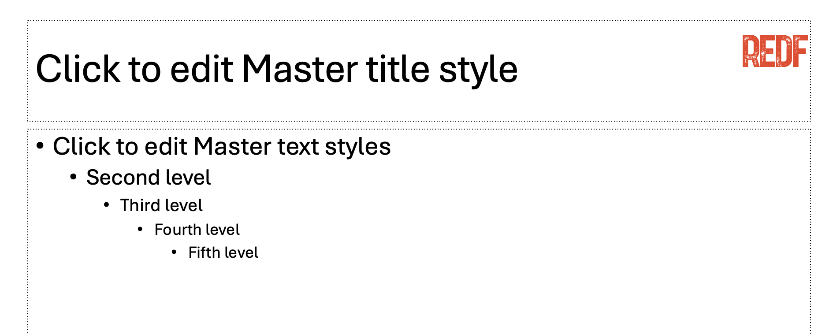

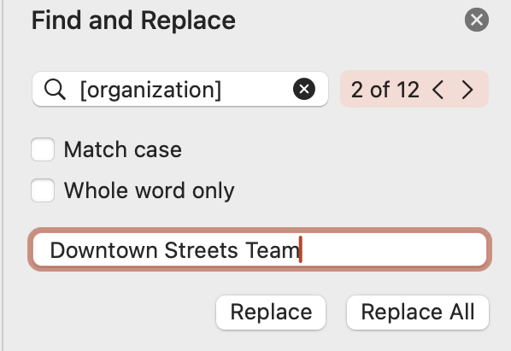
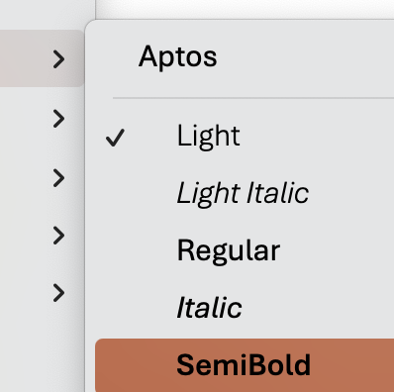
How to Use and Edit the Supervisor Success Series Modules
1. Update the content to your ESE’s branding, replace the REDF logo by searching in the top right for ‘Slide Master ‘→ delete the REDF logo from the Master title style slide, and replace it with your organization’s logo, click ‘close Master’ to save.
2. Update the colors throughout the presentation to match your organization’s color scheme by selecting the top red bar on each slide, Home tab → paint can → and selecting a fill color that works best for your branding.
Update the name of your organization by using the top right search bar again, selecting ‘Find and replace,’ type [organization] into the find bar and your ESE/ organization name into the replace bar, select ‘replace all.’ Anything content highlighted in gray
should be updated.
4. Editing Pro Tips… Use the font Aptos light to edit text on the slide and Aptos semibold to edit the titles. EDIT EVERY SLIDE to make sure it reflect your organization’s style and culture.
Need help? Reach out to a REDF staff member

Slide 3
Supervisor Success Series | Managing for Success
[OUR ORGANIZATION] Module 4 [Date]

Slide 4
Supervisor Success Series: Managing for Success
I
Showing up as the Best Version of Yourself!
II
Tips & Tricks for Executive Functioning and the Day-to-Day
III
Self-Care for Leaders
IV
Discussion: Managing a Team

Slide 5
Discuss tips & tricks for coaching a team!
Learn some basic tools for staying organized
Sharing life hacks for leaders
Understand why taking care of yourself outside of work is not always easy but important
GOALS
Notes:
Facilitator Note:
Before teaching, please be careful in the way you deliver content around self-care and decide if it is something that you should teach depending on your target population and level of housing security

Slide 6
Warm Up: Quote of the Day
What stands out to you in this statement?
“
‘‘80% of success in life is just showing up.’’
- Woody Allen
”
Notes:
Facilitator Notes:
Ask what this means to them
Clarify that showing up is the first step
If you want to operate at your BEST are some tools for leaders to feel their best

Slide 7
MANAGING
YOUR DAY TO
DAY
Notes:
Facilitator Definition:
What are executive functioning skills? Executive functioning skills are the important processes in our brain that help us finish tasks and meet our goals. If it sounds like we use them for everything we do, that’d be right – we do! It’s important to mention, though, that executive functioning skills are a huge umbrella. There are several different skills that work together to make up our executive functioning. Each skill is valuable and important.

Slide 8




Setting the Stage: What is Executive Functioning?
Executive functioning is the brain’s ”management system” it helps you…
  Stay organized & create structure
  Follow-through on tasks
  Manage time
  Make decisions and solve problems
Why does this matter?
Notes:
Facilitator Guide:
SOURCE: https://www.thepathway2success.com/10-executive-functioning-skills-the-ultimate-guide/
Why it matters in the workplace:
Many people in ESEs are rebuilding routines and facing stress. Understanding executive functioning helps you support team members effectively — not just manage performance but build skills for life.

Slide 9
Common Challenges at Work
Why do we all struggle with the following?
Showing up on time or remembering schedules
Staying focused
Switching between tasks or handling changes
Prioritizing long-term goals
Managing frustration or reactions
Asking for help when stuck
Notes:
Facilitator Guide:
SOURCE: https://www.thepathway2success.com/10-executive-functioning-skills-the-ultimate-guide/

Slide 10
Review: Supervisor Role
Before we continue to build on some tips and tricks, what is your job as a new supervisor?
STOP
Notes:
Facilitator Guide:
STOP, before they continue to discuss team building and managing their day-to-day… what are the only two things that you expect of them? Ask them this question. Be firm here.

Slide 11
Toolkit: Managing Your Day-to-Day Tips & Tricks
What are some life hacks for setting up your day well? Model this for participants!
Plan Early | Write down tasks for the week/day and how to accomplish them
Visual Schedules | Have your schedule visible and on the board
Reminders | Set phone alarms and use timers if needed for tracking tasks
Checklists | Much like this one… written instructions and reminders help!
Incentives | Give yourself a reward for finishing tasks, even just a quick break
Daily Check-ins | Hold a team stand up to share goals for the day (TBD)
Notes:
Facilitator Note: Toolkit – Managing Your Day-to-Day
Please heavily edit this.
Depends on the ESE – ex. duties of actually holding the day to check in and the daily stand up does it fall on the manager or the supervisor
Here are some tips for helping you structure your day. Have a plan, create a schedule.
What can we do to help our participant-employees with managing their day?
As a team leader, you can:
Model structure (be on time, use checklists, follow routines)
Coach, don’t criticize (ask “What would help you remember next time?”)
Break tasks down (give one step at a time if needed)
Repeat and review (some people need reminders to retain info)
Create a calm environment (your tone and consistency matter!)
You’re not expected to be a therapist — but you can be a supportive coach.

Slide 12
SHOWING UP
& SELF
CARE

Slide 13
Warm Up: Showing Up
Pick one and share. When you ‘show up’ and feel good – what does this look like?
What does showing up mean for you?
What do you do to get in the work ready mindset?
What does it mean to show up as yourself?
Why is showing up hard?
Notes:
Facilitator Note: Warm Up
Do not expect them to have an immediate answer or definition for showing up but it is good to discuss this as it can be a helpful mantra that it is 1. not always easy.. 2. share strategies with each other.
Again, be heavily mindful of the situation your supervisors are in and where they are at

Slide 14
Refresher: What Do We Expect from You?
Review your key responsibilities. What makes it easier to show up and do these well?
Professionalism and Consistency: Showing up on time or being early every single day. Creating a safe space.
Communication and Active Listening: Holding a team meeting every morning, reporting to your manager every day, checking-in with your participant-employees face to face every day.
Modeling Good Behavior: Safety first, show don’t tell, being calm and curious, maintaining composure even when your participant-employees might be overly agitated or stressed.
Accountability with Empathy: Hold your participants to a high standard but also understand they are humans first! Work with them to achieve their goals and make sure they understand their role.
Notes:
Facilitator Note: Recap key responsibilities and discuss what makes them easier
Insert your supervisor responsibilities checklist here. Talk about how they do these things and what makes it easy. Again, if your supervisor is coming from a highly stressful outside of work life into work (dealing with housing insecurity, family dynamics, loneliness, etc.) you need to make sure that you are teaching these modules in a way that they will resonate with. These sessions can feel out of touch if this is the case.
Preview: Trauma-informed Management – Module 3
Breathing
Take slow, deep breaths in and out; feel each breath filling your lungs and pushing back out
This helps calm your nervous system, allowing you to think clearly and calmly, and it also gives
you time to collect your thoughts before responding
Positive self-talk
Reframe the way you look at stressful situations (“This probably isn’t about me; they seem to be
having a bad day.”)
Use positive self-talk to keep yourself calm and approach challenges with the best of your ability
(“Stay calm. I can handle this.”)
Grounding
Take a moment of pause and think about what centers or grounds you; focus on what helps you
stay emotionally regulated when things get heated
Sometimes it helps to feel your physical reality (e.g., wiggle your toes, feel change in your pocket)

Slide 15
What is Self-Care?
What is self-care? Why is it important to being a good leader?
What does self-care mean to you?
Self-care is an essential social work survivor skill.
Why is it important?
The work that we do can be draining and stressful, and failure to care for yourself along the way can lead to stress. We need to take care of ourselves to help support our participant-employees.
Notes:
Facilitator Notes:
Definition | “Self-care is an essential social work survival skill. Self-care refers to activities and practices that we can engage in on a regular basis to reduce stress and maintain and enhance our short- and long-term health and well-being. Self-care is necessary for your effectiveness and success in honoring your professional and personal commitments.”
Practicing self-care can enhance your physical, mental and emotional health and prevent or reduce:
Traumatic stress (stress that induces intense and long-lasting physical and emotional responses)
Burnout (mental, emotional and physical exhaustion from work-related stress)
Compassion fatigue (the cumulative effect of traumatic stress and burnout, combined)
The stresses of our own work and lives make trauma a personal concern
None of us are immune to traumatic experiences in our own lives
Given our mission to help clients transition out of poverty and onto pathways to self- sufficiency, our work requires high levels of empathy, compassion and care on a daily basis
We work with people who are struggling with many challenges that are often
overwhelming
It’s important to be aware of how these experiences may challenge our own emotional resources. If left unchecked, they could lead to traumatic stress, burnout or compassion fatigue

Slide 16
[OPTIONAL PENDING TARGET POPULATION] Toolkit: Self-Care
Self-care can help you manage your day-to-day and beyond
Professional Self-Care
Take real PTO and learn about how to recharge*
Take a break outside
Set clear boundaries with participants
Ask for and accept help
Know when to say no
Don’t bring work home
Identify projects/tasks that are rewarding
Meet with your manager
Learn how to prioritize*
Listen to your body
Physical Self-Care
Eat healthy
Stay rested
Stay hydrated
Exercise
Take time off when sick
Get regular medical care for prevention
Engage in any sort of physical activity (walk, stretch, bike) when feeling anxious, overwhelmed or sad
Emotional Self-Care
Identify comforting activities, people and places and seek them out
Do a hobby you enjoy
Give yourself affirmations
Find things that make you laugh
Pause to notice your thoughts and feelings
Focus on positivity
Stay connected with friends or family who can provide support
Psychological & Spiritual Self-Care
Spend time in nature
Practice intentional breathing
Meditate
Connect with your inner spirit
Write in a journal
Unplug from technology
and social media
Make time for reflection
Notes:
Facilitator Note:
Please tweak for your specific population
Training a frontline supervisor who is still unhoused
Fine line between how much time for this
These are hard for anyone to do
Nobody can possibly do them all the time
Let’s build on the list we made! When do we feel our best, why?

Slide 17
Benefits of Self-Care & Warning Signs of Burnout
Why is practicing these helpful? What are some warning signs that we need self-care?
Notes:
Facilitator Notes:
As a recap, why is practicing self care helpful?
Practicing Self-Care Will Help You…
Become better equipped to manage & reduce stress
Increase happiness and improve energy
Promote positive physical and psychological health outcomes, such as fostering resilience and lowering cortisol levels
Be aware of your own personal vulnerabilities, such as the potential for traumatic stress, burnout and compassion fatigue
Achieve more balance in your life
Teaching Burnout
As a recap, what are some warning signs that we might need to practice better self care?
Physical: Exhaustion, fatigue, insomnia, headaches, nausea, upset stomach, dizziness
Emotional: Feeling emotionally disconnected, reduced ability to feel sympathy or empathy, mood swings, anxious or depressive symptoms, increased irritability, pessimism
In the workplace: Feeling unskilled as a helper, difficulty concentrating and making
decisions, trouble being productive, job dissatisfaction
We need to be aware of these signs of concern, learn to recognize them and seek out
support if experiencing them. It’s critical to prioritize self-care.
Facilitator Note: This is about teaching them to get in front of it. Please come to leadership if you’re feeling this way.

Slide 18
Activity: Let’s Make a Plan!
What is one self-care practice you will focus on this month?
Notes:
Facilitator Guide:
Let’s make a self care plan, what are you already good at? What is ONE thing you want to focus on this month?
Let’s hold each other accountable and report back
Making a Plan:
In developing a self-care plan, it is helpful to identify what you value and need as part of your day-to-day life (maintenance self-care), as well as the strategies you can use if you face a crisis (emergency self-care)
There is no “one size fits all” self-care plan. We each need to develop our own plan based on our unique life history, stressors, outlets and aspirations. Start by noticing when you feel invigorated and when you feel drained. Aim to do more of what makes you happy. Only you can determine what your mind, body and spirit need to thrive.
There are some common objectives that all self-care plans share: taking care of physical health, managing and reducing stress, tending to emotional and spiritual needs, nurturing relationships, and finding balance in life and work
Start small – choose one doable self-care practice to weave into your daily routine, learn what works and what doesn’t, and try adding in more when you feel ready

Slide 19
COACHING A
STRONG TEAM

Slide 20
Leadership in Action
Once we take care of ourselves, we can take care of others! Remember: culture & trust FIRST
What have supervisors done that you like?
What have supervisors done that you did not like?
What has a supervisor done to help create a good TEAM?
Notes:
Facilitator Guide:
Transition to... Once we take care of ourselves, we can take care of others!
Frame the discussion on how a leader how showed up that has contributed to a positive team environment
Build on the discussions around trust building from trauma informed management
Leadership Videos:
TED Talk – Great Leadership Starts With Self-Leadership
TED Talk - Own Your Behaviors

Slide 21
Review: Supervisor Role
Before we continue to build on some tips and tricks, what is your job as a new supervisor?
STOP
Notes:
Facilitator Guide:
STOP, before they continue to discuss team building and managing their day-to-day… what are the only two things that you expect of them? Ask them this question. Be firm here.

Slide 22

[OPTIONAL] Toolkit: Team Building 101
What are some basic things we can implement to help our participants be strong?
You’re on the same team!
  Ensure work goals are understood and supported by all team members
Clarify roles & responsibilities, set a good example
  Identify who is doing what to achieve goals, and where is there overlap
Keep learning alive!
  Ask your participants what they want to learn when they come to work
Be engaging & fun
  Hold energizing team meetings, help them get to know one another
Keep support regular
  Talk with your team members daily and watch for common mistakes or issues
Plan ahead
  Plan for: safety and getting the job DONE well
Notes:
Facilitator Guide:
Keep this list simple, limit the pitfalls and burdens on your supervisors to a pretty strong degree.
This is optional beyond keeping their team safe and getting the job done
It is just something to discuss
Keep in mind your 10 keys to supervisor success here: programs vs. enterprises slide
Frame the discussion on how a leader how showed up that has contributed to a positive team environment
Build on the discussions around trust building from trauma informed management
Dos:
Assess your own degree of assertiveness and ask others for feedback
Set realistic goals to make small changes in your behavior and stick to them
Establish professional rapport with crew members so that you feel more comfortable speaking up – it’s about trust and respect
Don’ts:
Assume that assertiveness is always a good thing; the context you work in and your gender both matter
Try to imitate someone else’s behavior. You can change while still being true to who you
are.
- Overcompensate and become aggressive; balance assertiveness with consideration of others

Slide 23
Common Challenges for New Supervisors
What makes it hard to lead a team?
Managing Former Peers
Navigating a New Perspective
Working with Technology
New Administrative Duties
Notes:
Facilitator Note: Common Challenges for New Supervisors
Take this time to talk about the very common challenges they might face in their day-to-day
What else am I missing?
Managing former peers
Acknowledge upfront that the new relationship may be a little awkward and will take some adjusting to but that you will do and be your best for them
Early on, try to have open, authentic one-on-ones with each team member to talk about your new roles going forward, solicit their feedback, and establish professional boundaries
Try to remain calm and act natural in your new role; it’s important to stay authentic to who you are
It’s a delicate line between remaining friendly and maintaining authority; try to establish authority with
grace and professionalism
Aim to create a dynamic of being there to help your team members do the best job possible and
supporting them as much as you can; “coach, don’t boss”
Do not show favoritism; be intentional about treating everyone fairly; be an objective leader
Leaders cannot be everyone’s friend, and you will need to give up being liked by everyone; try not to
take things personally, and hopefully in time this will be replaced by respect and trust
Navigating a new work culture / perspective
As a supervisor, you will be invited to new meetings, be expected to read and respond to emails, meet new faces throughout Chrysalis, collaborate with other departments, learn from peers, be offered new opportunities to grow professionally, and partner with upper management. This might require a shift in your mindset or approach, and if you need support, connect with your Senior Operations Manager or peer supervisors.
Working with technology
Supervisors have digital communication and documentation responsibilities (e.g., using a tablet to clock clients in/out, typing up feedback, sending emails), which can be difficult for those who are not as familiar with using a computer, tablet or phone. If you have any challenges navigating technology, reach out to your Senior Operations Manager, who can connect you with training, support and peer learning opportunities.
New administrative duties
Supervisors are in charge of new administrative tasks, such as reporting absences/tardies, requesting additional workers and determining inventory needs. As the main liaison between your team and internal operations, it is important to communicate these updates clearly and consistently.

Slide 24
Closing Reflection
What did you learn today? Let’s recap and be the best version of US!
One managing your day tip and trick
One team building tip and trick
One self-care tip and trick
Notes:
- One takeaway from today?
- One question you still have?
- Reminder: leadership is a process — not a finish line

