Slide 1
LIVED EXPERTISE & TRAUMA INFORMED MANAGEMENT
Supervisor Success Series | New Supervisor Training & Onboarding | Module 4
NOTE:
This presentation should be heavily edited by the facilitator to ensure that the roles and responsibilities match the organization
Notes:
Last edited by REDF: 9/30
Facilitator Note: Before you Begin
Before you begin teaching this module. You are equipping someone who possibly has never managed. You are both trying to teach the difference between personal and professional, those boundaries, while also overcoming snitching culture. This is why shadowing is the best because they need to get with trusted supervisors. Go back to the train the trainer session from continuing education week on training and onboarding new supervisors. There should be a two week shadow period before you teach some of these soft skills modules. It is up to you how to teach this content… It is a delicate balance between highlighting their lived experience vs. not solely defining them in this way. CAVEAT: You need a two week shadow that’s why you need to teach that FIRST.

Slide 2
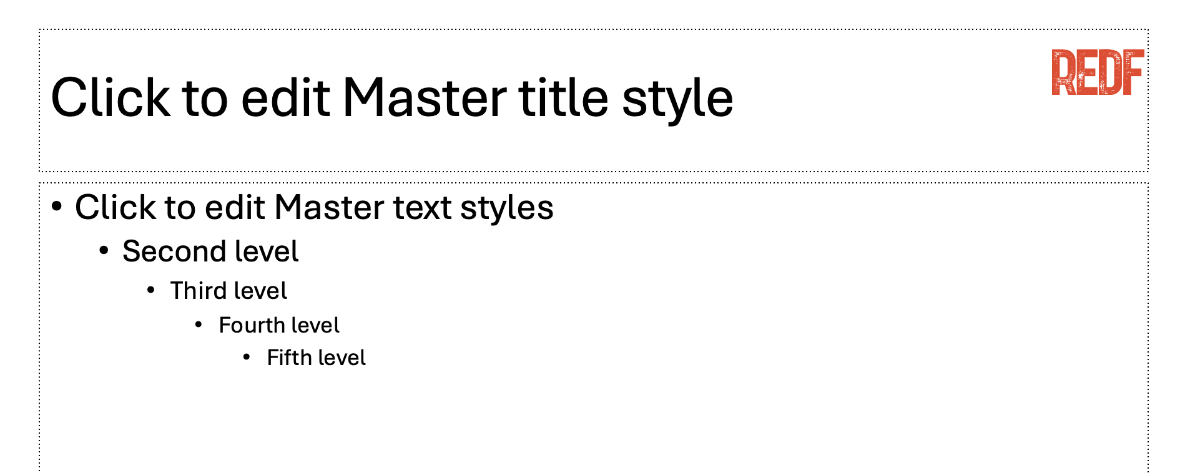

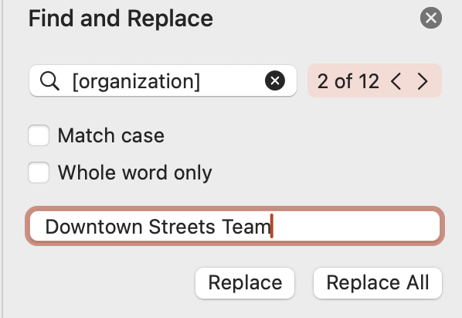
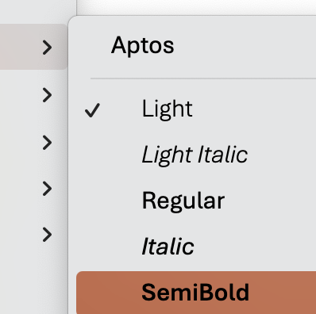
How to Use and Edit the Supervisor Success Series Modules
1. Update the content to your ESE’s branding, replace the REDF logo by searching in the top right for ‘Slide Master ‘→ delete the REDF logo from the Master title style slide, and replace it with your organization’s logo, click ‘close Master’ to save.
2. Update the colors throughout the presentation to match your organization’s color scheme by selecting the top red bar on each slide, Home tab → paint can → and selecting a fill color that works best for your branding.
Update the name of your organization by using the top right search bar again, selecting ‘Find and replace,’ type [organization] into the find bar and your ESE/ organization name into the replace bar, select ‘replace all.’ Anything content highlighted in gray
should be updated.
4. Editing Pro Tips… Use the font Aptos light to edit text on the slide and Aptos semibold to edit the titles. EDIT EVERY SLIDE to make sure it reflect your organization’s style and culture.

Slide 3
Supervisor Success Series | Lived Expertise & Trauma Informed Management [OUR ORGANIZATION] Module 3 [Date]

Slide 4
Supervisor Success Series: Lived Expertise
I
Trauma Informed Management
II
Building Trust and Creating Culture
III
Emotional Intelligence 101

Slide 5
Understand why your lived experience is a form of expertise that will help you be an amazing leader!
Learn key tips to building trust with your participants
Teaching emotional intelligence and resilience
GOALS

Slide 6
Warm Up: Quote of the Day
What stands out to you in this statement?
“
“The curious paradox is that when I accept myself just as I am, then I can change.”
- Gregory Boyle
”
Notes:
Facilitator Notes:
Ask what this means to them
Clarify that showing up is the first step
If you want to operate at your BEST are some tools for leaders to feel their best

Slide 7
TRAUMA
INFORMED
MANAGEMENT

Slide 8
Lived Expertise
Let’s discuss… Why are YOU the best person to supervise our new participants?
How does your lived experience inform how you lead our participant-employees and help us run our organization?
Notes:
Facilitator Guide:
Ask, why are you the best person to lead our participant-employees?
Why are you the best person for the job?
What might be challenging about this?

Slide 9
Trauma Informed Care to Management
What does it mean to be ‘trauma-informed’? Both about yourself and your team?
REMINDER | We don’t know everything! We are more than just our past experiences. It’s important to address the situation at hand, listen and assume best intentions, and be respectful and sensitive to what the other person could be feeling and experiencing. Not everyone will be familiar with these practices. All we can do is show up where we are.
TRAUMA INFORMED CARE | Understands and considers the pervasive nature of trauma and promotes environments of healing and recovery rather than practices or services that may inadvertently re-traumatize.
TRAUMA INFORMED MANAGEMENT | This care not only for our participants, but for us as well. We have all experienced trauma in some capacity, so it is important to use trauma-informed care in our communications and interactions with the understanding that we are not perfect.
Notes:
Facilitator Guide:
What does trauma informed care mean to you?
What does trauma informed management mean to you?
Note: We are setting up our participant-employees for success. A reminder that not every workplace is structured like an ESE. Not every supervisor in workplaces gets this training.
TRAUMA
Intense and overwhelming experiences that involve serious
loss, threat or harm to a person’s physical and/or emotional well being.
These experiences may occur at any time in a person’s life. They may involve a single traumatic event or may be repeated over many years.
These trauma experiences often overwhelm a person’s coping resources. The person finds other ways of coping that may work in the short run but may cause serious harm in the long run.

Slide 10










[OPTIONAL] 10 Keys to Supervisor Success: What We Are Doing
The things we do here at our organization to help make sure you are successful
Culture and trust at the core
Shadowing and experience
Transparency & communication
Operations vs. programs
Identifying strong supervisors (you!)
Systems and tools for support
Teaching is a journey
Plan it out
Full-time staff
Dedicate time and resources
Notes:
Facilitator Note: 10 Keys to Supervisor Success
This is optional but it can help build trust to help you as an organization be held accountable by your supervisors
Be transparent about what you as an organization are doing to elevate their success and help support them
Make it obvious the ways in which you are setting them up to succeed

Slide 11
Reflection
What is ONE way you will practice trauma informed management as a leader?
Notes:
Facilitator Guide:
What hurts?
Interactions that are humiliating, harsh, impersonal, disrespectful, critical, demanding or judgmental
Asking questions that imply that there is something wrong with the person
Judgments and prejudices based on cultural ignorance
Regarding a person’s difficulties only as symptoms of a mental health, substance use or medical problem
What helps?
Interactions that express kindness, patience, reassurance, calm, acceptance and listening
– Frequent use of words like “please” and
“thank you”
Asking questions to understand what harmful events may contribute to current problems (“What happened to you?”)
Understanding the role of culture in trauma Response
Recognizing that symptoms are often a person’s way of coping with trauma or are adaptations
Be mindful of the language you use:
Language is powerful, so we need to think carefully and speak with intention; we should be mindful of the words we choose and the tone we use
Consider someone’s history and experience and how what we say might impact them
Move away from labels, jargon, judgment or negative terms (e.g., “no show”) . .
. . . to language that promotes safety and trust, is empowering and reflects strength and resilience (e.g., “client who was unable to make it today”)
Avoid aggressive language or words that might trigger someone

Slide 12
BUILDING
TRUST &
CREATING
CULTURE

Slide 13
Culture & Trust at the CORE
Our job is to 1. Keep participants safe 2. Get the job done.
How do we do this best? BUILD TRUST and create culture
How will you keep your team safe and build trust with them?
Why is this important?
How will you help create an environment where people want to work?

Slide 14


Leader Toolkit: Building Trust
Being able to trust you will have a huge impact on how they perform. This takes TIME!
Be a good role model – as the leader of your team, it’s up to you to set an example
Always tell the truth – speaking the truth, even when it’s hard, increases your credibility and respect
Follow through on your commitments – people trust leaders who are reliable, so keep your word and be someone your team can count on
Show appreciation and gratitude – let every person on your team know how much you value their contribution
Unite your team – bring everyone together to work toward common goals
Be clear – set clear expectations, overcommunicating if necessary to avoid confusion
Stay accountable – take responsibility, own your mistakes right away, and take action to amend them
Be a good listener – listening carefully shows that you care; be fully present, have empathy and compassion, and try to understand what they mean
Notes:
Facilitator Notes:
Reminder this can be hard with turnover…
We are telling you to build trust but are we really equipping them realistically

Slide 15
Reflection
What is one new thing you learned about building trust and culture?
How will you keep professional boundaries while building trust with your team?
Notes:
Facilitator Note:
It takes time!
Add - What are you most worried about when it comes to this…

Slide 16
EMOTIONAL
INTELLIGENCE
Notes:
Facilitator Guide:
Optional Activity for Module 3
If it fits ESE culture

Slide 17
Emotional Intelligence 101
What is emotional intelligence? How do we control our internal and external emotions?
Self-Awareness: Ability to be aware of one’s feelings and emotions
Self-Regulation: Ability to manage impulses with coping skills to express
one’s feelings and thoughts verbally and non-verbally in a non-destructive way
Social Skills: Ability to contribute socially to the welfare of others
Being aware of your own feelings and thoughts is KEY to being an empathetic, trauma-informed leader.
Notes:
Facilitator Guide:
What is emotional intelligence?
Emotional intelligence refers to our capacity to be aware of, control and express our emotions, and to handle interpersonal relationships judiciously and empathetically
Self-Awareness: Is the ability to understand your own thoughts, feelings, and behaviors, and how they impact yourself and others. It involves recognizing your strengths and weaknesses, understanding your motivations, and being aware of how you are perceived by others. Essentially, it's about having a clear understanding of who you are as an individual.
The practice of self-awareness is one of the greatest skills in our work because it enables you to learn about yourself in a way no one else can teach you.
It teaches you how to manage yourself and how to productively engage with other people.
Self Regulation: In the most basic sense it involves controlling your impulses emotions and thoughts in pursuit of managing others.
Social Skills: Know your limits, know yourself so you can work well together as a team, build meaningful relationships, and develop a strong sense of self, which are all important aspects of emotional intelligence & leadership. To be successful when woriing as a team we will need skills allows us to handle and influence emotions effectively.

Slide 18
Toolkit: Self-Regulation Practices
Best in the moment tips for when you are feeling overwhelmed and out of control…
Breathing
Take slow, deep breaths in and out; feel each breath filling your lungs and pushing back out
This helps calm your nervous system, allowing you to think clearly and calmly, and it also gives you time to collect your thoughts before responding
Positive Self-Talk
Reframe the way you look at stressful situations (“This probably isn’t about me; they seem to be having a bad day.”)
Use positive self-talk to keep yourself calm and approach challenges with the best of your ability. (“Stay calm. I can handle this.”)
Grounding
Take a moment of pause and think about what centers or grounds you; focus on what helps you stay emotionally regulated when things get heated
Sometimes it helps to feel your physical reality (e.g., wiggle your toes, feel change in your pocket)
Notes:
Facilitator Note: Self-Regulation Practices
You will also review this with your de-escalation module and giving & receiving feedback

Slide 19
Activity: Emotional Quotient (EQ) Self Assessment
We are going to pass out an activity sheet that will help you assess what areas of emotional intelligence you are the strongest in.
Self awareness: Ability to recognize your emotions as they happened and understand your general tendencies for responding to different people and situations
Social awareness: Understanding where the other person is coming from whether you agree or not
Self management: Using awareness of your emotion to choose what you say and do in order to positively direct your behavior
Relationship management: Using awareness of other persons’ emotions to choose what you say and do in order to positively direct your behavior
Notes:
Facilitator Guide:
This is in the appendix

Slide 20
Closing Reflection
What did you learn today? Let’s recap!
Why are YOU the best person to be a new supervisor?
One way to get your team excited for work everyday?
How will you become a more self-aware leader?
Notes:
Facilitator:

Slide 21
EQ Self-Assessment Checklist
Rate each statement below on a scale of 1 – 5, according to how true it is of you.
1 2 3 4 5
1) I am aware of the physical reactions (twinges, aches, sudden changes) that signal a “gut reaction.”
2) I readily admit mistakes and apologize.
3) I let go of problems, anger, or hurts from the past and I can move beyond these.
4) I generally have an accurate idea of how another person perceives me during a particular interaction.
5) I have several important things in my life that I am enthusiastic about, and I let it show.
6) I can easily meet and initiate conversation with new people when I have to.
7) I take a break or use another active method of increasing energy when I sense that my energy level is getting low.
8) I have little trouble taking prudent risks.
9) I “open up” with people appropriately – not too much but enough so that I don’t come across as cold and distant.
10) I can engage in an interaction with another and pretty well size-up that person’s mood based on non-verbal signals.
11) Others usually feel inspired and encouraged after talking to me.
12) I have no trouble making presentations in front of groups or conducting meetings.
13) I take time every day for quiet reflection.
14) I take initiative and move ahead on tasks that need to be done.
15) I refrain from making up my mind on issues and expressing my opinion until I have all the facts.

Slide 22
EQ Self-Assessment Checklist (Continued)
Rate each statement below on a scale of 1 – 5, according to how true it is of you.
1 2 3 4 5
16) I have a number of people I can turn to, and I ask for their help when I need it.
17) I try to find the positive in any given situation.
18) I can deal calmly, sensitively and proactively with the emotional displays of others.
19) I can usually identify the emotion I am feeling at any given moment.
20) I am generally comfortable in new situations.
21) I neither bury my anger nor let it explode on others.
22) I can show empathy and match my feelings with those of another person in an interaction.
23) I can keep going on a big project, despite obstacles.
24) I am respected and liked by others, even when they don’t agree with me.
25) I am clear about my own goals and values.
26) I express my views honestly and thoughtfully, without being pushy.
27) I am good at managing my moods, and I seldom bring negative emotions to work.
28) I focus my full attention on another person when I listen to them.
29) I believe the work I do day-to-day has meaning and value to society.
30) I can effectively persuade others to adopt my point of view without coercing them.

Slide 23
Scoring the EQ Self-Assessment Checklist
Enter your ratings for each numbered question in the category where it appears.
Add the ratings for each category to obtain a total for that specific facet of EQ.
Self Awareness:
1
7
13
19
25
Total Self Awareness:
Self Confidence:
2
8
14
20
26
Total Self Confidence:
Self Control:
3
9
15
21
27
Total Self Control:
Empathy:
4
10
16
22
28
Total Empathy:
Motivation:
5
11
17
23
29
Total Motivation:
Social Competency:
6
12
18
24
30
Total Social Competency:

