Slide 1
GIVING FEEDBACK & EMPOWERING YOUR TEAM
Supervisor Success Series | New Supervisor Training & Onboarding | Module 5
NOTE:
This presentation should be heavily edited by the facilitator to ensure that the roles and responsibilities match the organization
Notes:
Last edited by REDF: 9/30
Topics: Giving feedback, trauma informed management skills in action, practicing for common scenarios at work

Slide 2
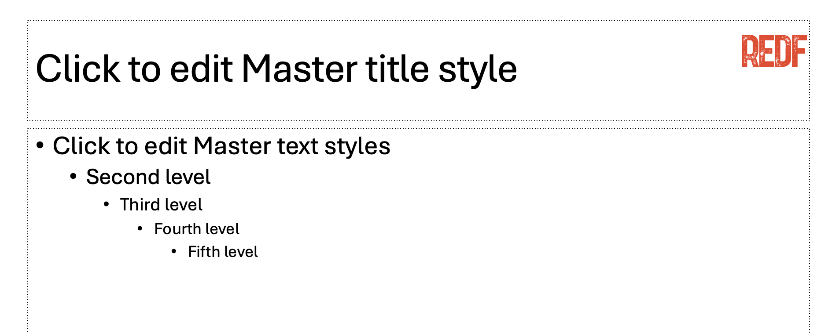

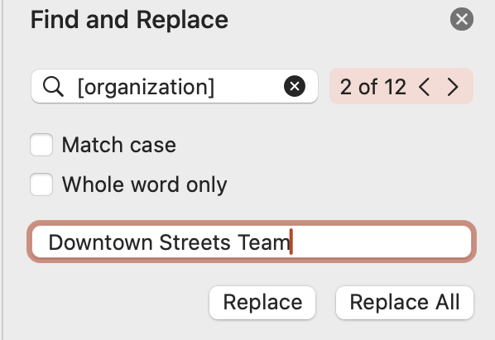
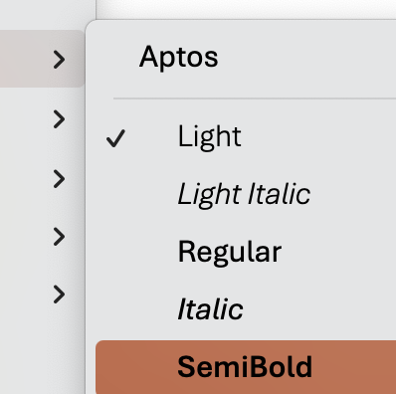
How to Use and Edit the Supervisor Success Series Modules
1. Update the content to your ESE’s branding, replace the REDF logo by searching in the top right for ‘Slide Master ‘→ delete the REDF logo from the Master title style slide, and replace it with your organization’s logo, click ‘close Master’ to save.
2. Update the colors throughout the presentation to match your organization’s color scheme by selecting the top red bar on each slide, Home tab → paint can → and selecting a fill color that works best for your branding.
Update the name of your organization by using the top right search bar again, selecting ‘Find and replace,’ type [organization] into the find bar and your ESE/ organization name into the replace bar, select ‘replace all.’ Anything content highlighted in gray
should be updated.
4. Editing Pro Tips… Use the font Aptos light to edit text on the slide and Aptos semibold to edit the titles. EDIT EVERY SLIDE to make sure it reflect your organization’s style and culture.
Need help? Reach out to a REDF staff member

Slide 3
Supervisor Success Series | Giving Feedback & Empowering Your Team
[OUR ORGANIZATION] Module 5 [Date]
Notes:
Facilitator Guide Upfront Note:
Frontline supervisors should lean on admin and operations team to deliver the feedback
They report and share concerns or issues with the correct POC in the social enterprise
If you have the wrong culture, it can come across as telling on your peers, but you don’t want to put your frontline supervisors in these direct documentation situations that can be avoided
SBI = More serious
Real-time – most of the time still admin that are doing this
SBI is way too formal
Encouragement focused correction
Short and fast
If… it’s not received well, or if it’s not fixed then ops team needs to follow up on it
E.g., people wanting to put headphones in when doing side of roadwork
But it is a SAFETY issues so we needed to call them out on it
But someone was sound sensitive, how to explain nuances
Any conversation that they have beyond just the one initial conversation should be escalated
“Hey man I really care about you, safety is my main priority, unfortunately
FOCUS: Safety, performance (making sure the job gets done, staying on task), time management (eg., 30-minute bathroom break) common ones: personality conflict, mitigate disagreements between your team members (e.g., our crew leads would have to try to separate or de-escalate, worst case – you have to pull them off) how do you teach your supervisors to know
When to Escalate: After that first conversation if it is not received or not addressed – coming to help support the supervisor, giving them the support they need
Culture: POSITIVE perspective, safe, on task, doing the job well
Never negative – trying our best to never make it negative
Frame it – ”Hey man, this is important, this is why you’re getting the write-up, coaching moment we want to help you through this”
Never punishment
”Hey, I need help.”
How we

Slide 4
Supervisor Success Series: Giving Feedback
I
How to Give Feedback
II
Using Trauma Informed Management Skills
III
Let’s Practice!
Notes:
Resources:
Trauma Informed Oregon
UC Berkeley Negotiations Lecture
Radical Respect
https://www.radicalcandor.com/blog/how-to-give-feedback
https://hbr.org/2023/06/how-to-give-and-receive-critical-feedback

Slide 5
Understand your role in the feedback process
Learn how to focus on positive corrections
Understand when to escalate to management
Stay centered and use perspective with your team
Practice so that you can crush it in real life!
GOALS

Slide 6
Warm Up: Why is Feedback Important?
Reflection Questions
1. When has a supervisor given you feedback, why, and how did it help you?
2. When has a supervisor not handled feedback well, why, what could they fix?
3. What is scary about giving feedback?
4. Why is it meaningful and helpful for participants?
5. What does trust, and our culture have to do with giving feedback?
Notes:
Facilitator Notes:
What is feedback?
“Helpful information or critique that is given to someone to say what can be done to
improve a performance” (constructive feedback)
“Recognition that is given to someone to say how well they are performing on a portion or all of their job” (affirmative feedback)
How does feedback help?
Performance context: Provides both worker and supervisor with an opportunity
to understand each other’s perspective of what is or isn’t working
Developmental context: The chance to improve!
Interpersonal context: Can improve professional relationships

Slide 7


Toolkit: Our Basic Rules for Feedback
Setting the stage and covering just the basics for supervisors… rules of the road
Don’t be a jerk! Approach with curiosity
Motivate, don’t demoralize
Focus on something that can be improved on
Be real and honest, direct and helpful
“Failure to warn”
  Failure to provide adequate warning
  To avoid being prejudiced, people are sometimes ‘‘too nice”
Notes:
Facilitator Notes: Toolkit Basic Rules for Feedback
Overall…. Don’t be a jerk ☺
Toolkit Basic Rules for Feedback
Overall it is essentially about teaching them how not to be a jerk :) and being patient with participants, knowing that you were once in their shoes
Also understanding that your first time supervisors are there in that room for a reason
They should start to learn when to be tough because they want to keep their team safe and get the work done
• You do not want to be too lenient with your participants but you also don’t want to be too harsh with them
Be mindful about when you teach this module as to not overwhelm, this should be a natural add on for supervisors who want to learn more who you feel are ready for it

Slide 8
Toolkit: What is Your Role in Feedback?
Here is your feedback checklist. What is YOUR role in the feedback process?
SAFETY #1: Your number one priority is to keep your team safe. If a participant is doing something to jeopardize their safety or the teams’ then it is appropriate for you to offer a correction.
GETTING THE JOB DONE: Your second priority is to ensure that the work gets done. If the work is not getting done, you can offer a ONE time positive-based correction. You want them to succeed. Ask them what might be going on.
KEEP IT BRIEF, KEEP IT POSITIVE: Keep the feedback short and sweet. It is an encouragement focused correction, and it is NEVER negative. Keep it based on observation and explain.
SEEK SUPPORT: If the feedback is not well received then you should talk with your management team and make a plan together for supporting the participant.
Notes:
Facilitator Note: What is your role in feedback?
- Additional optional checklist for

Slide 9
Escalation Reflection
How and when should you efficiently escalate to your manager?
1. If after one straightforward conversation, it is rejected
2. If you feel uncomfortable with the participant and need support
3. If there is general negativity or hostility towards you or others
4. Script: “I am trying to support X with X”, can you help me?
Notes:
Facilitator Notes:

Slide 10
TRAUMA
INFORMED
MANAGEMENT

Slide 11




Trauma Informed Approach to Feedback
How do we use our lived-expertise to help best support our participants?
  Have I ever been in a similar situation? How would I respond if someone had described my behavior in the same way?
  How can I work together with my team to create goals for addressing feedback?
  What are their needs?
Can I think of some reasons for the client’s behavior that could change my views of what happened?
  Have I recognized and built upon my team member’s strengths?
Questions to ask yourself…

Slide 12
Toolkit: Feedback Do’s and Don’ts
One pager for best practices, the do’s, and the don’ts
Best Practices
Set the tone
Ask permission
Make and follow a plan
Stick to one topic in the conversation
Avoid a feedback sandwich
Treat the receiver with an extra degree of respect
Don’t be a jerk!
Do’s
Use courtesy gestures
Be specific, factual, and objective
Separate observations about behavior from the impact of the behavior
Refer to behaviors about which the receiver can do something
Listen to the participant and seek understanding
Provide timely feedback and practice delivery
Don’ts
Take it personally
Talk over the participant or argue with them
Present the conversation as disciplinary, keep it POSITIVE and constructive
Do NOT get down on yourself if it doesn’t go as planned
Notes:
Set the tone
From the outset, let the receiver know if it’s a serious or trivial discussion.
Ask permission
“Do you mind if I give you some feedback?”
Make and follow a plan
First, calmly and objectively describe what happened and the receiver’s behavior that concerned you.
Make it short.
Next, ask for the receiver’s perspective.
Finally, explain how you would like things to be going forward and the change in the receiver’s
behavior that you’d like to see.
Stick to one or two topics in the conversation
Avoid feedback sandwich
Do not fit negative feedback between sets of compliments.
Treat receiver with an extra degree of respect
It is essential for the receiver to see feedback as benefiting them and making them better. Thank them for allowing you to give them feedback.

Slide 13
ACTIVITY: LET’S
PRACTICE

Slide 14
Activity: Scenarios
Here are some common challenges you may face. Let’s practice!
#1: You see your participant checking their phone consistently during working hours. What do you do?
#2: Two participants are in an argument and won’t stop bickering with each other. What do you do?
#3: One of your supervisees is struggling to get their task done every day. How might you handle this?
#4: You see your participant using headphones during their shift. What do you do?
#5: One of your team members consistently shows up late to their shift and misses your daily stand-up. How do you approach this?
Notes:
Facilitator Note: Activity - Scenarios
This training should be done in pairs so that new supervisors can have the chance to 1. Practice some common scenarios that make occur in the organization environment (edit for what commonly comes up) and 2. They should practice their own scenarios of what has already come up for them
Have them make up their own based on their first month ++ on the job!

Slide 15
Closing Reflection
What did you learn today? Let’s recap!
One feedback tip and trick
Something you learned during this training
How you will show up as a supervisor
Notes:
- One takeaway from today?
- One question you still have?
- Reminder: leadership is a process — not a finish line

