Slide 1
DE-ESCALATION & CONFLICT MANAGEMENT
Supervisor Success Series | New Supervisor Training & Onboarding | Module 6
NOTE:
This presentation should be heavily edited by the facilitator to ensure that the roles and responsibilities match the organization
Notes:
Last updated by REDF: 9/30
Topics: Conflict management basics, self-control, in-practice

Slide 2
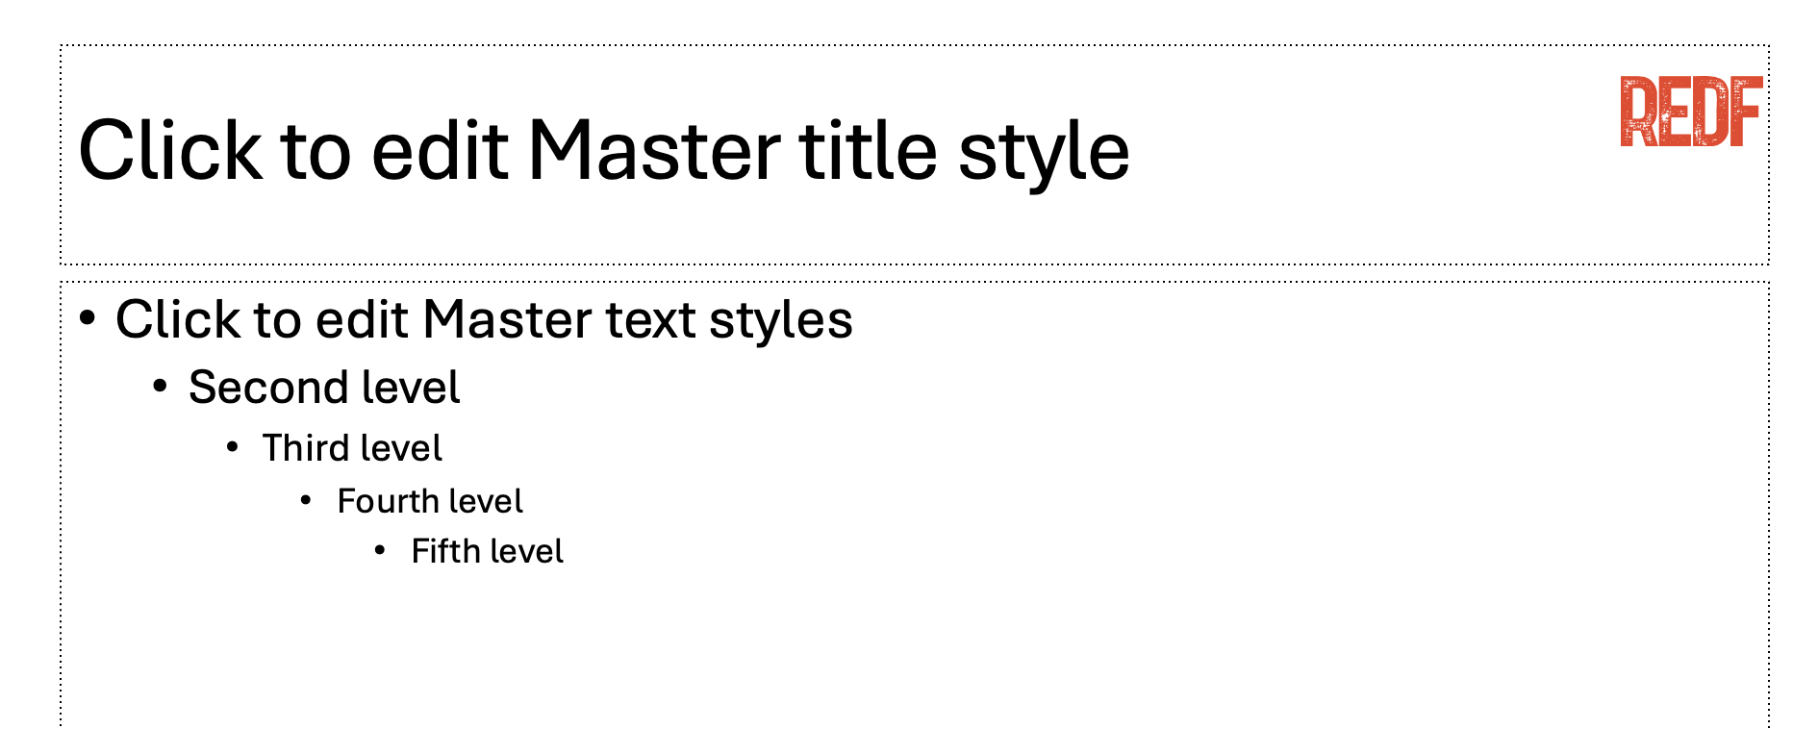
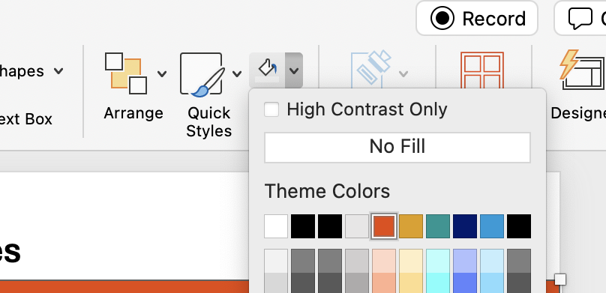
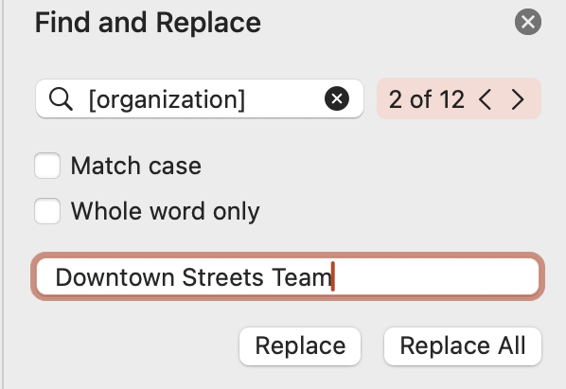
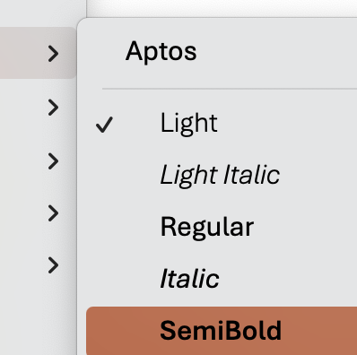
How to Use and Edit the Supervisor Success Series Modules
1. Update the content to your ESE’s branding, replace the REDF logo by searching in the top right for ‘Slide Master ‘→ delete the REDF logo from the Master title style slide, and replace it with your organization’s logo, click ‘close Master’ to save.
2. Update the colors throughout the presentation to match your organization’s color scheme by selecting the top red bar on each slide, Home tab → paint can → and selecting a fill color that works best for your branding.
Update the name of your organization by using the top right search bar again, selecting ‘Find and replace,’ type [organization] into the find bar and your ESE/ organization name into the replace bar, select ‘replace all.’ Anything content highlighted in gray
should be updated.
4. Editing Pro Tips… Use the font Aptos light to edit text on the slide and Aptos semibold to edit the titles. EDIT EVERY SLIDE to make sure it reflect your organization’s style and culture.
Need help? Reach out to a REDF staff member

Slide 3
Supervisor Success Series | De-Escalation & Conflict-Management for Supervisors
[OUR ORGANIZATION] Module 5 [Date]
Notes:
Facilitator Note: Before You Begin
Reminder that de-escalation is HARD, we cannot put too much on supervisors, this is to keep teams safe and teach them tools to de risk a situation. This should be taught to more experienced first-time supervisors and should focus on calm is contagious, and de-escalation strategies in the event of serious need. They should bring in help as soon as possible similar to feedback but can learn some simple tools to stay grounded and calm in potential chaotic situations. This should be an ongoing discussion and can be tricky as so not to re-traumatize.

Slide 4
Supervisor Success Series: De-Escalation for Supervisors
I
Conflict Management Basics and Using Empathy
II
Self-Control and Internal Conflict
III
Let’s Practice and Discuss

Slide 5
Learn about de-escalation and empathy
Recognize common conflict responses
Staying centered and using self-control
Practice so that you can crush it in real life!
GOALS

Slide 6
Warm-Up: Conflict & De-Escalation
Pick one or two questions and share your answer with the group
1. What is conflict?
2. How does conflict at work impact the culture and productivity of your team?
3. What are some common conflicts at work that you have seen?
4. How do you typically “de-escalate” and calm down someone who is stressed?
5. Tell me about a time when someone else helped you feel grounded and comfortable?
Notes:
Facilitator Notes:
Conflict = Anything that disrupts the flow of work
Facilitator Note: Learning about conflict and de-escalation
Focus on teaching and defining what these terms mean to help set them up to mitigate conflict if necessary

Slide 7

Toolkit: Pre-Conflict Warning Signs
Be on the lookout for emotional and behavioral reactions…
1
2
3
4
Fight or Flight
Over-Reacting
Hypervigilance
Abnormal Behavior
Fight response: Aggression
Flight response: Fleeing the situation (overwhelmed)
Freeze response: Shutting down (silence)
Fawn response: Over-apologizing
Inability to regulate their emotions or control themselves because they have an intense response.
Example: Fired up, angry, bursting out into tears
Paranoia –
The individual is in a safe situation but feels a sense of threat despite there being little to no issue. They are hyperaware and overly sensitive.
Example: Misinterpreting a neutral comment
What do you already know about your team members? Are they acting in a way that is a-typical from their day-to-day behavior?
What may have caused this?
Notes:
Facilitator Notes:
STOP: First make sure they know WHO to escalate to
TELL YOUR MANAGEMENT/LEADERSHIP TEAM
Building on giving feedback and supporting and building up our team, what happens when we face conflict with our teams?
Understanding our triggers – what is that person perceiving as a threat?
e.g., you give someone feedback
How does this show up? A behavior or an emotional reaction triggered by stress and past experiences
We do not expect you to be the person responsible for de-escalation
If you are on a work site and see these warning signs have a plan in place for back-up
Give your manager a heads up
They will bring their past experiences to the table
Fight: Employee is aggressive back to feedback

Slide 8
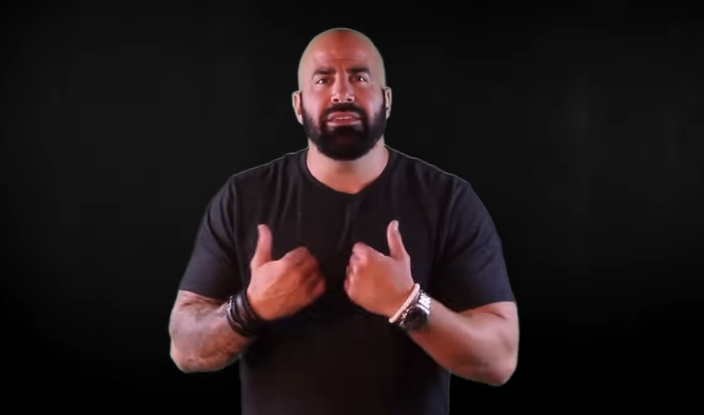
Video: Setting the Stage | How Do We De-Escalate?
How do we make our team members feel emotionally safe at work?
Notes:
Facilitator Guide:
What is de-escalating?
How do we handle it?
How do we help people gain control? VALIDATE HOW SOMEONE FEELS NO MATTER WHERE THEY ARE
- How do you know they are validated?
1: Acknowledge how somebody feels and help them feel heard to the point of a release where they feel listened to.
2: Go over the options and consequences of, starting with what they were going to do.
3: Let them really, decide what they will do, legitimately and truly.
https://youtu.be/4qsfBCatgX8?si=NSknwY7DG1eEAd6a

Slide 9
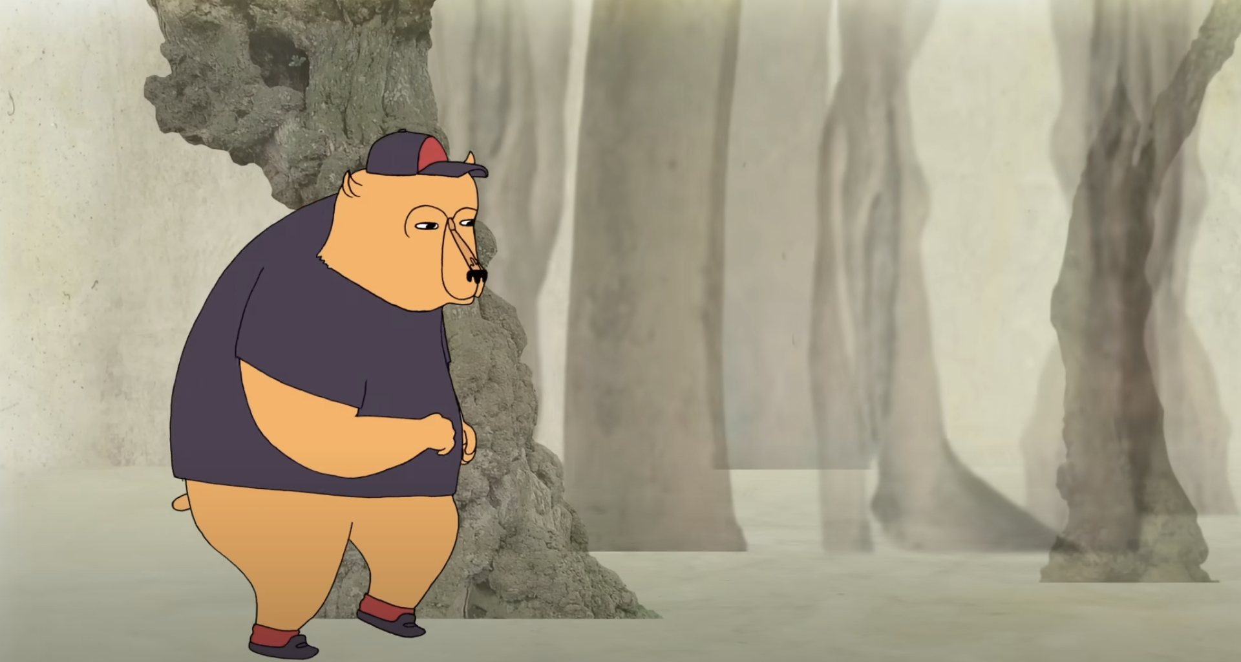
Video: How to Practice Empathy?
Why are you the best person to supervisor our new team members?
Notes:
Facilitator Guide:
THIS IS WHY YOU ARE OUR BEST LEADERS. Rarely can a response make something better. What makes something better? Connection.
What is the best way to ease someone's pain and suffering? In this beautifully animated RSA Short, Dr Brené Brown reminds us that we can only create a genuine empathic connection if we are brave enough to really get in touch with our own fragilities. Voice: Dr Brené Brown Animation: Katy Davis (AKA Gobblynne) www.gobblynne.com Production and Editing: Al Francis-Sears and Abi Stephenson Watch Dr Brené Brown's full talk 'The Power of Vulnerability' here: • The Power of Vulnerability - Brene Brown Dr Brené Brown is a research professor and best-selling author of "Daring Greatly: How the Courage to be Vulnerable Transforms the Way We Live, Love, Parent and Lead" (Penguin Portfolio, 2013). She has spent the past decade studying vulnerability, courage, worthiness, and shame.
https://youtu.be/1Evwgu369Jw?si=js7W_gtIzjzIiErR

Slide 10
De-Escalation and Empathy in Combination
What techniques can we use to de-escalate? Bring your manager in if it gets to be too much.
1
Slowing Down the Conversation, Give it TIME
Staying calm is key. Calm is contagious. It allows the person to process their emotions and think more clearly before responding. It takes 20—30 minutes for the body to regulate. Wait it out.
2
Validating their Emotions
Acknowledge what the other person is feeling without minimizing or dismissing it. No, “why?” or “I’m sorry you feel that way.” X Instead: I see you are struggling, I see this is hard.
3
Active Listening & Non-Verbal Communication
Paying full attention to the speaker without interrupting or planning your response while maintaining open, non-threatening body language to signal empathy and calmness.
4
Offering Choices
Give the person some control over the conversation by offering options and choices about how to receive. Try to do this in a non-judgmental, non-patronizing way.
Notes:
Facilitator Notes:
- Eric Davis material from trauma informed de-escalation

Slide 11
Toolkit: De-escalation Guiding Principles
Here is your de-escalation checklist. What is YOUR role in supporting your team?
MEET PEOPLE WHERE THEY ARE: Everyone has a different baseline (how one typically behaves during the day, at a specific time, or in a certain situation).
ONE RESPONSE DOES NOT FIT ALL: We must adapt to the needs of our team by understanding and listening to the individual we are trying to support.
SELF-CONTROL: We must check-in with ourselves before we assist others. To be effective, we need to remain in control of ourselves. Calm is contagious. Do not take it personally.
ASK FOR HELP: REMINDER – your goal as a supervisor is safety first and getting the job done. Beyond that ASK your manager for support when you feel you need it.
Notes:
Facilitator Note:
De-Escalation Guiding Principles
Our clients have needs; how can we assist them in meeting those needs safely?
We must always treat others with dignity and respect
Everyone has a different baseline (how one typically behaves during the day, at a specific time, or in a given situation), and we need to meet people where they are at
One response does not fit all; we must adapt in the moment to the needs of the person
we’re trying to support
A lack of professionalism or self-control can escalate a stressful situation; in order to be
effective, we need to remain in control of ourselves
It is important to maintain the safety of everyone involved

Slide 12
The Apology Menu
We all make mistakes! If you messed up as the leader... How do you say sorry?
“I’m Sorry” Authentically! No “if” or “but.” Just I am sorry for…
Acknowledgement of responsibility with a statement demonstrating giver understands their part in the offense. “I accept responsibility for my actions.”
Acknowledge the impact, not our intent. The more upset the person is, the less they care about your intent. (What feelings are there? What needs were not met?) “I’m hearing that…” (playback of impact). “I can imagine you’re feeling…because you wanted…is that right?
Thank the other person for feedback. “I’m really grateful you told me. I recognize this might be hard to share.
Say you learned with a statement of what you understand now. “I now realize.”
Repair. Not responsibility of receiver to determine repair but can give input with consent. Share what you will do going forward. “Is there anything I can do that would be supportive right now?
Request for Forgiveness: A statement asking for the receiver to pardon the giver’s actions. “Can you forgive my mistake?”
Notes:
Facilitator Notes: Conflict Lab at UC Berkeley
News flash: We are not perfect. We all make mistakes. How do we apologize when someone was hurt by our actions?

Slide 13
YOU ARE IN
CONTROL!

Slide 14
Understanding Internal Conflict
What happens when we feel conflict? Let’s unpack our “Fight or Flight” systems...
The need to survive is instinctual
“Fight or flight” is a normal response to a perceived threat and results in the immediate and powerful release of chemicals into the bloodstream
That chemical response reduces oxygen to the brain and results in impaired thinking
Maintaining self-control while feeling threatened is the hallmark of professionalism
The only reliable way to maintain self-control is to use a set of pre-planned, personal interventions when you feel it in your body
Notes:
Facilitator Guide:
What are your conflict warning signs?
How do you feel in your body?
How do you know when to practice internal de-escalation?

Slide 15
Self-Control Practices
Let’s go back to our wellness for leaders' learnings. First get in front of it and ask your team for help. We can also develop a self-control plan that incorporates…
1
2
3
Breathing
Positive Self-Talk
Grounding
Take slow, deep breaths in and out; feel each breath filling your lungs and pushing back out
This helps calm your nervous system, allowing you to think clearly and calmly, and it also gives you time to collect your thoughts before responding
Reframe the way you look at stressful situations (“This probably isn’t about me; they seem to be having a bad day.”)
Use positive self-talk to keep yourself calm and approach challenges with the best of your ability (“Stay calm. I can handle this.”)
Take a moment of pause and think about what centers or grounds you; focus on what helps you stay emotionally regulated when things get heated
Sometimes it helps to feel your physical reality (e.g., wiggle your toes, feel change in your pocket)
Notes:
Facilitator Guide Notes:
Remember our self-care for leaders' principles and emotional regulation training?
How can we calm ourselves down?

Slide 16
ACTIVITY: LET’S
PRACTICE

Slide 17
Activity: De-Escalation Scenarios
Let’s talk about some common challenges you may face. Let’s practice!
Notes:
You had a terrible day at home; you come in fired up and agitated and you go off on a participant
A participant gets violent with another participant, verbally abusive or physically abusive
A participant has a panic attack and is not being safe

Slide 18
Closing Reflection
What did you learn today? Let’s recap!
One conflict resolution, de-escalation, or empathy tip and trick
One self-control practice
Interesting thing you learned from this training
Notes:
- One takeaway from today?
- One question you still have?
- Reminder: leadership is a process — not a finish line

Slide 19
Notes:
Additional videos:
https://www.youtube.com/watch?v=R2PSExM-NhU&list=TLPQMDIwOTIwMjW613tk2Wqbkg&index=1

